Slide 1
Customer Churn analysis syriatel
Joey Husney
12/23/20

Slide 2

overview
We have been hired by SyriaTel, a telecommunication company, to advise them based on our analysis of the data they have given us
Specifically, they would like to know which customers they are most likely to lose in order that they can target them with incentives etc.
Some of the steps we will discuss:
The data
Insights through EDA’s
Our initial and final model
Summary/conclusions
Business Recommendations
Future work

Slide 3

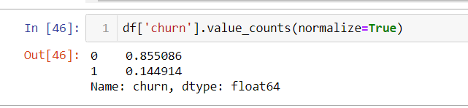
The data
The data we have been given is called SyriaTel Customer Churn and is available on Kaggle here
It Initially contained 3333 rows and 21 columns
After using SMOTE due to class imbalance, the number of rows increased to 5700
See below for distribution of churn column percentages before SMOTE
After balancing, the distribution was 50-50 as opposed to the 85-15 that it was before

Slide 4
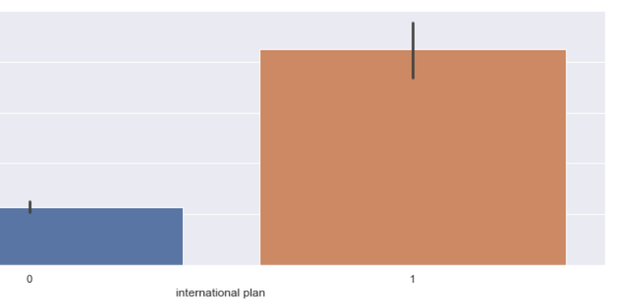
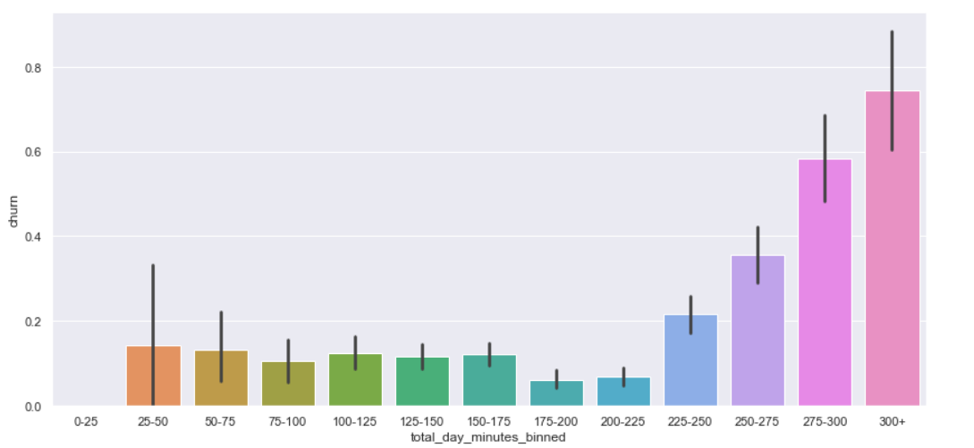
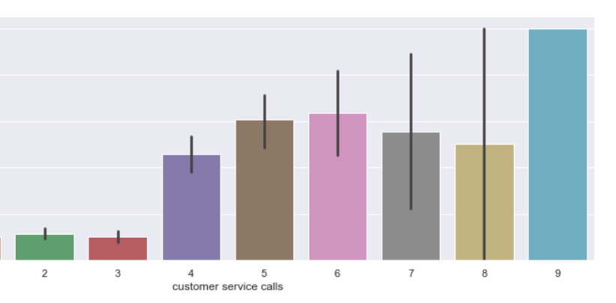
visualizations
People with international plan are way more likely to churn. Perhaps other companies are offering more competitive pricing
Minutes spent on the phone during the day are correlated with customers leaving the service
More than 3 customer service calls suggest that they are on the brink of leaving

Slide 5
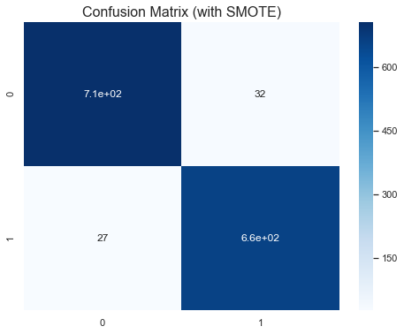
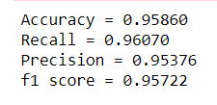
Final model
Many models were tested before deciding that the Random Forest Model was best for this case
Other models had lower precision or low recall. Overall, the Random Forest model had a high f1 score
The f1 score was a very important classifier to us because it considers both precision and recall

Slide 6

Conclusions and recommendations
SyriaTel should give incentives to those customers making higher customer service calls as this was the top indicator that a customer would churn
Another idea would be to increase the quality of these calls in order to retain these customers
Minutes spend on the phone during the daytime is an indicator that a customer may leave. SyriaTel should consider lowering prices for customers who fit into this category
The international call system must be further investigated as people who are making these calls are likely to churn. One suggestion would be to lower prices. Another suggestion would be to increase the quality of these calls.

Slide 7
Future work
Delve into international call customers and investigate why they are leaving
Determine if the number of minutes per day is correlated due to some other factor or if it is playing a significant role in customers churning
Get more specific information on our clients and see if that can help us better predict whether they are more likely to churn or not

Slide 8
Thank you for listening
Email: joeyhusney1@gmail.com
Git hub repo: https://github.com/jhusney1/Customer-Churn-Project

