Slide 1
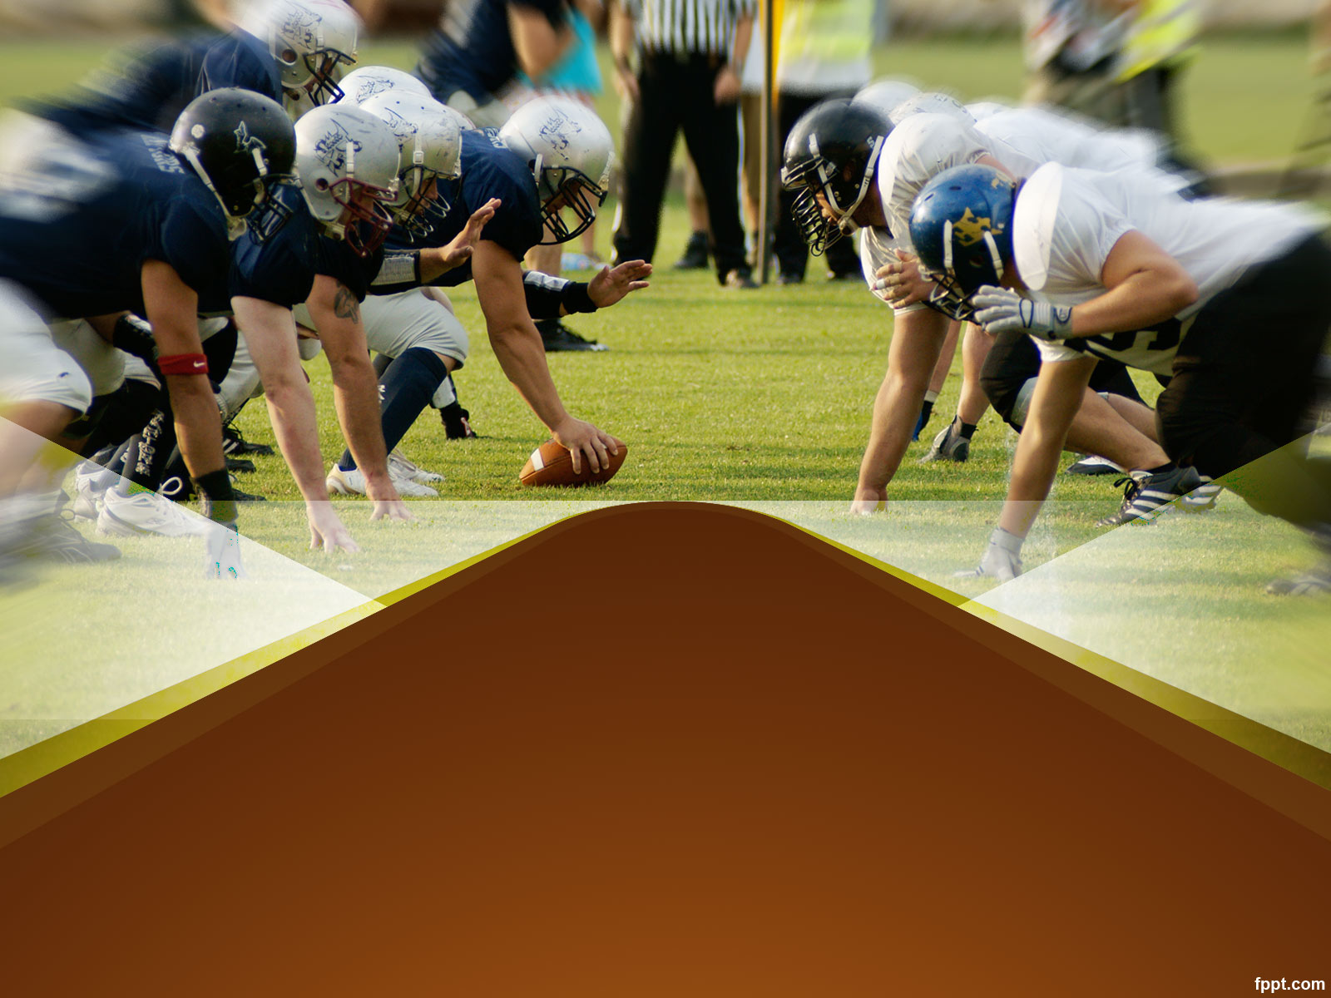
NFL Daily Fantasy Ownership Prediction
Aishwarya Srinivasan, Harsheel Soin, Jamie Hussman, Matthew Spitz, Victor Allen

Slide 2
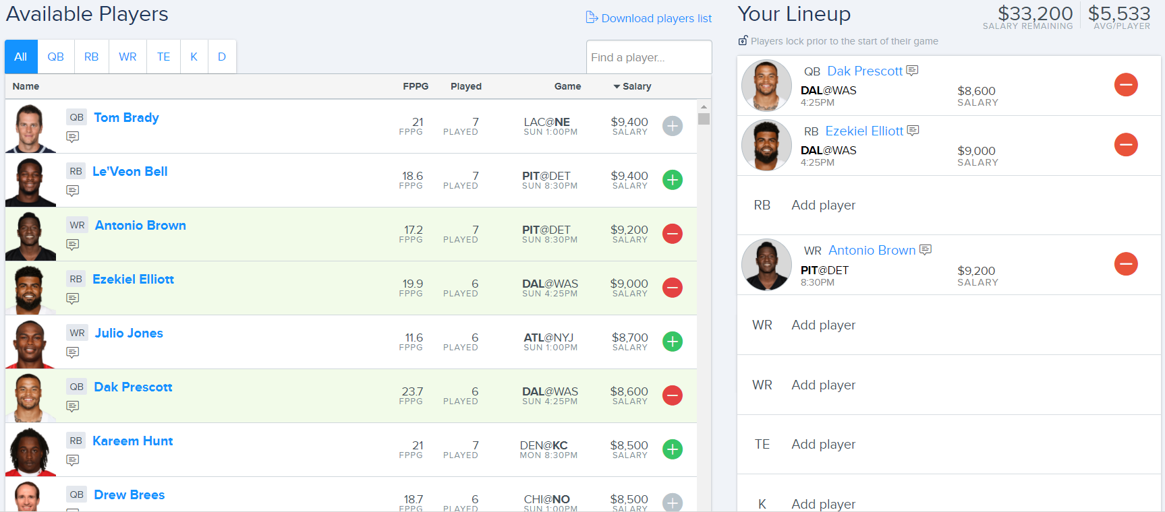
What is Daily Fantasy Football?
Weekly competition to create the highest scoring combination of players from teams around the league
Notes:
Where we DFS teams from

Slide 3
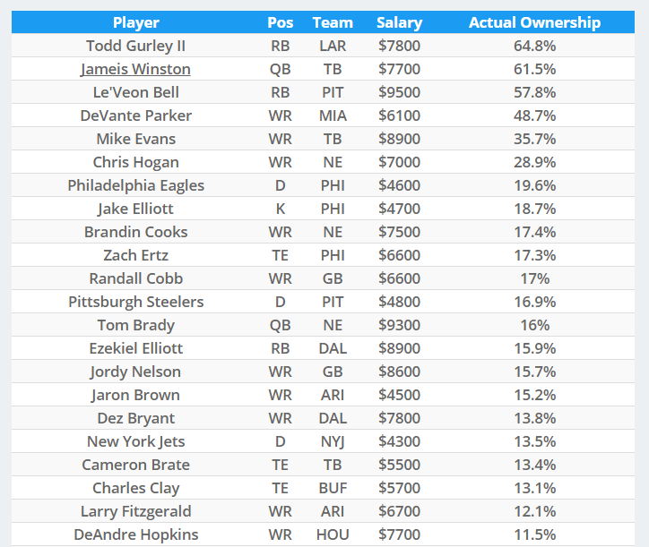
The Ownership Angle
Our goal is to project ownership and optimize lineup based on:
Minimizing ownership percentage
Maximizing projected points
Notes:
Where we get projected points from

Slide 4
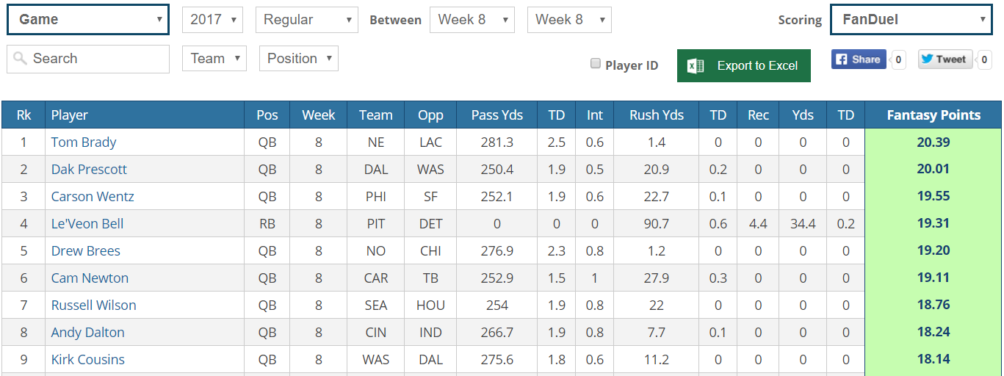
Datasets
Ownership % - Linestarapp.com
Home/away, opponent, position, salary – Rotoguru1.com
Projected fantasy points – FantasyData.com
Tweets - Twitter
Notes:
Tues/Wed before each slate of games, search terms (‘D’ included for defense)

Slide 5
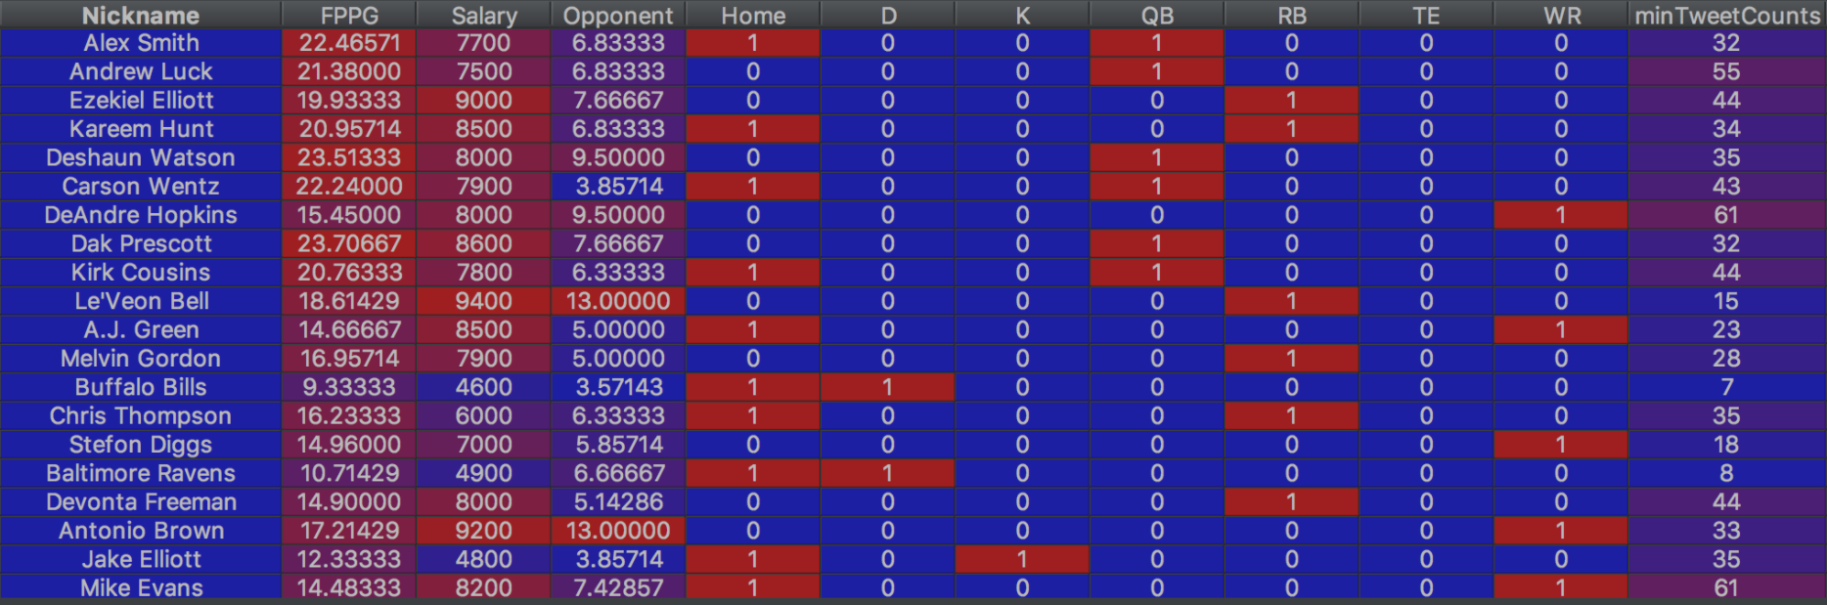
Features
Salary
Position
Projected fantasy points
Tweet count
Home/Away
Opponent

Slide 6
Feature Ranking
Feature | Score (between -1 and 1)
Projected fantasy points | 0.52
Salary | 0.49
Defense opponent points | -0.25
Tweet count | 0.15
Position: TE | -0.04
Home/Away | 0.03
Position: K | 0.02
Position: QB | 0.02
Position: D | 0.01
Position: WR | -0.002
Position: RB | -0.001

Slide 7
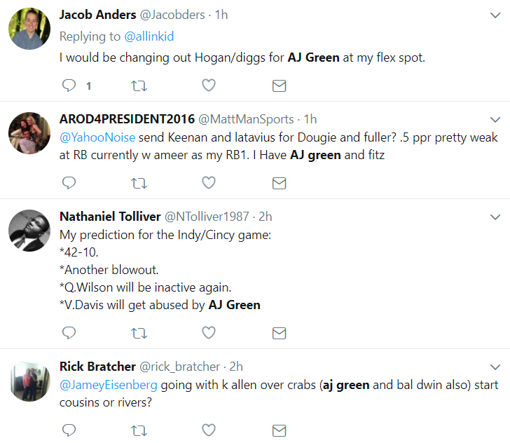
The Game Plan: Twitter
Use tweets to predict player ownership
Count number of times a player is mentioned on Tuesday &Wednesday of week

Slide 8
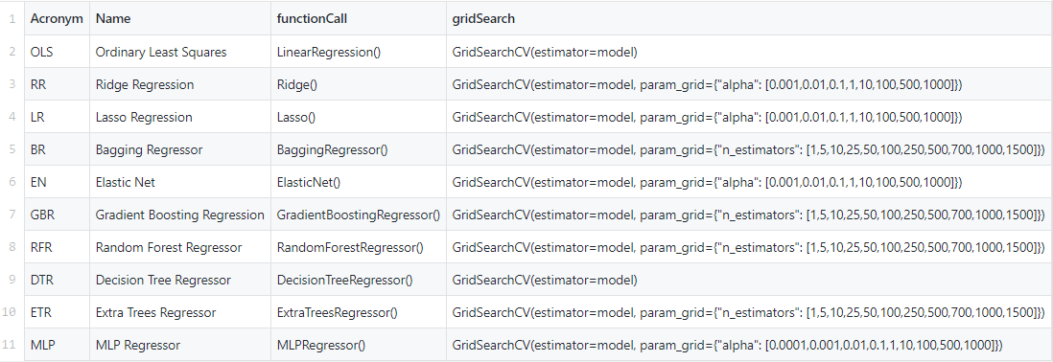
The Game Plan: Methodology
Run through 10 models and selects most accurate one
Gradient Boosting Regression: 53.8% accuracy

Slide 9
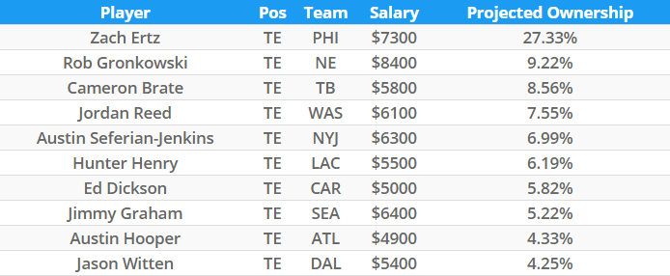
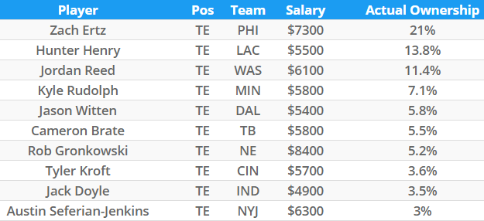
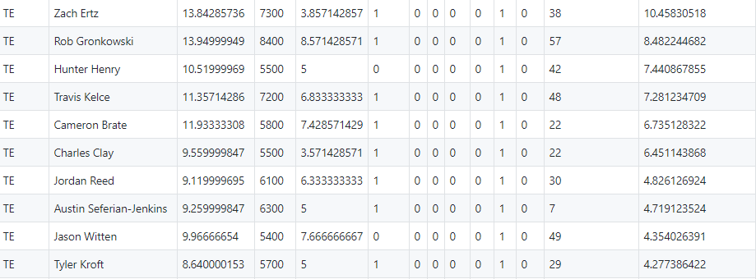
Results
LineStar Projected Ownership
Actual Ownership
Our Projected Ownership

Slide 10
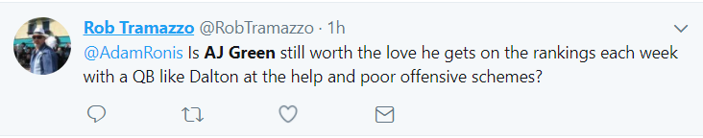
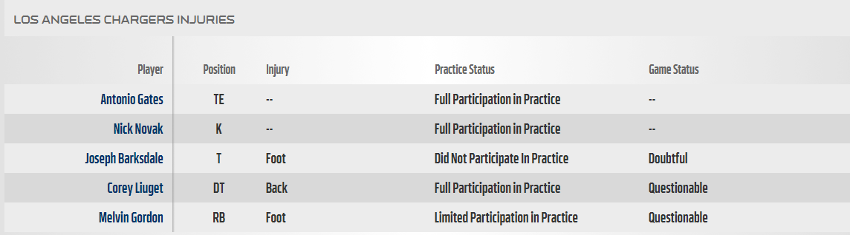
Next Steps: Model
Add 2015 data
Add chatter from Daily Fantasy NFL forums
Add injuries as a feature

Slide 11
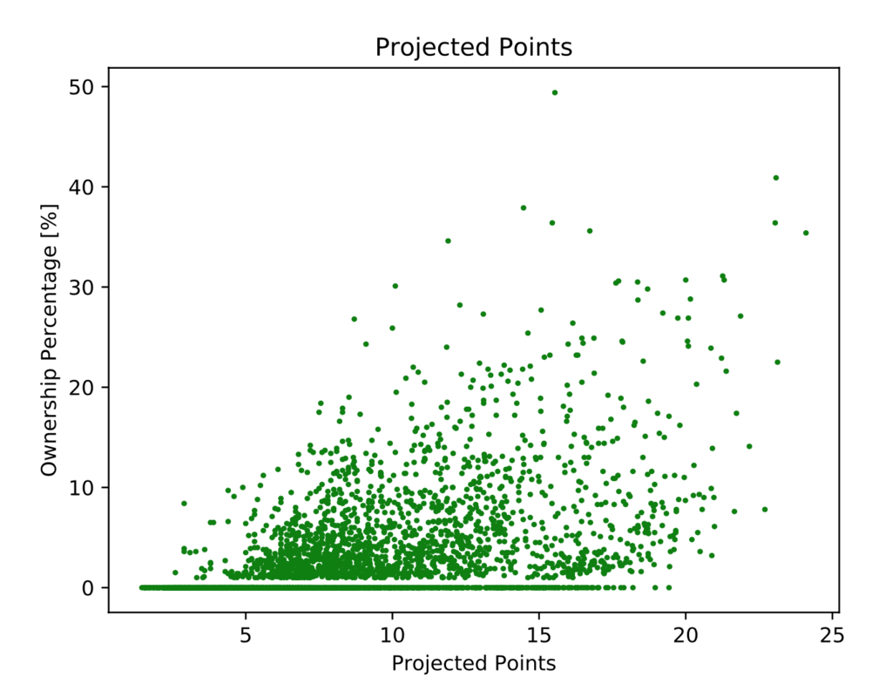
Next Steps: Projected Points
Remove injured players from training data
Notes:
Talk about how injuries skew correlation because of zeros

Slide 12
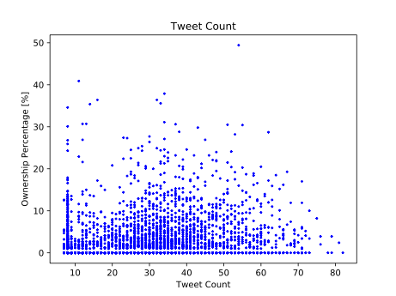
Next Steps: Twitter
Add twitter sentiment

Slide 13
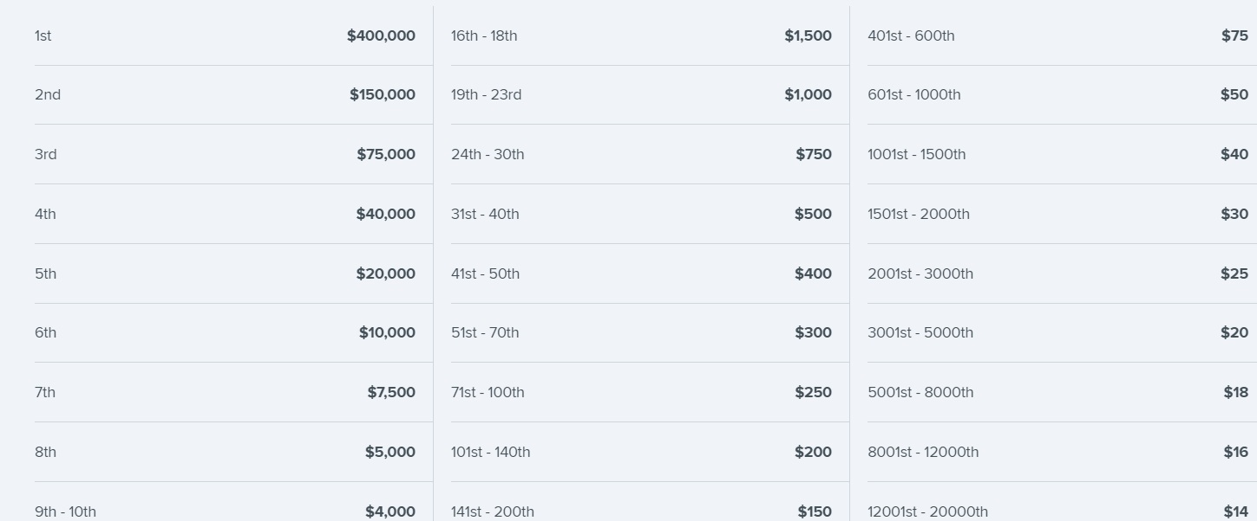
Optimization
Multi-objective approach: maximize projected points & minimize projected ownership percentage
Constraints:
Salary
Player Positions
Notes:
Logic – creating a high quality team that is most different from other competitors maximizes the chance of an “outlier” performance, which aligns with prize money incentives

