Slide 1
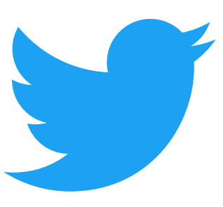
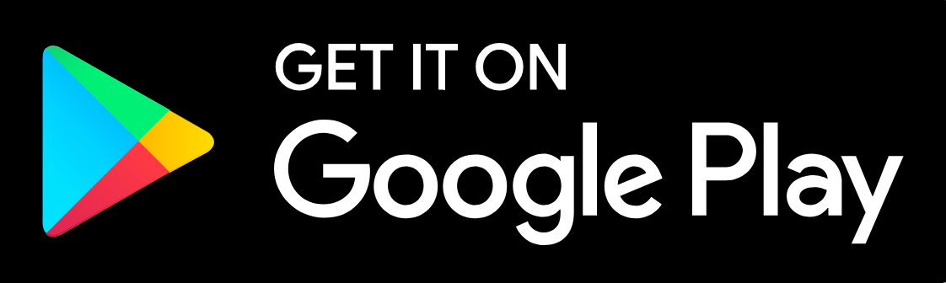

The Impact Of Tweets On Your Favorite Mobile Apps
By Team zeta:
Johnny Giang – Project lead
Jeffery Anthony
David pham

Slide 2
The Impact Of Twitter On Modern Business:
Since 2006, Twitter has revolutionized the way businesses engage with their customers, which drives brand recognition, customer satisfaction, and sales
Examples:
NBA - Boosts app engagement by providing custom experience for fans
Target - Uses Twitter data to connect with guests and make business decisions
Hilton Worldwide - Leveraging Gnip & Twitter Ads APIs for insights and ad targeting
Universal Music Group - Builds relevant and personalized interactions between fans and artists
World of WarCraft - Build community and share amazing in-game experiences

Slide 3
The Problem and Hypothesis: Is there a relationship between Google Play and Apple App Store, and Twitter Activity?
Questions:
Hypotheses:
What is the population of apps, and types of apps?
Which app categories had the highest ratings?
What is the impact of Twitter Activity? Is it measurable, if so how?
Is there a relationship between Twitter activity, ratings and reviews?
15k Plus apps; categories include: social media, gaming, productivity, finance, food and entertainment and etc.
Instagram, Yelp, Google Maps, Facebook, Twitter
Customer engagement and marketing, the impact would be Twitter each users respective twitter followers
Team Zeta believes that there is a relationship for social type apps

Slide 4
About The Data And Sources: Organized Google Play and Apple App Stores By Review Count
Google Play Store (GPS)
Apple App Store
Twitter API
Kaggle Dataset – web scraped data of GPS apps
10,842 apps listed
Main Parameters: review count, user ratings, categories
Updated in January 2019
Kaggle Dataset – web scraped data of Apple apps
7,198 apps listed
Main Parameters: review count, user ratings, categories
Updated in June 2018
Built Twitter Query Function using Python
360+ queries for top 10 apps for each app store, resulting in over 10k+ tweets
Recent and popular Tweets from March 27 – April 3, 2019 (7 day max window for free products)
Notes:
Talk about clean data and calculation – 80% of the work
Duplicates

Slide 5
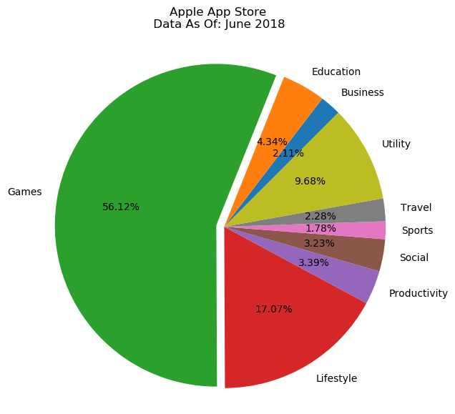
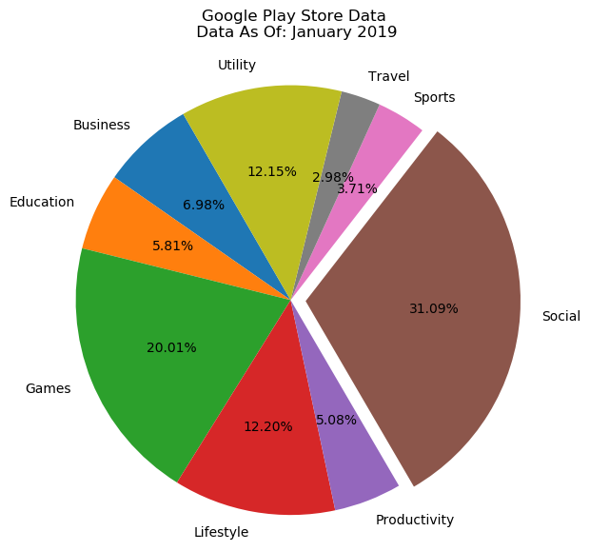
1. Games and Lifestyle Apps Are Dominant Google Play vs Apple App Stores
Notes:
After we filtered the data
We organized our data by review counts.
The chart says: there’s a correlation between apps that get reviewed have high avg rating
** On the power point we can state that, and the avg rating too among all of them as a group and individually or just have it ready in case someone ask

Slide 6
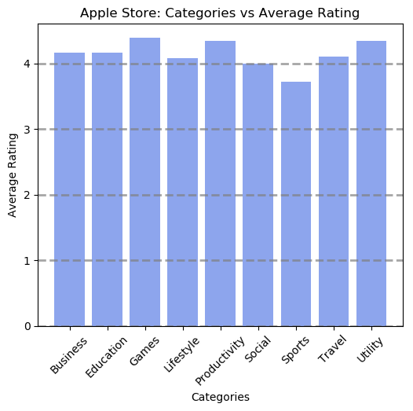
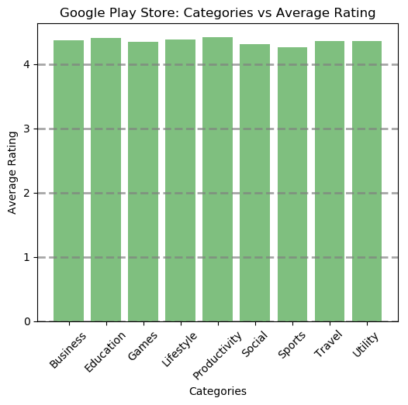
2. Sports Apps Had The Lowest Ratings Apple App Stores vs Google Play
Notes:
Talk about how you grouped them, and examples of what type of apps are in what, just a few big ones - methodology

Slide 7
16 Unique Apps Between Both Platforms Google Play and Apple’s Top 10 Apps
Google Play Store Rankings:
Apple App Store Rankings:
Facebook
Whatsapp
Instagram
Clash of Clans
Clean Master - Space Cleaner
Subway Surfers
YouTube
Security Master - Antivirus, VPN
Clash Royale
Candy Crush Saga
Facebook
Instagram
Clash of Clans
Temple Run
Pandora
Pinterest
Bible
Candy Crush Saga
Spotify Music
Angry Birds
Note: the 4 bolded apps are in the top 10 most reviewed apps on both platforms.
Apps that were on both platforms were averaged on the following slides.

Slide 8
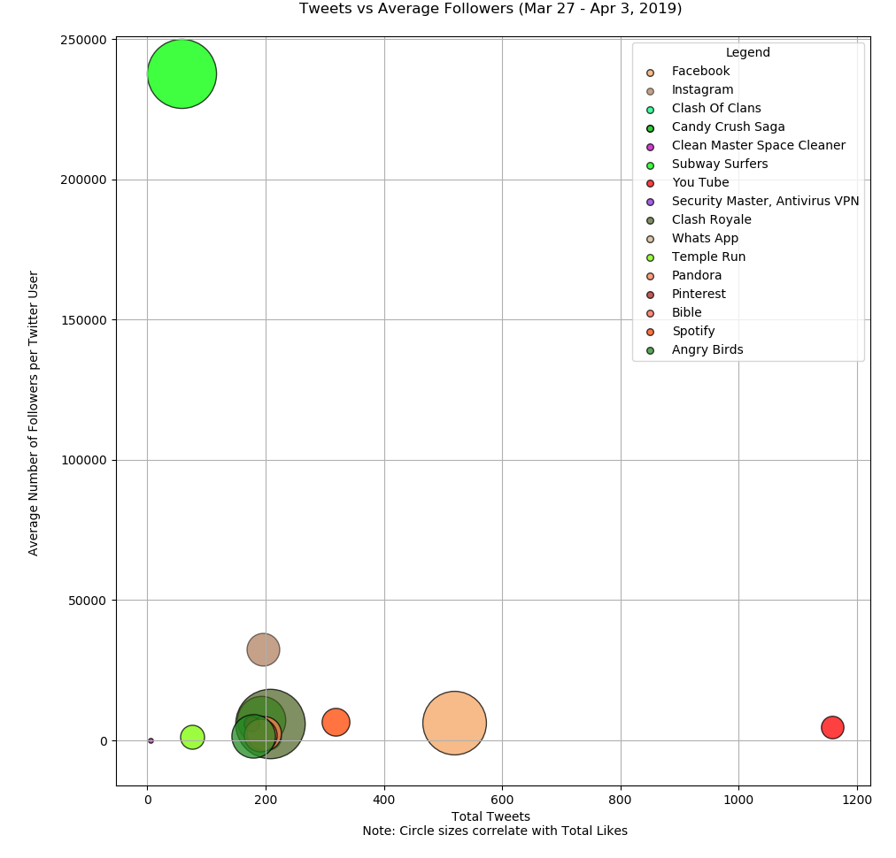
3a. 200 Tweet Impacts About 15k Followers Tweets vs Average Followers
Observations:
On average, each app is mentioned about 250 tweets in one week, with the exception of the outlier YouTube (1159 Tweets)
Subway Surfers (Game) had very few tweets, but have the highest avg. followers (23k), and significant likes
Little relationship between Tweets to average followers for the top apps
13 apps experienced similar results
Notes:
Here we charted the total tweets each app in had in 7 seven days against how many followers they have.
Interested in to see if there was a relationship when people would tweet about these apps, and how impactful.
- Measured impact by total of followers and engagements (likes)
We found that there appears to be no relationship between

Slide 9
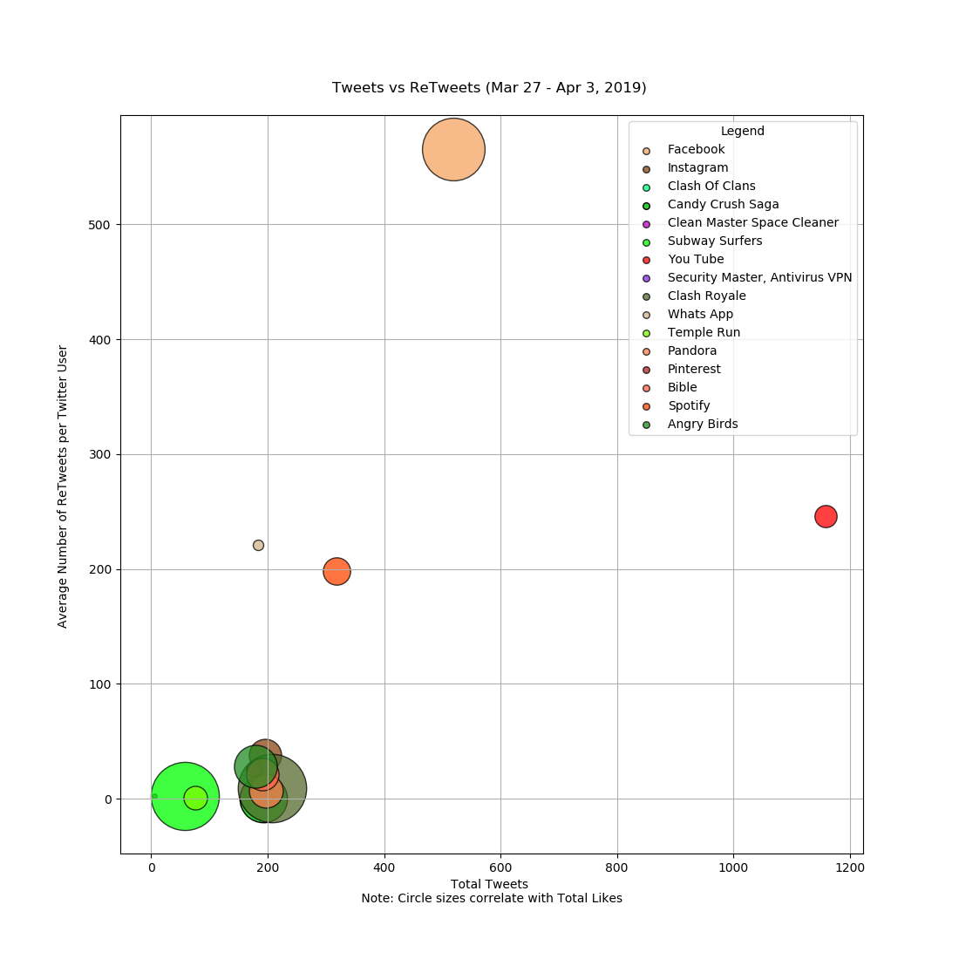
3b. 200 Tweets Averaged About 65 Retweets Google Play and Apple App Store
Observations:
2 social and lifestyle apps experienced higher tweets and retweets (e.g. Facebook, YouTube) – possibly due to people promoting content on these platforms
12 apps experience similar behavior related Tweets and Retweets
Facebook had about 500 tweets mentioning them, and had the highest retweets of 565

Slide 10
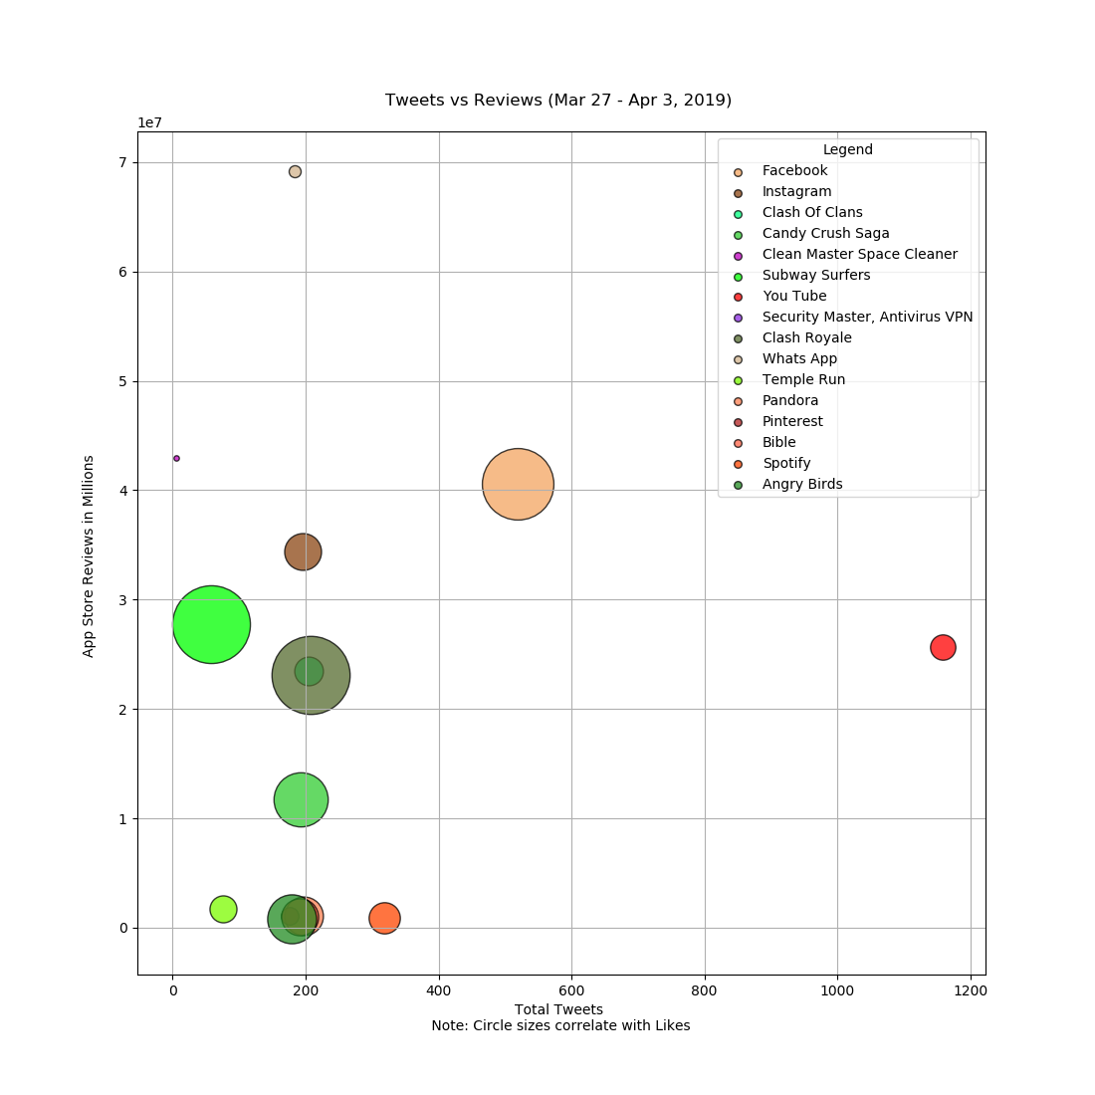
4a. Regardless of Reviews, Majority of Apps Averaged 200 Tweets Total Tweets to Average App Store Reviews (Millions)

Slide 11
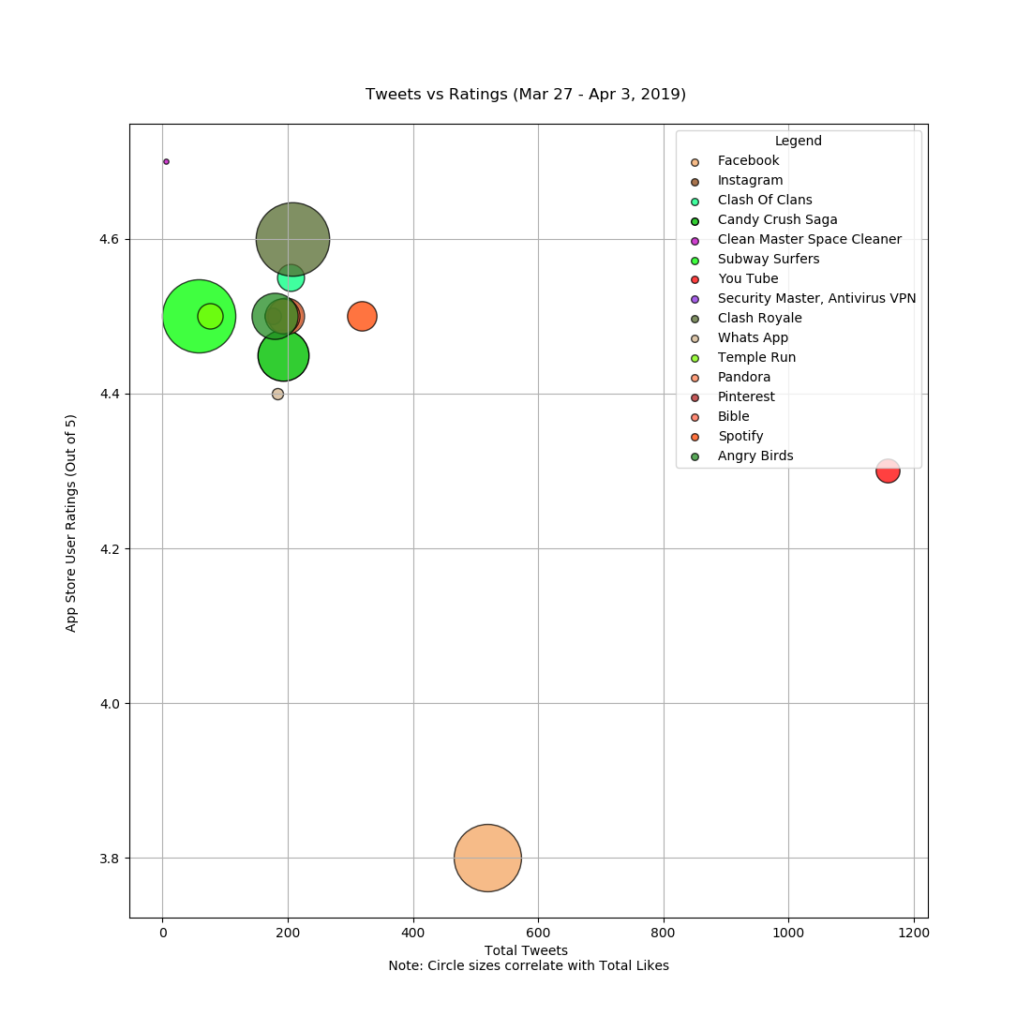
4b. Apps With 200 Tweets Were Rated 4.5 Google Play and Apple App Stores
Observations:
Apps with 200 Tweets were mainly Games, Social, Life Style, and Productivity
Outliers: You Tube experienced the most Tweets and had an average rating of 4.3
Facebook had the lowest rating (3.8) when averaging between the two app stores

Slide 12
Summary of Analyses:
All top 16 apps have a Twitter
Facebook Inc’s Products – (Facebook, Instagram and Whats App) dominate on both Google Play and Apple App Stores
Allows direct engagement between business and customers
Twitter engagement varies by category (e.g. Productivity apps vs Social)
Twitter API Consideration: API data set was only for 1 week
To increase your odds to be in the top 10 apps of either app store, you need to have about 200 tweets a week!

Slide 13
Next Steps
Expand analysis to 75th, 50th, and 25th percentile to further understand the impact of Twitter across different apps and categories
Automate the Twitter Query Function to query Tweets over a historical period
Remove outliers
Further investigate how Twitter, Rating, and Reviews, drive the impacts sales

