Slide 1
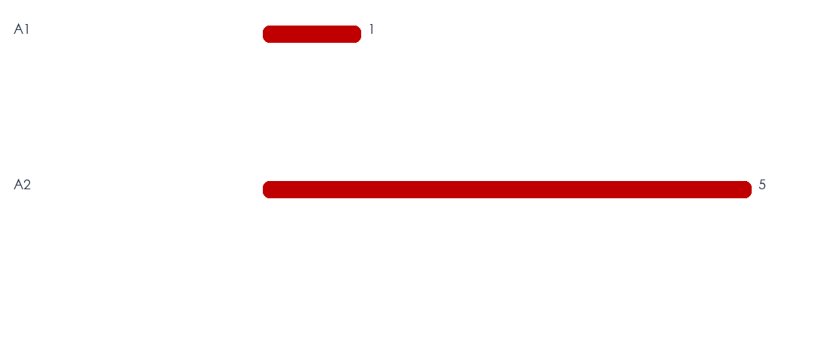
一、交通事故分析
115年1月1日至2月28日
A1+A2：6件（未提供同期資料）
A1：1件（未提供同期資料）
A2：5件（未提供同期資料）
本期統計6件；易肇事路段以文化路（5件）為首，主要肇因為未保持安全距離（3件），應依熱點與高風險時段持續部署勤務。
1
Notes:
[AutoFill]
This deck preserves the original report style and replaces approved fields with {{TOKEN}} values.
Use Excel 件數 as the aggregation measure.
Field groups: A/A1-A2 KPI; R/N road name/count; I/IN intersection name/count; T/TN time/count; C/CN cause/count; AAG/AN age label/count; V/VN vehicle label/count; A1T/A1L/A1C/A1V/A1F/A1N fatal detail; E/F enforcement.
Charts are redrawn by the generator from the corresponding token groups. Map frames are manual placeholders and are not filled by the generator.
Long labels must be shortened before insertion; do not change frame geometry.
[/AutoFill]

Slide 2
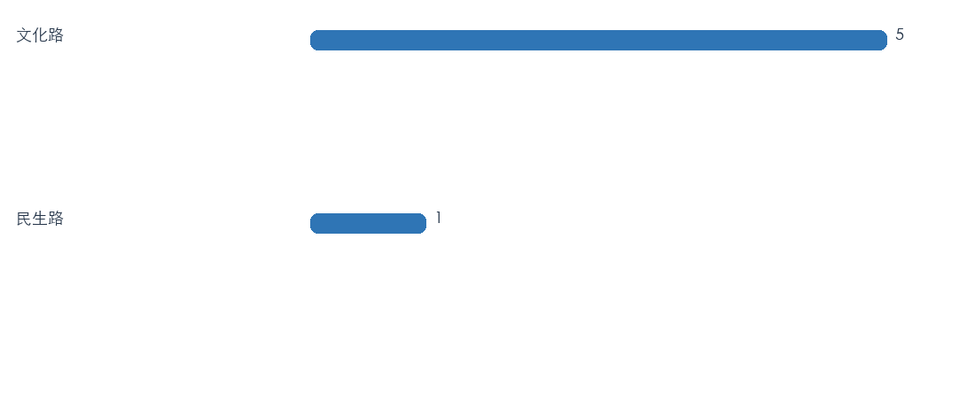
二、易肇事路段分析
易肇事路段地圖
（請由人工置入地圖圖片）
排名 | 文化路 | 民生路
件數 | 5 | 1
排名 | 1 | 2 | 3 | 4 | 5 | 6 | 7 | 8 | 9 | 10
路段：文化路 5件；民生路 1件； 件。共2處。
2
Notes:
[AutoFill]
This deck preserves the original report style and replaces approved fields with {{TOKEN}} values.
Use Excel 件數 as the aggregation measure.
Field groups: A/A1-A2 KPI; R/N road name/count; I/IN intersection name/count; T/TN time/count; C/CN cause/count; AAG/AN age label/count; V/VN vehicle label/count; A1T/A1L/A1C/A1V/A1F/A1N fatal detail; E/F enforcement.
Charts are redrawn by the generator from the corresponding token groups. Map frames are manual placeholders and are not filled by the generator.
Long labels must be shortened before insertion; do not change frame geometry.
[/AutoFill]

Slide 3
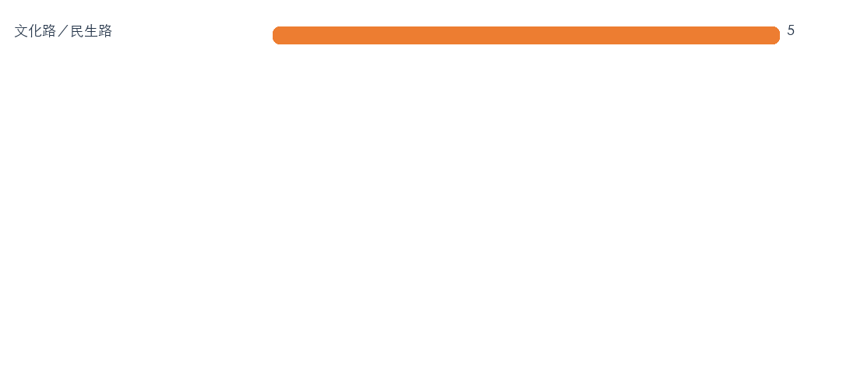
三、易肇事路口分析
易肇事路口地圖
（請由人工置入地圖圖片）
排名 | 文化路／民生路
件數 | 5
排名 | 1 | 2 | 3 | 4 | 5 | 6 | 7 | 8 | 9 | 10
路口：文化路／民生路 5件； 件； 件。
3
Notes:
[AutoFill]
This deck preserves the original report style and replaces approved fields with {{TOKEN}} values.
Use Excel 件數 as the aggregation measure.
Field groups: A/A1-A2 KPI; R/N road name/count; I/IN intersection name/count; T/TN time/count; C/CN cause/count; AAG/AN age label/count; V/VN vehicle label/count; A1T/A1L/A1C/A1V/A1F/A1N fatal detail; E/F enforcement.
Charts are redrawn by the generator from the corresponding token groups. Map frames are manual placeholders and are not filled by the generator.
Long labels must be shortened before insertion; do not change frame geometry.
[/AutoFill]

Slide 4
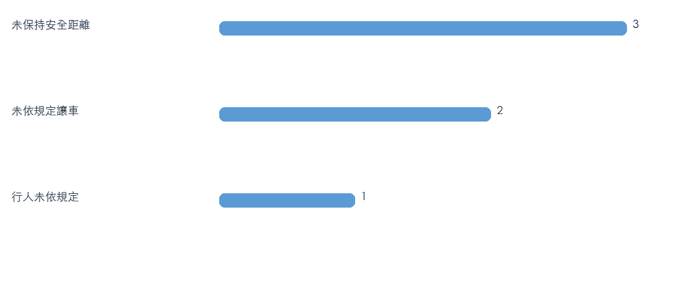
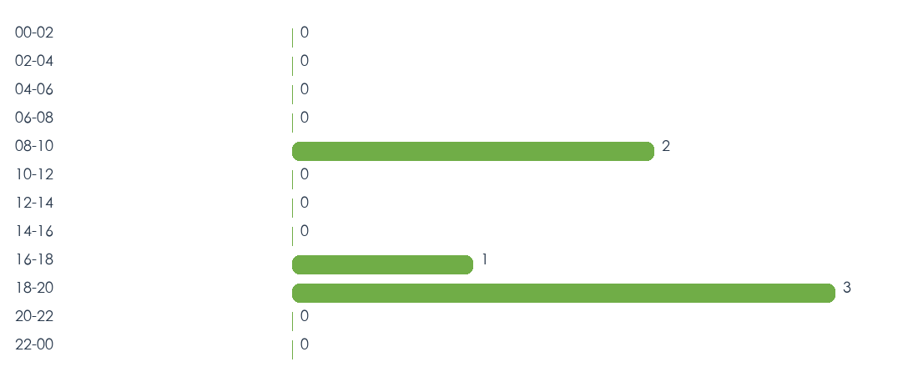
四、事故肇因分析
事故時段分析
時間 | 00-02 | 02-04 | 04-06 | 06-08 | 08-10 | 10-12 | 12-14 | 14-16 | 16-18 | 18-20 | 20-22 | 22-00
件數 | 0 | 0 | 0 | 0 | 2 | 0 | 0 | 0 | 1 | 3 | 0 | 0
排名 | 1 | 2 | 3 | 4 | 5 | 6 | 7 | 8 | 9 | 10 | 11 | 12
肇因 | 未保持安全距離 | 未依規定讓車 | 行人未依規定
件數 | 3 | 2 | 1
肇因：未保持安全距離 3件（50.0%）；未依規定讓車 2件（33.3%）；行人未依規定 1件（16.7%）。
時段：00-02 0件（50.0%）；02-04 0件（33.3%）；04-06 0件（16.7%）。
4
Notes:
[AutoFill]
This deck preserves the original report style and replaces approved fields with {{TOKEN}} values.
Use Excel 件數 as the aggregation measure.
Field groups: A/A1-A2 KPI; R/N road name/count; I/IN intersection name/count; T/TN time/count; C/CN cause/count; AAG/AN age label/count; V/VN vehicle label/count; A1T/A1L/A1C/A1V/A1F/A1N fatal detail; E/F enforcement.
Charts are redrawn by the generator from the corresponding token groups. Map frames are manual placeholders and are not filled by the generator.
Long labels must be shortened before insertion; do not change frame geometry.
[/AutoFill]

Slide 5
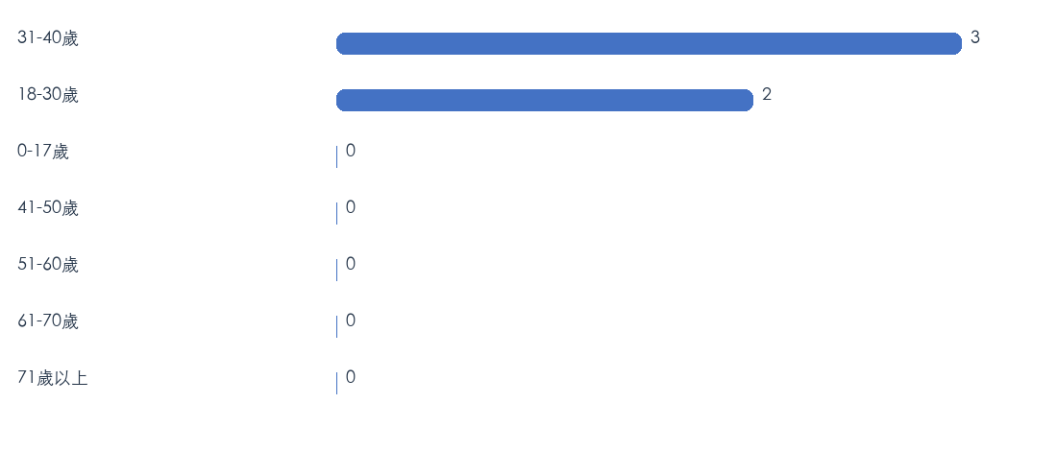
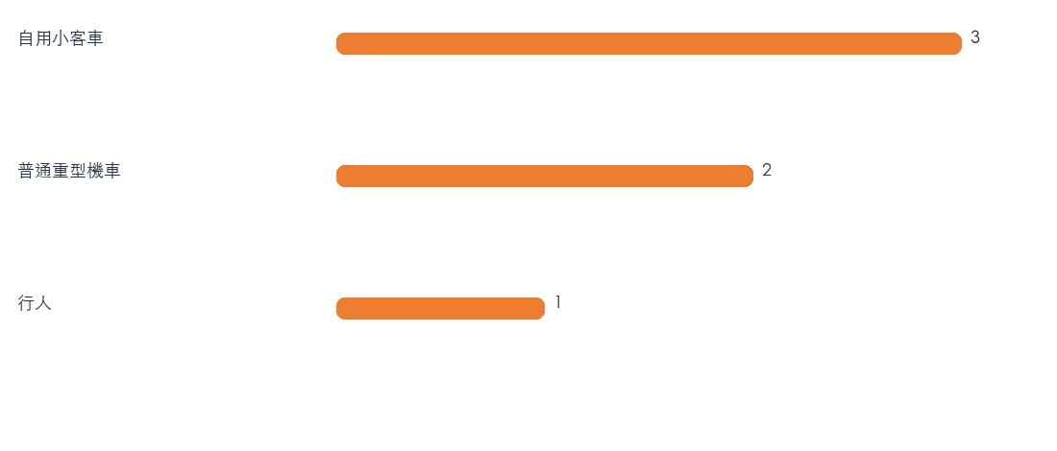
五、事故年齡分析
六、事故車種分析
年齡 | 31-40歲 | 18-30歲 | 0-17歲 | 41-50歲 | 51-60歲 | 61-70歲 | 71歲以上
件數 | 3 | 2 | 0 | 0 | 0 | 0 | 0
車種 | 自用小客車 | 普通重型機車 | 行人
件數 | 3 | 2 | 1
年齡：31-40歲 3件（50.0%）；18-30歲 2件（33.3%）；0-17歲 0件（0.0%）。
車種：自用小客車 3件（50.0%）；普通重型機車 2件（33.3%）；行人 1件（16.7%）。
5
Notes:
[AutoFill]
This deck preserves the original report style and replaces approved fields with {{TOKEN}} values.
Use Excel 件數 as the aggregation measure.
Field groups: A/A1-A2 KPI; R/N road name/count; I/IN intersection name/count; T/TN time/count; C/CN cause/count; AAG/AN age label/count; V/VN vehicle label/count; A1T/A1L/A1C/A1V/A1F/A1N fatal detail; E/F enforcement.
Charts are redrawn by the generator from the corresponding token groups. Map frames are manual placeholders and are not filled by the generator.
Long labels must be shortened before insertion; do not change frame geometry.
[/AutoFill]

Slide 6
七、A1事故案件明細
板橋分局轄內115年度A1事故明細
編號 | 時間 | 地點 | 肇因 | 車種 | 死亡 | 備註
1 | 2月10日 1740 | 民生路 | 行人未依規定 | 行人 | 1人
2
3
4
5
6
7
A1事故斑點圖
（請由人工置入地圖圖片）
6
Notes:
[AutoFill]
This deck preserves the original report style and replaces approved fields with {{TOKEN}} values.
Use Excel 件數 as the aggregation measure.
Field groups: A/A1-A2 KPI; R/N road name/count; I/IN intersection name/count; T/TN time/count; C/CN cause/count; AAG/AN age label/count; V/VN vehicle label/count; A1T/A1L/A1C/A1V/A1F/A1N fatal detail; E/F enforcement.
Charts are redrawn by the generator from the corresponding token groups. Map frames are manual placeholders and are not filled by the generator.
Long labels must be shortened before insertion; do not change frame geometry.
[/AutoFill]

Slide 7
八、交通大執法專案
交通大執法勤務地圖
（請由人工置入地圖圖片）
一、日程：115年1月1日至2月28日
二、勤務方式：
（一）各所、隊於文化路編排勤務，加強取締超速。
（二）加強取締A1事故路段：民生路、民生路。
四、獎勵規定：每執行超速取締勤務達1小時，且總取締件數不低於1件者，核予嘉獎一次，以嘉獎3次為上限。
編號 | 板橋所
1 | 板城路
2 | 縣民大道
編號 | 沙崙所
1 | 篤行路3段
2 | 環漢路4段
3 | 21號越堤道
編號 | 後埔所
1 | 四川路1段
2 | 重慶路
編號 | 信義所
1 | 四川路2段
2 | 廣權路
編號 | 大觀所
1 | 大觀路1、2段
2 | 板城路
3 | 環河西路5段
7
7
Notes:
[AutoFill]
This deck preserves the original report style and replaces approved fields with {{TOKEN}} values.
Use Excel 件數 as the aggregation measure.
Field groups: A/A1-A2 KPI; R/N road name/count; I/IN intersection name/count; T/TN time/count; C/CN cause/count; AAG/AN age label/count; V/VN vehicle label/count; A1T/A1L/A1C/A1V/A1F/A1N fatal detail; E/F enforcement.
Charts are redrawn by the generator from the corresponding token groups. Map frames are manual placeholders and are not filled by the generator.
Long labels must be shortened before insertion; do not change frame geometry.
[/AutoFill]

