Slide 1
貳、拖吊場拍賣
壹、績效檢討
參、A1事故分析與策進作為
一、交通事故分析
{{PERIOD}}
A1+A2：{{TOTAL}}件（{{TD}}）
A1：{{A1}}件（{{A1D}}）
A2：{{A2}}件（{{A2D}}）
{{SUMMARY}}
{{A1}}
1
Notes:
[AutoFill]
This deck is a clean data-entry template. Replace short {{tokens}} only.
Use Excel 件數 as the aggregation measure.
Field groups: A/A1-A2 KPI; R/N road name/count; I/IN intersection name/count; T/TN time/count; C/CN cause/count; AAG/AN age label/count; V/VN vehicle label/count; A1T/A1L/A1C/A1V/A1F/A1N fatal detail; E/F enforcement.
Long labels must be shortened before insertion; do not change frame geometry.
[/AutoFill]

Slide 2
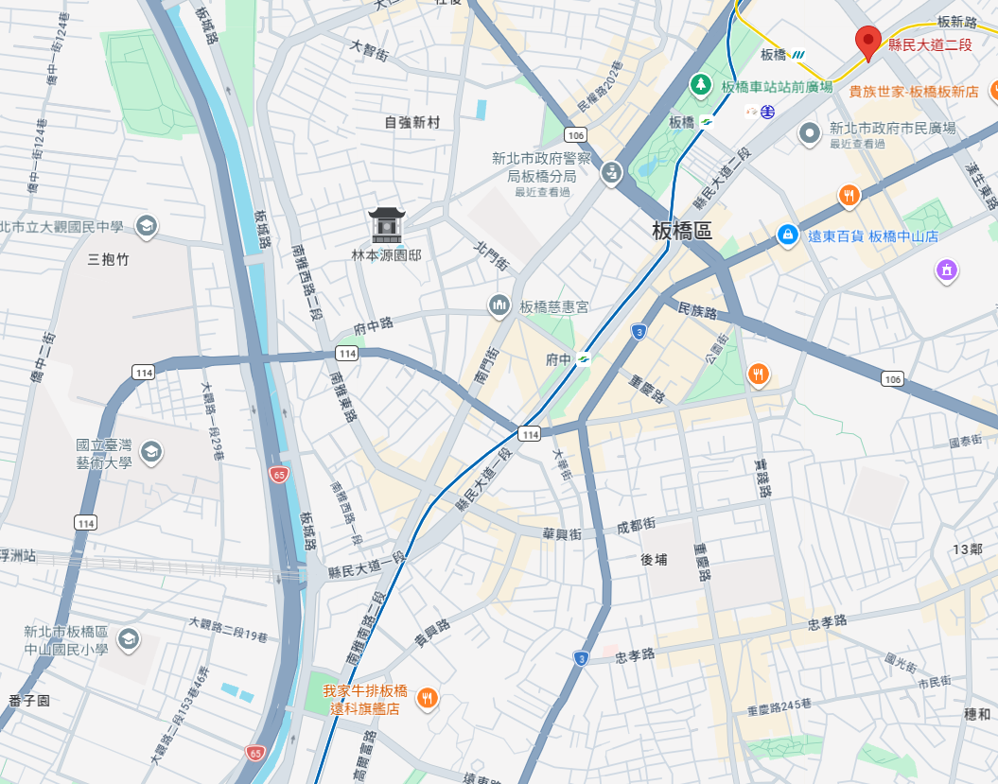
貳、拖吊場拍賣
壹、績效檢討
參、A1事故分析與策進作為
二、易肇事路段分析
{{R9}}
{{R8}}
{{R6}}
{{R7}}
{{R2}}
排名 | {{R1}} | {{R2}} | {{R3}} | {{R4}} | {{R5}} | {{R6}} | {{R7}} | {{R8}} | {{R9}} | {{R10}}
件數 | {{N1}} | {{N2}} | {{N3}} | {{N4}} | {{N5}} | {{N6}} | {{N7}} | {{N8}} | {{N9}} | {{N10}}
排名 | 1 | 2 | 3 | 4 | 5 | 6 | 7 | 8 | 9 | 10
路段：{{R1}} {{N1}}件；{{R2}} {{N2}}件；{{R3}} {{N3}}件。共{{RCOUNT}}處。
{{R4}}
{{R3}}
{{R1}}
{{R5}}
2
Notes:
[AutoFill]
This deck is a clean data-entry template. Replace short {{tokens}} only.
Use Excel 件數 as the aggregation measure.
Field groups: A/A1-A2 KPI; R/N road name/count; I/IN intersection name/count; T/TN time/count; C/CN cause/count; AAG/AN age label/count; V/VN vehicle label/count; A1T/A1L/A1C/A1V/A1F/A1N fatal detail; E/F enforcement.
Long labels must be shortened before insertion; do not change frame geometry.
[/AutoFill]

Slide 3
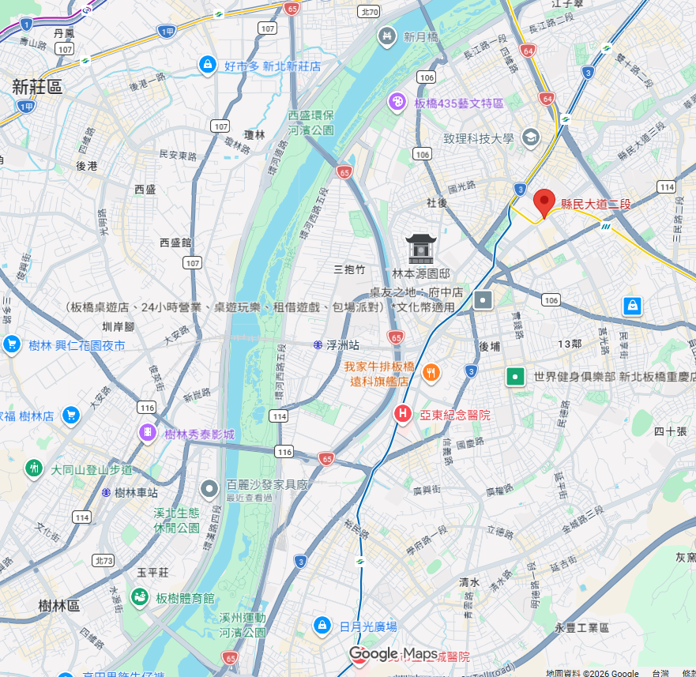
貳、拖吊場拍賣
壹、績效檢討
參、A1事故分析與策進作為
三、易肇事路口分析
3
{{I5}}
{{I7}}
{{I8}}
{{I4}}
10
4
{{I1}}
排名 | {{I1}} | {{I2}} | {{I3}} | {{I4}} | {{I5}} | {{I6}} | {{I7}} | {{I8}} | {{I9}} | {{I10}}
件數 | {{IN1}} | {{IN2}} | {{IN3}} | {{IN4}} | {{IN5}} | {{IN6}} | {{IN7}} | {{IN8}} | {{IN9}} | {{IN10}}
排名 | 1 | 2 | 3 | 4 | 5 | 6 | 7 | 8 | 9 | 10
{{I9}}
1
5
9
{{I10}}
6
2
7
路口：{{I1}} {{IN1}}件；{{I2}} {{IN2}}件；{{I3}} {{IN3}}件。
{{I3}}
8
{{I6}}
{{I2}}
3
Notes:
[AutoFill]
This deck is a clean data-entry template. Replace short {{tokens}} only.
Use Excel 件數 as the aggregation measure.
Field groups: A/A1-A2 KPI; R/N road name/count; I/IN intersection name/count; T/TN time/count; C/CN cause/count; AAG/AN age label/count; V/VN vehicle label/count; A1T/A1L/A1C/A1V/A1F/A1N fatal detail; E/F enforcement.
Long labels must be shortened before insertion; do not change frame geometry.
[/AutoFill]

Slide 4
貳、拖吊場拍賣
壹、績效檢討
參、A1事故分析與策進作為
四、事故肇因分析
事故時段分析
時間 | {{T1}} | {{T2}} | {{T3}} | {{T4}} | {{T5}} | {{T6}} | {{T7}} | {{T8}} | {{T9}} | {{T10}} | {{T11}} | {{T12}}
件數 | {{TN1}} | {{TN2}} | {{TN3}} | {{TN4}} | {{TN5}} | {{TN6}} | {{TN7}} | {{TN8}} | {{TN9}} | {{TN10}} | {{TN11}} | {{TN12}}
排名 | 1 | 2 | 3 | 4 | 5 | 6 | 7 | 8 | 9 | 10 | 11 | 12
肇因 | {{C1}} | {{C2}} | {{C3}} | {{C4}} | {{C5}} | {{C6}} | {{C7}} | {{C8}} | {{C9}} | {{C10}} | {{C11}} | {{C12}}
件數 | {{CN1}} | {{CN2}} | {{CN3}} | {{CN4}} | {{CN5}} | {{CN6}} | {{CN7}} | {{CN8}} | {{CN9}} | {{CN10}} | {{CN11}} | {{CN12}}
時段：{{T1}} {{TN1}}件（{{TP1}}）；{{T2}} {{TN2}}件（{{TP2}}）；{{T3}} {{TN3}}件（{{TP3}}）。
肇因：{{C1}} {{CN1}}件（{{CP1}}）；{{C2}} {{CN2}}件（{{CP2}}）；{{C3}} {{CN3}}件（{{CP3}}）。
4
Notes:
[AutoFill]
This deck is a clean data-entry template. Replace short {{tokens}} only.
Use Excel 件數 as the aggregation measure.
Field groups: A/A1-A2 KPI; R/N road name/count; I/IN intersection name/count; T/TN time/count; C/CN cause/count; AAG/AN age label/count; V/VN vehicle label/count; A1T/A1L/A1C/A1V/A1F/A1N fatal detail; E/F enforcement.
Long labels must be shortened before insertion; do not change frame geometry.
[/AutoFill]

Slide 5

貳、拖吊場拍賣
壹、績效檢討
參、A1事故分析與策進作為
五、事故年齡分析
六、事故車種分析
{{AN1}}
{{AN2}}
{{AN3}}
{{AN5}}
{{AN4}}
{{AN6}}
{{AN7}}
年齡 | {{AAG1}} | {{AAG2}} | {{AAG3}} | {{AAG4}} | {{AAG5}} | {{AAG6}} | {{AAG7}}
件數 | {{AN1}} | {{AN2}} | {{AN3}} | {{AN4}} | {{AN5}} | {{AN6}} | {{AN7}}
車種 | {{V1}} | {{V2}} | {{V3}} | {{V4}} | {{V5}} | {{V6}} | {{V7}}
件數 | {{VN1}} | {{VN2}} | {{VN3}} | {{VN4}} | {{VN5}} | {{VN6}} | {{VN7}}
年齡：{{AAG1}} {{AN1}}件（{{AP1}}）；{{AAG2}} {{AN2}}件（{{AP2}}）；{{AAG3}} {{AN3}}件（{{AP3}}）。
車種：{{V1}} {{VN1}}件（{{VP1}}）；{{V2}} {{VN2}}件（{{VP2}}）；{{V3}} {{VN3}}件（{{VP3}}）。
5
Notes:
[AutoFill]
This deck is a clean data-entry template. Replace short {{tokens}} only.
Use Excel 件數 as the aggregation measure.
Field groups: A/A1-A2 KPI; R/N road name/count; I/IN intersection name/count; T/TN time/count; C/CN cause/count; AAG/AN age label/count; V/VN vehicle label/count; A1T/A1L/A1C/A1V/A1F/A1N fatal detail; E/F enforcement.
Long labels must be shortened before insertion; do not change frame geometry.
[/AutoFill]

Slide 6
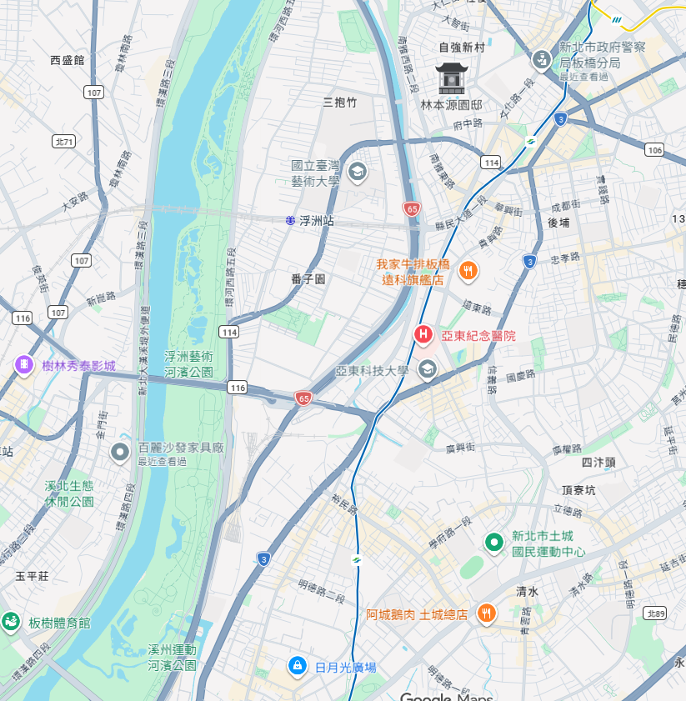

貳、拖吊場拍賣
壹、績效檢討
參、A1事故分析與策進作為
七、A1事故案件明細
{{a1_map_title}}
板橋分局轄內{{YEAR}}年度A1事故明細
編號 | 時間 | 地點 | 肇因 | 車種 | 死亡 | 備註
1 | {{A1T}} | {{A1L}} | {{A1C}} | {{A1V}} | {{A1F}} | {{A1N}}
2 | {{A2T}} | {{A2L}} | {{A2C}} | {{A2V}} | {{A2F}} | {{A2N}}
3 | {{A3T}} | {{A3L}} | {{A3C}} | {{A3V}} | {{A3F}} | {{A3N}}
4 | {{A4T}} | {{A4L}} | {{A4C}} | {{A4V}} | {{A4F}} | {{A4N}}
5 | {{A5T}} | {{A5L}} | {{A5C}} | {{A5V}} | {{A5F}} | {{A5N}}
6 | {{A6T}} | {{A6L}} | {{A6C}} | {{A6V}} | {{A6F}} | {{A6N}}
7 | {{A7T}} | {{A7L}} | {{A7C}} | {{A7V}} | {{A7F}} | {{A7N}}
{{A3L}}
{{A5L}}
{{A7L}}
{{A6L}}
{{A4L}}
{{A1L}}
{{A2L}}
6
Notes:
[AutoFill]
This deck is a clean data-entry template. Replace short {{tokens}} only.
Use Excel 件數 as the aggregation measure.
Field groups: A/A1-A2 KPI; R/N road name/count; I/IN intersection name/count; T/TN time/count; C/CN cause/count; AAG/AN age label/count; V/VN vehicle label/count; A1T/A1L/A1C/A1V/A1F/A1N fatal detail; E/F enforcement.
Long labels must be shortened before insertion; do not change frame geometry.
[/AutoFill]

Slide 7
貳、拖吊場拍賣
壹、績效檢討
參、A1事故分析與策進作為
八、交通大執法專案
一、日程：{{EPERIOD}}
二、勤務方式：
（一）各所、隊於{{HOTSPOT}}編排勤務，加強取締超速。
（二）加強取締A1事故路段：{{FOCUS1}}、{{FOCUS2}}。
四、獎勵規定：每執行超速取締勤務達{{AHOURS}}小時，且總取締件數不低於{{ACOUNT}}件者，核予嘉獎一次，以嘉獎{{ALIMIT}}次為上限。
沙崙、分隊加強取締違規
板橋、分隊加強取締違規
編號 | 板橋所
1 | 板城路
2 | 縣民大道
編號 | 沙崙所
1 | 篤行路3段
2 | 環漢路4段
3 | 21號越堤道
{{FOCUS2}}
{{FOCUS1}}
2
1
編號 | 後埔所
1 | 四川路1段
2 | 重慶路
2
2
1
1
1
3
1
3
2
編號 | 信義所
1 | 四川路2段
2 | 廣權路
編號 | 大觀所
1 | 大觀路1、2段
2 | 板城路
3 | 環河西路5段
2
7
7
Notes:
[AutoFill]
This deck is a clean data-entry template. Replace short {{tokens}} only.
Use Excel 件數 as the aggregation measure.
Field groups: A/A1-A2 KPI; R/N road name/count; I/IN intersection name/count; T/TN time/count; C/CN cause/count; AAG/AN age label/count; V/VN vehicle label/count; A1T/A1L/A1C/A1V/A1F/A1N fatal detail; E/F enforcement.
Long labels must be shortened before insertion; do not change frame geometry.
[/AutoFill]

