Slide 1
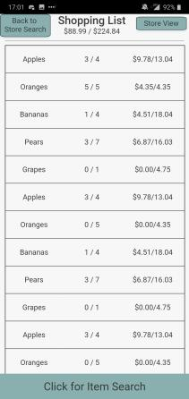
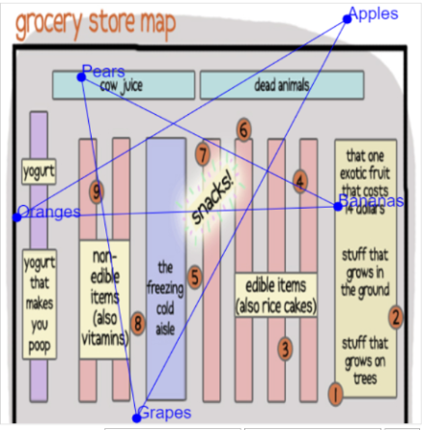
Ostrich
Ostrich is an indoor positioning system and mobile application for locating items in a store.
We are currently integrating (a) our mobile application, (b) a database for storing item positions, and (c) scripts to acquire item locations from the hardware modules, supplied by Decawave.

