Slide 2

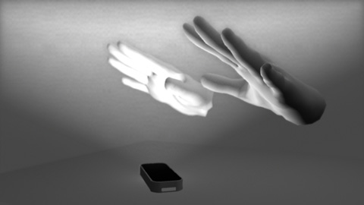
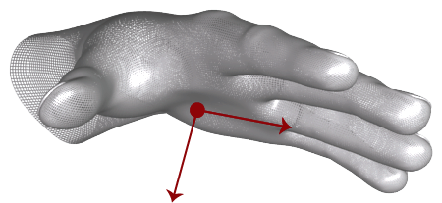
(a)
(b)
(c)

Slide 4
* Not to scale
5cm
5cm
2cm
2cm
1cm
4cm
3cm
Cylinder
Square
Sword
Anisotropic Sword

