Slide 1
알고리즘 기본 - 2
2024.05.07
정현서

Slide 2
Problem
Given an array A[1..N], answer Q questions given as:
Find out the sum of elements in the interval A[l..r]

Slide 3

A simple approach
for (int i = 0; i < q; i++) {
int l, r;
cin >> l >> r;
int sum = 0;
for (int j = l; j <= r; j++) {
sum += a[j];
}
cout << sum << ‘\n’;
}
$$O(NQ)$$

Slide 4

“Prefix Sum”
A[]
prefix[0]
prefix[1]
prefix[r] – prefix[l – 1]
prefix[2]
...
prefix[N]
$$O(N+Q)$$

Slide 5
Prefix Sum
for (int i = 1; i <= n; i++) {
prefix[i] = prefix[i – 1] + a[i];
}
Since we need prefix[0] = 0, use 1-based indices!

Slide 6
Prefix Sum

Slide 7
Prefix Sum

Slide 8
Prefix Sum

Slide 9
Prefix Sum

Slide 10

Prefix Sum
$$O(NM+Q)$$

Slide 11
Example
Given an array A[1..N], find the interval with maximum sum.
minimum
prefix[l]
prefix[r]

Slide 12
Code
for (int i = 1; i <= n; i++) {
prefix[i] = prefix[i – 1] + a[i];
}
int ans = 0;
for (int r = 1; r <= n; r++) {
for (int l = 0; l < r; l++) {
ans = max(ans, prefix[r] – prefix[l]);
}
}

Slide 13
Code
for (int i = 1; i <= n; i++) {
prefix[i] = prefix[i – 1] + a[i];
}
int ans = 0;
int minv = 0;
for (int r = 1; r <= n; r++) {
ans = max(ans, prefix[r] – minv);
minv = min(minv, prefix[r]);
}

Slide 14
Example
Given an array A[1..N],
find two disjoint intervals with maximum total sum.

Slide 15
Example
prefix_max[1]
prefix_max[2]
...
prefix_max[n]
suffix_max[1]
suffix_max[2]
...
suffix_max[n]

Slide 16
Code
// calculcate calc_pre[i], calc_suf[i]
for (int i = 1; i <= n; i++) {
prefix_max[i] = max(prefix_max[i - 1], calc_pre[i])
}
for (int i = n; i >= 1; i--) {
suffix_max[i] = max(suffix_max[i + 1], calc_suf[i]);
}
int ans = 0;
for (int i = 0; i <= n; i++) {
ans = max(ans, prefix_max[i] + suffix_max[i + 1]);
}

Slide 17
Let’s solve some problems!

Slide 18
Problem
Given an array A[1..N] of positive integers,
find out the shortest interval with sum at least K.

Slide 19

Approach
int ans = INF;
for (int r = 1; r <= n; r++) { for (int l = 0; l < r; l++) {
if (prefix[r] – prefix[l] >= k)
ans = min(ans, r – l);
}
}
}
$$O(N^{2})$$

Slide 20

Approach
int ans = INF;
for (int r = 1; r <= n; r++) { for (int l = r - 1; l >= 0; l--) {
if (prefix[r] – prefix[l] >= k)
ans = min(ans, r – l);
break;
}
}
}
still
$$O(N^{2})$$

Slide 21
Observation
A[] =
3
1
4
1
5
9
2
6
5
, K = 9
Monotonicity! (단조성)

Slide 22
Observation
A[] =
3
1
4
1
5
9
2
6
5
, K = 9
S = 0
0
0

Slide 23
Observation
A[] =
3
1
4
1
5
9
2
6
5
, K = 9
S = 3
0
1

Slide 24
Observation
A[] =
3
1
4
1
5
9
2
6
5
, K = 9
S = 4
0
2

Slide 25
Observation
A[] =
3
1
4
1
5
9
2
6
5
, K = 9
S = 8
0
3

Slide 26
Observation
A[] =
3
1
4
1
5
9
2
6
5
, K = 9
S = 9
0
4

Slide 27
Observation
A[] =
3
1
4
1
5
9
2
6
5
, K = 9
S = 6
1
4

Slide 28
Observation
A[] =
3
1
4
1
5
9
2
6
5
, K = 9
S = 11
1
5

Slide 29
Observation
A[] =
3
1
4
1
5
9
2
6
5
, K = 9
S = 10
2
5

Slide 30
Observation
A[] =
3
1
4
1
5
9
2
6
5
, K = 9
S = 6
3
5

Slide 31

Code
int ans = INF;
for (int l = 0, r = 0, s = 0; l < n; l++) {
while (r < n && s < k) {
s += a[r];
r++;
}
if (s >= k) ans = min(ans, r – l);
s -= a[l];
}
$$O(N)$$

Slide 32
Code
int ans = INF;
for (int l = 0, r = 0, s = 0; l < n; l++) {
while (r < n && s < k) {
s += a[r];
r++;
}
if (s >= k) ans = min(ans, r – l);
s -= a[l];
}
Current interval we’re looking at is [l, r)
Use half-closed intervals!

Slide 33
Two-pointers
This technique is called “two-pointers technique”,
By the fact we maintain two pointers that only moves on way.

Slide 34
Example
Given an array A[1..N] of positive integers,
find out the longest interval with sum at most K.

Slide 35
Code
int ans = 0;
for (int l = 0, r = 0, s = 0; l < n; l++) {
while (r < n && s + a[r] <= k) {
s += a[r];
r++;
}
ans = max(ans, r – l);
s -= a[l];
}
$$O(N)$$

Slide 36
Example
Given an array A[1..N] of integers,
determine if some three integers sum up to 0.

Slide 37

Code
bool flag = false;
for (int i = 0; i < n; i++) { for (int j = 0; j < i; j++) {
for (int k = 0; k < j; k++) {
if (a[i] + a[j] + a[k] == 0) {
flag = true;
}
}
}
}
$$O(N^{3})$$

Slide 38

Code
bool flag = false;
unordered_set<int> st;
for (int i = 0; i < n; i++) { for (int j = i + 1; j < n; j++) {
if (st.find(-a[i] – a[j]) != st.end())
flag = true;
}
st.insert(a[i]);
}
$$O(N^{2})$$
, but slow!

Slide 39
Code
sort(a, a + n);
bool flag = false;
for (int i = 0; i < n; i++) { for (int j = 0, p = i - 1; j < i; j++) {
while (p - 1 > j && a[p] + a[i] + a[j] > 0) {
--p;
}
if (p > j && a[i] + a[j] + a[p] == 0) {
flag = true;
}
}
}
$$O(N^{2})$$
, but slow!

Slide 40
Example
Given an array A[1..N] of integers,
find out the longest interval with distinct elements.

Slide 41
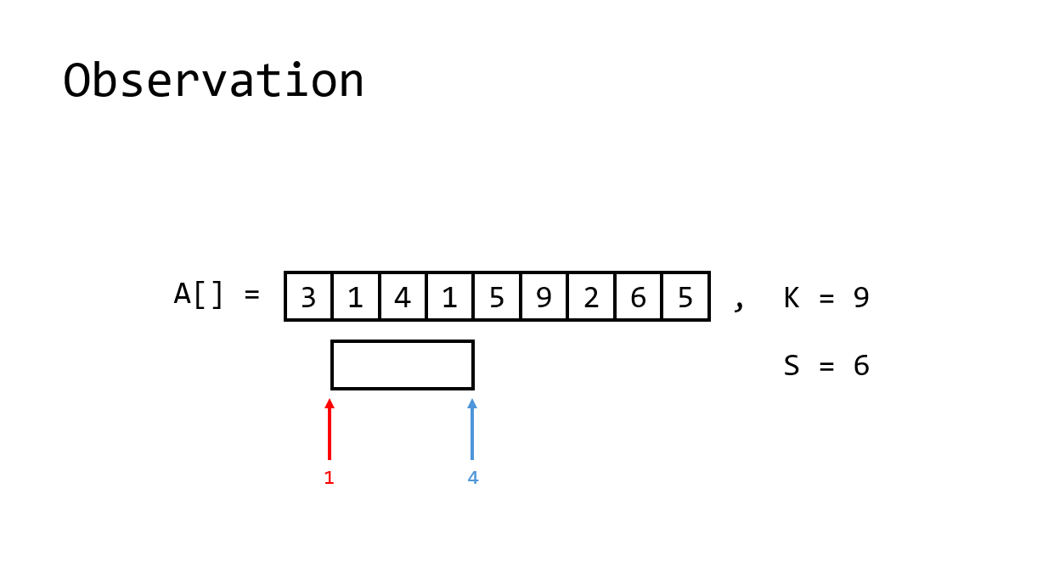
Example
Some data structure

Slide 42
Let’s solve some problems!

