Slide 1
Lab 4: Web Applications Testing
Software Testing 2023
2023/03/16

Slide 2
whoami
Software Quality Lab @ EC547
TA
蔡惠喬
hctsai.cs10@nycu.edu.tw
陳舜寧
xdev11.cs11@nycu.edu.tw
萬尚宏
sun.cs11@nycu.edu.tw

Slide 3
GitHub Repo
<student_id>-ST-2023
Add collaborators
XDEv11, chameleon10712, skhuang

Slide 4
Selenium

Slide 5

About selenium
Selenium automates browsers.
Primarily used for autimating web applications for testing purpose, but is certainly not limited to just that.
Boring web-based administration tasks can also be automated as well.

Slide 6

Selenium webdriver
WebDriver uses browser automation APIs provided by
browser vendors to control browser and run tests,
as if a real user is operating the browser.
Support multiple browsers and langauges.

Slide 7
Install selenium library with pip
pip3 install selenium
pip3 install webdriver_manager

Slide 8
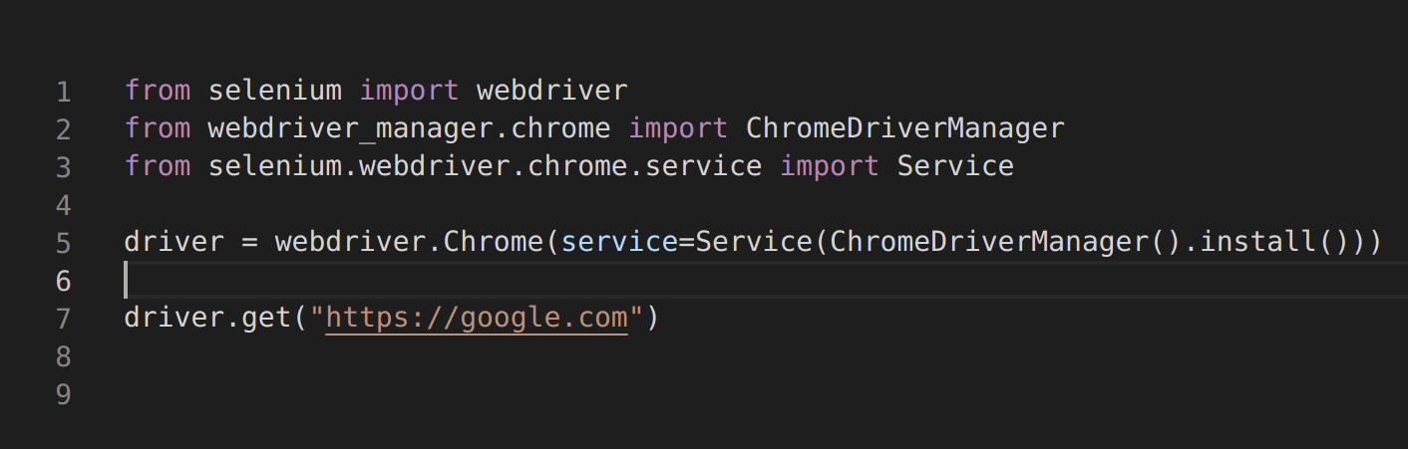
Auto install and use webdriver
https://pypi.org/project/webdriver-manager/

Slide 9
Example

Slide 10


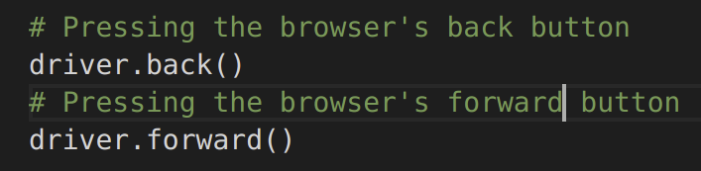

Browser navigation
Navigate to:
Refresh the current page:
Pressing the browser’s forward, back button:
Quitting the browser at the end of a session:

Slide 11
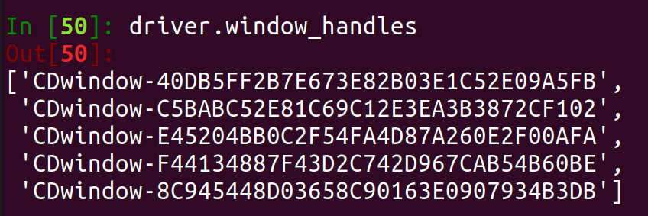
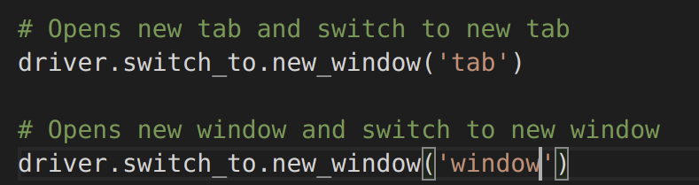
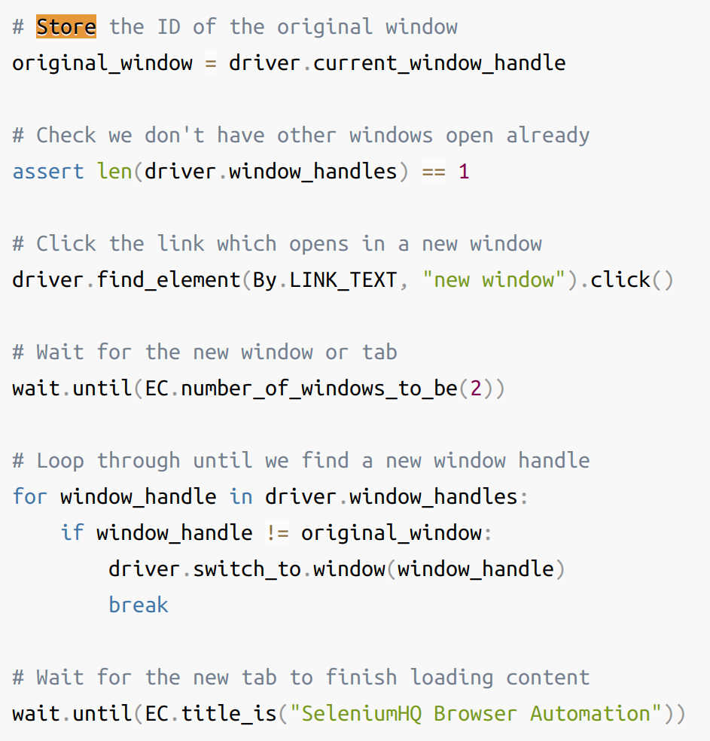
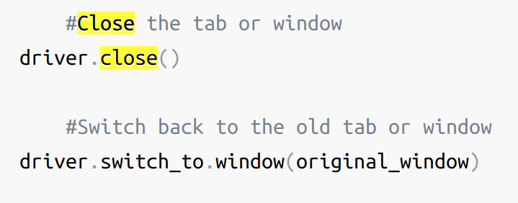
Windows and Tabs
Create new window (or) new tab and switch:
Get window handle:
Switching windows or tabs:
Closing a window or tab:

Slide 12
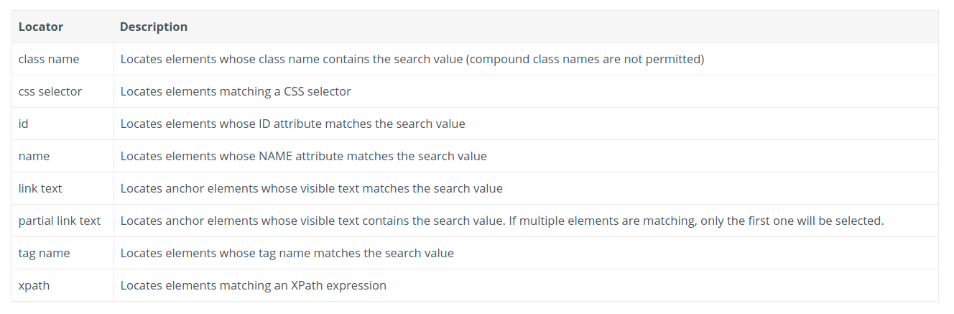
Element selection strategies
https://www.selenium.dev/selenium/docs/api/py/webdriver/selenium.webdriver.common.by.html

Slide 13
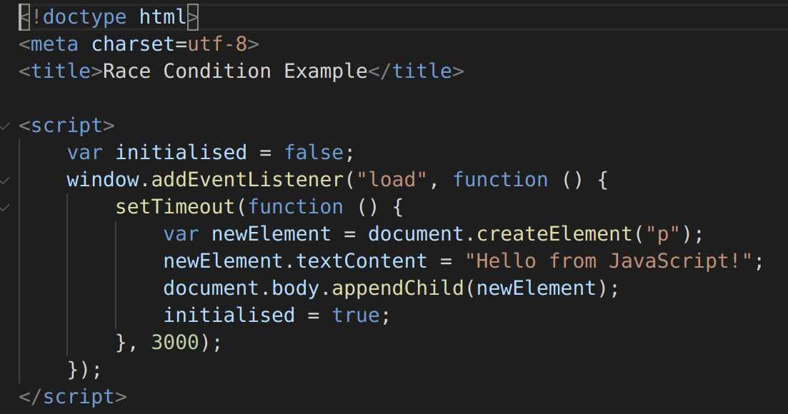
Waits

Slide 14
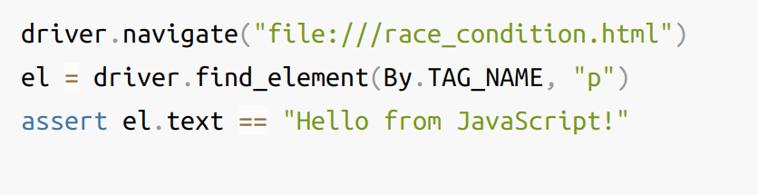
Waits

Slide 15
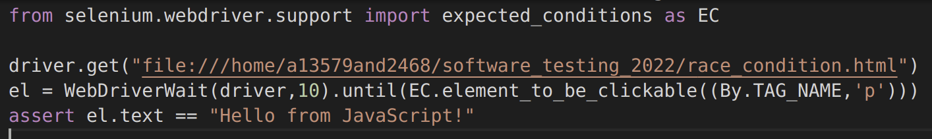
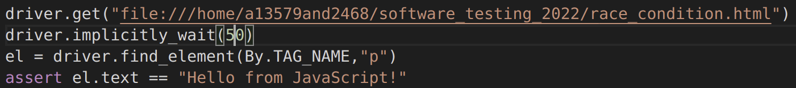
Waits
Explicit wait: (with condition)
Expected condition:
Implicit wait: (without condition)
https://www.selenium.dev/documentation/webdriver/waits/

Slide 16
Others
.text
.click()
.send_keys()
Other information can be found in document
https://www.selenium.dev/documentation/en/webdriver/

Slide 17
Lab

Slide 18
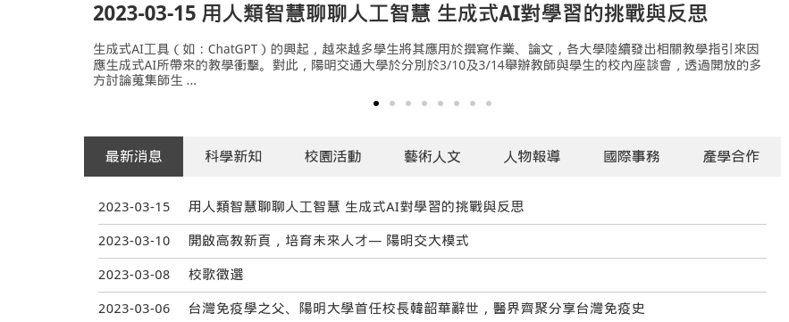
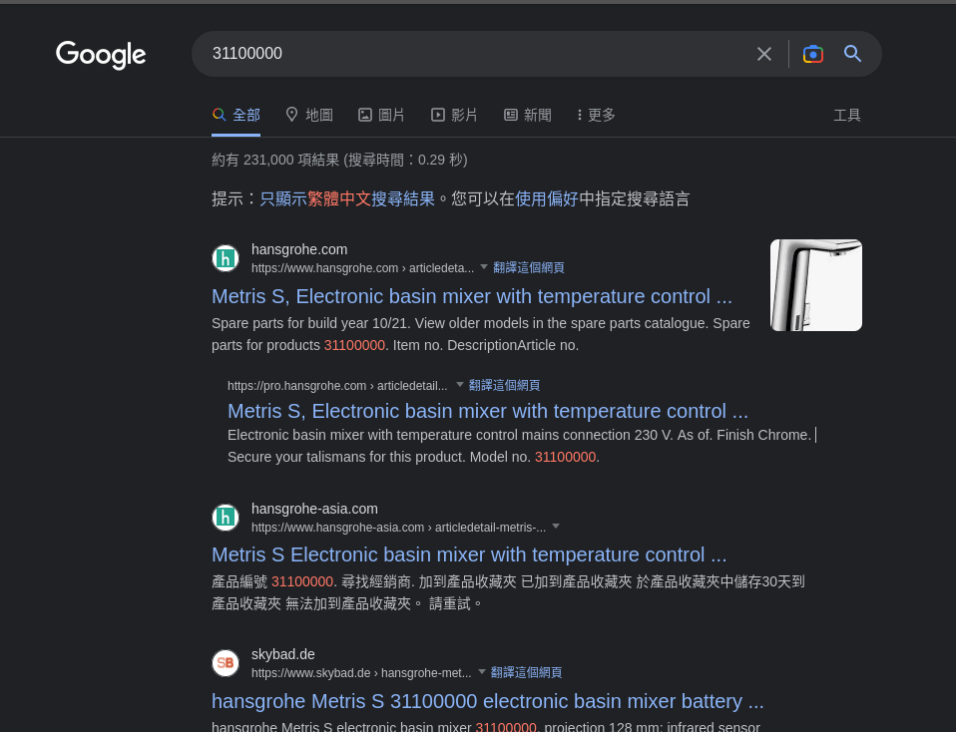
Lab 4
Write scripts to emulate a user's operations below:
launch browser →
navigate to NYCU home page (https://www.nycu.edu.tw/) →
maximize the window →
click 新聞 →
click first news →
print the title and content →
open a new tab and switch to it →
navigate to google (https://www.google.com) →
input your student number and submit →
print the title of second result →
close the browser

Slide 19
Lab 4
By default, GitHub Actions cannot run Selenium. To complete the lab, you can use the following code to initialize the webdriver. However, note that this option will not open the browser. Therefore, we recommend that you do not add this option until you have finished all jobs.
from selenium.webdriver.chrome.options import Options
options = Options()
options.add_argument('--headless')
options.add_argument('--window-size=1920,1080')
options.add_argument('--disable-gpu')
driver = webdriver.Chrome(service=ChromeService(ChromeDriverManager().install()), options=options)

Slide 20
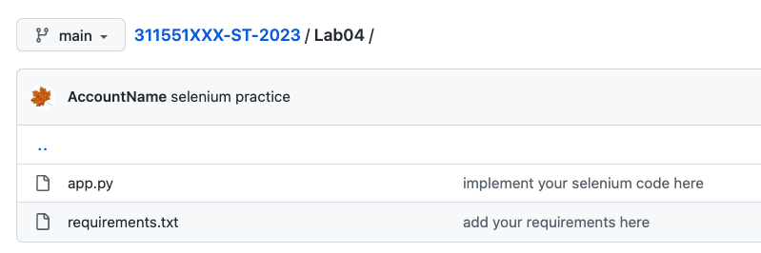
Lab 4
command
python3 app.py
put your requirements.txt under Lab04 directory
pip freeze > requirements.txt

Slide 21
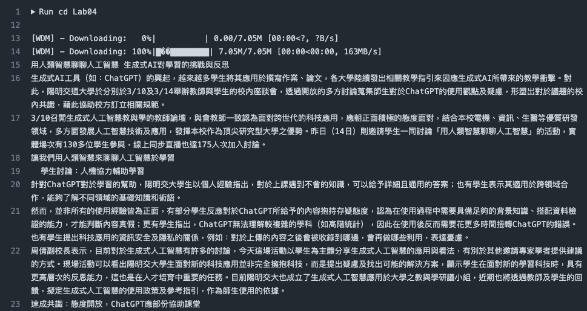
Lab 4

Slide 22
Demo

Slide 23
Submission

Slide 24
Submission
Add Lab04 status badge in your README file
Please submit your Github repo <student_id>-ST-2023, and upload these to E3:
commit URL
refer to Lab 1 submission
github action job URL
refer to Lab 3 submission

Slide 25
Reference
https://www.selenium.dev/
https://pypi.org/project/webdriver-manager/
https://www.selenium.dev/selenium/docs/api/py/webdriver/selenium.webdriver.common.by.html
https://selenium-python.readthedocs.io/

Slide 26
