Slide 1
Lab 1
Software Testing 2023
2023/02/23

Slide 2
#whoami
Software Quality Lab @ EC547
TA
蔡惠喬
hctsai.cs10@nycu.edu.tw
陳舜寧
xdev11.cs11@nycu.edu.tw

Slide 3
GitHub Repo
<student_id>-ST-2023
Add collaborators
XDEv11, chameleon10712, skhuang

Slide 4
Unit Test

Slide 5
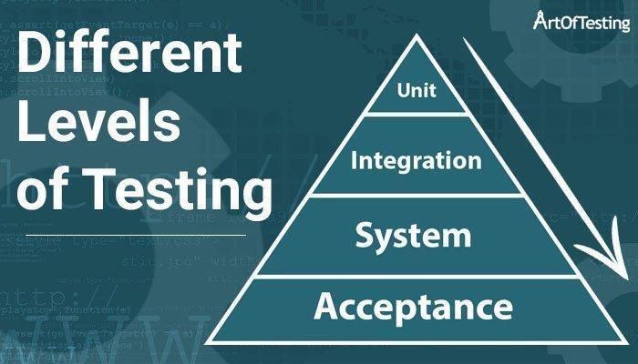
Unit Test

Slide 6
Unit Test
Python unittest module
unittest doc

Slide 7
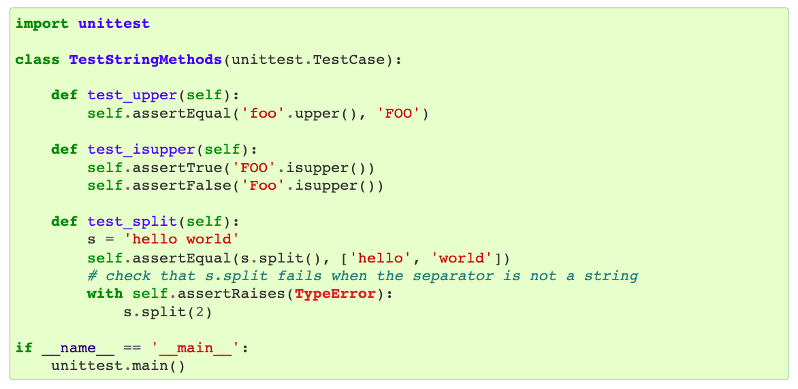
Unit Test

Slide 8
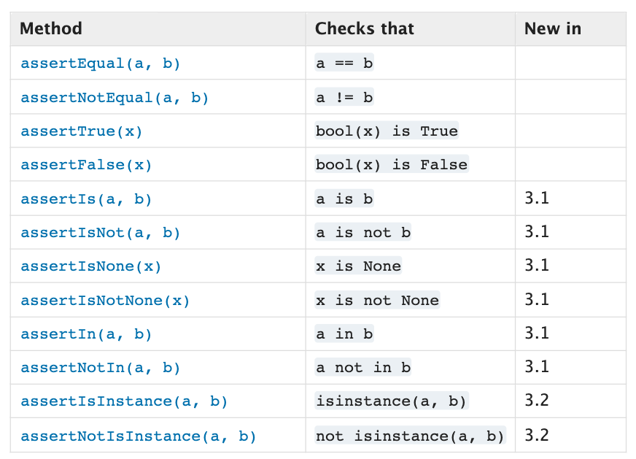
Unit Test

Slide 9
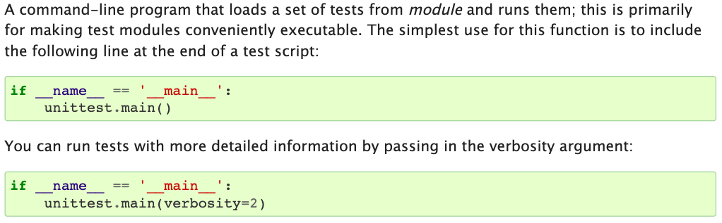
Unit Test

Slide 10
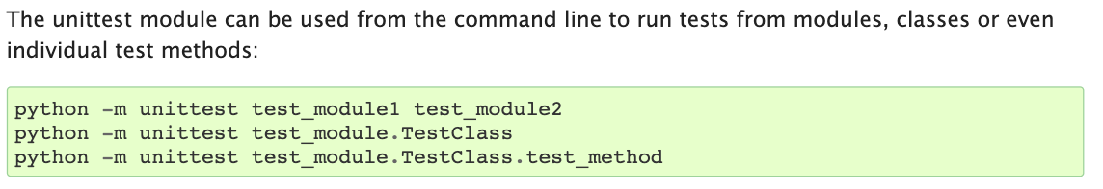
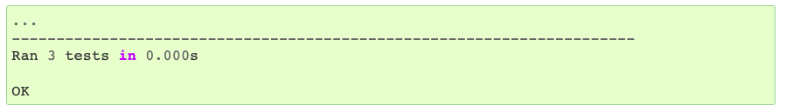
Unit Test

Slide 11
Coverage

Slide 12
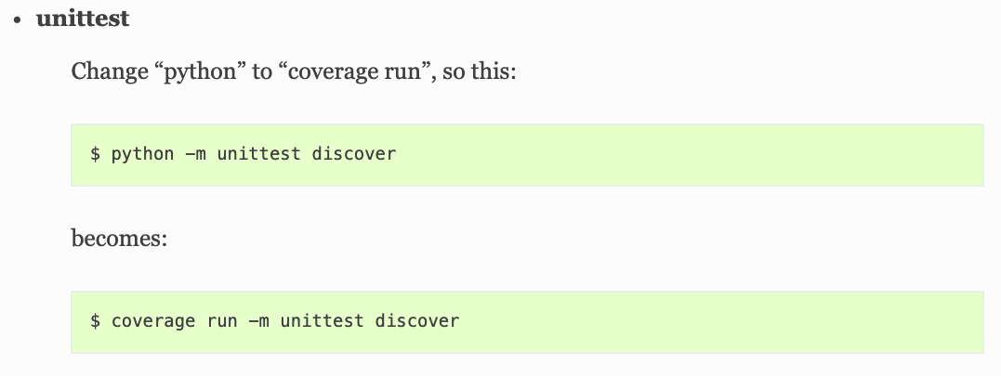
Coverage

Slide 13
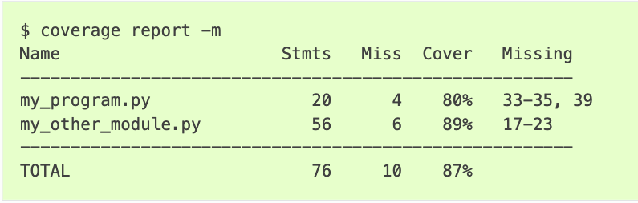
Coverage

Slide 14
Lab 1

Slide 15
Part 1 - unittest
In this Lab, you are going to implement unit test for Students.py.
spec
There are 4 students in the classroom, who are John, Mary, Thomas, and Jane. Please modify StudentsTest.py and add these names to a student object. You need to test for set_name and get_name method in Students Class. The required output is listed in page 15.

Slide 16
Part 1 - unittest
spec
In test_1_get_name(), you have to test for all the valid ids, and an invalid id using mex.
Mex
The mex of a set of integers is the smallest non-negative integer that does not belong to the set.

Slide 17
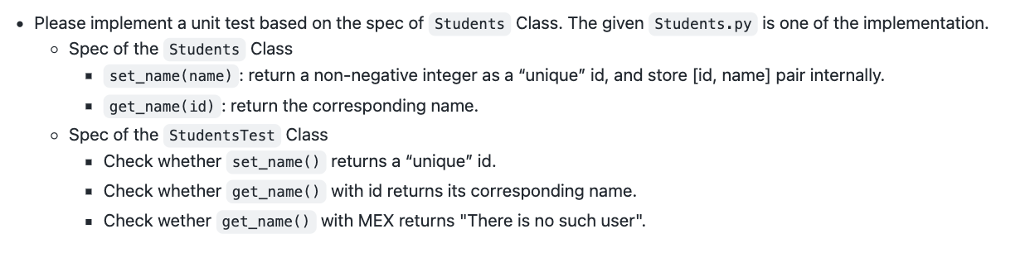
Part 1 - 補充
spec

Slide 18
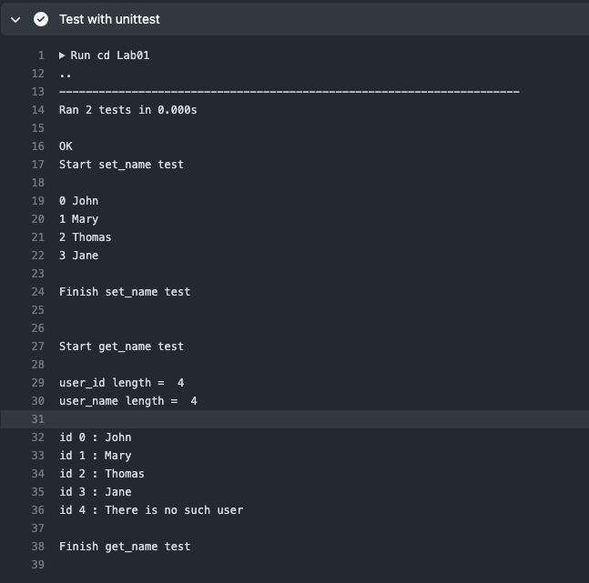

Slide 19
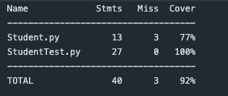
Part 1 - unittest
python3 -m unittest StudentsTest.py

Slide 20
Part 2 - coverage
Please test the coverage of your program. Modify Students.py and StudentsTest.py to make coverage to 100%.

Slide 21
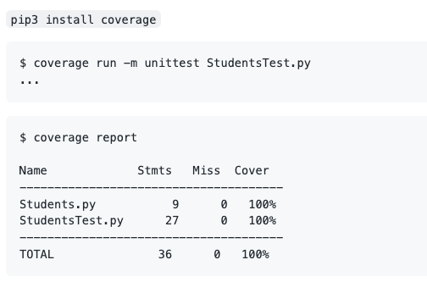
Part 2 - coverage

Slide 22
Lab 1 Submission

Slide 23
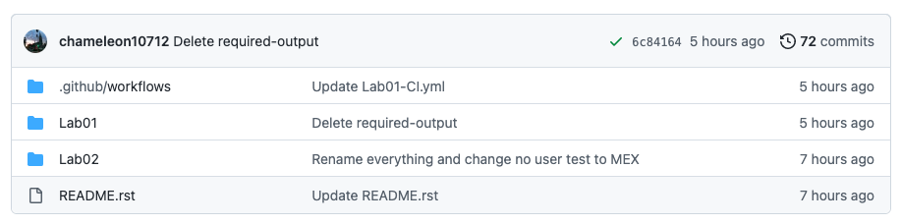
Submission
Please create a directory named Lab01 in your <student_id>-ST-2023 repo
Lab01 shall contain Students.py and StudentsTest.py

Slide 24
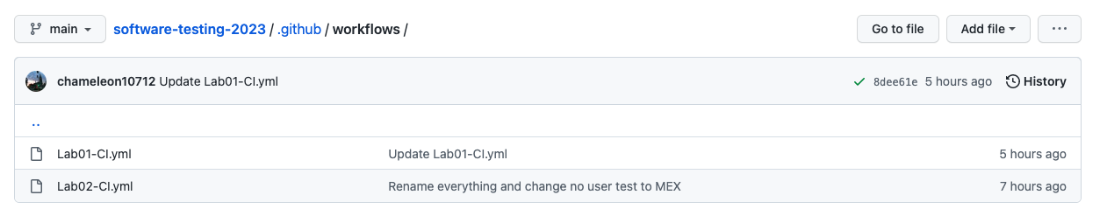
Submission
Please add Lab01-CI.yml to .github/workflows.

Slide 25
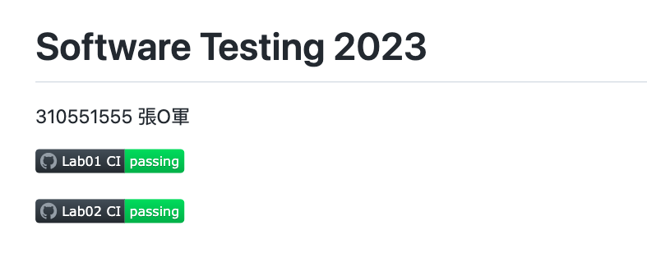
Submission
Please add Lab 1 CI status badge in your README

Slide 26
Submission
Please submit your commit url to E3

Slide 27
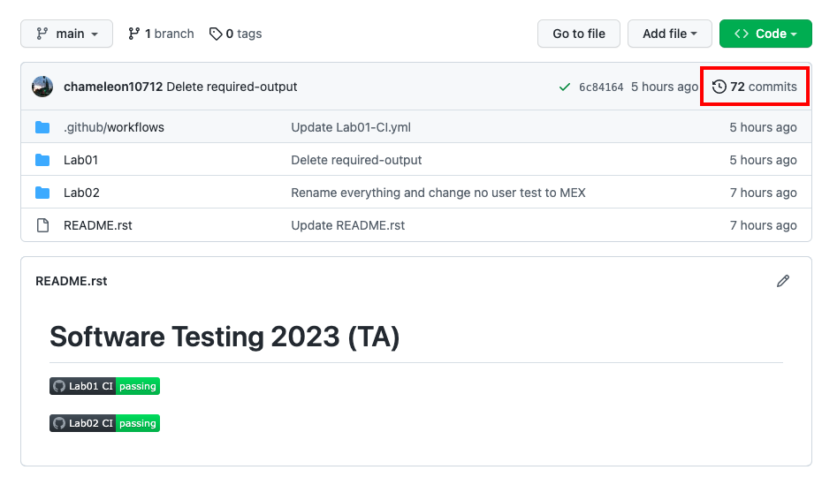

Slide 28
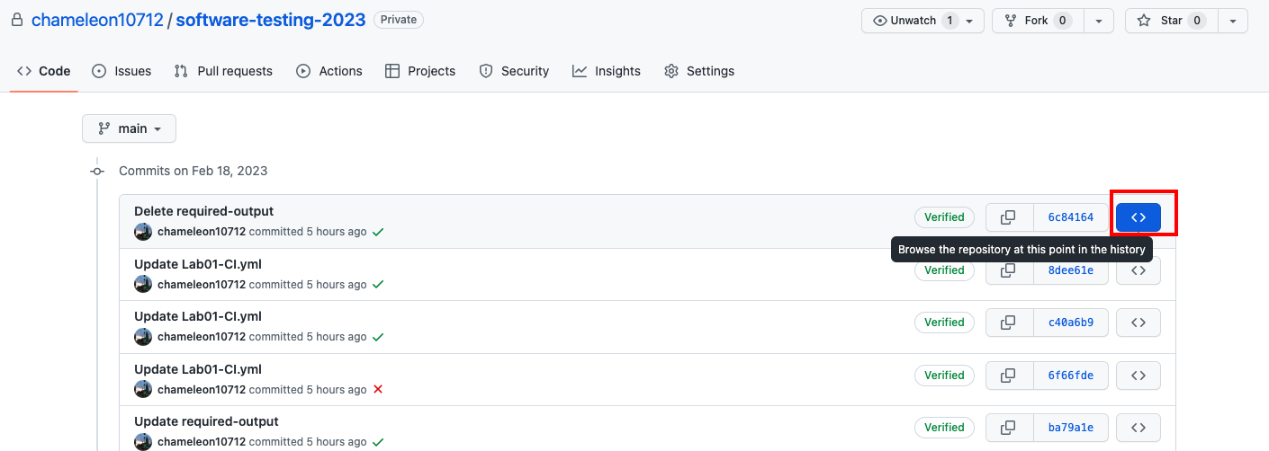

Slide 29
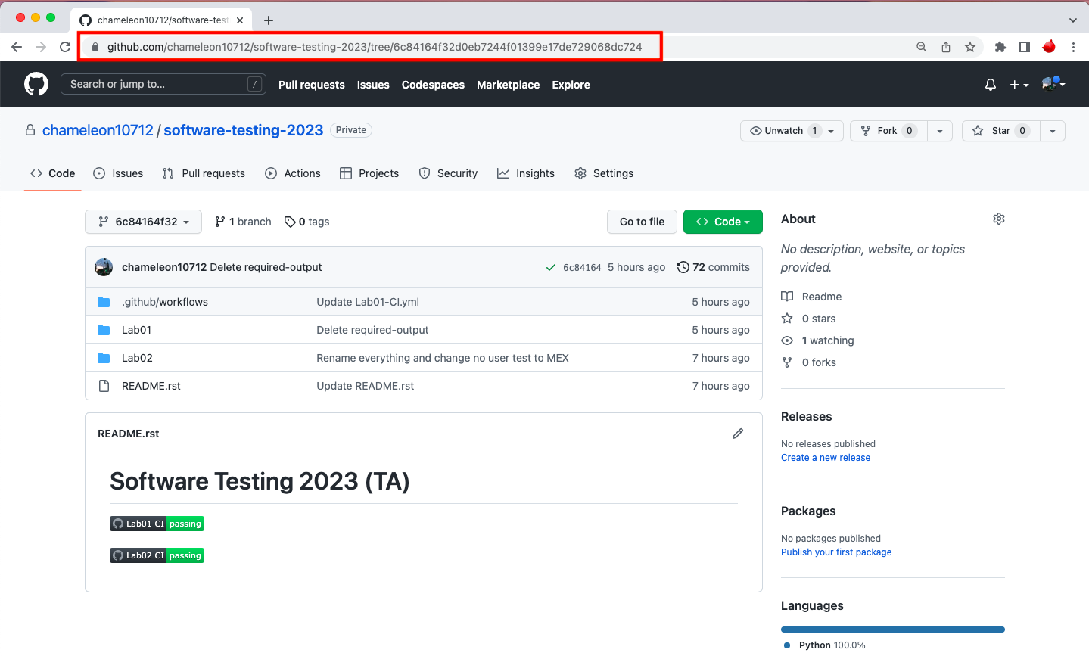

Slide 30
Reference
https://coverage.readthedocs.io/en/7.1.0/
https://docs.python.org/3/library/unittest.html
https://coverage.readthedocs.io/en/7.1.0/branch.html#structurally-partial-branches
https://plainenglish.io/blog/a-quick-intro-to-to-test-coverage-in-python-9bf299711c6c

Slide 31
Lab 1 CI output

Slide 32
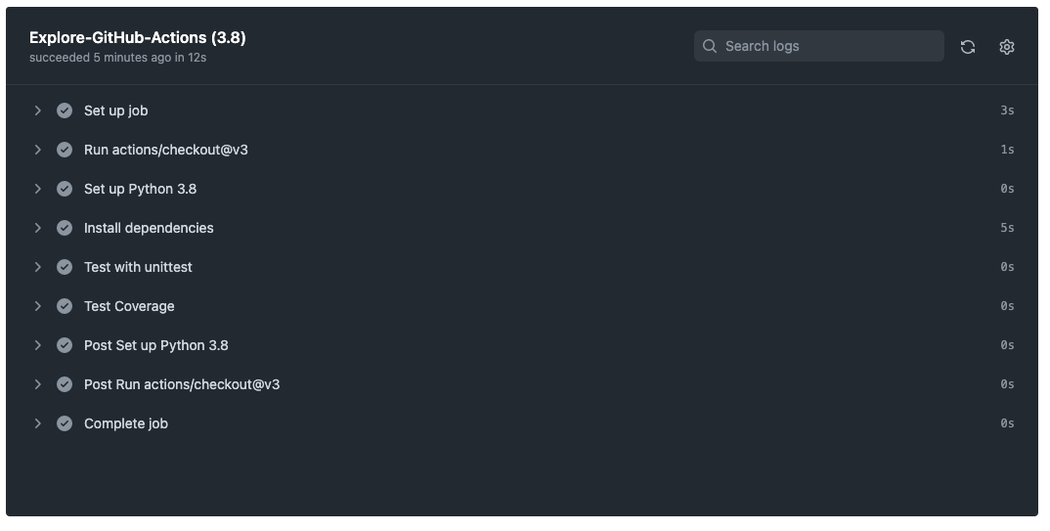

Slide 33
