Slide 1
Lab 2
Software Testing 2023
2023/03/02

Slide 2
#whoami
Software Quality Lab @ EC547
TA
蔡惠喬
hctsai.cs10@nycu.edu.tw
陳舜寧
xdev11.cs11@nycu.edu.tw

Slide 3
GitHub Repo
<student_id>-ST-2023
Add collaborators
XDEv11, chameleon10712, skhuang

Slide 4
Mock

Slide 5
Mocks
Stubs
Provide a canned response to method calls
Spy
Real objects that behave like normal except when a specific condition is met
Mocks
Verifies behavior (calls) to a method

Slide 6
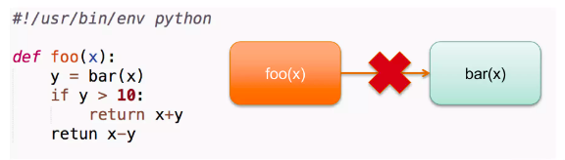
Mocks
Eliminates dependencies in the class under test

Slide 7
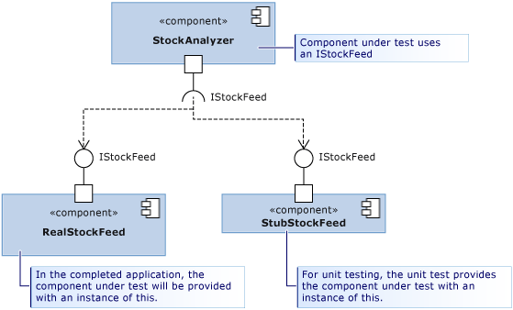
Stub

Slide 8
unittest.mock

Slide 9
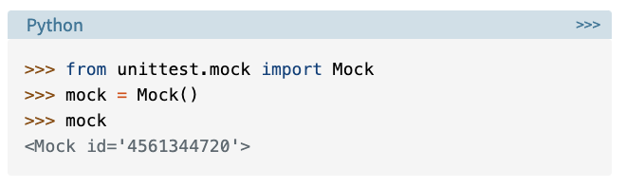
The Mock Object

Slide 10
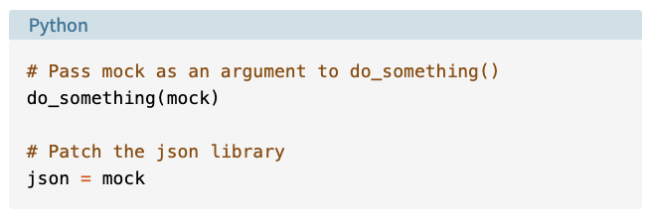
The Mock Object

Slide 11
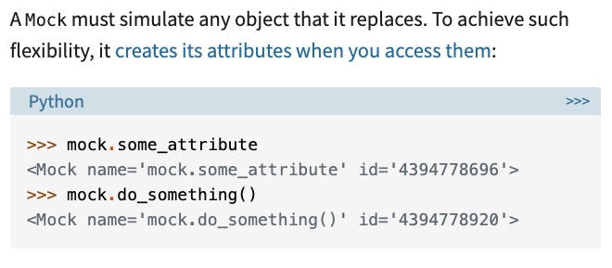
Lazy Attributes and Methods

Slide 12
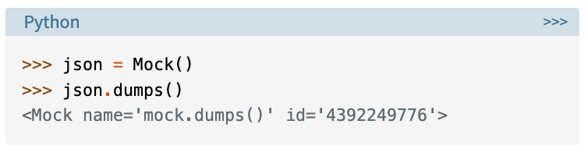
Lazy Attributes and Methods

Slide 13
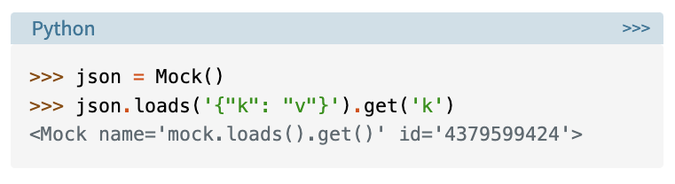
Lazy Attributes and Methods

Slide 14
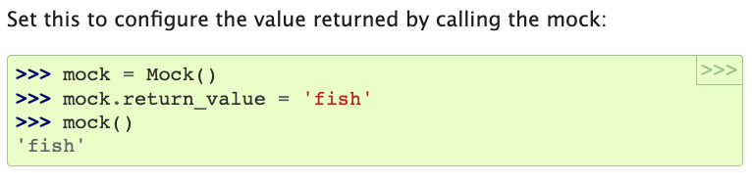
return_value

Slide 15
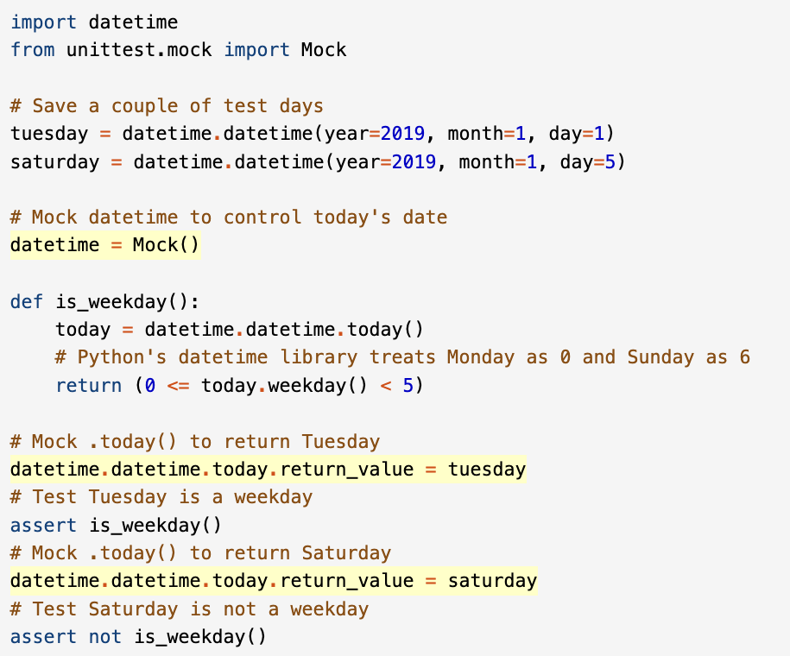

Slide 16
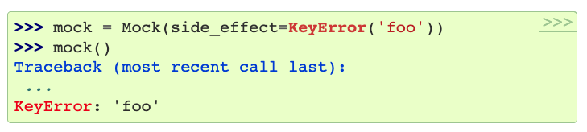
side_effect()

Slide 17
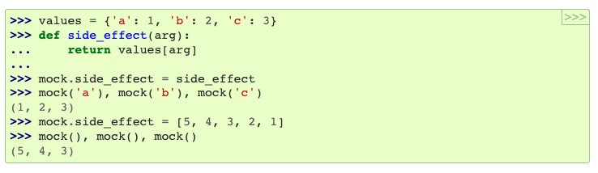
side_effect()

Slide 18
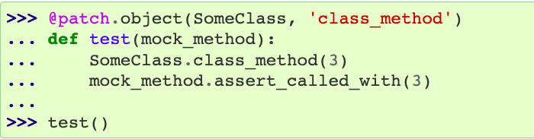
patch

Slide 19
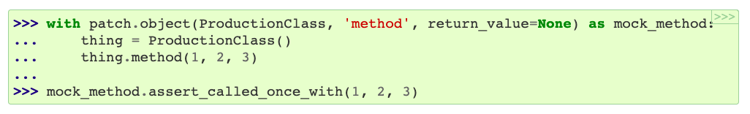
patch

Slide 20
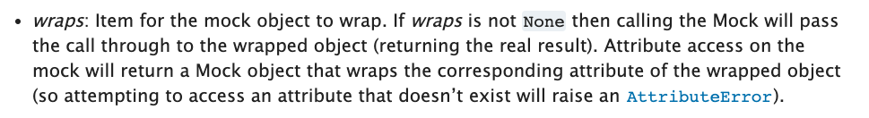
patch

Slide 21
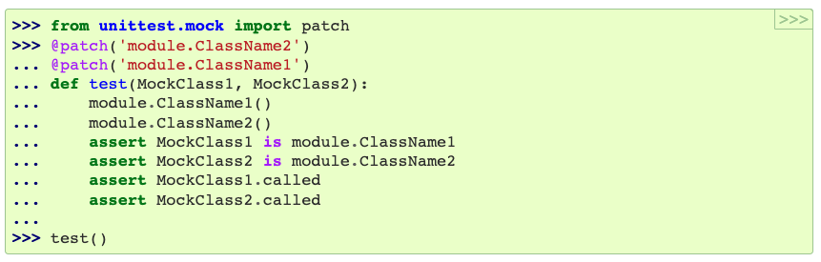
Nesting Patch Decorators

Slide 22
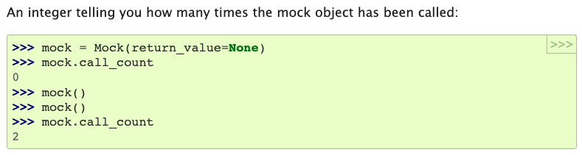
call_count

Slide 23
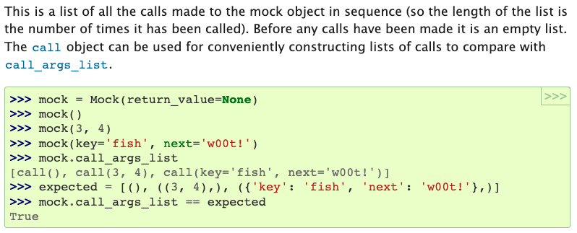
call_args_list

Slide 24
Lab 2

Slide 25
The Hunger Games
The nation Utopian select several children each year to fight to death in the annual Hunger Games. Contrast to the old games, the government wants to utilize new technology to assist management. Therefore, the ruler recently asked to develop a random selector app for this significant activity. As a test engineer, the government command you to test for this app.

Slide 26
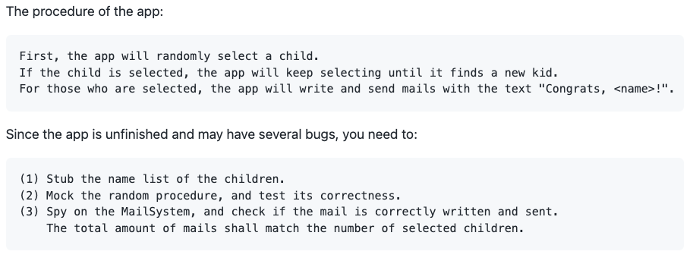
The Hunger Games

Slide 27
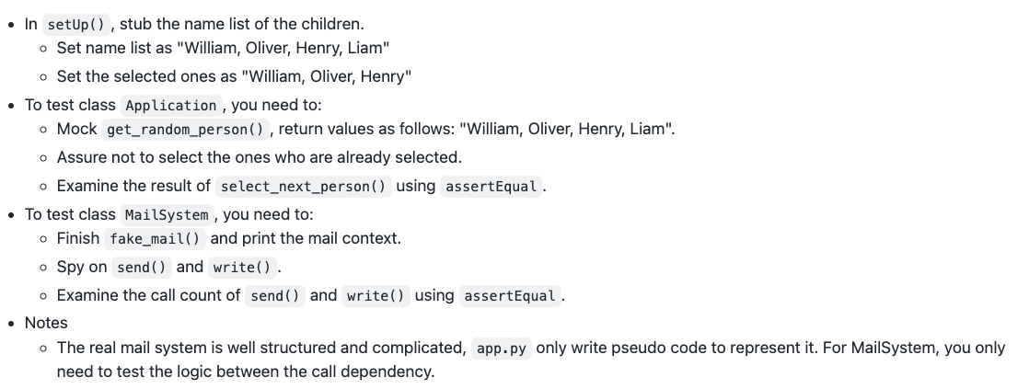
Requirements

Slide 28
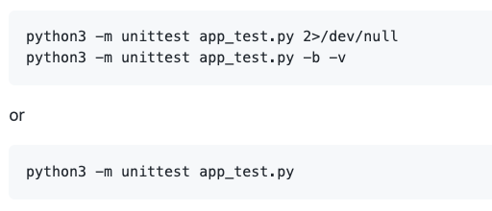

Slide 29
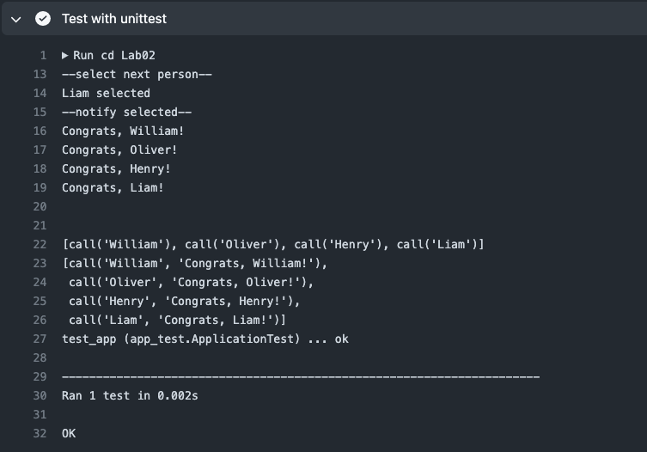

Slide 30
Spec & Code
NYCU-Software-Testing-2023/Lab02/

Slide 31
Submission

Slide 32
Submission
Use Lab02-CI.yml, and add Lab02 status badge in your README
Please submit your Github repo <student_id>-ST-2023 commit URL to E3
commit URL
refer to Lab 1 submission

Slide 33
Reference
https://docs.python.org/3/library/unittest.mock.html#nesting-patch-decorators
https://learn.microsoft.com/en-us/visualstudio/test/using-stubs-to-isolate-parts-of-your-application-from-each-other-for-unit-testing?view=vs-2022&tabs=csharp
https://www.baeldung.com/mockito-spy#simple-spy-example
https://realpython.com/python-mock-library/

