Slide 1
Lab 3
Software Testing 2023
2023/03/09

Slide 2
#whoami
Software Quality Lab @ EC547
TA
蔡惠喬
hctsai.cs10@nycu.edu.tw
陳舜寧
xdev11.cs11@nycu.edu.tw

Slide 3
GitHub Repo
<student_id>-ST-2023
Add collaborators
XDEv11, chameleon10712, skhuang

Slide 4
Parameterization & Exception

Slide 5
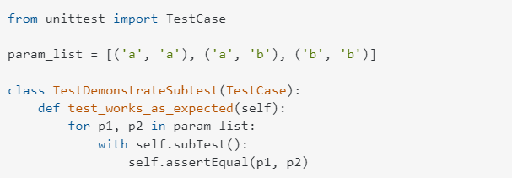
Parameterization

Slide 6
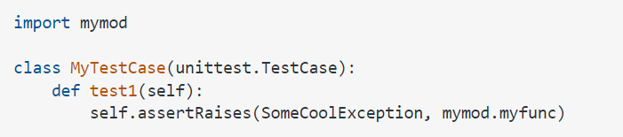
Exception

Slide 7
Continuous Integration

Slide 8
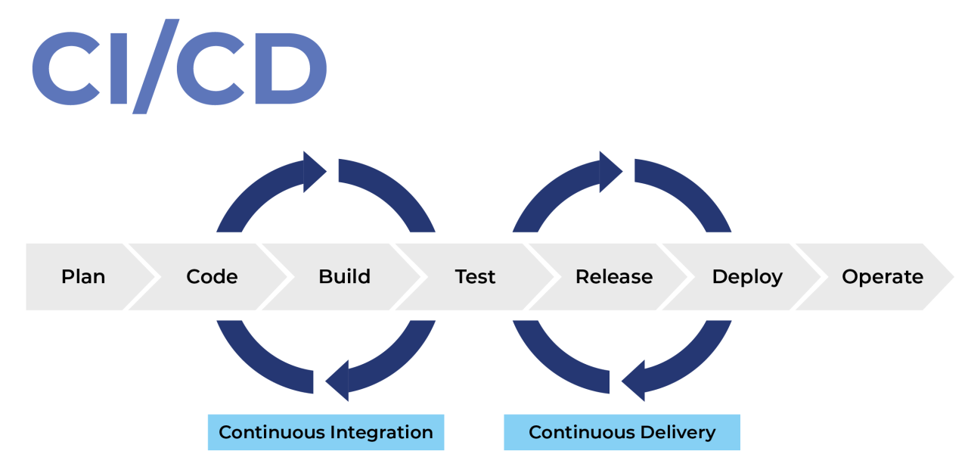
Notes:
持續整合（Continuous Integration，CI）顧名思義，就是當開發人員完成一個階段性的程式碼後就經由自動化工具測試、驗證，協助偵測程式碼問題，並建置出即將部署的版本（Build）。
持續部署（Continuous Deployment）可以說是CI的下一階段，經過CI測試後所構建的程式碼可以透過CD工具部署至伺服器，減少人工部署的時間。

Slide 9
GitHub Action
CI / CD platform
Provides Linux, Windows, and macOS virtual machines to run your workflows

Slide 10
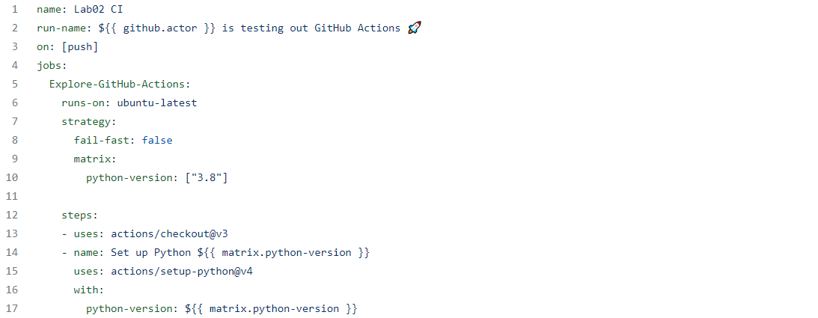
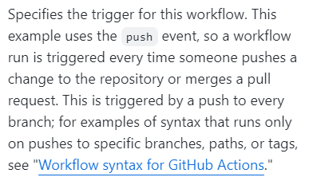
The Workflow File

Slide 11
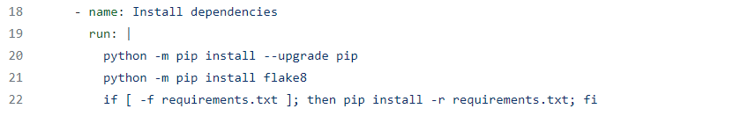
The Workflow File

Slide 12
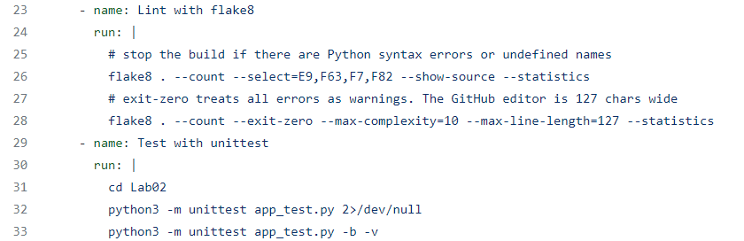
The Workflow File

Slide 13
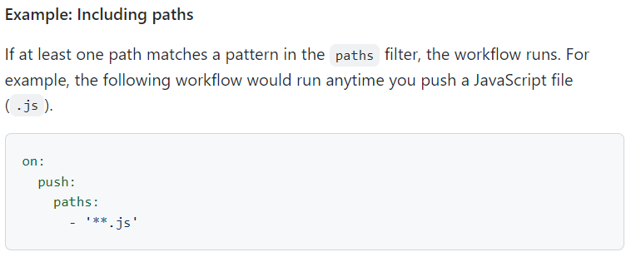
The Workflow File

Slide 14
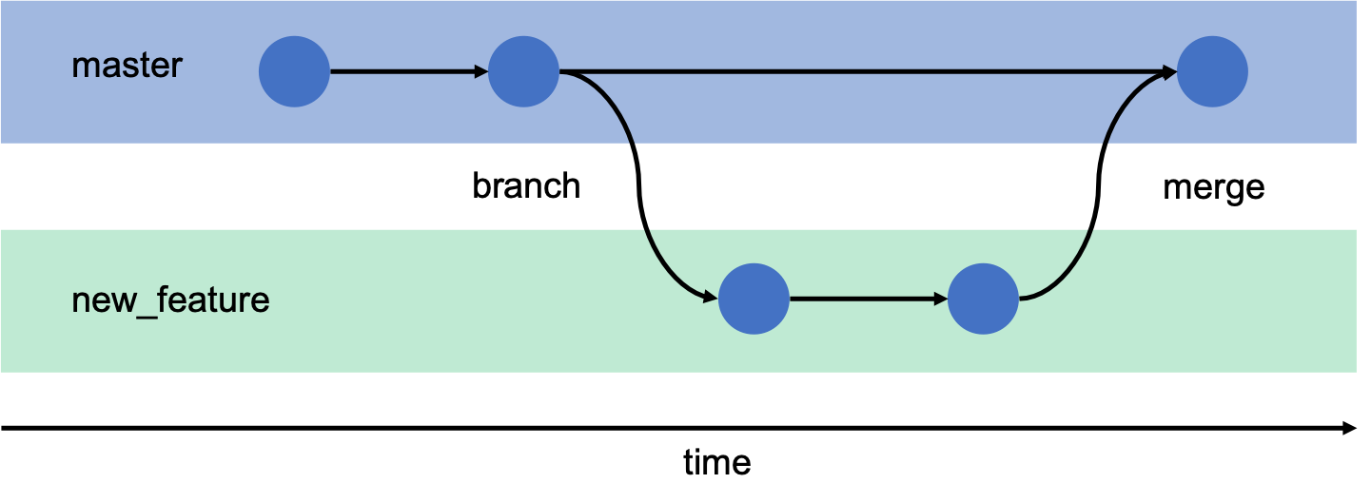

Slide 15
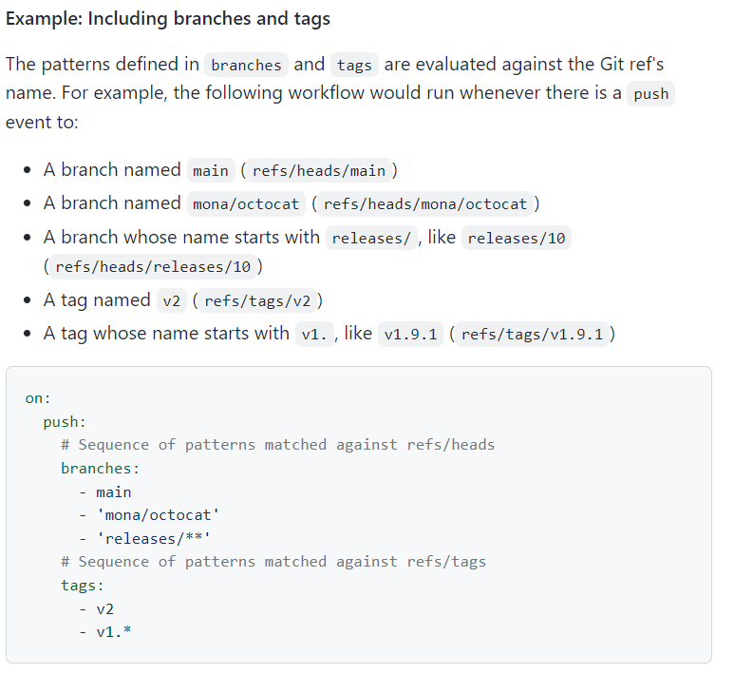

Slide 16
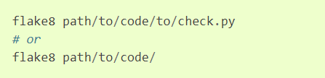
flake8
flake8 is a python tool that glues together pycodestyle, pyflakes, mccabe, and third-party plugins to check the style and quality of some python code.

Slide 17
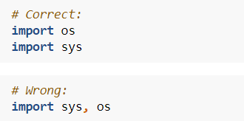
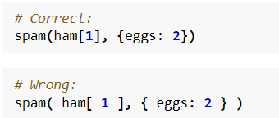
PEP 8
Style Guide for Python Code

Slide 18
Lab 3

Slide 19
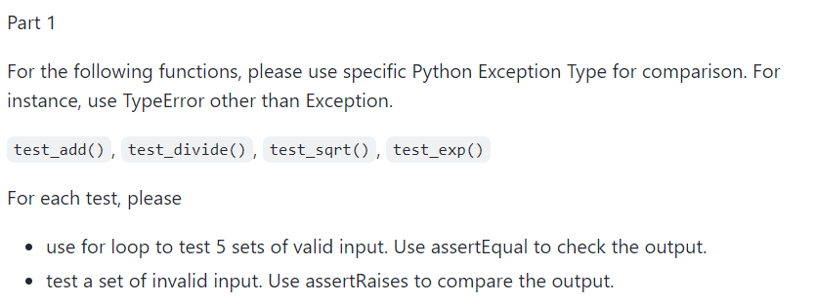
Lab 3

Slide 20
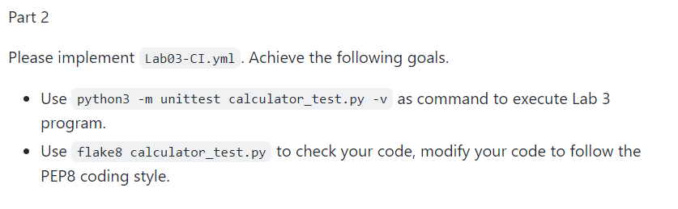
Lab 3

Slide 21
Spec & Code
NYCU-Software-Testing-2023

Slide 22
Submission

Slide 23
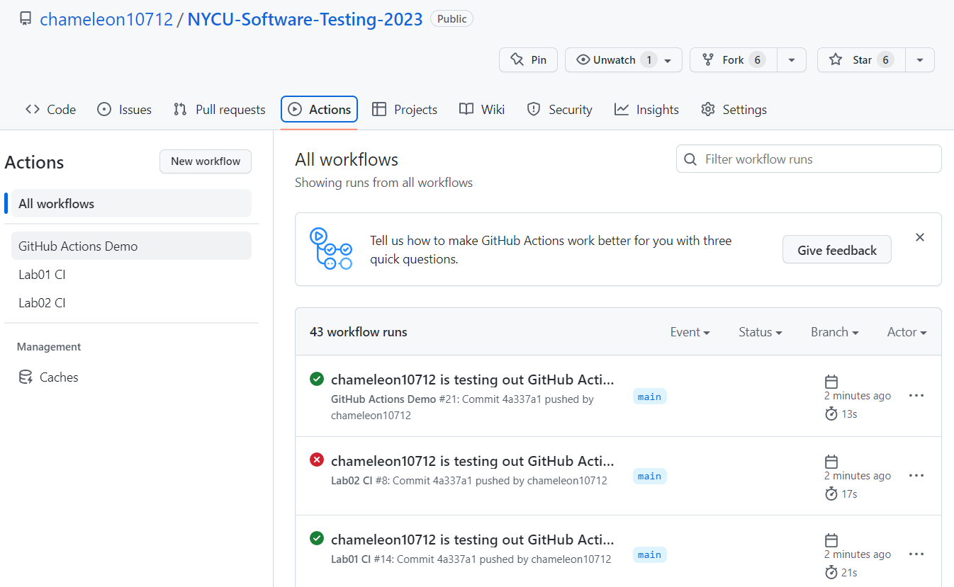

Slide 24
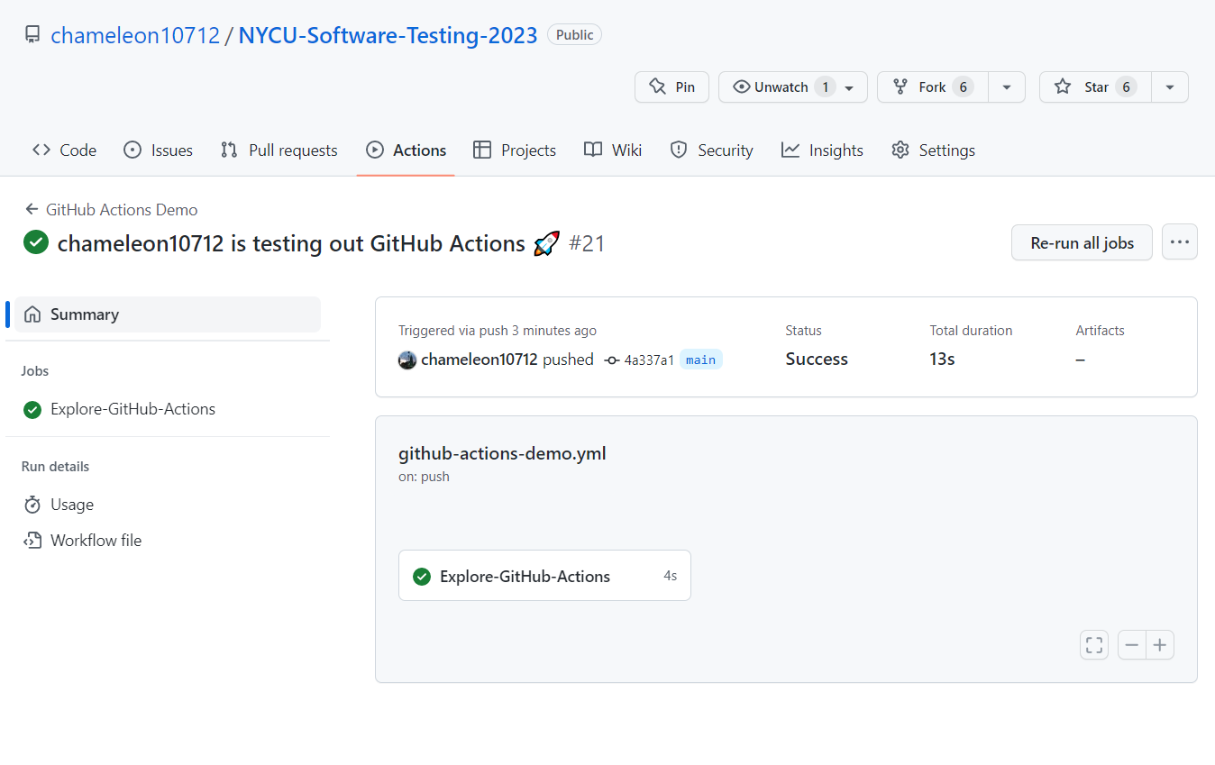

Slide 25
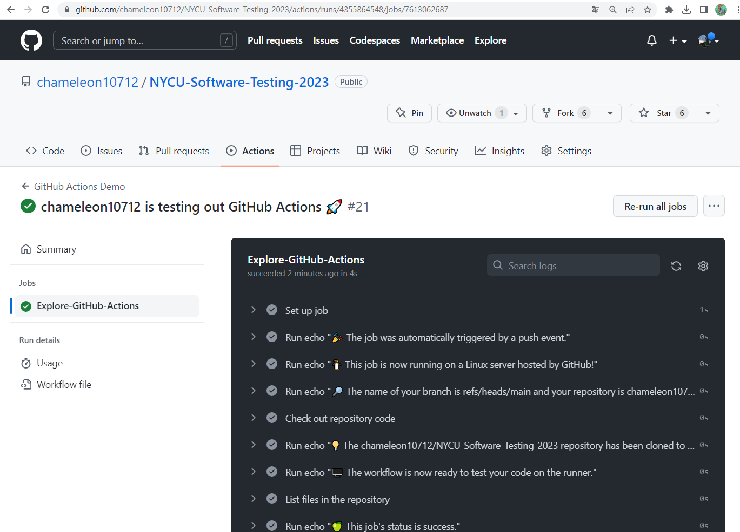

Slide 26
Submission
Add Lab03 status badge in your README file
Please submit your Github repo <student_id>-ST-2023 (1) commit URL (2) github action job URL to E3
commit URL
refer to Lab 1 submission

Slide 27
Reference
https://docs.github.com/en/actions/using-workflows/workflow-syntax-for-github-actions#example-including-paths
https://docs.github.com/en/actions/using-workflows/workflow-syntax-for-github-actions#example-including-branches-and-tags
https://flake8.pycqa.org/en/latest/
https://peps.python.org/pep-0008/

