Slide 1
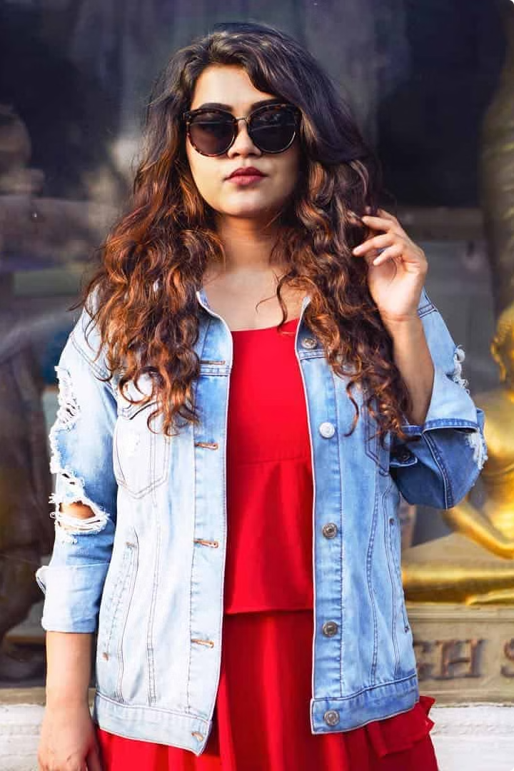


Reimagining Fashion Engagement: Myntra's GenZ Strategy
In today's fast-paced digital world, engaging young fashion enthusiasts requires more than just a static online store. Myntra aims to become the ultimate destination for Gen Z shoppers by weaving social media seamlessly into its platform. This strategy goes beyond traditional e-commerce, creating an interactive, dynamic, and community-driven experience that fuels engagement, drives sales, and fosters brand loyalty.
by Jhanvi Jain

Slide 2

The Problem: Disconnected Shopping Experiences
1
Lack of Social Interaction
2
Limited Engagement
Traditional online shopping platforms often feel isolated, lacking the social elements that resonate with Gen Z. Users crave interaction, inspiration, and a sense of community that goes beyond simply browsing and purchasing.
Without interactive elements, shopping apps struggle to retain users. Once a purchase is made, the engagement often fades, leading to a decline in app usage and brand loyalty.
3
Missing the Pulse of Trends
Younger shoppers are heavily influenced by social trends and peer recommendations. Lacking a strong social integration limits Myntra's ability to tap into these trends and provide relevant, engaging content.

Slide 3
The Impact: Lost Revenue and Brand Value
Decreased Conversion Rates
Reduced Brand Awareness
Eroded Customer Loyalty
Limited social interaction and engagement contribute to lower conversion rates, as users are less likely to make purchases without a sense of community and excitement.
Lacking a strong social presence hinders Myntra's ability to reach and connect with Gen Z audiences. This limits brand awareness and leads to missed opportunities for growth.
Without engaging features and a vibrant social community, Myntra risks losing customers to competitors who offer more interactive and community-driven experiences.

Slide 4
The Solution: A Social Shopping Revolution
1
Live Video
Live fashion shows, product launches, interactive sessions with influencers and designers, and behind-the-scenes looks at collections provide real-time, engaging content that fuels purchase decisions.
2
Virtual Wardrobe
Users can share their outfits, get feedback from friends and influencers, and discover styling inspiration, creating a community-driven fashion experience within the app.
3
Notifications & Personalized Recommendations
Myntra can leverage user data and social trends to deliver personalized product recommendations and notifications about new launches, tailoring the shopping experience to individual preferences.
4
Influencer Collaboration
Partnerships with popular Gen Z influencers can drive product awareness, boost sales, and create a sense of authenticity and credibility among target audiences.

Slide 5
Feasibility and Implementation
Existing Social Media Integrations
Tech Stack Expertise
Myntra can leverage existing social media APIs and functionalities to streamline the integration process and accelerate development.
Myntra's internal development team possesses the technical expertise to develop and implement the required features, ensuring a seamless user experience.
User Feedback and Testing
Partnerships and Collaboration
A phased rollout with user feedback and testing cycles will ensure the success of the new features and address any technical challenges.
Collaborating with leading social media platforms and influencer marketing agencies can provide valuable insights and resources for a successful implementation.

Slide 6




The Benefits: A Flourishing Fashion Ecosystem
Increased Customer Acquisition
Enhanced Customer Engagement
Elevated Conversion Rates
Boosted Revenue
Increased customer acquisition, engagement, and conversion rates will result in significant revenue growth for Myntra, solidifying its position as a market leader.
Social features will attract new customers through viral content, influencer marketing, and user-generated content, expanding Myntra's reach within Gen Z.
Interactive features, personalized recommendations, and a sense of community will drive repeat visits, increase user time spent on the app, and foster brand loyalty.
Real-time shopping experiences, influencer recommendations, and user-generated content will directly influence purchase decisions, leading to higher conversion rates.

