Slide 1





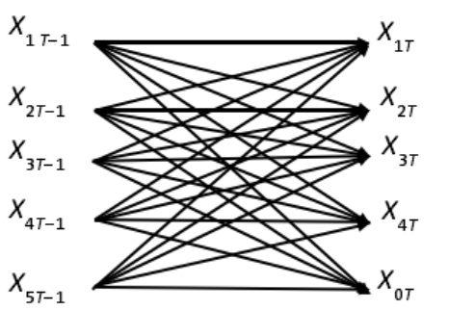




Quantitative properties
profits=The average probability of fuzzy return on investment
risk=The semi-variance probability of fuzzy returns on investment
Model construction
Determine restraint conditions
transaction cost
borrowing constraints
threshold constraint
revenue demand constraints
cardinality constraint
Building a game model based on time consistency
Algorithm for the model
Discrete state variables according to the network diagram method
Transform the model into a multi-stage weighted directed graph
Using maximum-algebra to solve the maximal path
Iterate over feasible solutions until the two feasible solutions are very close
Empirical Research
Determine the parameters
Investment cycle, transaction costs, initial capital, etc.
Using simple estimation method to obtained the possible trapezoidal distribution of investment return rate
Data processing
Plug it in and get the conclusion

