Slide 1



high income
high risk
single investment
high income
low risk
mixed investment

Slide 2







Better choice
Better choice

Slide 3
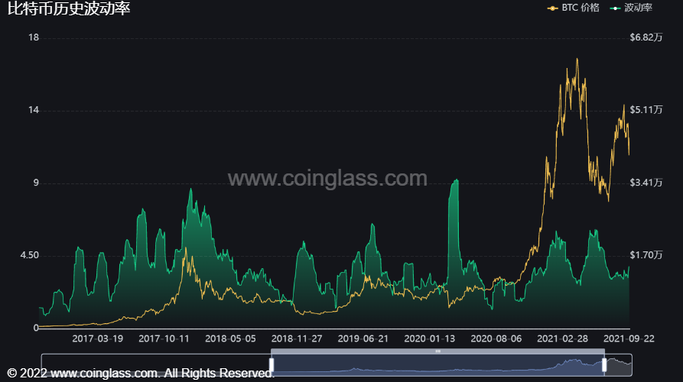
price
volatility

Slide 4
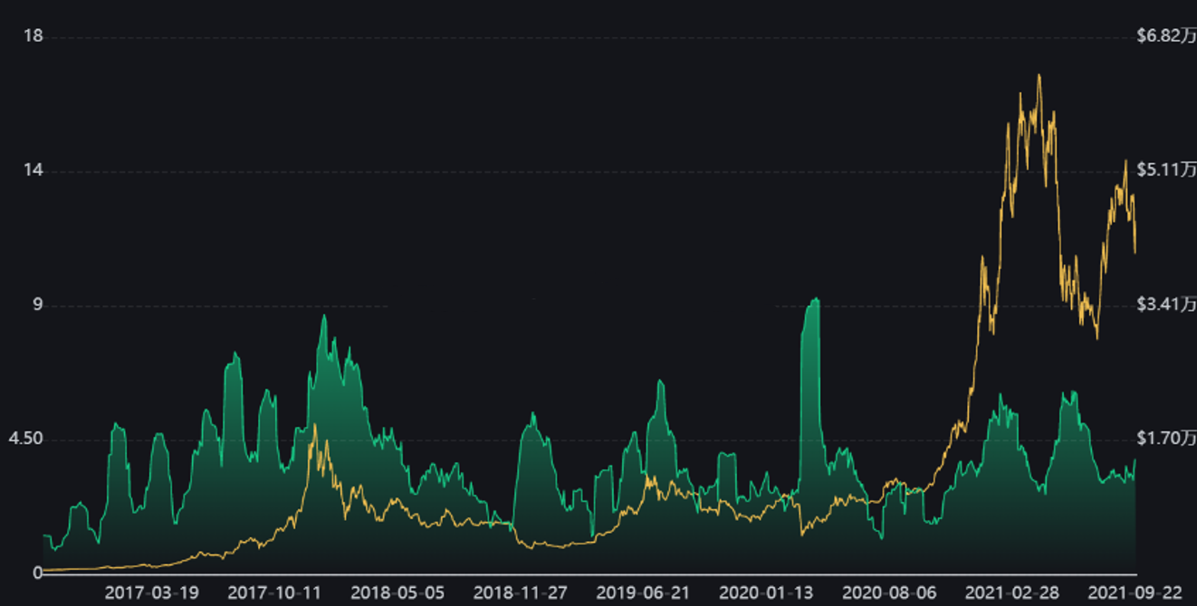
price
volatility

Slide 5
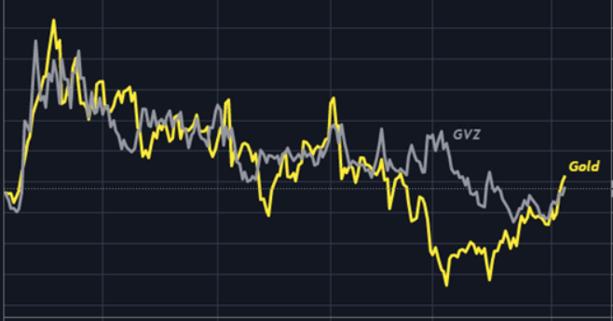
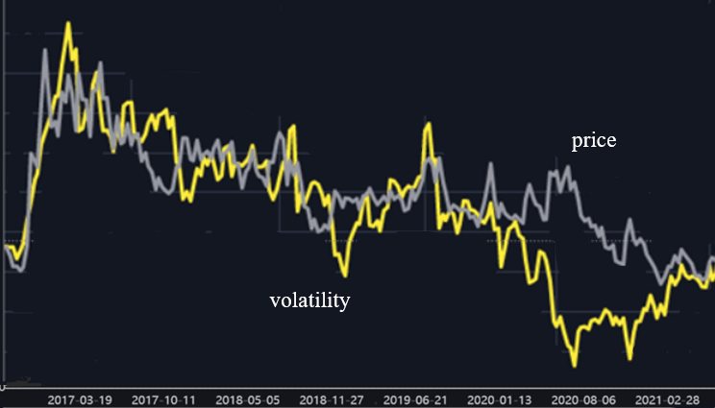


















price
volatility

Slide 6



bitcoin
gold
cash
high-risk assets
low-risk assets
risk-free assets

Slide 7

















Slide 8






small position long-term allocation
automatic investment plan
long-term factors
high returns
gold
bitcoin
sudden
short factors
low risk
uncertainty

Slide 9

adjust
[C,G,B]
affect
affect
small position long-term
allocation
long-term factors
automatic investment
plan
high returns
gold
bitcoin
sudden
short-term
factors
low risk
uncertainty

Slide 10

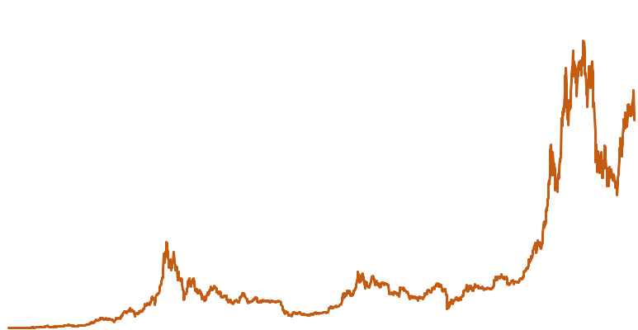


Slide 15
60

