Slide 1



high income
high risk
single investment
high income
low risk
mixed investment

Slide 2







Better choice
Better choice

Slide 3
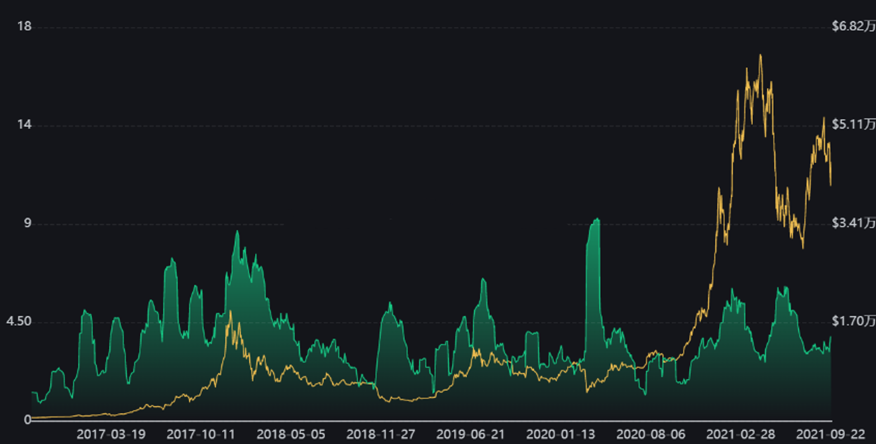
price
volatility

Slide 4
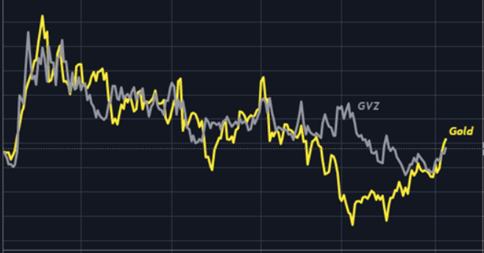
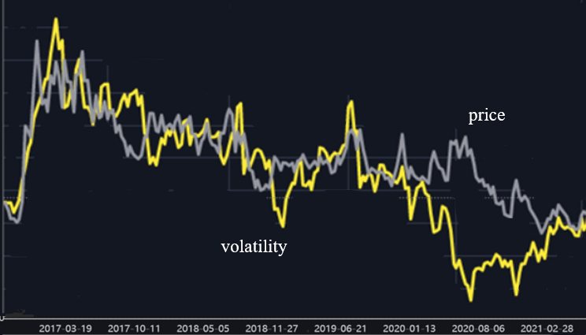


















price
volatility

Slide 5



bitcoin
gold
cash
high-risk assets
low-risk assets
risk-free assets

