Slide 1


Background
得到收益
输出投资方案
迄今为止的每日价格流
返回现有资产价值
The model
每一个月投入一次

Slide 2
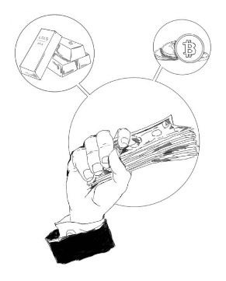

Background
这是一个关于个人小金额投资的模型报告。
·投资对象：黄金、比特币
·投资目标：低风险、高收益、后悔程度低
Descriptions
Strategy
Reasons
1.黄金小仓位长期持有，仓位保持在5%~10%
2.比特币定期投入一定比例的资金
1.黄金价格的影响因素较为复杂且难以预测
2.比特币的波动大，收益高的同时风险高，定期投资尽管会错过部分收益但可以平滑损失

Slide 3


Descriptions
how to model？
how to use this model？
总的来说就是，先预测，再规划
规划目标是确保无借款，黄金仓位保持，风险低，收益高
Strengths and weakness of the model
Strengths
Weakness
1.收益高的同时风险较低，投资者后悔程度低
2.易于操作
为了降低风险可能错过一部分收益
The result of the model
这里会是结果
这里会是比例曲线图
Questions you may have
Q1:如何证明模型的优越性？
A:我们引入了对投资者的后悔心理的具体量度，通过与其他方案分析比较可以得出结论：我们的模型给出的投资决定，在实现了风险尽量小的情况下，收益尽量大，让投资者后悔程度尽量低。这是一个优越的模型
Q2:对成本敏感吗？
A:敏感，····
Q3:可以改变周期吗,我想2个月进行一次投资？
A:可以，但决定后不再更改

Slide 4

Background
This is a memorandum of the model about small-amount personal investment.
Assets: cash , gold , bitcoin
Goal: low tisk, high return, low regret value
Descriptions
Strategy
Reasons
Gold:
Low position, i.e. 5%~10%
Long-term holding
Bitcoin:
Automatic investment plan
Modify the investment amount according to the market
1.黄金小仓位长期持有，仓位保持在5%~10%
2.比特币定期投入一定比例的资金
1.黄金价格的影响因素较为复杂且难以预测
2.比特币的波动大，收益高的同时风险高，定期投资尽管会错过部分收益但可以平滑损失
The price of gold is influenced by many factors and hard to predict
The price of bitcoin fluctuates violently. Its high return is born with high risks. Automatic investment plan shares the risk equally under the condition of obtaining no less than the average market income.

Slide 5
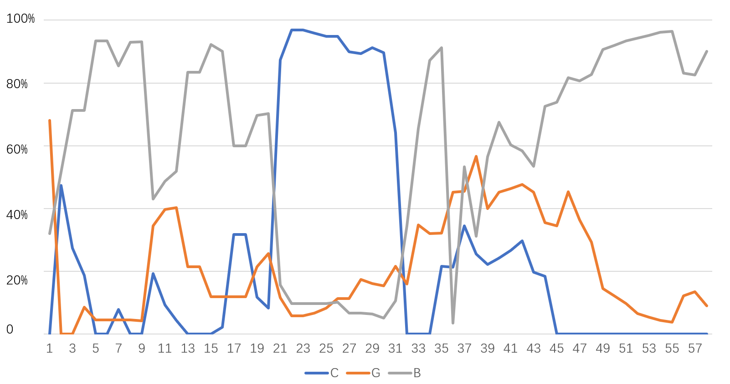
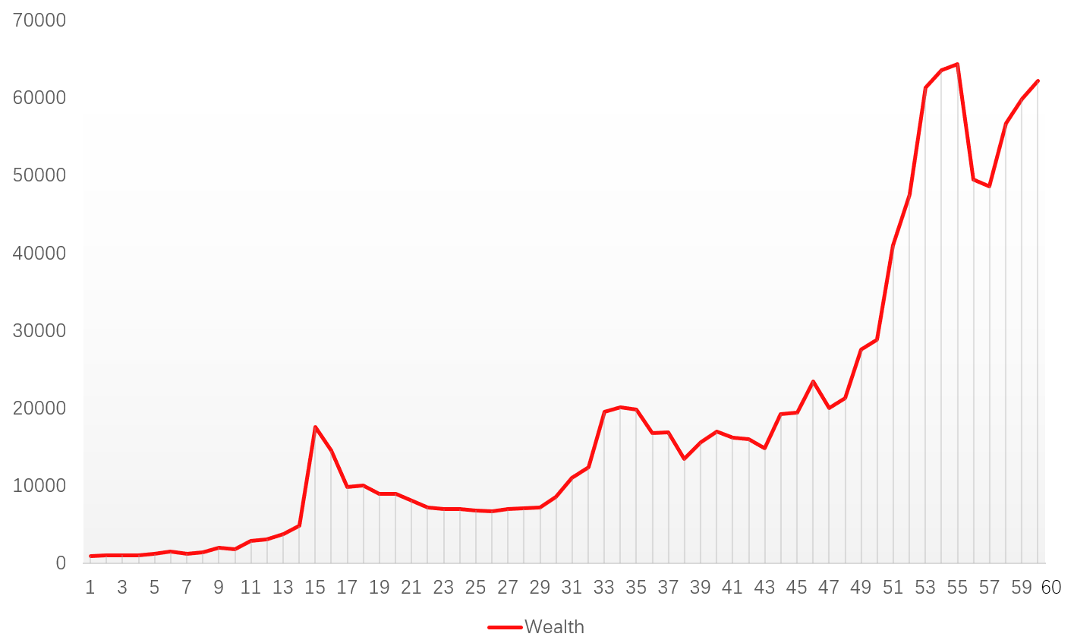
Descriptions
how to construct the model？
how to use this model？
总的来说就是，先预测，再规划
规划目标是确保无借款，黄金仓位保持，风险低，收益高
In a nutshell, predict first, plan next, make decisions last. Make sure it balances returns and risks.
Strengths and weakness of the model
Strengths
Weakness
1.收益高的同时风险较低
2.投资者后悔程度低
3.易于操作
High return with low risks
Low regret value of investors
Easy to handle
为了降低风险可能错过一部分收益
May give up some return to lower the risks
The result of the model
Dynamic proportion of assets
Total wealth
Questions you may have
Q1:如何证明模型的优越性？
A:我们引入了对投资者的后悔心理的具体量度，通过与其他方案分析比较可以得出结论：我们的模型给出的投资决定，在实现了风险尽量小的情况下，收益尽量大，让投资者后悔程度尽量低。这是一个优越的模型
Q2:对成本敏感吗？
A:敏感，····
Q3:可以改变周期吗,我想2个月进行一次投资？
A:可以，但决定后不再更改
Q1: How to prove the superiority of the model?
A: We introduce the specific measurement of the degree of investors’ unsatisfaction. By comparing with other choices, we draw the conclusion that decisions made by our model make investors regret less, gain more and take less risks. That is how we prove its superiority.
Q: Is is sensitive to transcation costs?
A: Yes. The lower transaction costs are, the more we trade, and the more we earn.
Q: Is the length of the period variable?
A: Yes. But we sugget you do not change it after you make your decision.

