Slide 1






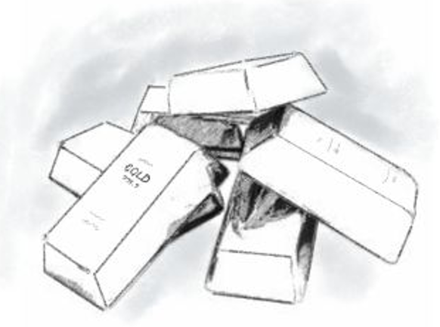


adjust
[C,G,B]
affect
affect
small position long-term
allocation
automatic investment
plan
long-term factors
high returns
sudden
short-term
factors
low risk
uncertainty

