Slide 1
Quantum Mechanics III: Output: bands, forces, stresses, phonons
Yuan Ping
Last Update: 10/8/24
Part of slides from lecture of Shobhana Narasimhan, JNCASR and Dane Morgan, UW-Madison

Slide 2
Density of States (DOS)
The DOS is a histogram of the number of electronic states per unit energy as a function of energy
DOS are useful for
Band gaps. Fermi level
Identifying which atoms/orbitals are contributing to states at what energy
Simpler to read than band structure – they summarize key information
Projected DOS and projection in general
Projection of A onto B measures how much of A comes from B.
One can project sets of wave functions (e.g., from given energy range at the valence band maximum) onto specific atoms, atom types, quantum orbitals (e,g, specific angular momentum) to see contributions to total DOS.
These projected wave functions can then give projected DOS, Bands, and charge densities.

Slide 3
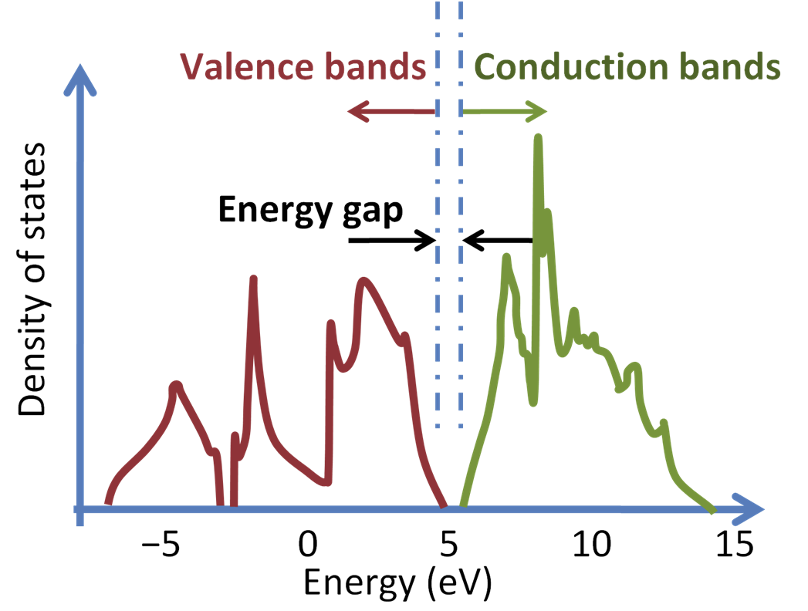
Bulk Si Density of States
http://en.citizendium.org/images/3/38/Silicon_density_of_states.PNG
Gap is about 1 eV (standard DFT get’s this wrong, DFT ~ 0.6 eV, Expt ~ 1.1 eV)

Slide 4
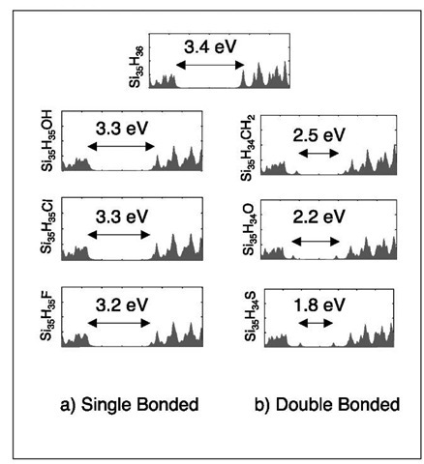
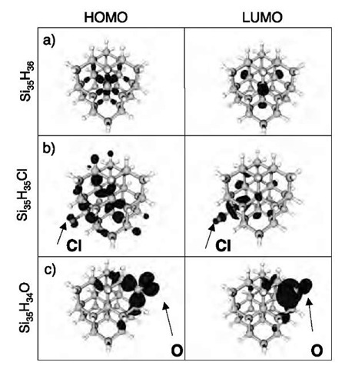
Si Nanoclusters and Effect of Surface Impurities on Band Gap
Band gap from DOS shows changes with surface species
Projected charge densities for HOMO, LUMO states give insight into how the surface species couples to gap (e.g., O localizes the HOMO an LUMO on the oxygen, dramatically changing the gap)
http://what-when-how.com/nanoscience-and-nanotechnology/silicon-nanoclusters-simulations-part-1-nanotechnology/

Slide 5
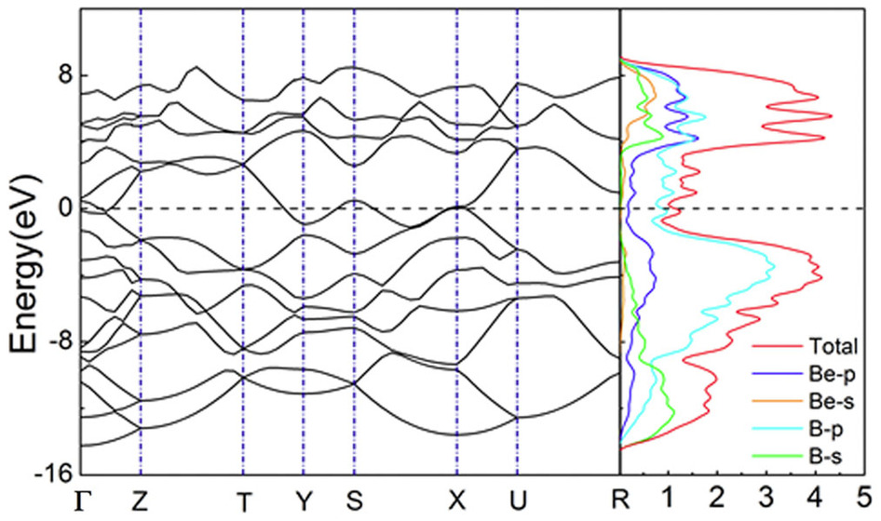
Projected Density of States
New BeB₂ phase
Fan, et al, Sci Rep. ‘14
States are projected on local orbitals with specific angular momentum
Hybridization of the s and p states from both Be and B in the region of 4 eV to 8 eV, implying the tendency to form covalent bonds between Be and B atoms.

Slide 6
Band Structure (Periodic Systems)
Solutions for periodic systems have to have the same physics under translations ⇒ wave functions are Bloch states: Ψ_{n}(r+R)=e^{ikR} Ψ_{n}(r), where k is in the first Brillouin zone (this is Bloch’s theorem)
Electronic energy states in periodic systems are conveniently indexed with n,k – n are called the bands, and k the wavevector. The plot of the electronic energy states is called the band structure.
Energy of Eigenstates
ε_{3k*}
Empty bands
n=3
ε_{2k*}
E_{Fermi}
n=2
Filled bands
n=1
ε_{1k*}
k*
k values (in 1st Brillouin Zone)

Slide 7
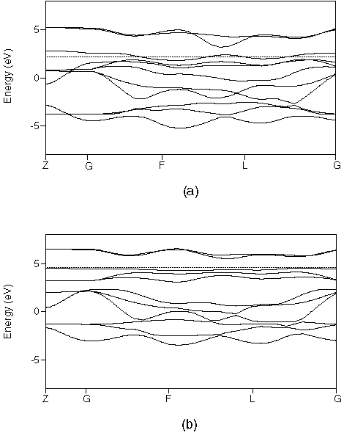
QM Codes Output: Band Structure CoO₂
Fermi level – states at Fermi level ⇒ metallic
Co(e_{g})
Co(t_{2g})
Energy (eV)
O(p)
Location in Brillouin zone – high symmetry k values are labeled

Slide 8
QM Codes Output: Band Structure LiCoO₂ Band Structure
Fermi level – no states at Fermi level ⇒ insulator
Co(e_{g})
Co(t_{2g})
Energy (eV)
O(p)

Slide 9
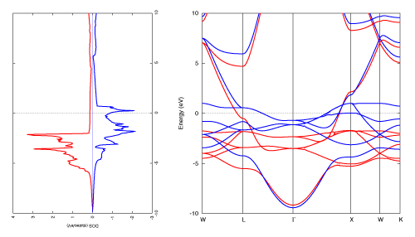
Relationship Between Band Structure, DOS
Ni – Can you see the effect of magnetism?
https://www.fsis.iis.u-tokyo.ac.jp/theme/nanoscal/periodic_detail/atom_28_Ni/Ni_ggapbe_us_01/Ni_ggapbe_us_01.html

Slide 10
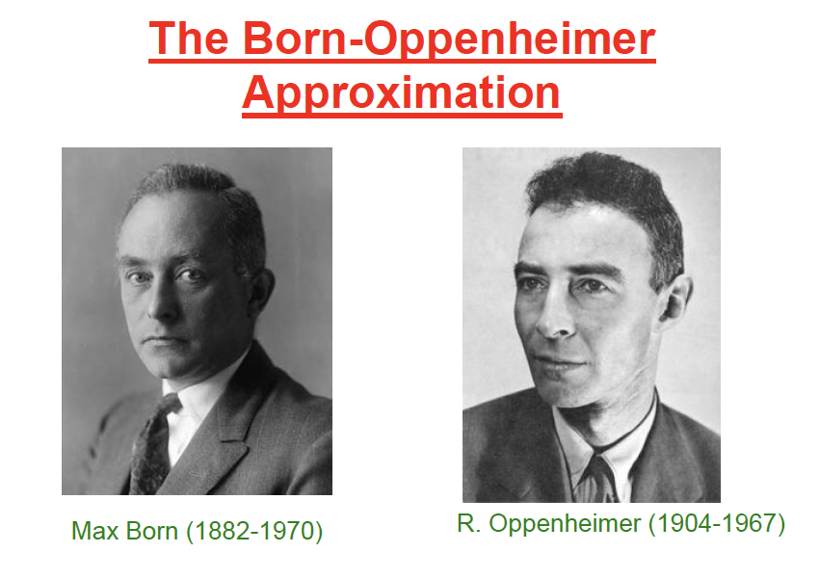
Forces

Slide 11
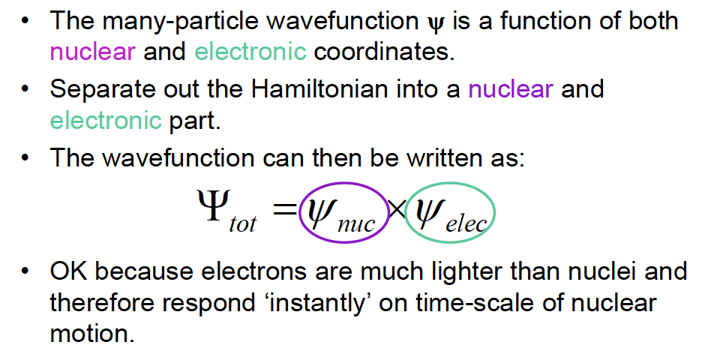
The Born-Oppenheimer Approximation

Slide 12
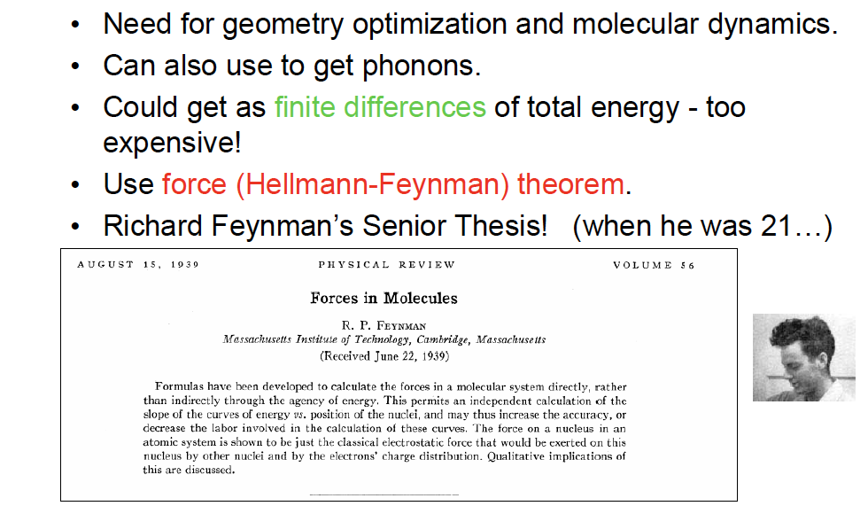
Calculation of forces?

Slide 13
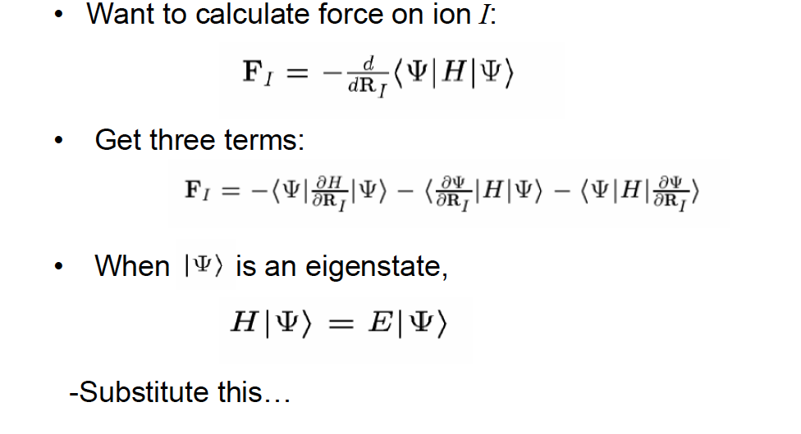
Hellmann-Feynman Theorem

Slide 14
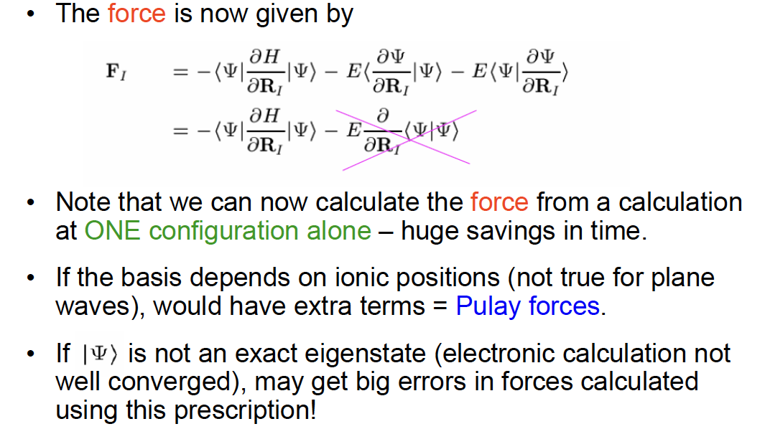
Hellmann-Feynman Theorem

Slide 15
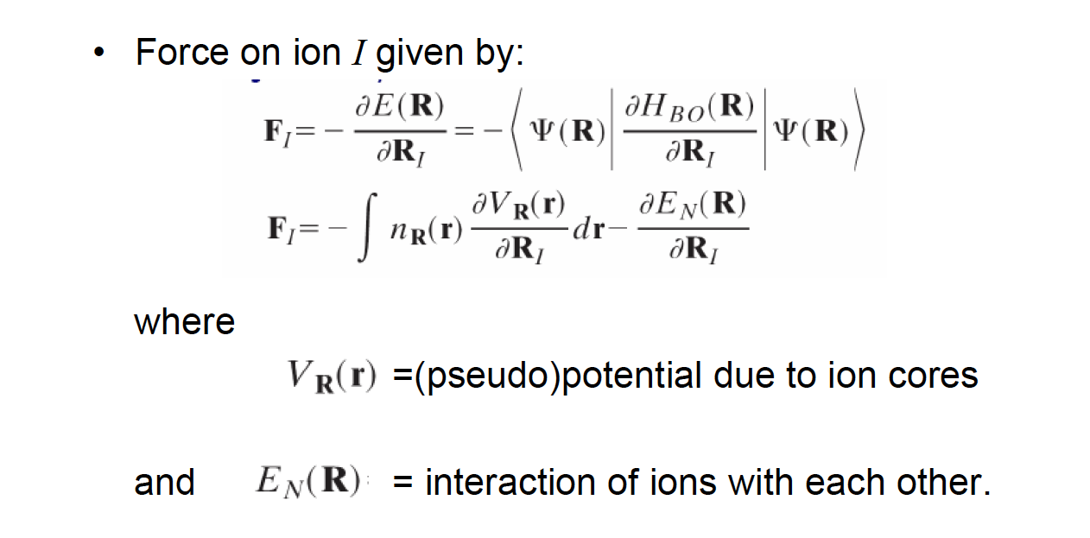
Forces in DFT

Slide 16
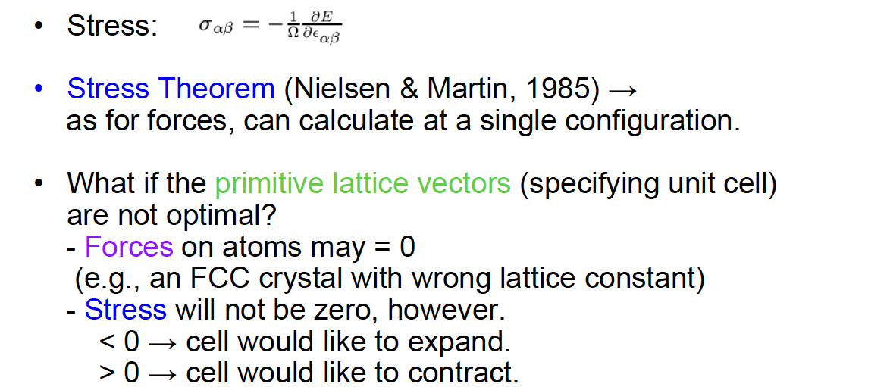
Stress

Slide 17
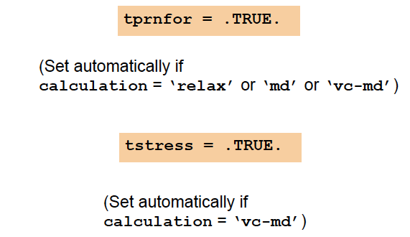
Computing Forces & Stress with QE

Slide 18
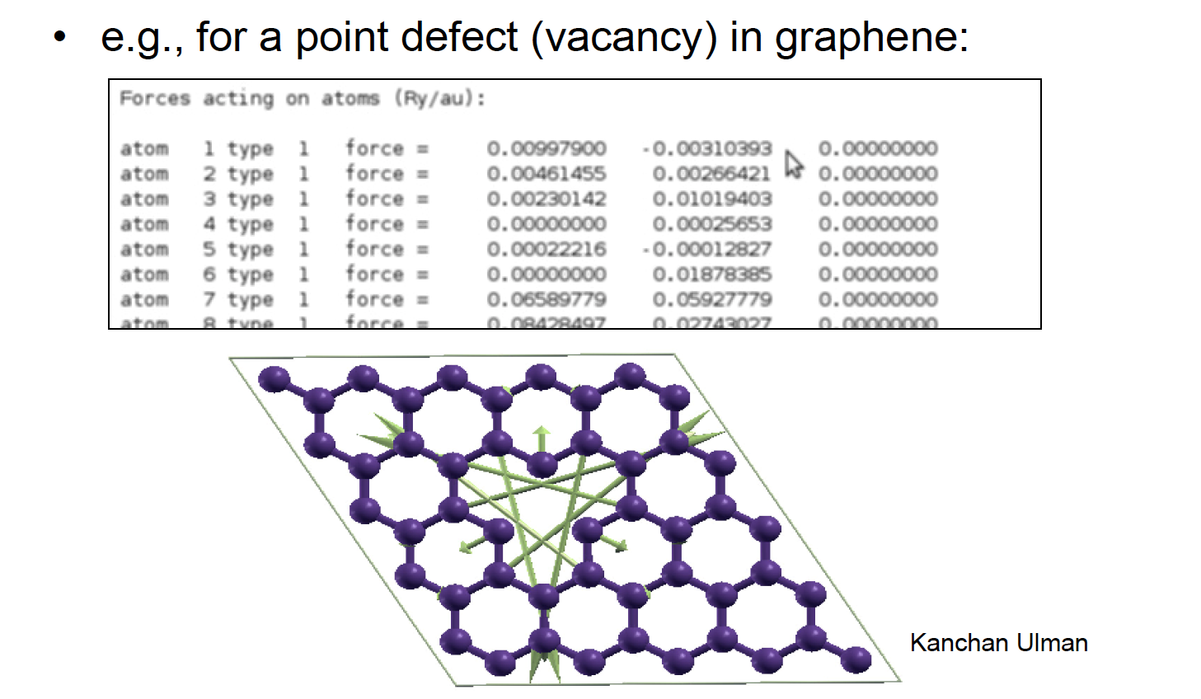
Forces obtained using QE

Slide 19
What can one do with forces?
Optimize ionic positions (geometric relaxation).
Force constants, vibrational frequencies.
Molecular dynamics.

Slide 20
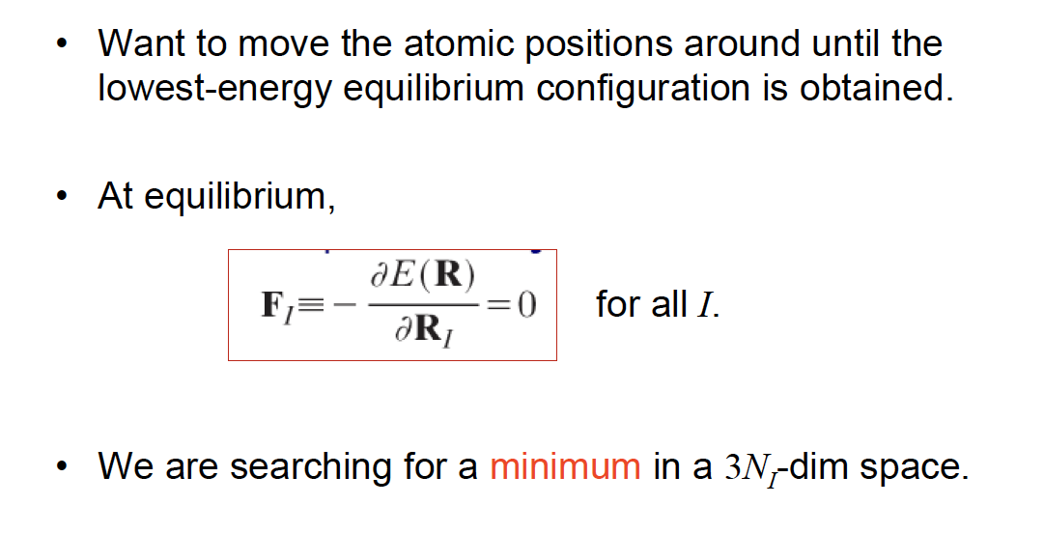
Geometry optimization

Slide 21
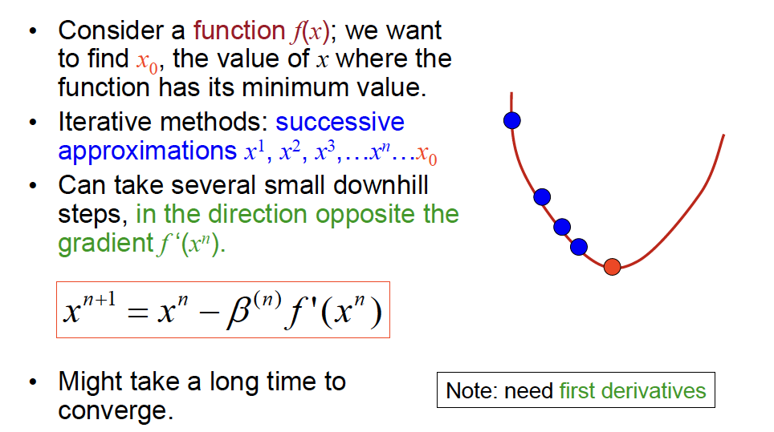
Minimization in 1-D using gradients

Slide 22
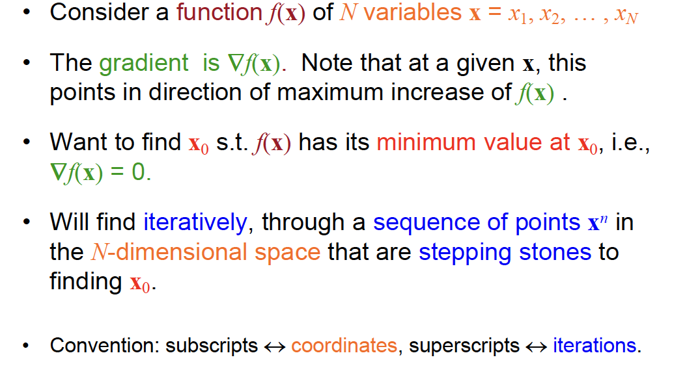
Minimization in an N-d space

Slide 23
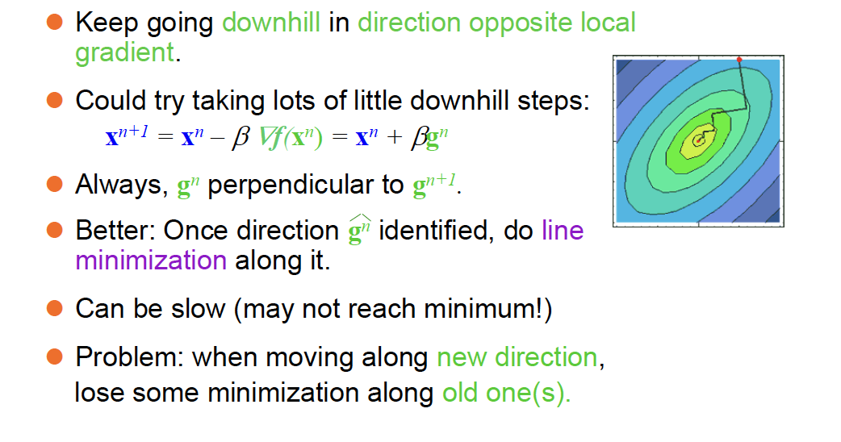
Steepest Descent

Slide 24
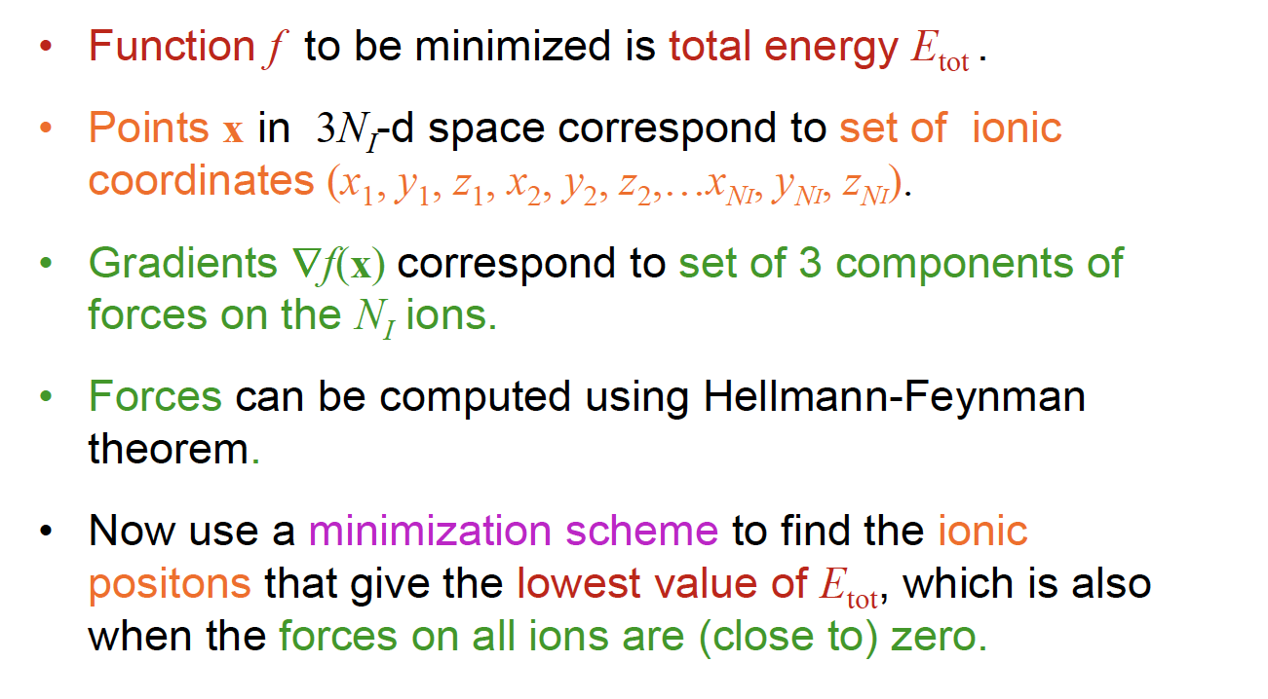
Ionic Relaxation

Slide 25
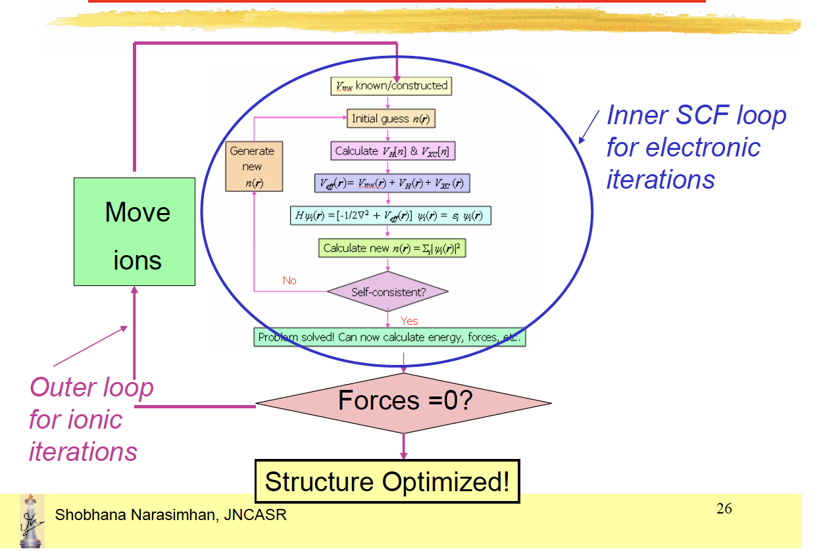
Ionic Relaxation
QE input:•Tell the program to carry out ionic relaxation, and
say which method to use to find minimum
&Control
calculation = ‘relax’
ion_dynamics = ‘bfgs’

Slide 26
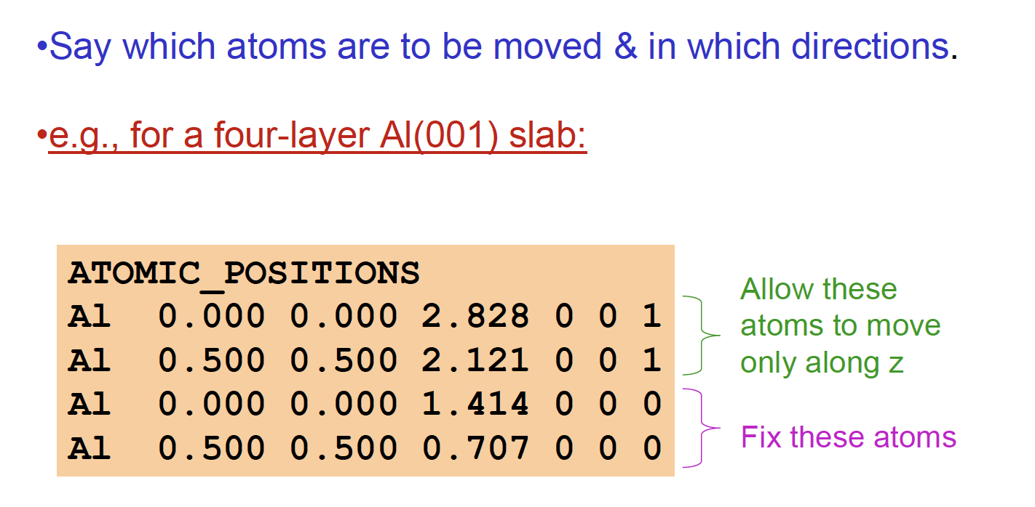
Ionic Relaxation in PWscf (contd.)

Slide 27
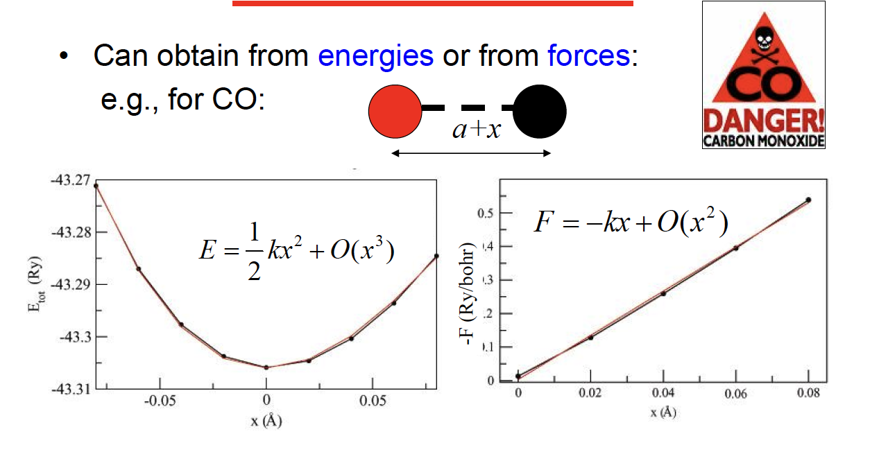
The Vibrational Frequency of a Diatomic Molecule

Slide 28
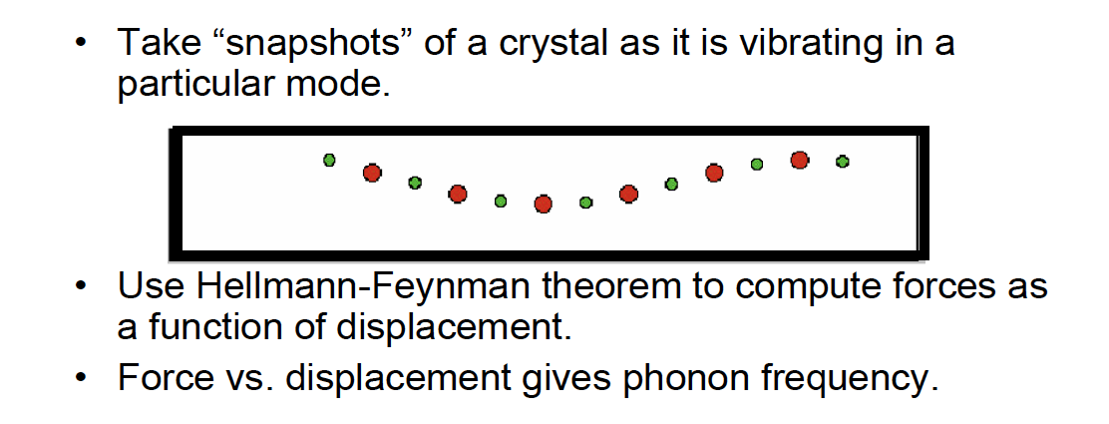

Frozen phonon calculations
$$F=−kx$$

Slide 29
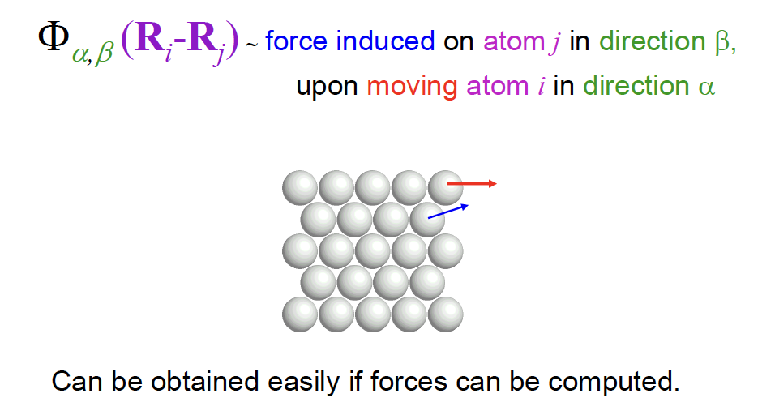
The Force-Constant Tensor

Slide 30
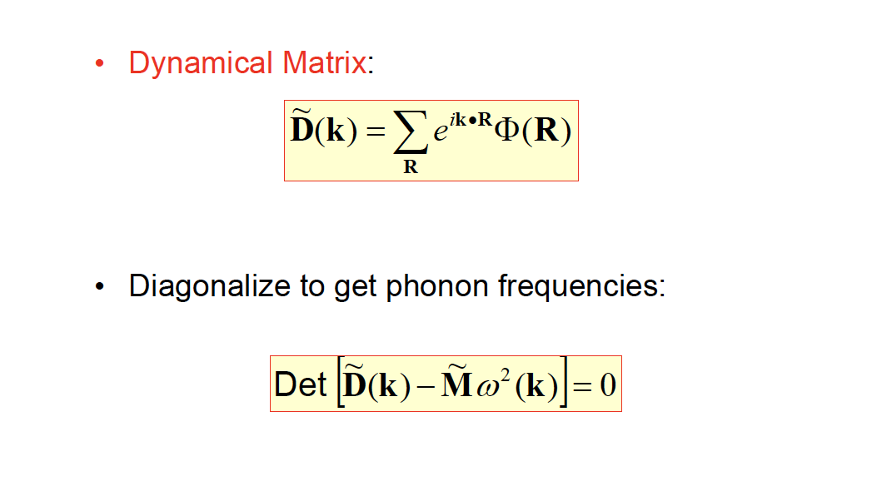
Getting Phonon Frequencies

Slide 31
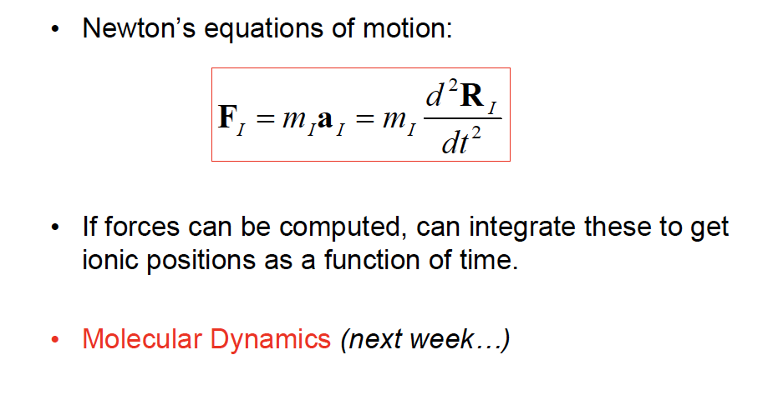
Forces and Motion

