Slide 1
Quantum Mechanics for Electronic Structure I
a quick overview of terms and concepts
Yuan Ping
University of Wisconsin-Madison

Slide 2
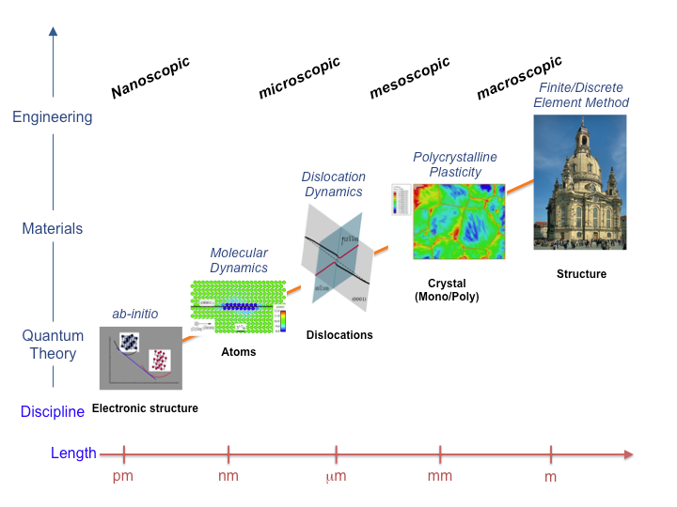
The saga of time and length scales
http://tu-freiberg.de/fakult4/imfd/cms/Multiscale/multiscale.html

Slide 3

size vs. accuracy
classical empirical methods
☛ pair potentials
☛ force fields
☛ shell models
quantum empirical methods
☛ tight-binding
☛ embedded atom
quantum self-consistent methods
☛ density Functional Theory
☛ Hartree-Fock
quantum many-body methods
☛ quantum Monte Carlo
☛ MP2, CCSD(T), CI
☛ GW, BSE
size/duration
accuracy

Slide 4
size vs. accuracy
classical empirical methods
☛ pair potentials
☛ force fields
☛ shell models
quantum empirical methods
☛ tight-binding
☛ embedded atom
quantum self-consistent methods
☛ density Functional Theory
☛ Hartree-Fock
quantum many-body methods
☛ quantum Monte Carlo
☛ MP2, CCSD(T), CI
☛ GW, BSE
size/duration
accuracy

Slide 5
What is QM?
Describes matter on small length and energy scales – joins smoothly to classical mechanics on larger length scales. We will use it to describe electrons (atoms will still mostly be classically described)
The state function of particles are described by wavefunctions (or states, or eigenstates) Y_{n}(r), where n indexes the state and is called a quantum number.
Observables (e.g., position, momentum, energy of a particle) are described by matrices (or operators) whose eigenvalues give the possible values of the observable. e.g.
Energy operator = Hamiltonian
Eigenvalue gives energy in state Ψ_{n}
This equation is the (time independent) Schrodinger equation

Slide 6
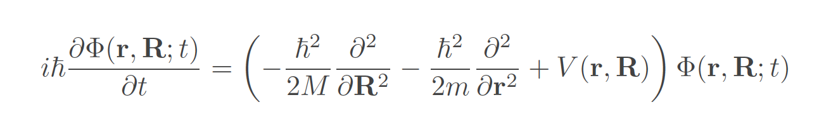
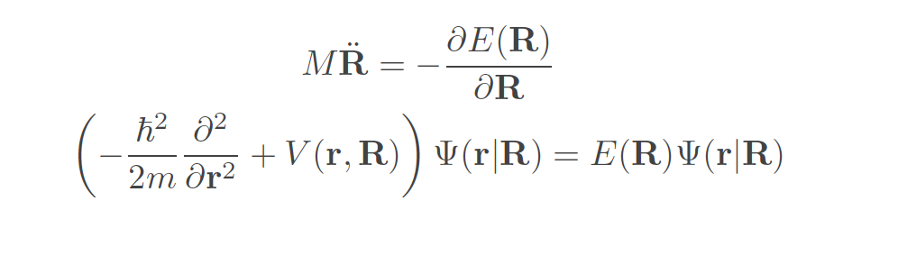
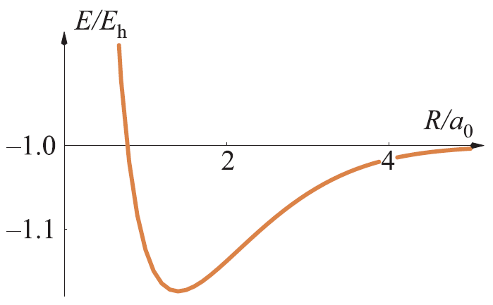
ab-initio Simulations
Time-dependent Schrodinger equation:
The Born-Oppenheimer approximation (M≫m)
E(R)
Nuclei movement (R):
Time-independent Schrodinger equation for electron:

Slide 7

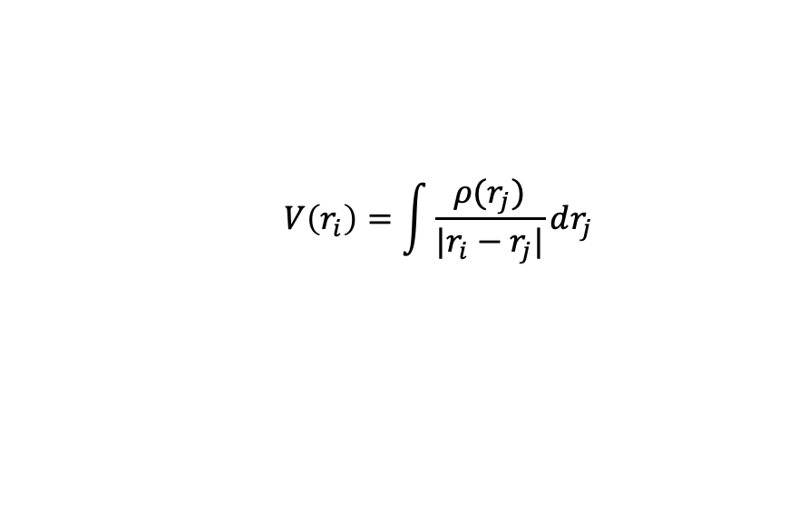

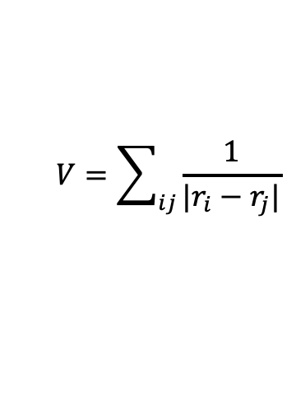
Ab-initio theory for electronic structure
Correlated electron interaction
Mean-field theory
Beyond mean-field theory
Dressed particle
e–
e–
e–
W
e–
e–
e–
e–
e–
$$V=\sum_{ij}{\frac{1}{|r_{i}−r_{j}|}}$$
$$V\left(r_{i}\right)=\int{\frac{{ρ(r}_{j})}{|r_{i}−r_{j}|}}dr_{j}$$
$$Σ=iGW$$
GW approximations (GW)
Dynamic Mean Field Theory (DMFT)
Quantum Monte Carlo
Full Configuration Interaction
…
Many-body problem
- unsolvable exactly
Density-functional theory
Hartree Fock approximation

Slide 8
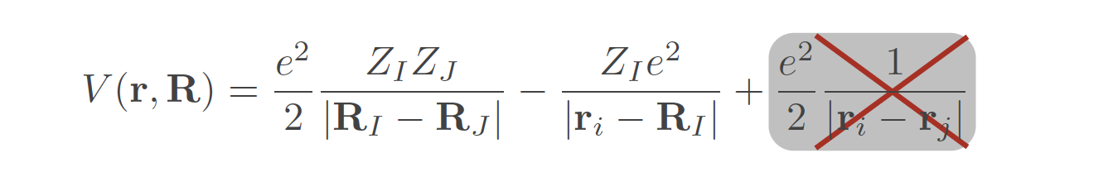
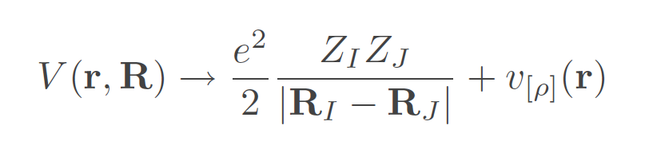
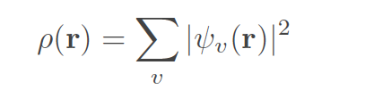
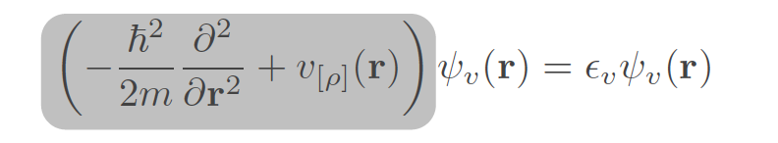
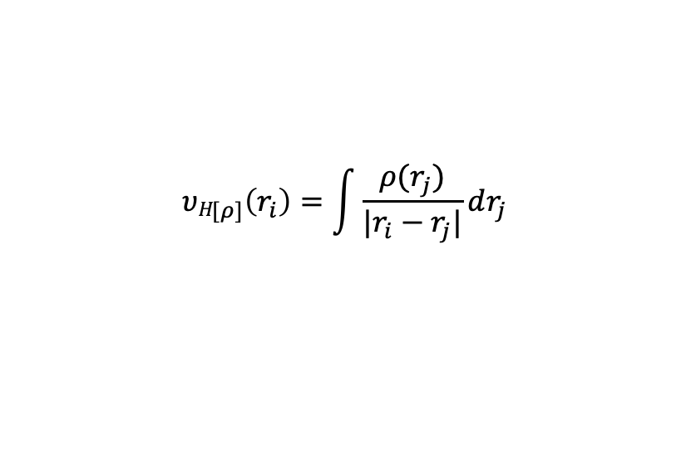
Mean-Field Theory
Mean field theory, e.g. DFT
$${υH}_{[ρ]}\left(r_{i}\right)=\int{\frac{{ρ(r}_{j})}{|r_{i}−r_{j}|}}dr_{j}$$
Classical Hartree term
Other terms: e-nuclei; exchange-correlation potential (the rest many-body effects)
Kohn-Sham Hamiltonian

Slide 9
Using The Solution of the Schrodinger Equation at Mean-Field Level
We order the quantum states by their energies
The total energy of N electrons is approximately given by summing the first N states (the electrons occupy the lowest states)
The probability of finding an electron i in any small volume dV around r is
The total electron charge density is therefore

Slide 10
QM calculated Charge Density
Charge Density Difference with Li Intercalation in LiCoO₂

Slide 11
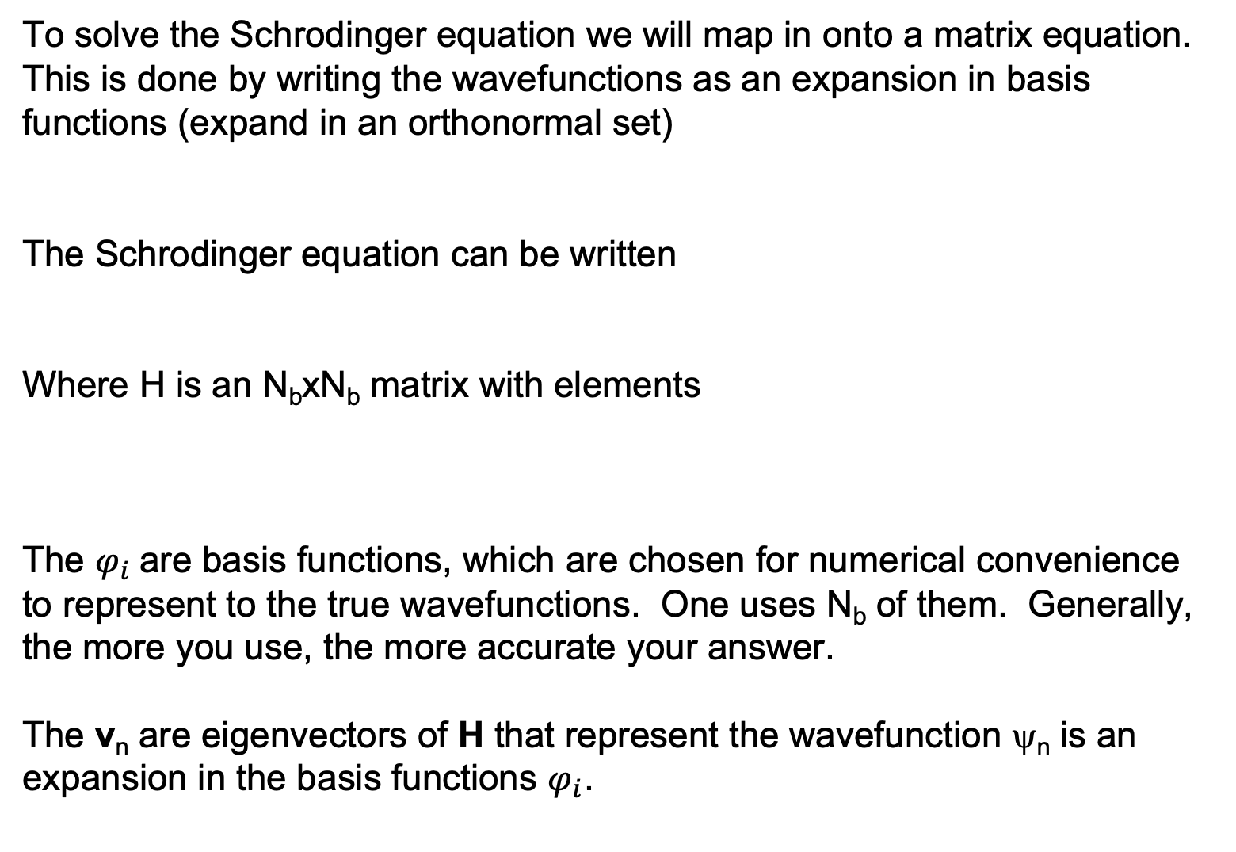
Solving the Schodinger Equation
To solve the Schrodinger equation we will map in onto a matrix equation. This is done by writing the wavefunctions as an expansion in basis functions (expand in an orthonormal set)
The Schrodinger equation can be written
Where H is an N_{b}xN_{b} matrix with elements
The $φ_{i}$are basis functions, which are chosen for numerical convenience to represent to the true wavefunctions. One uses N_{b} of them. Generally, the more you use, the more accurate your answer.
The v_{n} are eigenvectors of H that represent the wavefunction ψ_{n} is an expansion in the basis functions $φ_{i}$.

Slide 12
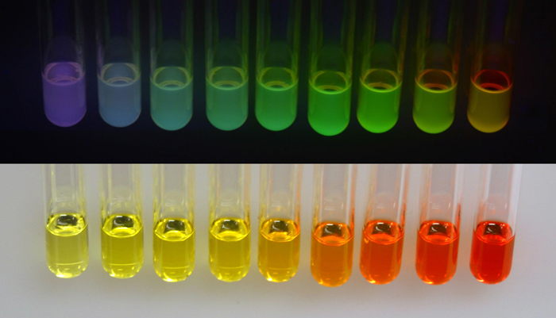
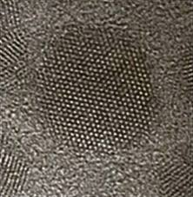

Model of 3D PIB: Semiconductor Nanocrystals
band gap $∝\frac{1}{L^{2}}$
UV light
Size-dependent optical properties!
CdSe nanocrystal
Ambient light
Nanocrystals are 0D nanomaterials, which exhibit strong quantum confinement in all three dimensions, and thus they are also called “quantum dots”.

Slide 13
The Particle in a Box (“Simplest” QM problem)
V=∞
V=∞
What are the wavefunctions and energy?
e⁻
Length L
Note:
V=0
(These are in atomic units: $ℏ$=1,m_{e}=1,e=1,4$π$ε₀=1)

Slide 14
Choose Basis States
Since the particle cannot go outside the box the wavefunction must be 0 at x=0 and x=L (continuity of wavefunctions).
So let’s pick basis functions to have that property. There are many functions that might allow this but we choose
For n=1 to N_{b}.

Slide 15
Build the Hamiltonian
This gives a Hamiltonian matrix of
Or written as a matrix for N_{b}=3

Slide 16
Solve the Matrix Equation
This is done by diagonalizing the Hamiltonian – which is equivalent to solving
The same idea gives
⇒

Slide 17
Now Get Energy and Charge Distribution
Energy for three non-interacting quantum particles in the box is
The charge density for one electron is

Slide 18
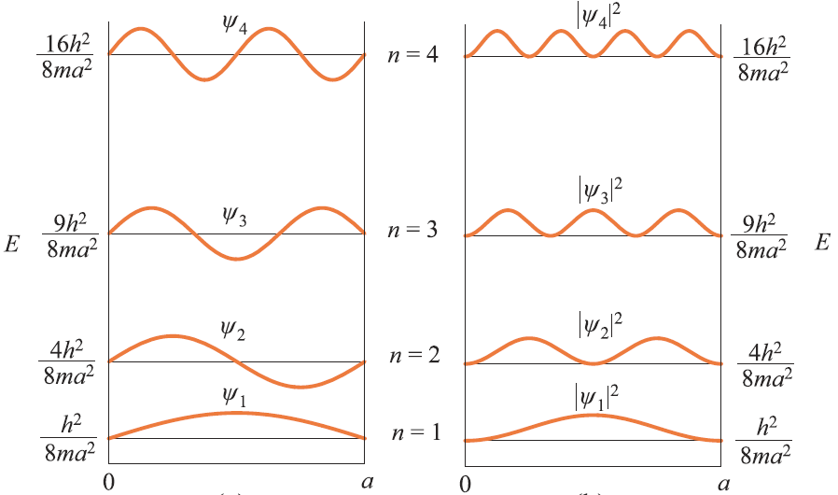
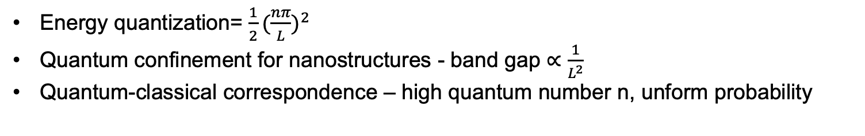
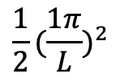

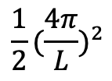
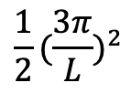
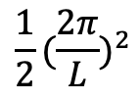
Energy and charge density distribution
$$ρ\left(x\right)=$$
$$\frac{1}{2}{(\frac{4π}{L})}^{2}$$
$$\frac{1}{2}{(\frac{3π}{L})}^{2}$$
$$\frac{1}{2}{(\frac{2π}{L})}^{2}$$
$$\frac{1}{2}{(\frac{1π}{L})}^{2}$$
Energy quantization= $\frac{1}{2}{(\frac{nπ}{L})}^{2}$
Quantum confinement for nanostructures - band gap $∝\frac{1}{L^{2}}$
Quantum-classical correspondence – high quantum number n, unform probability

Slide 19
Summary
Quantum mechanics describes matter on very small scales, e.g., electrons
The Schrodinger equation governs the physics
The wavefunctions=eigenfunctions=eigenstates describe the state of electrons and their module square describes where they are.
The eigenvalues=energy levels describe the energies of the electrons
The wavefunctions can be used to get the charge density
The energy levels can be used to get the total energy
The Schrodinger equations can be solved by expanding the wavefunctions in basis states, and solving a matrix equation
Choice of good basis states (and good matrix diagonalizer) is key to the numerical challenge of solving the Schrodinger equation

Slide 20
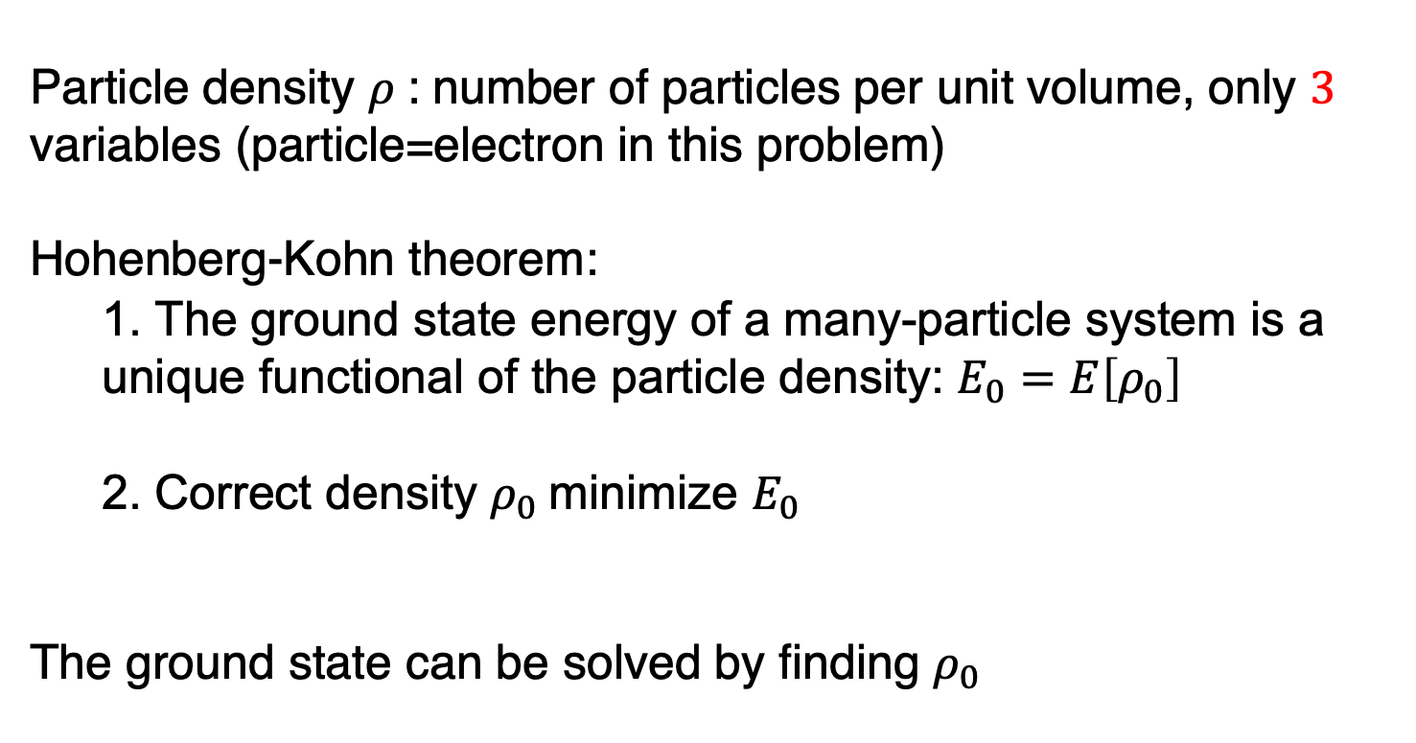
Density functional theory
Particle density $ρ$: number of particles per unit volume, only $3$ variables (particle=electron in this problem)
Hohenberg-Kohn theorem:
1. The ground state energy of a many-particle system is a unique functional of the particle density: $E_{0}=E\left[ρ_{0}\right]$
2. Correct density $ρ_{0}$minimize $E_{0}$
The ground state can be solved by finding $ρ_{0}$

Slide 21
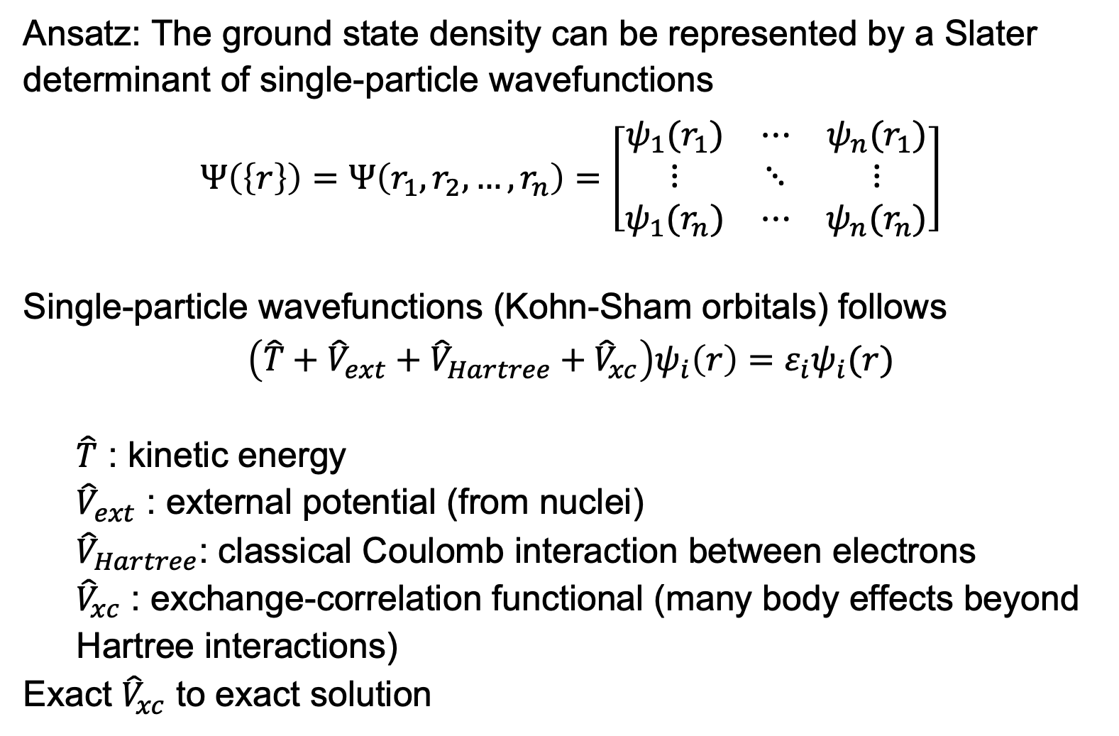
Kohn-Sham equation
Ansatz: The ground state density can be represented by a Slater determinant of single-particle wavefunctions
$$Ψ\left(\left\{r\right\}\right)=Ψ\left(r_{1},r_{2},…,r_{n}\right)=\left[\begin{matrix}ψ_{1}(r_{1}) & ⋯ & ψ_{n}(r_{1}) \\ ⋮ & ⋱ & ⋮ \\ ψ_{1}(r_{n}) & ⋯ & ψ_{n}(r_{n})\end{matrix}\right]$$
Single-particle wavefunctions (Kohn-Sham orbitals) follows
$$\left(\hat{T}+{\hat{V}}_{ext}+{\hat{V}}_{Hartree}+{\hat{V}}_{xc}\right)ψ_{i}\left(r\right)=ε_{i}ψ_{i}(r)$$
$\hat{T}$ : kinetic energy
${\hat{V}}_{ext}$ : external potential (from nuclei)
${\hat{V}}_{Hartree}$: classical Coulomb interaction between electrons
${\hat{V}}_{xc}$ : exchange-correlation functional (many body effects beyond Hartree interactions)
Exact ${\hat{V}}_{xc}$ to exact solution

Slide 22
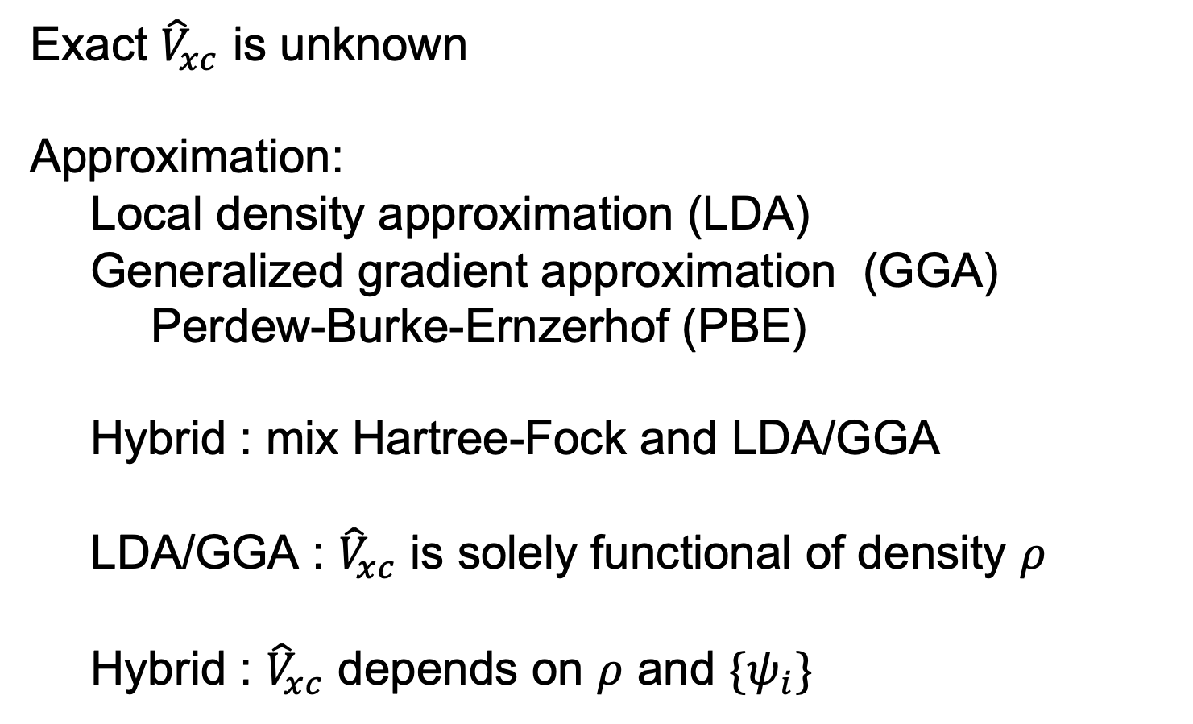
Exchange-correlation functional
Exact ${\hat{V}}_{xc}$ is unknown
Approximation:
Local density approximation (LDA)
Generalized gradient approximation (GGA)
Perdew-Burke-Ernzerhof (PBE)
Hybrid : mix Hartree-Fock and LDA/GGA
LDA/GGA : ${\hat{V}}_{xc}$ is solely functional of density $ρ$
Hybrid : ${\hat{V}}_{xc}$ depends on $ρ$ and $\{ψ_{i}\}$

Slide 23
Self consistent field (SCF)
ρ_{j}
V_{H,} V_{xc}
ψ_{i}, ε_{i}
ρ_{j+1}=ρ_{j}?
Atomic Density
No
Finish!
Yes
External potential

Slide 24
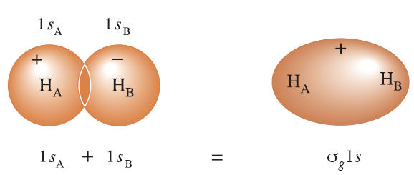
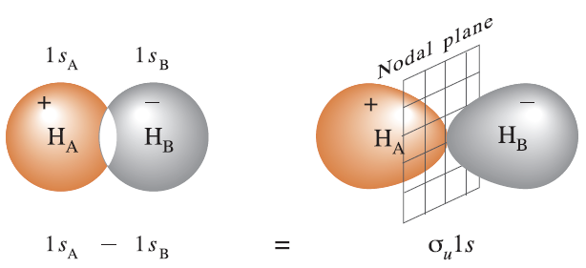




Wavefunctions : Molecule orbitals
Molecule orbitals : linear combination of atomic orbitals (LCAO)
H₂ : 1s AO + 1s AO
one bonding MO : density concentrates
one anti-bonding MO : nodal plane
$$ψ_{anti}$$
1s
$$↿⇂$$
1s
$$ψ_{bond}$$
A.O.
$σ$ bond
gerade
ungerade

Slide 25
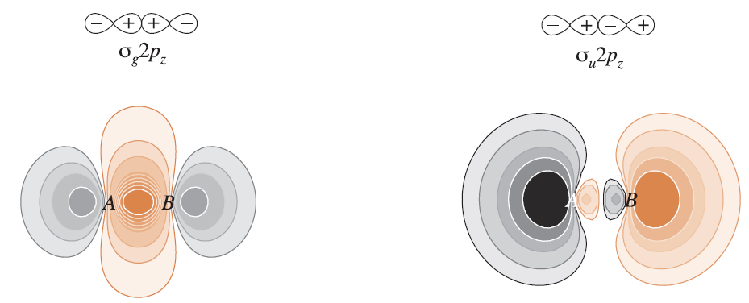
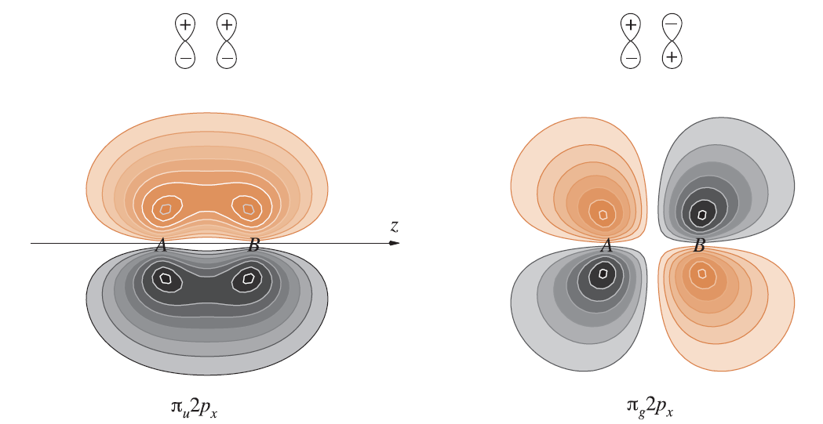
Molecule orbitals
σ and π bonds for two p orbitals
σ bond
π bond

Slide 26
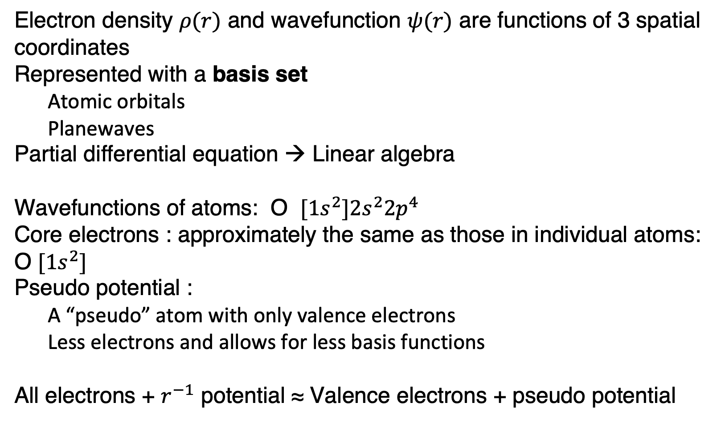
Basis set and pseudo potential
Electron density $ρ(r)$ and wavefunction $ψ(r)$ are functions of 3 spatial coordinates
Represented with a basis set
Atomic orbitals
Planewaves
Partial differential equation → Linear algebra
Wavefunctions of atoms: O $[1s^{2}]2s^{2}2p^{4}$
Core electrons : approximately the same as those in individual atoms: O $[1s^{2}]$
Pseudo potential :
A “pseudo” atom with only valence electrons
Less electrons and allows for less basis functions
All electrons + $r^{−1}$ potential ≈ Valence electrons + pseudo potential

Slide 27
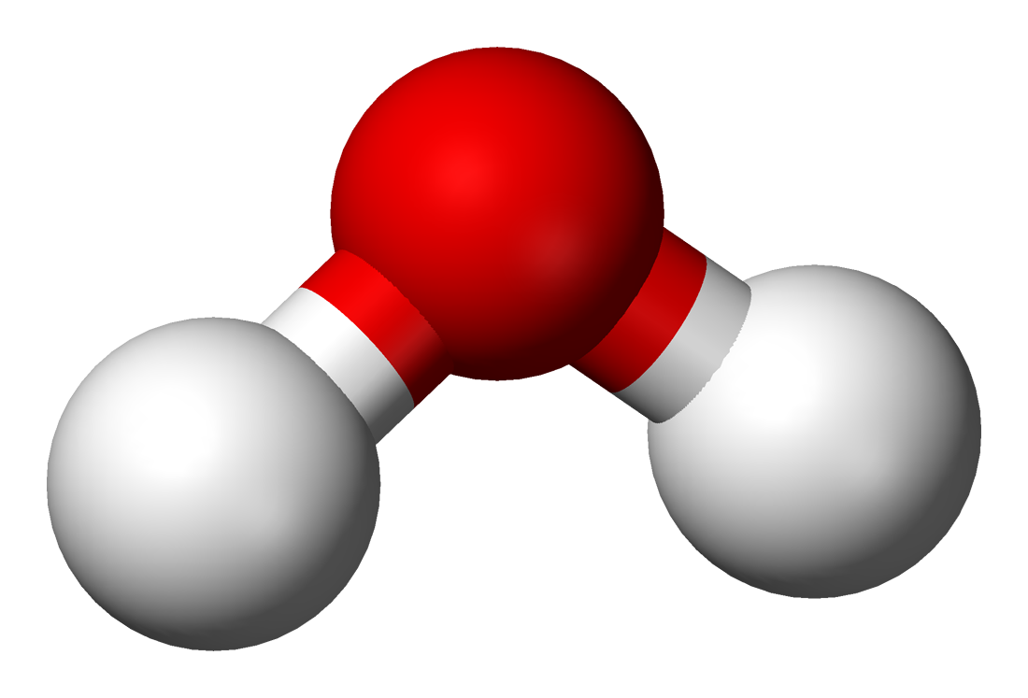
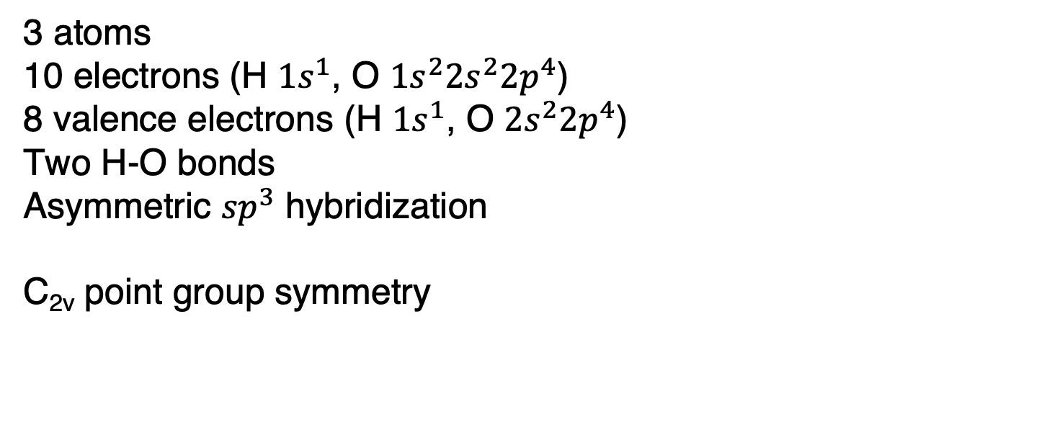
Example: H₂O molecule
3 atoms
10 electrons (H $1s^{1}$, O $1s^{2}2s^{2}2p^{4}$)
8 valence electrons (H $1s^{1}$, O $2s^{2}2p^{4}$)
Two H-O bonds
Asymmetric ${sp}^{3}$ hybridization
C_{2v} point group symmetry
Wikipedia contributors. (2018, May 21). Properties of water. In Wikipedia, The Free Encyclopedia. Retrieved 06:40, May 28, 2018, from https://en.wikipedia.org/w/index.php?title=Properties_of_water&oldid=842285831

Slide 28
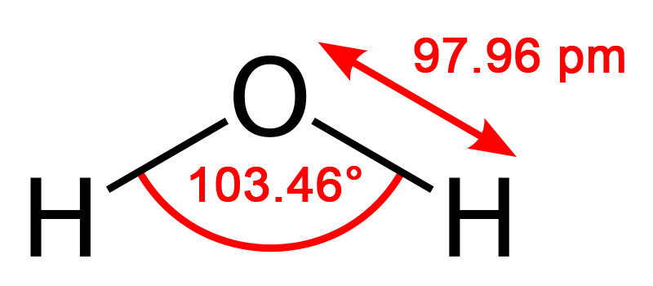
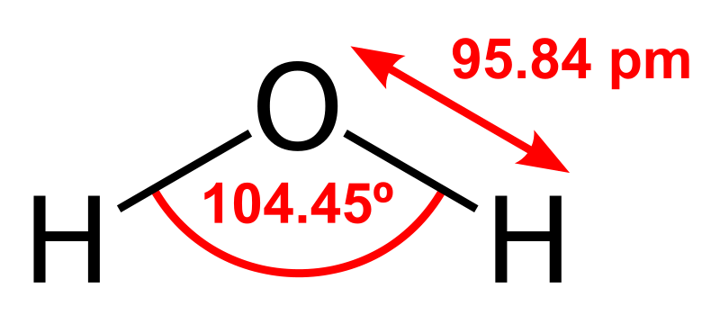
H₂O structure
Our result
Question: why different ?
Exchange-correlation functional
Basis set
Pseudo potential
Box size
Experimental error
Reference
Wikipedia contributors. (2018, May 21). Properties of water. In Wikipedia, The Free Encyclopedia. Retrieved 06:40, May 28, 2018, from https://en.wikipedia.org/w/index.php?title=Properties_of_water&oldid=842285831

Slide 29
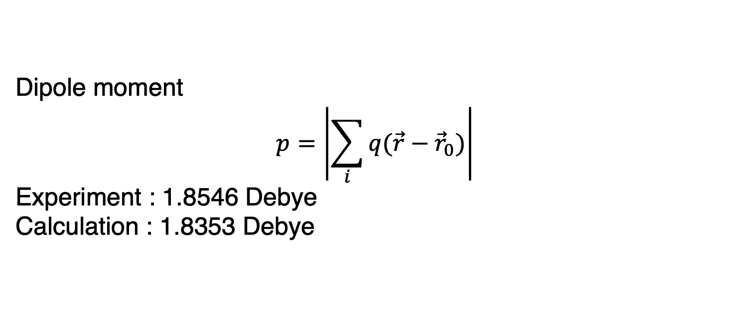
Dipole moment
Dipole moment $$p=\left|\sum_{i}{q(\vec{r}−{\vec{r}}_{0})}\right|$$
Experiment : 1.8546 Debye
Calculation : 1.8353 Debye
reference position (x0): 7.55890453 7.55890453 8.34095072 bohr
Dipole moments (with respect to x0):
Elect -0.0000 -0.0000 0.7221 au (Ha), -0.0000 -0.0000 1.8353 Debye
Ionic 0.0000 0.0000 0.0000 au (Ha), 0.0000 0.0000 0.0000 Debye
Total -0.0000 -0.0000 0.7221 au (Ha), -0.0000 -0.0000 1.8353 Debye

Slide 30
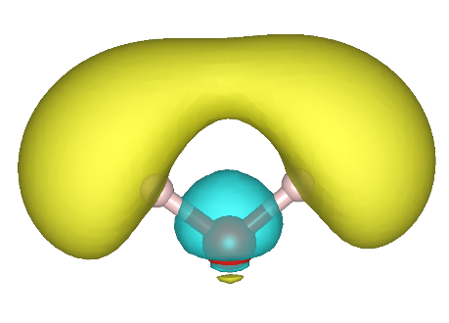
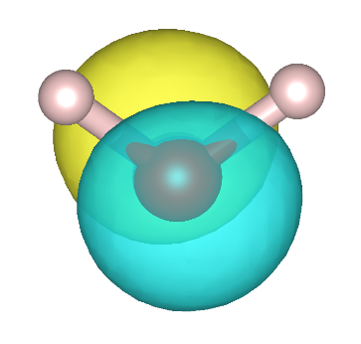
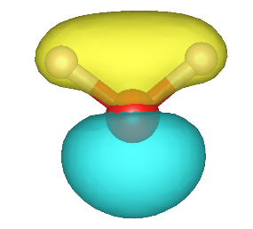
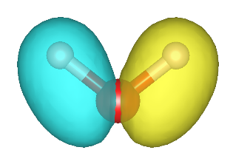
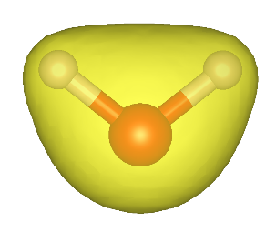

Molecule orbitals
$$ε_{i}$$
4 occupied orbitals for 8 electrons
1 unoccupied orbital shown
Questions
σ or π orbitals?
Number of nodal surfaces?
What the energy of each orbital means?

