Slide 1
Tutorial on phonon calculations with Quantum-Espresso
Yuan Ping
Oct. 14 2024
Part of slides are from Nicola Bonini from MIT and QE2009

Slide 2
Outline
Introduction
Exercise 1: Phonon calculations at Γ Exercise 2: Phonons in polar materials
Exercise 3: Phonon dispersion and density of states Exercise 4: Tests

Slide 3
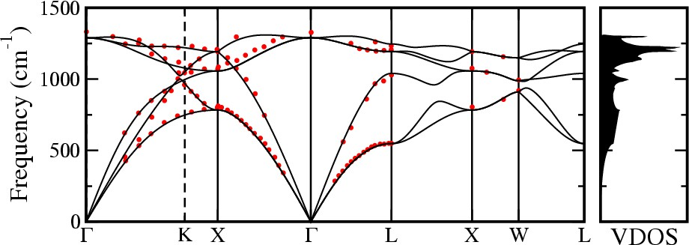
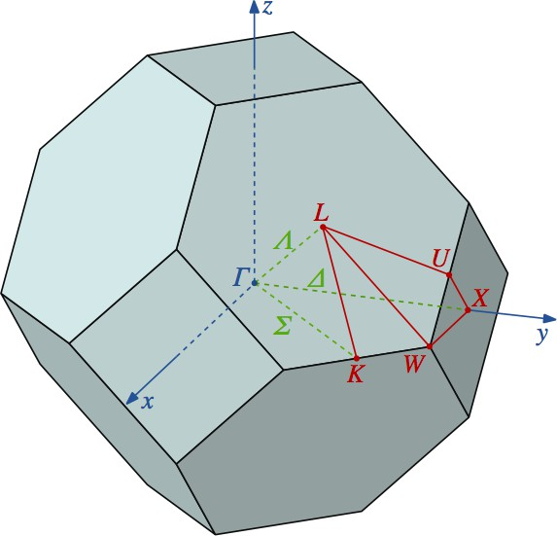
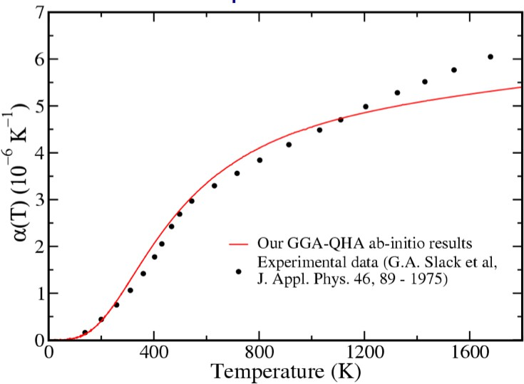
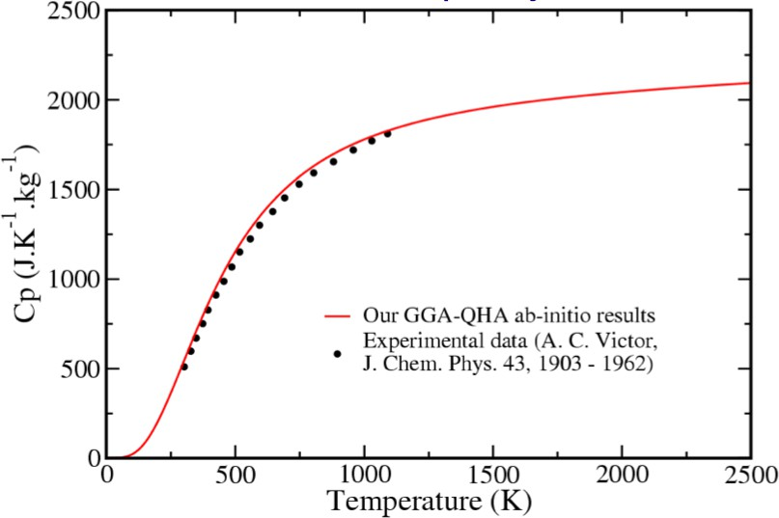
Phonons and related quantities
Phonon dispersion of diamond
Brillouin zone of a FCC
Thermal expansion coefficient
Heat capacity
N.Mounet and N.Marzari, PRB 71, 205214 (2005)

Slide 4

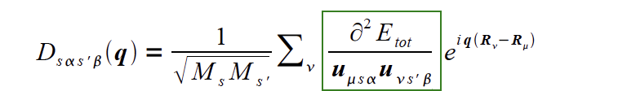
Phonons
Normal mode frequencies, ω, and eigenvectors, u, are determined by the secular equation:
where
Interatomic force constants (IFC)
is the dynamical matrix of the solid.
This matrix can be calculated from the linear response ∂ n r / ∂ u_{s } q
and diagonalized to get phonon modes at q.

Slide 5
Exercise 1: phonon calculations at Γ
Part 1: Calculation of the phonon frequencies of silicon at Γ
To perform the calculation use the script run_ph_G_Si.sh in the directory exercise1:
prompt> ./run_ph_G_Si.sh &
The script allows you to perform:
A scf calculation for silicon at the equilibrium structure using pw.x
A phonon calculation at Γ using ph.x

Slide 6
Exercise 1: phonon calculations at Γ
1) A scf calculation for silicon at the equilibrium structure using pw.x
&control
calculation='scf' restart_mode='from_scratch', prefix='si',
pseudo_dir = '../',
/ &system
ibrav= 2,
celldm(1) =10.187,
nat= 2,
ntyp= 1,
ecutwfc =16
/
&electrons
conv_thr = 1.0d-10
Smaller than for simple total energy
/
ATOMIC_SPECIES
Si 0.0 Si.pz-rrkj.UPF ATOMIC_POSITIONS
Si 0.00 0.00 0.00
Si 0.25 0.25 0.25 K_POINTS AUTOMATIC
4 4 4 1 1 1

Slide 7
Exercise 1: phonon calculations at Γ
2) Phonon calculation at Γ using ph.x
Input file si.phG.in of ph.x:
phonons at Gamma &inputph
prefix='si', epsil=.true., fildyn='dyn.G', tr2_ph=1.0d-14,
/
0.0 0.0 0.0
Same prefix as in the scf calculation (and same outdir)
To calculate the dielectric tensor and the effective charges
File containing the dynamical matrix
Threshold
q point (Γ)

Slide 8
Exercise 1: phonon calculations at Γ
Output file si.phG.out :
Dielectric constant in cartesian axis
(
(
(
13.99782
0.00000
0.00000
0.00000
13.99782
0.00000
0.00000 )
0.00000 )
13.99782 )
Effective charges (d Force / dE) in cartesian axis
atom 1 Si
Ex | ( | -0.07434 | 0.00000 | 0.00000 )
Ey | ( | 0.00000 | -0.07434 | 0.00000 )
Ez | ( | 0.00000 | 0.00000 | -0.07434 )
atom 2 Si
Ex | ( | -0.07434 | 0.00000 | 0.00000 )
Ey | ( | 0.00000 | -0.07434 | 0.00000 )
Ez | ( | 0.00000 | 0.00000 | -0.07434 )
Diagonalizing the dynamical matrix
q = ( 0.000000000 0.000000000 0.000000000 )
************************************************************
omega( 1) =
omega( 2) =
omega( 3) =
omega( 4) =
omega( 5) =
0.081752 [THz] =
0.081752 [THz] =
0.081752 [THz] =
15.549026 [THz] =
15.549026 [THz] =
2.726975 [cm-1]
2.726975 [cm-1]
2.726975 [cm-1]
518.663131 [cm-1]
518.663131 [cm-1]
omega( 6) = 15.549026 [THz] = 518.663131 [cm-1]
************************************************************

Slide 9
Exercise 1: phonon calculations at Γ
Dynamical matrix file dyn.G :
Diagonalizing the dynamical matrix
q = ( 0.000000000 0.000000000 0.000000000 )
*****************************************************************
Acoustic modes
omega( 1) ( 0.400413 ( 0.400413 omega( 2) ( 0.578307 ( 0.578307 omega( 3) ( 0.072322 ( 0.072322 | = 0.081752 [THz] = 0.000000 -0.325855 0.000000 0.000000 -0.325855 0.000000 = 0.081752 [THz] = 0.000000 0.294894 0.000000 0.000000 0.294894 0.000000 = 0.081752 [THz] = 0.000000 -0.553946 0.000000 0.000000 -0.553946 0.000000 | 2.726975 [cm-1] -0.483206 0.000000 -0.483206 0.000000 2.726975 [cm-1] 0.280354 0.000000 0.280354 0.000000 2.726975 [cm-1] 0.433490 0.000000 0.433490 0.000000 | ) ) ) ) ) )
omega( 4) ( -0.445151 ( 0.445151 omega( 5) ( -0.535639 ( 0.535639 omega( 6) ( 0.122195 ( -0.122195 | = 15.549026 [THz] = 0.000000 0.547867 0.000000 0.000000 -0.547867 0.000000 = 15.549026 [THz] = 0.000000 -0.444530 0.000000 0.000000 0.444530 0.000000 = 15.549026 [THz] = 0.000000 0.047270 0.000000 0.000000 -0.047270 0.000000 | 518.663131 [cm-1] 0.041012 0.000000 -0.041012 0.000000 518.663131 [cm-1] 0.124435 0.000000 -0.124435 0.000000 518.663131 [cm-1] 0.694863 0.000000 -0.694863 0.000000 | ) ) ) ) ) )
Optical modes
*****************************************************************

Slide 10
Exercise 1: phonon calculations at Γ
Problems with the frequency of the acoustic phonon modes at Γ and with the effective charges.
Because of numerical inaccuracies the interatomic force constants
and the effective charges do not strictly satisfy the following rules due to the translational invariance of the system:
Reasons for numerical inaccuracies:
Insufficiently accurate scf thresholds (in pw.x and/or in ph.x). DO NOT USE large thresholds in pw.x to save time !!
XC energy is computed in real space. More problematic for GGA than in LDA. For US pseudopotentials it could require large ecutrho.
k point sampling not accurate enough (in particular Z* and ε require a very dense k-point sampling).

Slide 11
Exercise 1: phonon calculations at Γ
The acoustic sum rules can however be imposed after the phonon calculation.
To do this we use the code dynmat.x which imposes the acoustic sum rules on the elements of the dynamical matrix and dyagonalizes it.
The input of dynmat.x in this case is:
&input
fildyn='dyn.G', asr='simple',
/
File containing the dynamical matrix
A way to impose the acoustic sum rules (if you put 'no' instead of 'simple' the code does not impose the asr)
To submit the calculation:
prompt> dynmat.x < si.dynmat.in > si.dynmat.out

Slide 12
Exercise 1: phonon calculations at Γ
Dynmat.x produces the file dynmat.out which contains the new frequencies:
diagonalizing the dynamical matrix ... q = 0.0000 0.0000 0.0000
**************************************************************************
omega( 1) = 0.000000 [THz] = 0.000000 [cm-1]
( | 0.000000 | 0.000000 |  | -0.707107 | 0.000000 |  | 0.000000 | 0.000000 | )
( | 0.000000 | 0.000000 |  | -0.707107 | 0.000000 |  | 0.000000 | 0.000000 | )
omega( 2) |  | = |  | 0.000000 [THz] | = | 0.000000 [cm-1]
( | -0.707107 | 0.000000 |  | 0.000000 | 0.000000 |  | 0.000000 | 0.000000 | )
( | -0.707107 | 0.000000 |  | 0.000000 | 0.000000 |  | 0.000000 | 0.000000 | )
omega( 3) |  | = |  | 0.000000 [THz] | = | 0.000000 [cm-1]
( | 0.000000 | 0.000000 |  | 0.000000 | 0.000000 |  | -0.707107 0.000000 |  | )
( | 0.000000 | 0.000000 |  | 0.000000 | 0.000000 |  | -0.707107 0.000000 |  | )
omega( 4) |  | = | 15.548811 [THz] |  | = | 518.655959 [cm-1]
( | 0.000000 | 0.000000 |  | 0.707107 | 0.000000 |  | 0.000000 | 0.000000 | )
( | 0.000000 | 0.000000 |  | -0.707107 | 0.000000 |  | 0.000000 | 0.000000 | )
omega( 5) |  | = | 15.548811 [THz] |  | = | 518.655959 [cm-1]
( | 0.000000 | 0.000000 |  | 0.000000 | 0.000000 |  | -0.707107 | 0.000000 | )
( | 0.000000 | 0.000000 |  | 0.000000 | 0.000000 |  | 0.707107 | 0.000000 | )
omega( 6) |  | = | 15.548811 [THz] |  | = | 518.655959 [cm-1]
( | -0.707107 | 0.000000 |  | 0.000000 | 0.000000 |  | 0.000000 | 0.000000 | )
( | 0.707107 | 0.000000 |  | 0.000000 | 0.000000 |  | 0.000000 | 0.000000 | )
**************************************************************************
Dynmat.x creates also the file dynmat.axsf which contains the phonon eigendisplacements. You can use xcrysden to visualize them:
prompt> xcrysden –axsf dynmat.axsf &

Slide 13
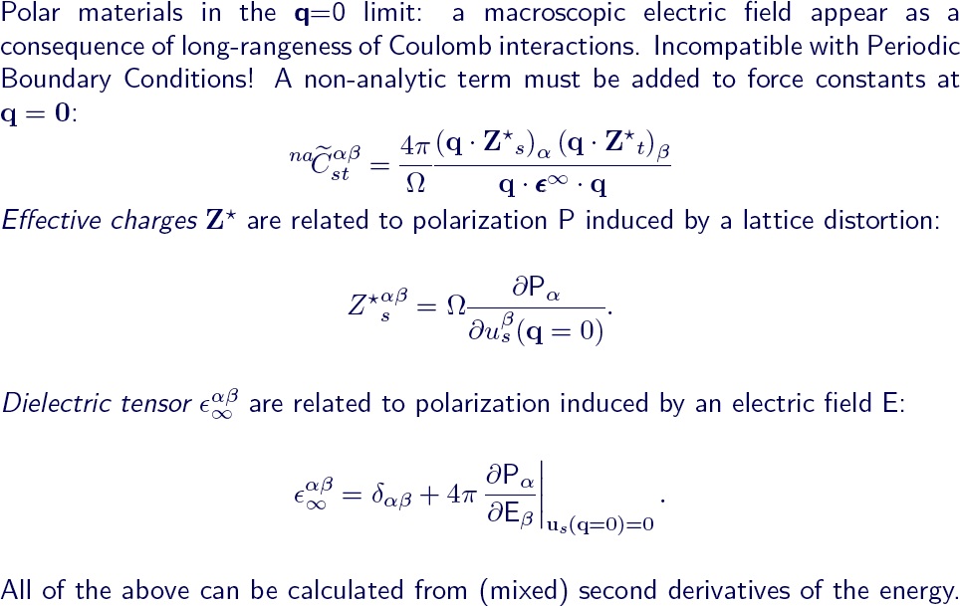
Exercise 2: phonons in polar materials

Slide 14
Exercise 2: phonons in polar materials
Part 2: Phonons in polar materials
Use the script run_ph_G_AlAs.sh to calculate the phonons at Γ :
prompt> ./run_ph_G_AlAs.sh &
Dielectric constant in cartesian axis
(
(
(
9.33612
0.00000
0.00000
0.00000
9.33612
0.00000
0.00000 )
0.00000 )
9.33612 )
Effective charges (d Force / dE) in cartesian axis atom 1 Al
Ex (
Ey (
Ez (
Ex (
Ey (
Ez (
2.12370
0.00000
0.00000 | 0.00000 )
2.12370 | 0.00000 )
0.00000 | 2.12370 )
0.00000 | 0.00000 )
-2.17270 | 0.00000 )
0.00000 | -2.17270 )
0.00000
atom
2 As
-2.17270
0.00000
0.00000
Diagonalizing the dynamical matrix
q = ( 0.000000000 0.000000000 0.000000000 )
*************************************************************
omega( 1) =
omega( 2) =
omega( 3) =
omega( 4) =
omega( 5) =
0.155039 [THz] =
0.155039 [THz] =
0.155039 [THz] =
11.220317 [THz] =
11.220317 [THz] =
5.171595 [cm-1]
5.171595 [cm-1]
5.171595 [cm-1]
374.271992 [cm-1]
374.271992 [cm-1]
No LO-TO
splitting
omega( 6) = 11.220317 [THz] = 374.271992 [cm-1]
*************************************************************

Slide 15
Exercise 2: phonons in polar materials
To add the non-analytic term to the force constants and recalculate the frequencies we use dynmat.x.
In this case the input for dynmat.x is:
&input
fildyn='dyn.G',
asr='simple',
q(1)=1.d0, q(2)=0.d0, q(3)=0.d0
Direction for the LO-TO splitting.
/
Re-calculate the phonons at Γ :
prompt> dynmat.x < alas.dynmat.in > alas.dynmat.out
Check the output file :
# mode
[cm-1]
[THz]
IR
1 | 0.00 | 0.0000 | 0.0000
2 | 0.00 | 0.0000 | 0.0000
3 | 0.00 | 0.0000 | 0.0000
4 | 374.24 | 11.2195 | 5.3672
5 | 374.24 | 11.2195 | 5.3672
6 | 410.67 | 12.3115 | 5.3672
LO-TO
splitting

Slide 16
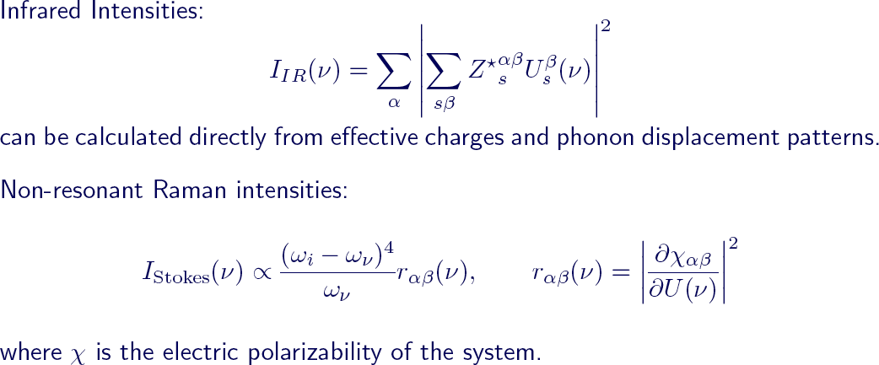
Exercise 2: phonons in polar materials
# m
ode [cm-1] [THz] 1 0.00 0.0000 |  |  | IR 0.0000
2 | 0.00 | 0.0000 | 0.0000
3 | 0.00 | 0.0000 | 0.0000
4 | 374.24 | 11.2195 | 5.3672
5 | 374.24 | 11.2195 | 5.3672
6 | 410.67 | 12.3115 | 5.3672

Slide 17
Exercise 3: phonon dispersion calculations
Phonon calculation for q≠0
The procedure to calculate phonons for q≠0 is the same as the one for a calculation at Γ.
Modify the script run_ph_G_Si.sh and calculate the phonons at X = (0,0,1):
prompt> cp ../exercise1/run_ph_G_Si.sh run_ph_X_Si.sh
Use your favorite editor to remove epsil=.true. (that works only at Γ), change the q point and the name of the dynamical matrix.
Execute the new script:
prompt> ./run_ph_X_Si.sh &
Notice that the output file for the phonon calculation is slightly different from the one at q=0. It is because for q≠0 the code has to calculate also the wavefunctions ψ_{k+q} (in addition to the ψ_{k}'s in the scf calculation).
Notice also that the symmetry of the small group of q is used (not the crystal symmetry).

Slide 18

Exercise 3: phonon dispersion calculations
First step: Phonon calculation on a grid of q points
Modify the script run_ph_X_Si.sh as described below.
prompt> cp run_ph_X_Si.sh run_ph_Si.sh
The script should allow you to perform both scf and phonon calculations. The input file for the phonon calculations should be like this:
phonons on a grid &inputph
prefix='si',
epsil=.true., ldisp=.true. fildyn='dyn',
Option for the calculation on a grid Uniform grid of q points
nq1=4, nq2=4,
nq3=4, tr2_ph=1.0d-14,
/
The phonon code generates the files of the dynamical matrices on the specified grid of points. The files are dyn1, dyn2, ... dyn8.
The file dyn0 contains the list of the inequivalent q points (8, in this case).

Slide 19
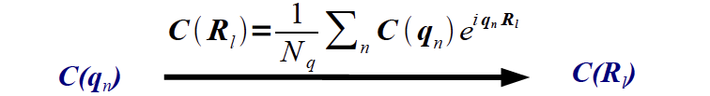
Exercise 3: phonon dispersion calculations
Second step: calculation of the interatomic force constants
C(q_{n})
Matrices on a grid of q points NxNxN in reciprocal space
C(R_{l})
Interatomic force constants in a supercell NxNxN in real space
We use the code q2r.x. The input file for q2r.x is:
&input fildyn='dyn',
Dynamical matrices from the phonon calculation
Output file of the interatomic force constants
zasr='simple',
flfrc='si.444.fc'
/
To perform the calculation:
prompt> q2r.x < q2r.in > q2r.out

Slide 20

Exercise 3: phonon dispersion calculations
Third step: phonons at a generic q' point using the IFC
Interatomic force constants in a supercell NxNxN in real space
Fourier interpolation
Dynamical matrix at a generic q' point
We use the code matdyn.x. The input file for matdyn.x is:
&input
asr='simple', amass(1)=28.0855,
flfrc='si.444.fc', flfrq='si.freq'
IFC input file
Output file of the frequencies
Number of q points List of q points
/
1
0.300000 0.200000 0.050000
To perform the calculation:
prompt> matdyn.x < matdyn_ex.in > matdyn_ex.out

Slide 21
Exercise 3: phonon dispersion calculations
Si phonon dispersion
Using the script run_dispersion_Si.sh you can calculate and generate a plot of the phonon dispersion:
prompt> ./run_dispersion_Si.sh &
The script includes a matdyn.x calculation on a list of q points (along particular lines in the Brillouin zone) and a plotband.x post-processing calculation that generates a user-friendly file of the frequencies and a postscript figure.
Using a gnuplot script (plot_dispersion.gnu) you can plot the theoretical results together with some experimental data (exp.dat):
prompt> gnuplot plot_dispersion.gnu

Slide 22
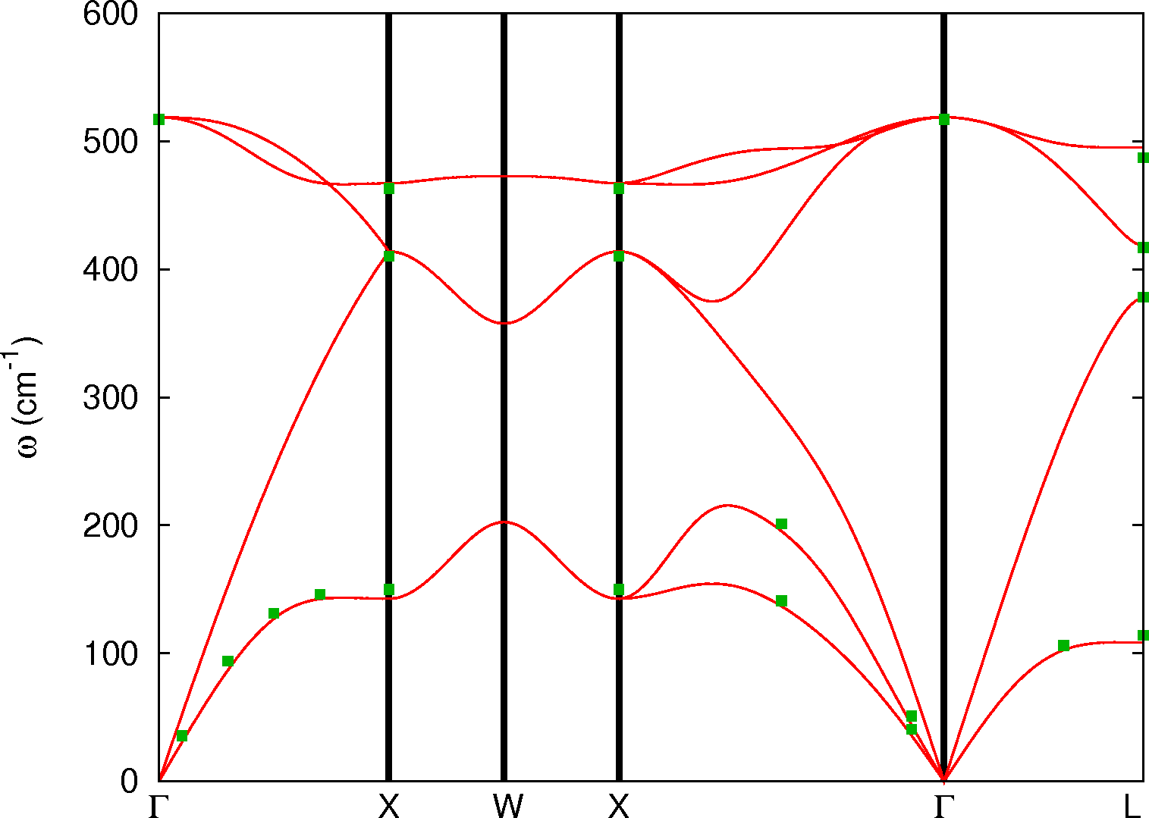
Exercise 3: phonon dispersion calculations
Si phonon dispersion (file gnuplot_dispersion.eps)
Brillouin zone of a FCC

Slide 23
Exercise 3: phonon dispersion calculations
Si vibrational density of states
The code matdyn.x can also be used to calculate the phonon density of states. In this case the input file should be like this:
&input
asr='simple', amass(1)=28.0855,
flfrc='si.444.fc',
flfrq='si.dos.freq' dos=.true., fldos='si.dos' deltaE=1.d0,
nk1=4, nk2=4, nk3=4,
Option for a DOS calculation Energy interval
Grid of q points for the DOS calculation
/
Modify the matdyn.x input file and perform the calculation.
You can use the gnuplot script plot_dos.gnu to generate a picture.
prompt> gnuplot plot_dos.gnu
Calculate the phonon density of states using different grid of q points. Which grid gives a converged result?

Slide 24
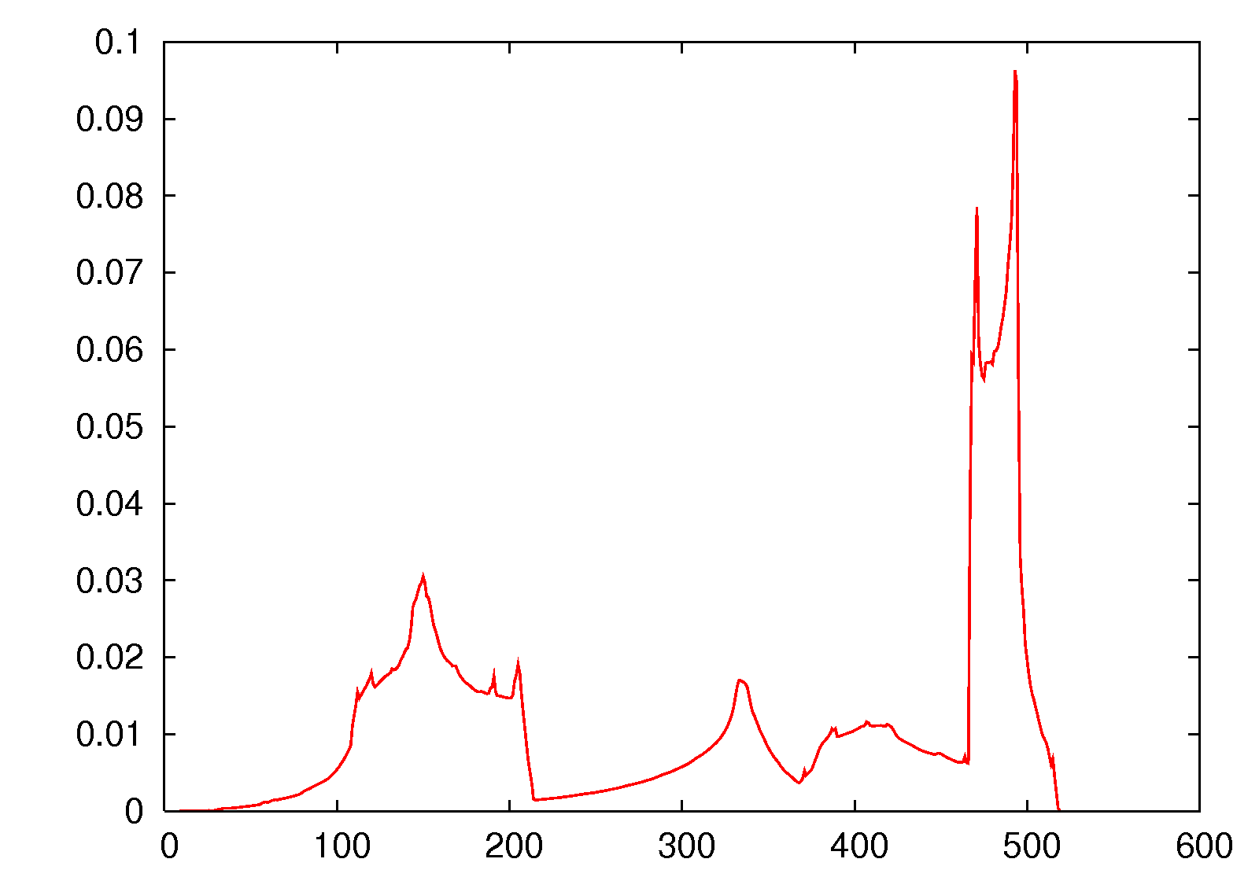
Exercise 3: phonon dispersion calculations
Si vibrational density of states
VDOS (states/cm⁻¹)
Frequency (cm⁻¹)
Notice that the VDOS is normalized to 3N_{at} , where N_{at} is the number of

Slide 25

Exercise 4: checking the Fourier interpolation
Dynamical matrix at a generic q' point
Interatomic force constants in a supercell NxNxN in real space
Fourier interpolation
We need to check if the Fourier interpolation works properly. To do that we can calculate:
the phonon frequencies at a certain q point (not belonging to the grid on which we calculated the dynamical matrices) using matdyn.x and our file of the interatomic force constants (from exercise3).
the phonon frequencies at the same point using ph.x (i.e. performing the ab initio calculation).
and compare the results.
You can run a ph.x calculation modifying the script of exercise3 and perform a matdyn.x calculation as in exercise3.

Slide 26
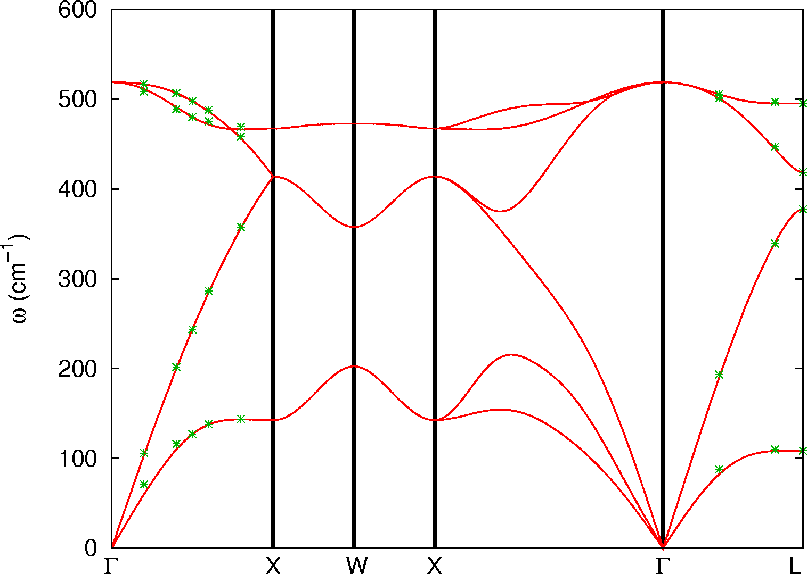
Exercise 4: checking the Fourier interpolation
You can use the script run_check_Si.sh and use plot_check.gnu Where the comparison is done automatically for a few q points.

Slide 27
Exercise 4: checking the Fourier interpolation
The Fourier interpolation works if the interatomic force constants are known on a sufficiently large supercell (i.e, large enough grid of q points in the phonon calculation).
There are cases in which the interatomic force constants are long range and the Fourier interpolation does not work properly:
When there are Kohn anomalies in metals. In this case the dynamical matrices are not a smooth function of q and the interatomic force constants are long range.
In polar insulators where the atomic displacements generate long range electrostatic interactions and the dynamical matrix is non analytic for q → 0. As we have seen, this case, however, can be dealt with by calculating the Born effective charges and the dielectric tensor of the material.

Slide 28
Electron-Phonon interaction

Slide 29
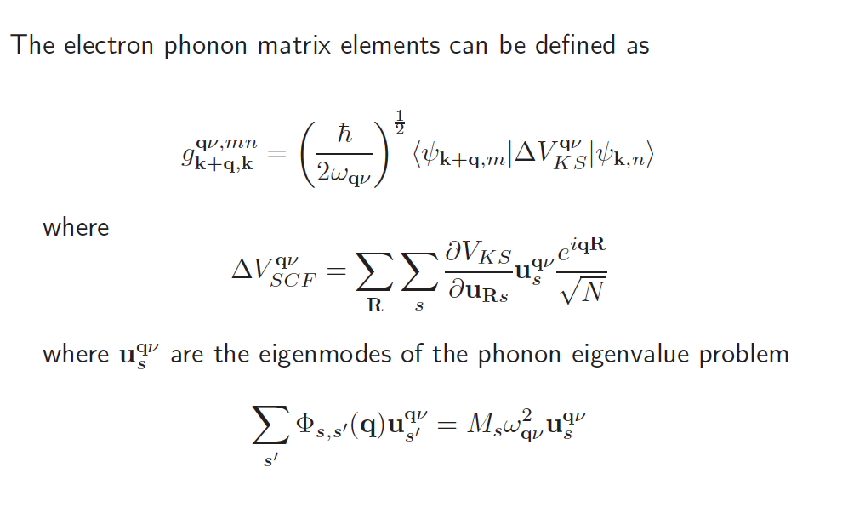

Slide 30
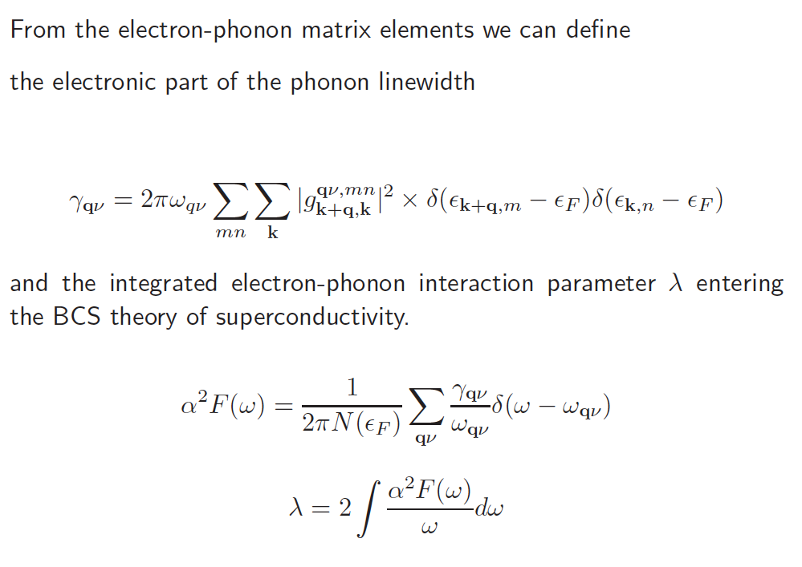

Slide 31
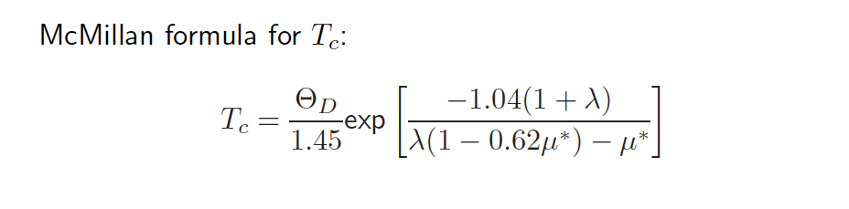
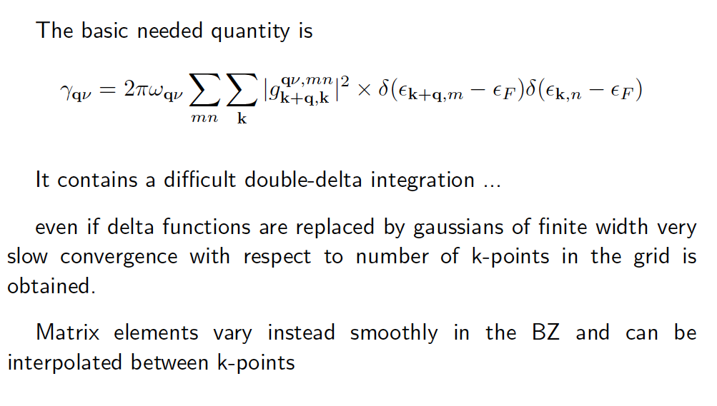
https://docs.epw-code.org/doc/Tutorials.html

Slide 32
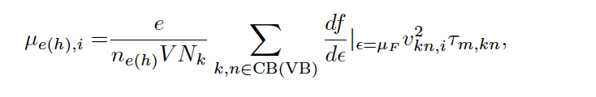

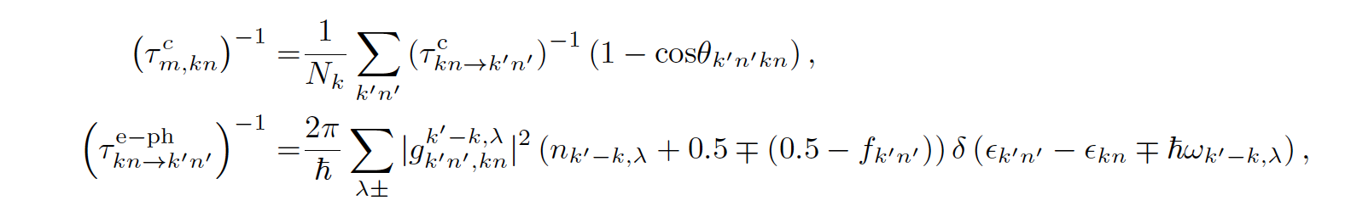
Carrier transport and Boltzmann equation
Linearized Boltzmann equation in relaxation time approximation

Slide 33
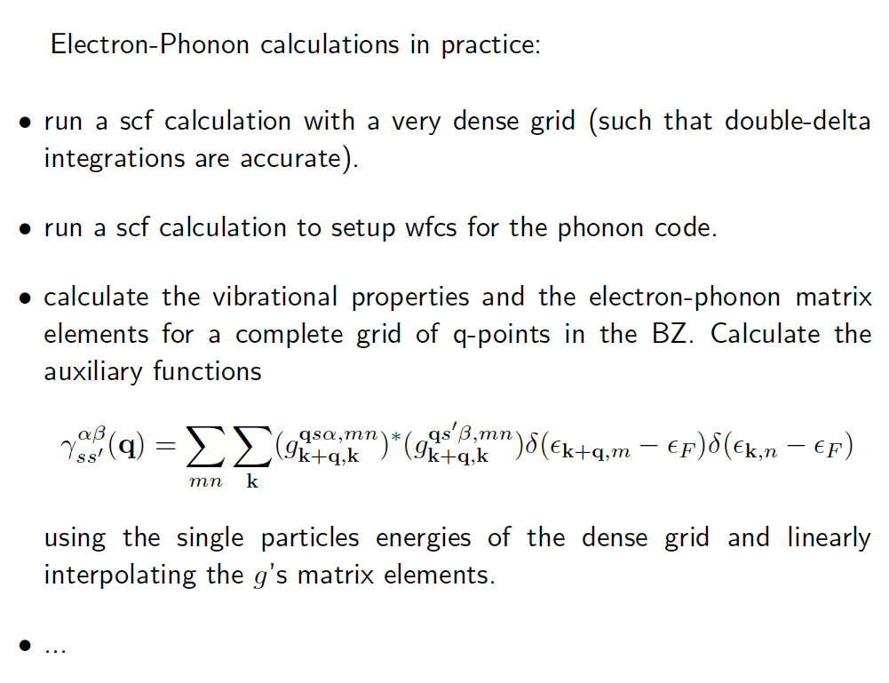

Slide 34
Electron-phonon coupling:
Momentum relaxation time and carrier mobility/conductivity by Boltzmann transport equation
Phonon assisted optical transition
Photoluminescence line shape
BCS superconductivity and transition temperature
….

Slide 35
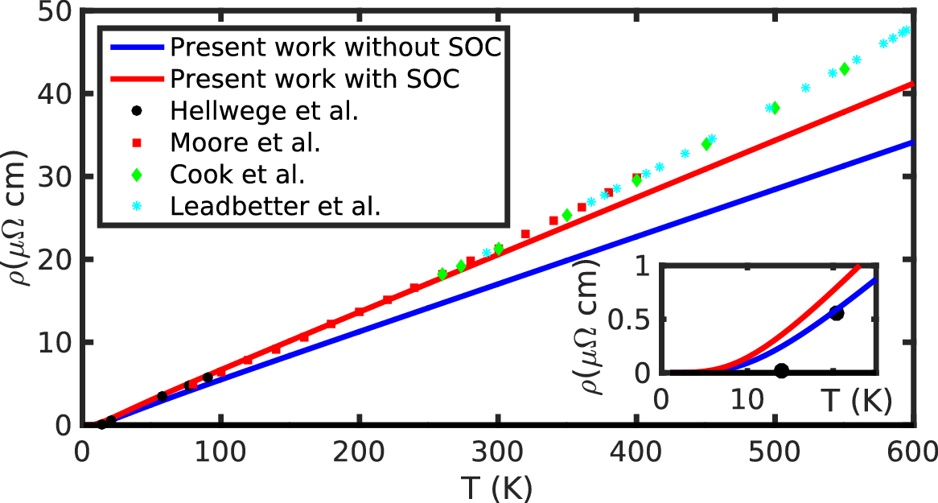
Carrier transport
Calculated resistivity with (plain red line) and without (plain blue line) spin-orbit coupling. The inset shows a zoom of the resistivity on the 0-25~K temperature range.
https://epw-code.org/
EPW tutorials

Slide 36
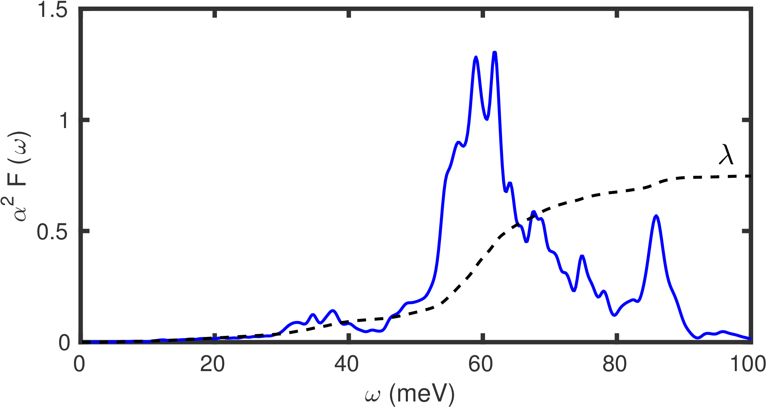
BCS superconductivity
Calculated isotropic Eliashberg spectral function 𝛼2𝐹(𝜔). of MgB₂ (blue solid line), and cumulative electron-phonon coupling strength 𝜆λ (black dashed line). The results are integrated on a homogeneous fine k-point grid containing 60x60x60 points, and a fine homogeneous q-mesh with 30x30x30 points.
https://epw-code.org/
EPW tutorials

Slide 37
Extra slides...

Slide 38
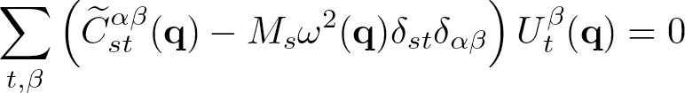
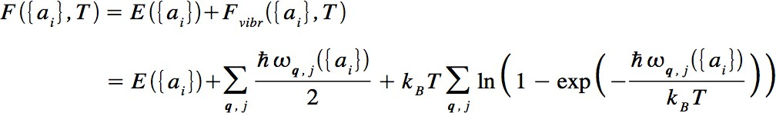

Phonons and thermo-mechanical properties
Phonons are determined by this secular equation:
Free energy in quasi-harmonic approximation:
Thermal expansion coefficient
And also: heat capacity, temperature dependence of the elastic constants....

Slide 39
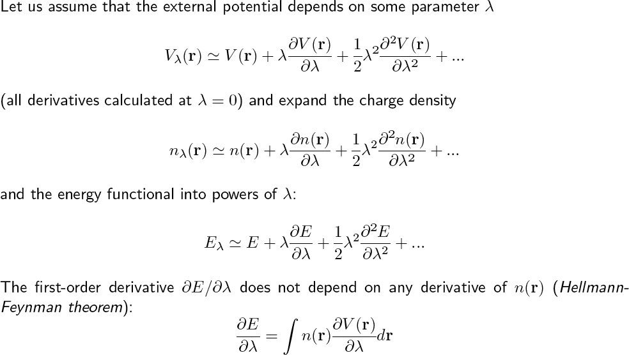
Density functional perturbation theory (1)

Slide 40
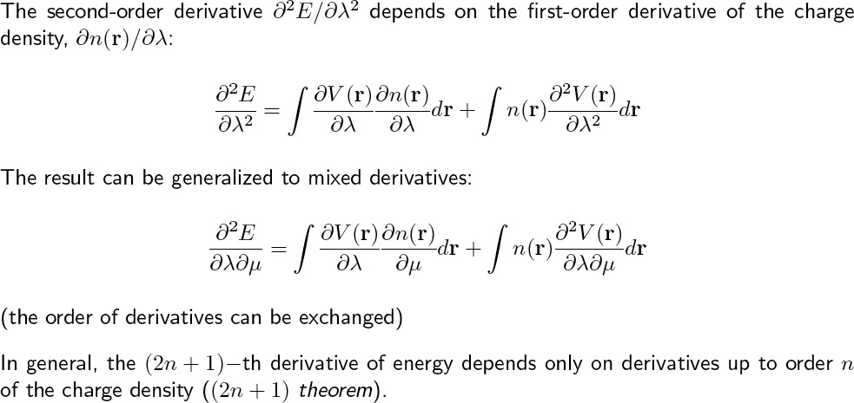
Density functional perturbation theory (2)

Slide 41
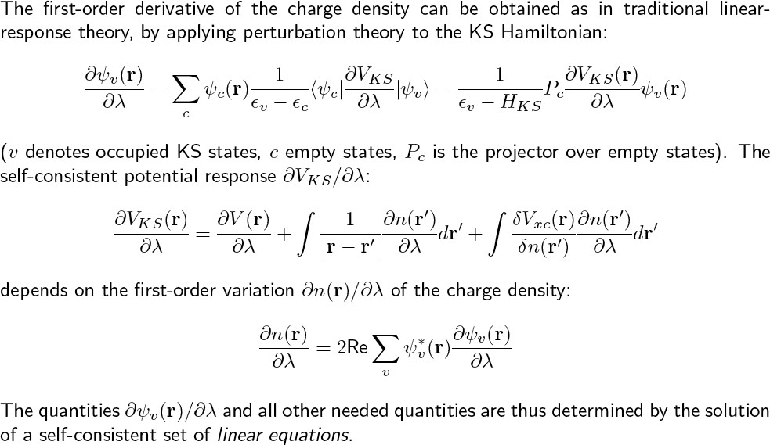
Density functional perturbation theory (3)

Slide 42
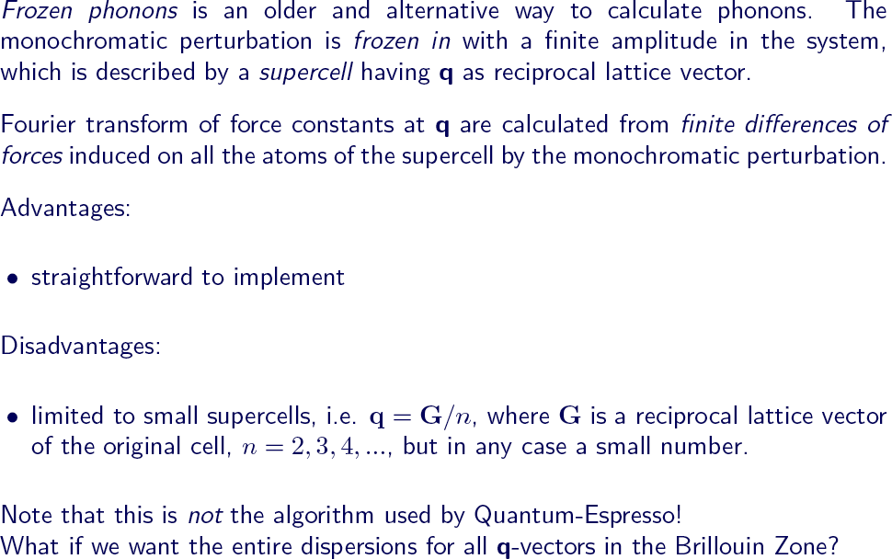
Frozen phonons vs DFPT

Slide 43
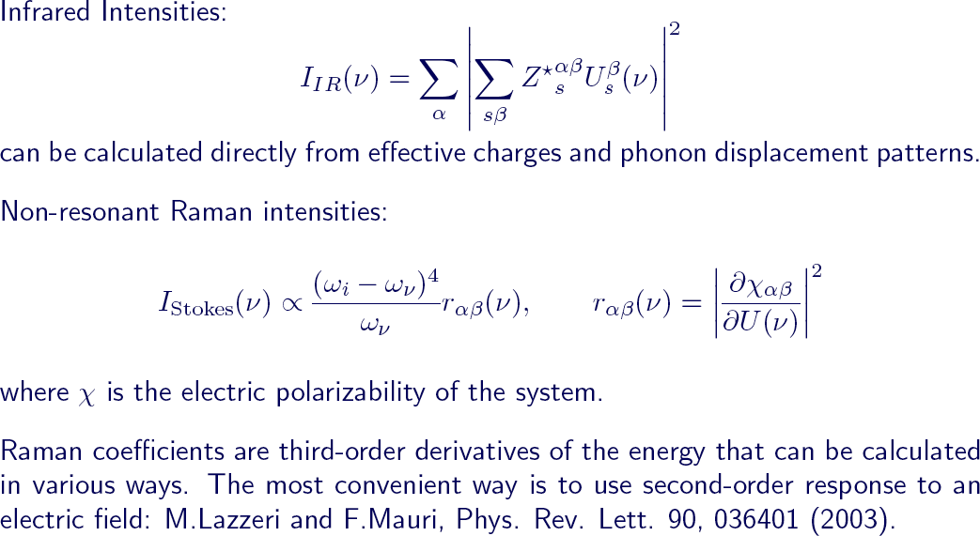
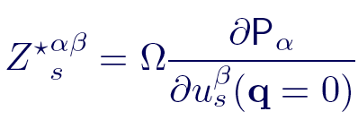
Calculation of IR and Raman intensities

