Slide 1
Module 1: Machine Learning Basics in Materials Science
Yuan Ping
All ML slides updated from https://nanohub.org/resources/intromllab/about
Credits of slides to Ben Afflerbach and Dane Morgan

Slide 2
Summary
What is Machine Learning?
Machine learning is a tool that finds patterns in large datasets that might be hard to discover otherwise
How can we use it for Materials Science?
It can be included in existing materials science workflows to accelerate research, materials design, and materials discovery
Identify Materials Properties
Train Model of Properties
Predict Properties For New Chemical Compositions
Synthesize and Verify Predictions
Notes:
- There are two key takeaway messages that we’ll cover in this slide deck. We’ll highlight them now and then again at the end.
- Bottom diagram is our basic overview of a simple materials design workflow

Slide 3
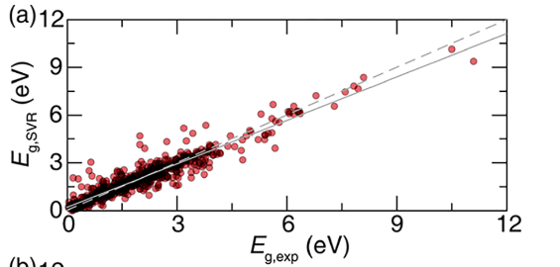
An Application: Predict a Materials Property
Bandgaps in Semiconductors
ML Predictions
Known Values
Machine learning prediction here is obtained from only properties of the elements in the material!
Y. Zhuo, et al. The Journal of Physical Chemistry Letters 2018 9 (7), 1668-1673. DOI: 10.1021/acs.jpclett.8b00124
Notes:
Before jumping in we’ll show one example that highlights some of the power of machine learning
Machine Learning can predict materials properties much faster than traditional techniques (experiments, computational simulations)
This example shows predictions on the Y-axis that were obtained from only compositional information of the materials!
Notice how close the majority of data points are to a “perfect prediction” which would fall on the dashed line

Slide 4
A Basic Materials Design Workflow
Identify Materials Properties
Train Model of Properties
Predict Properties For New Chemical Compositions
Synthesize and Verify Predictions
Training Details
Generate Training Data
Data Cleaning
Feature Generation and Engineering
Model Assessment
Model Optimization
Predictions
Notes:
Throughout these materials we’ll be calling back to our over-arching example of performing materials design
Point out how a machine learning model in the second box could basically be substituted with any other modeling technique as well.
We’ll talk more about training details in the next slide decks
For now the key idea is that we’ll be focusing on this idea of building models to predict properties
Worth pointing out that this isn’t everything that machine learning can do! We’re just choosing a specific objective to focus on!

Slide 5
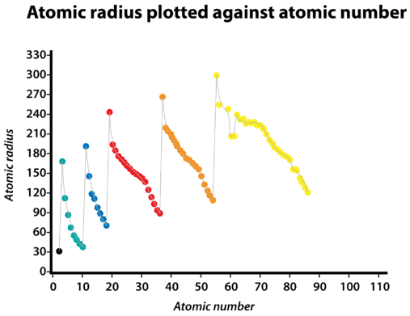
Machine Learning is Pattern Matching
https://chem.libretexts.org/Bookshelves/Introductory_Chemistry (accessed May, 2020)
Notes:
Machine learning makes predictions by identifying patterns within data that it has been trained on
As an example in materials science students probably already have an intuition about various trends within the periodic table.
For example if we view this representation of atomic radius vs atomic number we can see a general trend of increasing radius with atomic number, but also a sawtooth pattern as well
In this example the pattern can be seen by simply plotting against the atomic number, but in general patterns tend to be much more complex and may require many variables that our brains can’t visualize as easily.
In order to find these patterns a model needs large amounts of data to train on, ideally thousands of data points.

Slide 6
Key Distinction in ML
Supervised Learning
Unsupervised Learning
Labels (Output Data)
Input Data X₂
Input Data X
Input Data X₁
Find a Function that represents the data
Find Structure in the data
No Labels
Notes:
Now we’re going to talk about a bit more specifics of machine learning.
When talking about machine learning there are a few major different types, and depending on which one we choose we would have to approach things very differently
For the rest of our discussion we’ll be talking about supervised learning, where we have output data or “labels” for everything
Therefore the goal of machine learning is to find some function that predicts these labels from the inputs

Slide 7
Key Distinction in ML
Regression
Classification
Bandgap
Insulator
Conductor
Fatigue Strength
Brittle Failure
Ductile Failure
Transformation Temp.
Is Shape Memory Alloy
Not Shape Memory Alloy
Notes:
The second key distinction is in how our outputs for supervised learning are structured
Regression gives continuous outputs, while classification gives distinct predictions of a class
For our examples we’ll be assuming regression models going forward

Slide 8
Model Types
Linear Models
Kernel Ridge
Support Vector Machines
Nearest Neighbors
Gaussian Processes
Decision Trees
Random Forests
Neural Networks
…
These can be very technical so we will not spend time on any detailed methods at this point.
Most can be trained with a simple function call so only qualitative understanding is necessary for using them.
For a more complete list of models
https://scikit-learn.org/stable/supervised_learning.html
Notes:
There are many different model types, some of which you may have heard of
They all are fundamentally trying to do the same thing, finding that function to map inputs to outputs and identify patterns
However, they all do that is drastically different ways
We’re going to again limit ourselves to just one choice, in the interest of time. Decision trees are easy to get a grasp of, and require little math background to understand

Slide 9
Decision Trees: Structure
Root Node: Starting point which contains all data
Leaf Node: Final Node in a branch where prediction is made
Decision Node: Contains a single splitting criteria based on one feature
Root
Leaf
Decision
Split: A single division in the dataset based on the values of a single feature
Branch: Refers to a subset of data that is present after a series of splits
Decision
Leaf
Leaf
Leaf
Notes:
This is the key structure of a decision tree. Identify components
To make a prediction we would flow from the top to the bottom of the tree making a “decision” at each node about which direction or branch of the tree to follow
Which leaf we reach determines what the model prediction is

Slide 10
Decision Trees: Inputs
Input Data
A_{N} > 10
Features (descriptors)
Leaf
T_{m} < 1000
Index | A_{N} | T_{m} (K)
Fe | 26 | 1800
Al | 13 | 930
C | 6 | 3800
Leaf
Leaf
Individual Data points
Notes:
Break down the example dataset on right, explaining rows and columns
Now let’s remind talk a bit more about the inputs to the model. We mentioned making decisions, but how do we do that?
The model using information from the data called Features to make each decision. For example is X1 greater than 0.5?

Slide 11
Decision Trees: Outputs
Features (descriptors)
Input Data
A_{N} > 10
Index | A_{N} | T_{m} (K)
Fe | 26 | 1800
Al | 13 | 930
C | 6 | 3800
Individual Data points
Radius = 67 pm
T_{m} < 1000
Radius = 156 pm
Radius = 118 pm
Notes:
Outputs of the model are given by the leaves
Each leaf has a single value associated with it

Slide 12
Summary
What is Machine Learning?
Machine learning is a tool that finds patterns in large datasets that might be hard to discover otherwise
How can we use it for Materials Science?
It can be included in existing materials science workflows to accelerate research, materials design, and materials discovery
Identify Materials Properties
Train Model of Properties
Predict Properties For New Chemical Compositions
Synthesize and Verify Predictions
Notes:
Remind students of again the two key takeaways
In the next set of slides we’ll talk through in more details about the machine learning workflow

