Slide 1
Module 4: Machine Learning and Molecular Modeling
Yuan Ping
Credits of slides to Ben Afflerbach and Dane Morgan

Slide 2
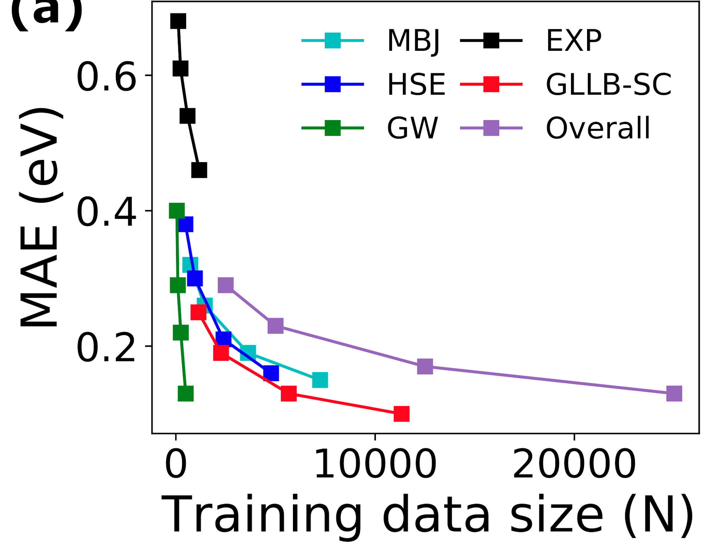
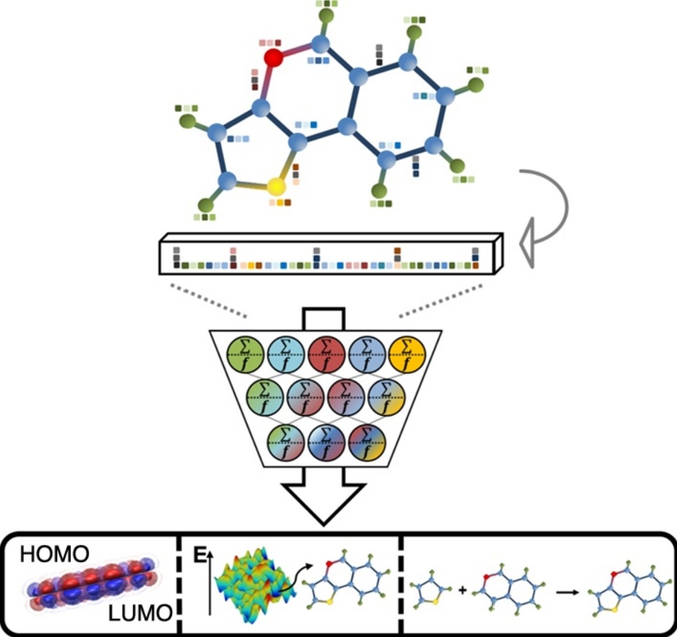
There is a Special Connection Between Machine Learning (ML) and Molecular Modeling (MM)
Molecular modeling is a common source of data for predictive models since data is easy to obtain, described with full atomic resolution, and consistent (e.g. from just a few methods).
Atomic structure is correlated with many many properties, traditional through physical modeling (MM), and now increasingly through (ML)
Redox energies
Dielectric constant
Stability
Energies and Forces (an interatomic potential!)
806,600 band gaps, 0.2% from experiment [1]
[1] Li et al, J. Chem. Phys. ’21, https://doi.org/10.1063/5.0066009; [2] Haghighatlari and Hachmann, Curr Opin in Chem Eng, ‘19, https://doi.org/10.1016/j.coche.2019.02.009
[2]

Slide 3
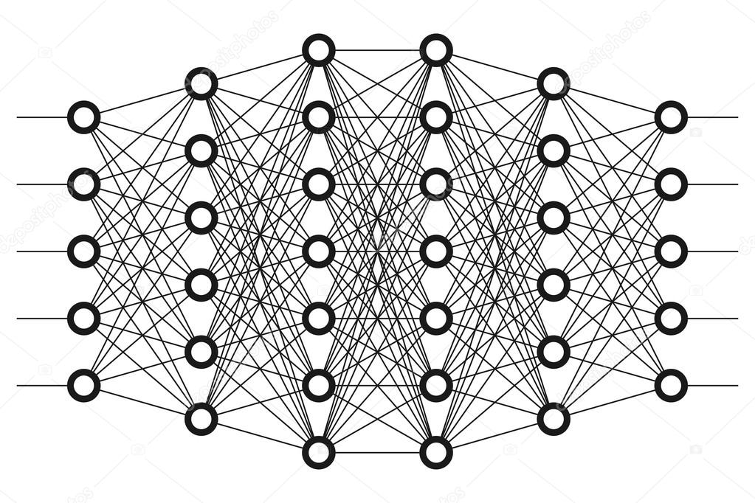
Machine Learning Interatomic Potentials
Potentials are a natural application of machine learning
E({R}), F({R})
Atom types and positions
Energies and forces on atoms
Traditional potential
E({R})
F({R})
Machine learned potential
{R}

Slide 4
Traditional Interatomic Potentials (TIPs) vs. Machine Learning Potentials (MLPs)
E({R})
F({R})
{R}
TIPs have physically motivated functional forms
Require extensive consideration of physics of atoms.
Have ~10⁰-10² adjustable parameters.
Can be fit with ~10¹-10³ training points.
Behave physically almost always (e.g., atoms cannot be within 0.5 Å).
Cannot adapt when they don’t have all the physics (e.g., C in diamond, graphite, CO, CO2, and WC).
MLPs have machine learning functional forms
Require extensive consideration of featurization and ML model
Have ~10¹-10⁶ adjustable parameters.
Can be fit with ~10²-10⁶ training points.
Behave unphysically easily (e.g., atoms can be within 0.5 Å if not told otherwise) .
Can adapt to any situation with enough training data (e.g., C in diamond, graphite, CO, CO2, and WC).
Prediction: With increasing ease of training data and MLP refinement, they will come to dominate of TIPs

Slide 5
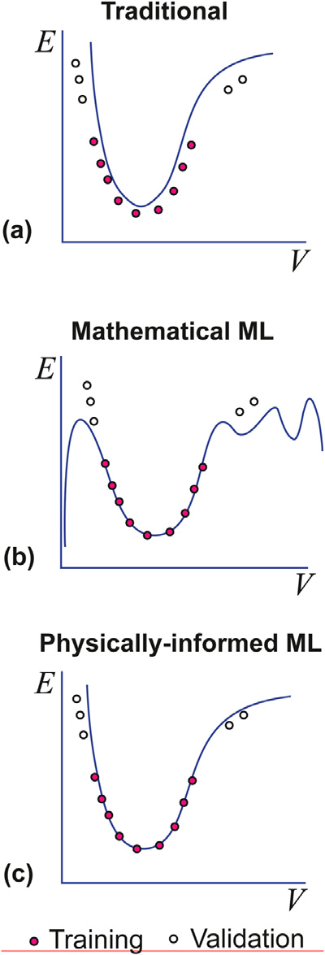
Schematic of Difference Between TIP and MIP (and MLP with some physical terms added)
Mishin, Acta Metal. ‘21; https://doi.org/10.1016/j.actamat.2021.116980

Slide 6
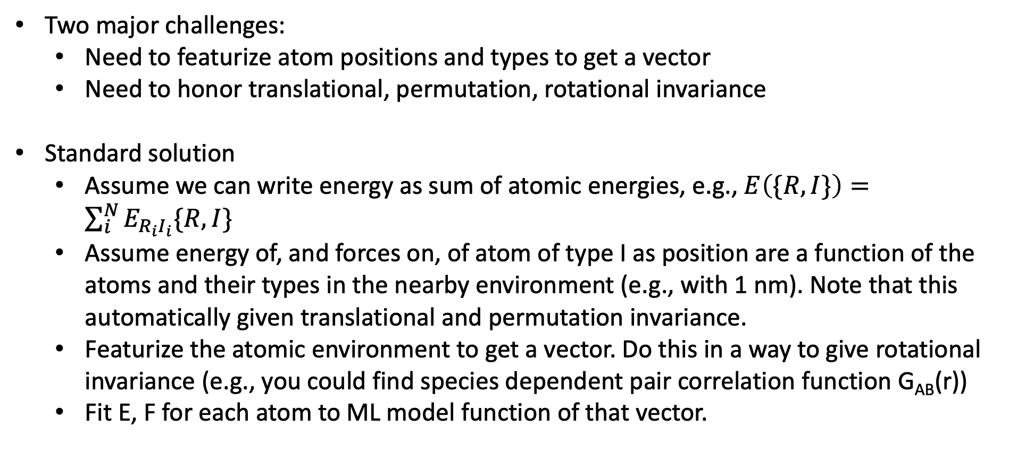
How Do We Construct and MLP?
Two major challenges:
Need to featurize atom positions and types to get a vector
Need to honor translational, permutation, rotational invariance
Standard solution
Assume we can write energy as sum of atomic energies, e.g., $E\left(\{R,I\}\right)=\sum_{i}^{N}{E_{R_{i}I_{i}}\{R,I\}}$
Assume energy of, and forces on, of atom of type I as position are a function of the atoms and their types in the nearby environment (e.g., with 1 nm). Note that this automatically given translational and permutation invariance.
Featurize the atomic environment to get a vector. Do this in a way to give rotational invariance (e.g., you could find species dependent pair correlation function G_{AB}(r))
Fit E, F for each atom to ML model function of that vector.

Slide 7
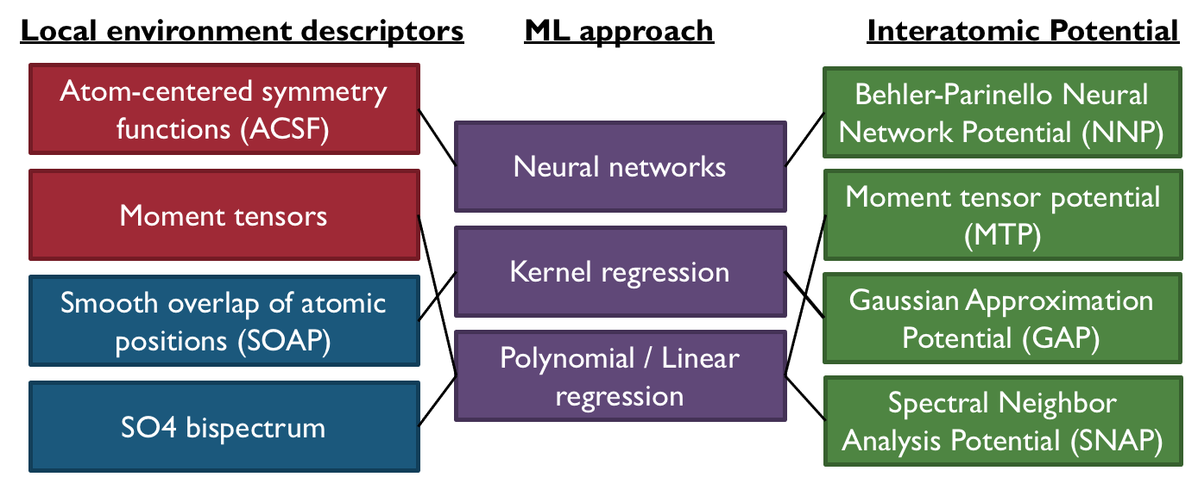
A Family of MLPs
Schematic representation of basic MLIP approaches. [Figure from Shyue Peng Ong and Xiangguo Li]
Many MLPs have free fittings tools (NNP, MTP, GAP, SNAP) and are implemented in LAMMPS ready for use in MD

Slide 8
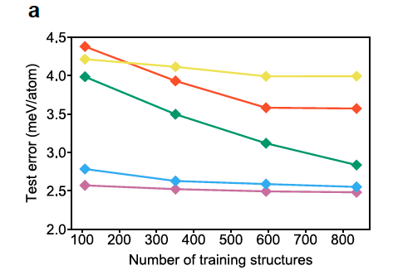
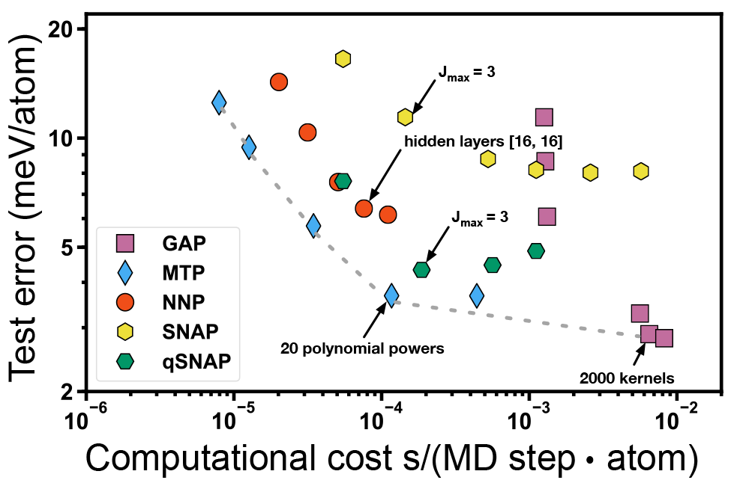
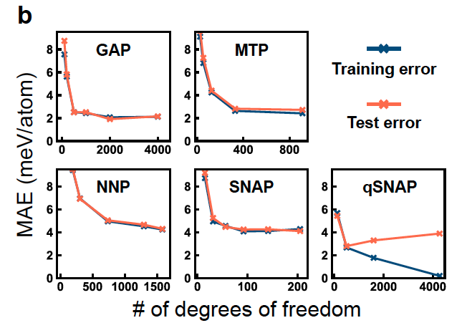
Some Examples of MLP Performance
Lennard-Jones
EAM
EAM ~ 40 meV/atom
Mo alloy
Zhou, et al, J. Phys. Chem. A ‘20;
https://pubs.acs.org/doi/abs/10.1021/acs.jpca.9b08723

Slide 9
Summary
MLPs are like TIPs but replace physics based functional forms with numerical ones.
MLPs vs. TIPs: Need more fitting data and may have more issues extrapolating, but generally more accurate.
Approximately as fast as many TIPs.
Ability to extrapolate and enable new materials discovery still unproven but promising.
Development of new MLP forms and fitting strategies is rapid. Likely to achieve near DFT accuracy for many problems at ~10⁶ x speedup and many components and conditions. May largely replace TIPs.

