Slide 1

Using CHTC’s HPC Cluster
Christina Koch
Center for High Throughput Computing
September 24, 2024

Slide 2
Computing Services at CHTC
The Center for High Throughput Computing (CHTC) operates a High Throughput Computing system and a High Performance Computing system.
High Throughput Computing System
Over 40,000 cores of capacity
80+ GPUs
High memory servers (2TB memory)
Run 10s-1000s of calculations using 1-16 cores each
Access computing capacity external to CHTC
High Performance Computing System
5,120 cores of capacity
40 general use execute nodes (128 AMD Epyc 7763 processor cores, 512GB memory, 1.5TB of local fast NVME disk)
Run 1-10 calculations of 32+ cores each
→ Good for lots of independent jobs
→ Good for large jobs, MPI jobs

Slide 3




Using a Large-Scale Computing System
Worker Nodes / Execution Points
Log In Node / Access Point
Jobs are scheduled + run
Log in (ssh)
Submit jobs to a queue
Laptop by Circlon Tech from Noun Project
Server by Pundimon from Noun Project
Server by mungang kim from Noun Project
Checklist by Sofía Trujillo Quesada from Noun Project (CC BY 3.0)

Slide 4
Using a Large-Scale Computing System
Worker Nodes / Execution Points
Log In Node / Access Point
Jobs are scheduled + run
Log in (ssh)
Job Scheduling Software
SLURM
Submit jobs to a queue
Laptop by Circlon Tech from Noun Project
Server by Pundimon from Noun Project
Server by mungang kim from Noun Project
Checklist by Sofía Trujillo Quesada from Noun Project (CC BY 3.0)

Slide 5
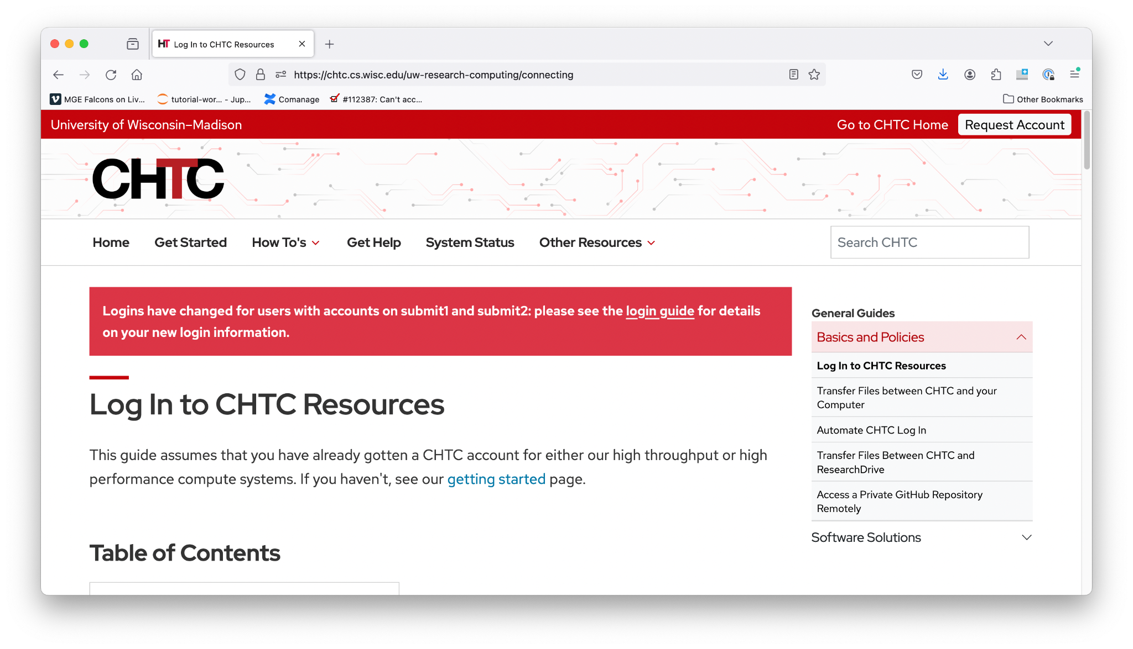
1. Log In
Use SSH to login to the submit server. Your accounts should already be active.
Server: spark-login.chtc.wisc.edu Username: your NetID Password: your NetID's password
https://chtc.cs.wisc.edu/uw-research-computing/connecting

Slide 6
Exploring the Login Node
You should have access to:
/home/NetID
/scratch/NetID
/home/groups/mse_course_ping
Important: None of these spaces are backed up. If a file is deleted, it’s gone forever. We strongly recommend having a backup plan for all of your files.
It’s possible to use tools like putty, MobaXTerm, WinSCP and Cyberduck to log in, view files, and upload/download files. See this page for more details.

Slide 7
Login Node Etiquette
Don’t run programs on the login node.
Don’t share your login information with anyone.
Keep an eye on your quota (request an increase if needed).
Submit jobs from /scratch (not required, but nice to do).
Test at a small scale, before running larger jobs.
Don’t run programs on the login node

Slide 8
2a. Submit a job - interactive
To request a four-core interactive session, use:
srun -n4 -N1 -p int --pty bash
Or
salloc -n4 -N1 -p int
Type “exit” to leave either type of session.
https://chtc.cs.wisc.edu/uw-research-computing/hpc-job-submission#1-submitting-jobs-using-slurm

Slide 9
2b. Submit a job - automated/batch
#!/bin/sh
#SBATCH --partition=pre # default "shared", if not specified
#SBATCH --time=0-04:30:00 # run time limit in days-hh:mm:ss
#SBATCH --nodes=1 # require 1 nodes
#SBATCH --ntasks-per-node=16 # cpus per node (by default, "ntasks"="cpus")
#SBATCH --mem=4000 # RAM per node in megabytes
#SBATCH --error=job.%J.err
#SBATCH --output=job.%J.out
module load mpimodule
srun -n 16 /home/username/mpiprogram
Submit with “sbatch filename”
https://chtc.cs.wisc.edu/uw-research-computing/hpc-job-submission#1-submitting-jobs-using-slurm

Slide 10
Tips and Best Practices for Jobs
Check on your jobs:
Use “squeue -u $USER” to see your job status
Error messages should be written to the --error and --output files
Best Practices:
Expect to wait in the queue – don’t wait until the last minute!
It’s good to run a small test that will fail quickly before doing a big calculation.
Backup your files!!!
Submit out of /scratch

Slide 11
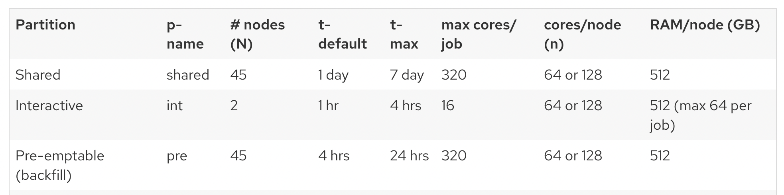
Tips and Best Practices for Jobs
Optimize your job submissions:
Know the difference between the “pre” and “shared” partitions.
“Pre” has a shorter time limit and can be interrupted, but jobs usually start much faster
“Shared” guarantees a longer time limit, but wait times are usually longer

Slide 12
Resources
Cluster Overview:
https://chtc.cs.wisc.edu/uw-research-computing/hpc-overview
Using SLURM:
https://chtc.cs.wisc.edu/uw-research-computing/hpc-job-submission
User Expectations:
https://chtc.cs.wisc.edu/uw-research-computing/user-expectations

Slide 13

How to Get Help
Twice-weekly office hours, online on Zoom: - Tuesdays, 10:30 AM - 12:00 PM - Thursdays, 3:00 PM - 4:30 PM (link in welcome message when you log in to the server)
Email support: chtc@cs.wisc.edu
https://chtc.cs.wisc.edu/uw-research-computing/get-help

Slide 14
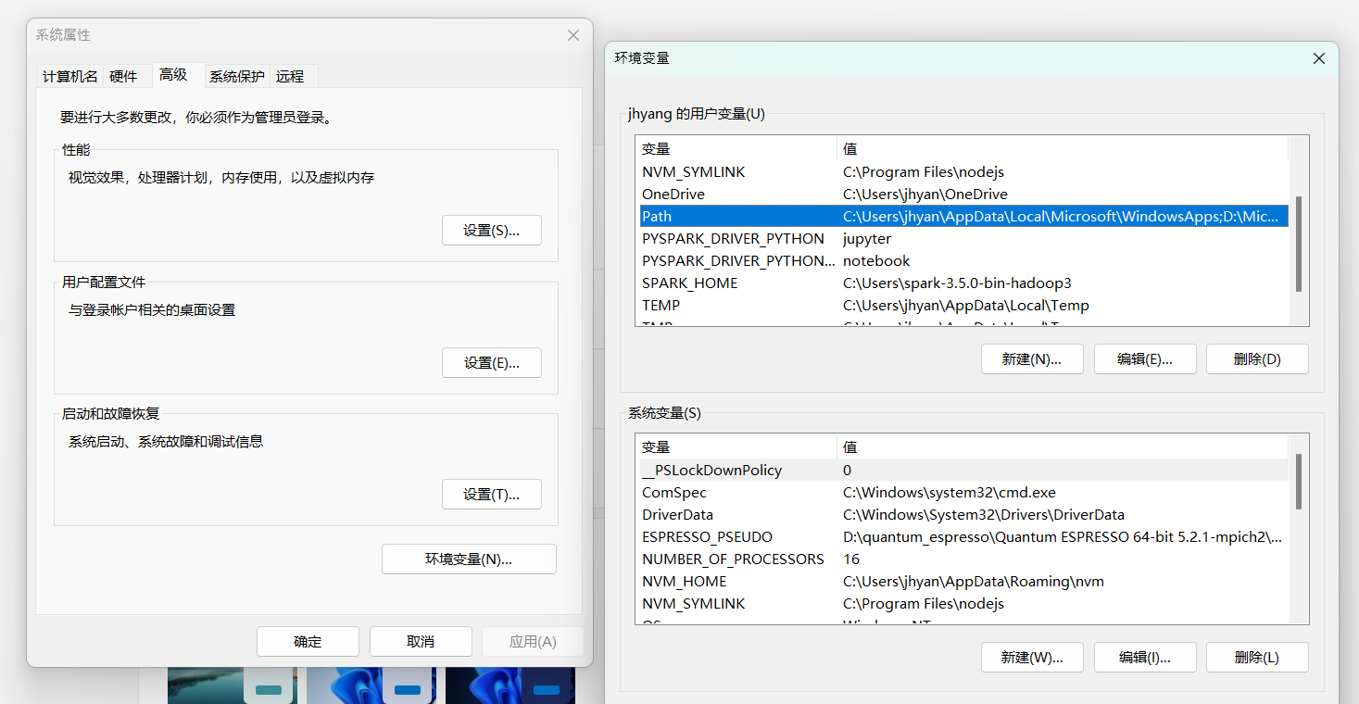

Slide 15
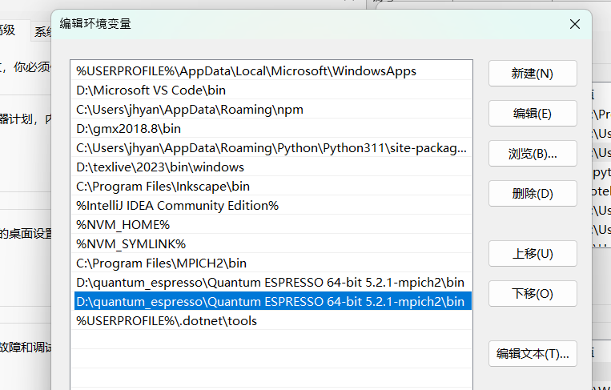

Slide 16
