Slide 1
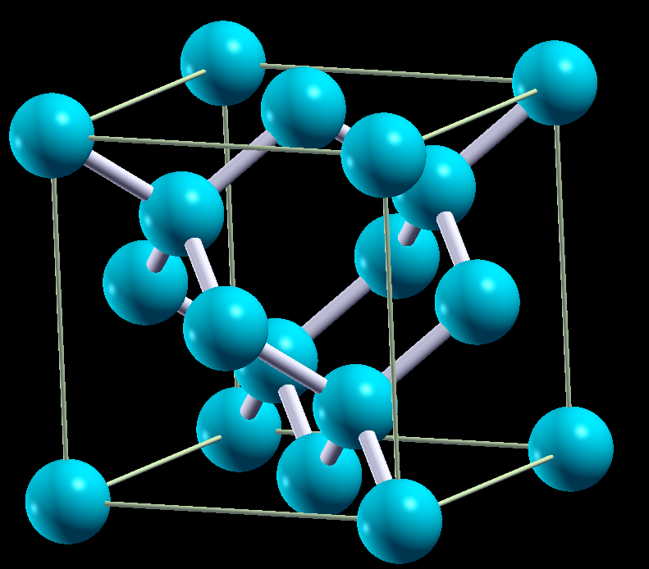
Example: Si bulk
FCC lattice
2 atoms in primitive cell
Each Si bonded with 4 Si
Band structures: eigenvalues at each k-points
Band gap (direct or indirect)
Density of states: number of states at given energy

Slide 2
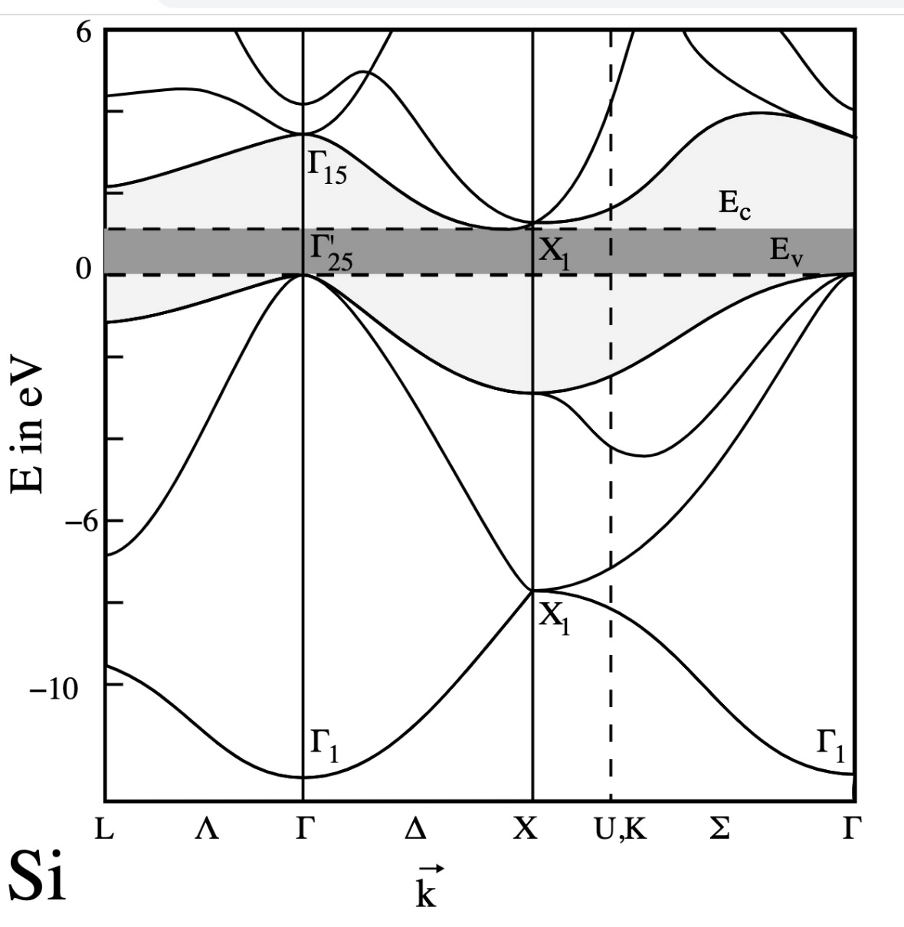
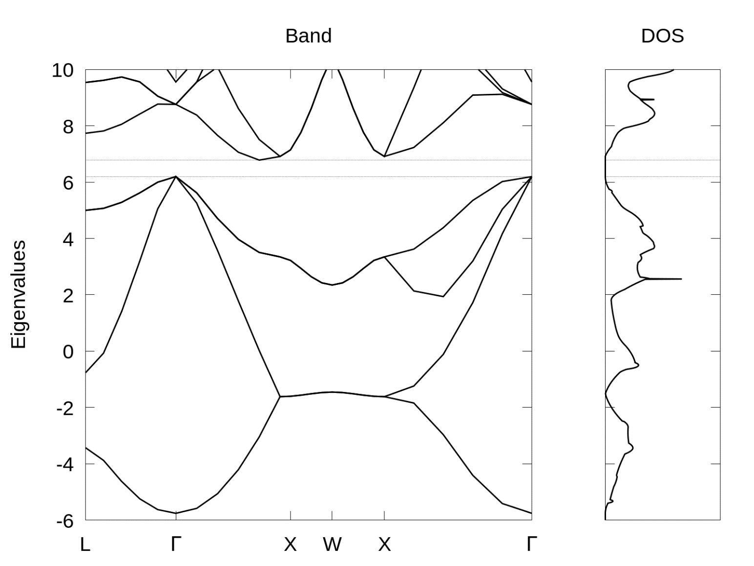
Experimental Si Band structure
Calculated Si Band structure

Slide 3
Practice in terminal
Top left :Applications – System Tools – Terminal
Type commands and press enter to run commands in terminal
Run following commands one by one to start:
CHTC:
ssh username@spark-login.chtc.wisc.edu
cd /scratch/username
cp -r /home/groups/mse_course_ping/examples/QE/silicon/
cd silicon

Slide 4
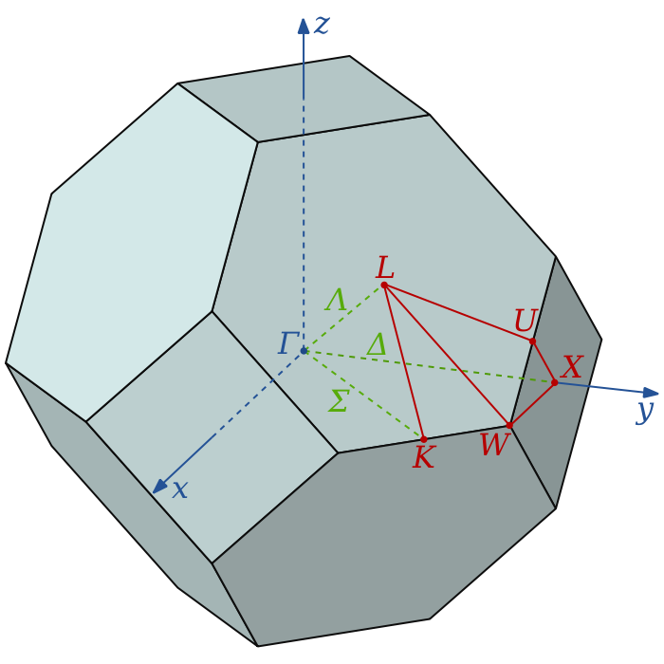
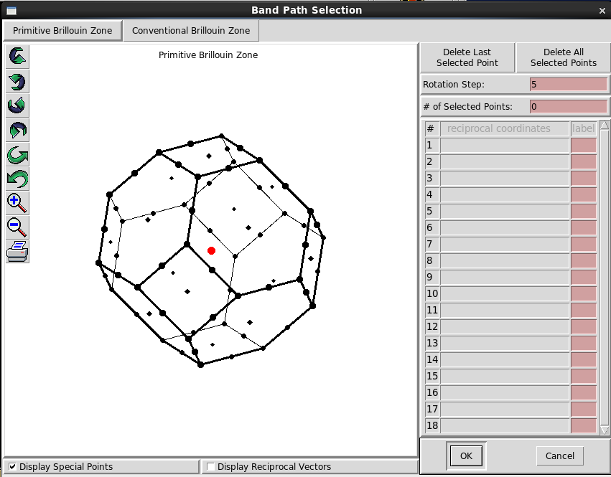
FCC band structure
Special k-points
Xcrysden: Menu-Tools-k-path
https://en.wikipedia.org/wiki/Brillouin_zone

Slide 5
Tasks
On CHTC, type: sbatch qe-batch-script.sh
On local machine
Run a scf calculation to get charge density pw.x < scf.in > scf.out
Run a nscf calculation to get eigenvalues on special k-points pw.x < nscf.in > nscf.out
Run bands.x and plotband.x to generate data files to plot bands.x < bands.in > bands.out plotband.x < plotband.in > plotband.out
Run a nscf calculation for better density of states plot pw.x < nscf-dos.in > nscf-dos.out
Run dos.x to generate data files to plot dos.x < dos.in > dos.out
Alternatively, run: chmod +x run.sh after finish: ./run.sh
CHTC: After finish, download the entire folder to local directory. The visualization software does not work on CHTC.
scp -r username@spark-login.chtc.wisc.edu:/scratch/username/silicon .
Plot bandstructure and DOS gnuplot –persist plot.v4.gnu

Slide 6
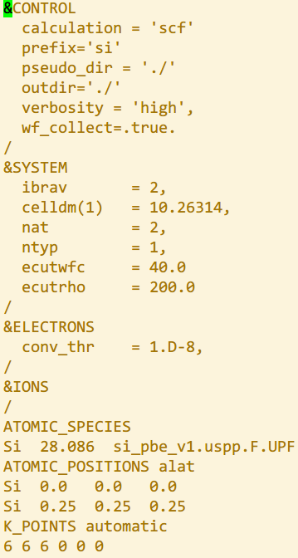
Run SCF
‘scf’ for self-consistent-field
set files/folder to read and write and what to write
10.26 Bohr (5Å) FCC cell
2 atoms and 1 types of atoms (Si)
basis set size of wavefunction
Species: Pseudo potentials filename
Position of 2 atoms
6x6x6 K-points

Slide 7
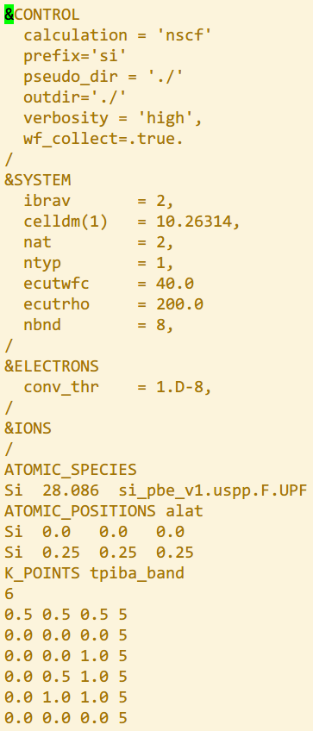
Run NSCF for band structure
Non-self consistent field: compute eigenvalues and wavefunctions from fixed charge density (no update)
Including more bands to plot
A list of special k-points
5 points along each line

Slide 8
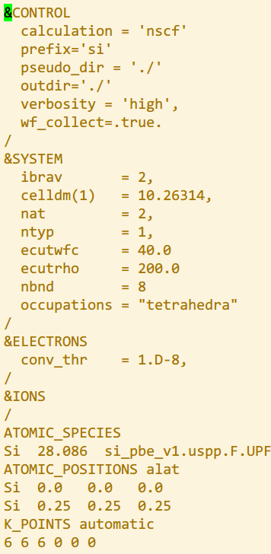
Run NSCF for density of states
Non-self consistent field: compute eigenvalues and wavefunctions from fixed charge density (no update)
Specific to make DOS looks better
More k-points for better looking DOS and preserve fine DOS structures
(In this example only 6x6x6 for speed)

Slide 9

Band structure and DOS
Experimental band gap: 1.1eV, indirect
DFT band gap problem: always underestimate gap, 40% to no gap

