Slide 1
Adversarial Deepfake Generation and
an Investigation of Purification-Based
Adversarial Detection
Notebook for the ImageCLEF at CLEF 2026
Junghyun Kim, Seunghyun Kim, Jiyoung Woo
Soonchunhyang University, South Korea
Team Go To Germany

Slide 2
ImageCLEF 2026 Deepfake Task
Two parallel sub-tasks — we participated in both.
Generation
Detection
Create 1,002 deepfake images that:
Classify 24,404 images
as Real or Fake
• match MediaPipe FaceMesh 478 landmarks
• preserve target identity
• evade detectors
During Generation task, we observed:
cross-detector responses to face cropping
differed substantially on adversarial images.
Can these detectors help flag adversarial inputs?
GTG @ ImageCLEF 2026
2 / 14

Slide 3
Overview
1. Generation
Adversarial PGD attack against 12 detectors(Effort, Xception, etc.)
2. Detection
Two-detector specialist ensemble
3. Flagging adversarial inputs
Via input-space purification (further experiments)
GTG @ ImageCLEF 2026
3 / 14

Slide 4
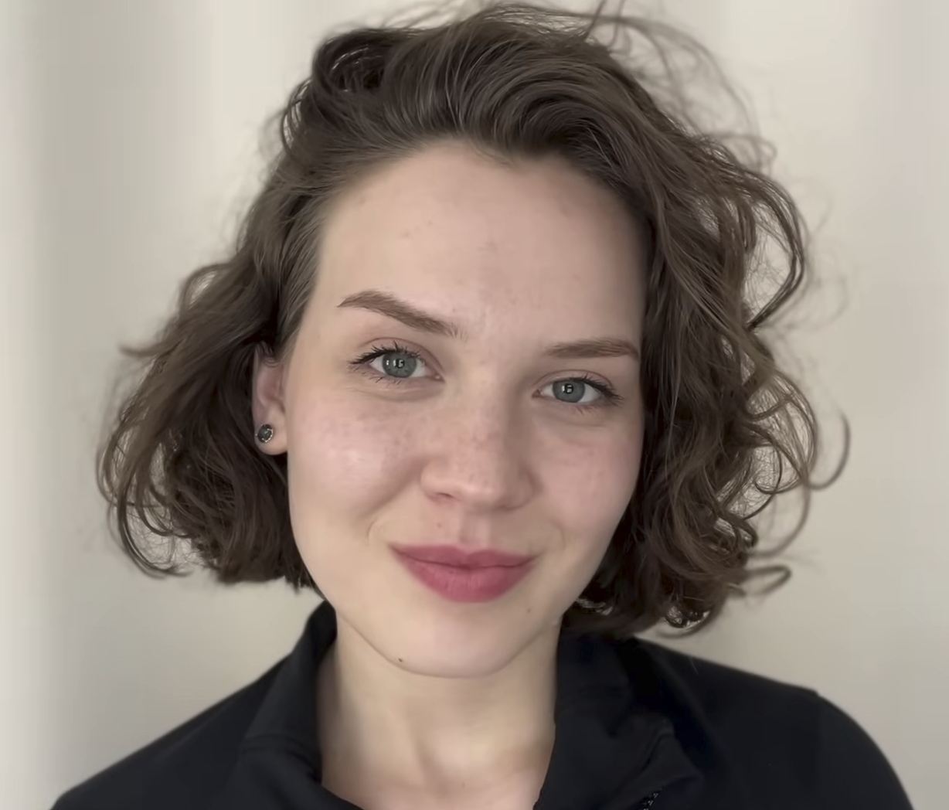
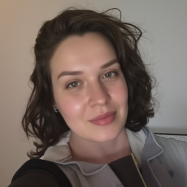

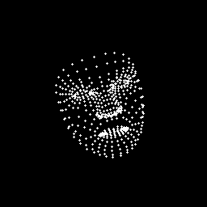
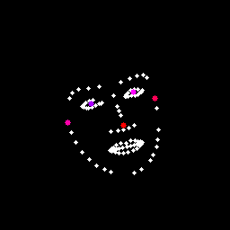
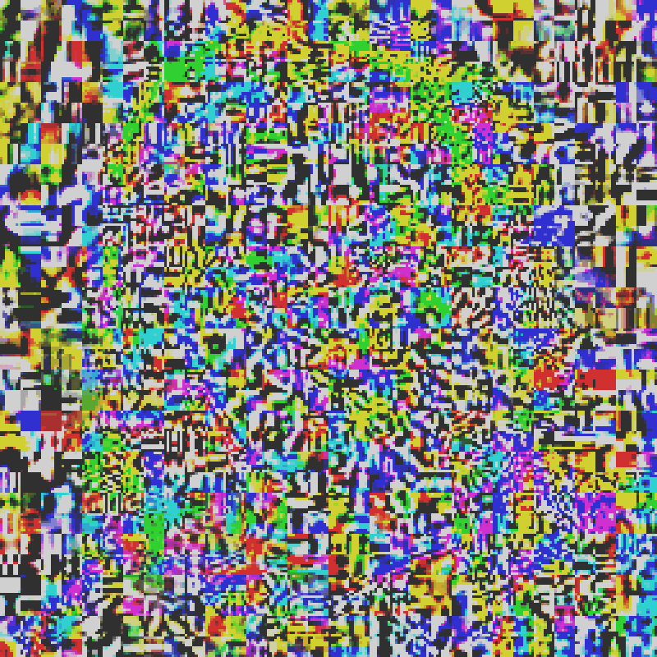
Generation Pipeline
Base synthesis
PuLID
Adversarial attack
Identity encoder
identity
PGD adversarial attack
T = 25 iterations
ε = 2/255 12 detectors (joint loss)
DiffJPEG Q=80 | DI + MI + EoT
x20
Reference
FLUX.1-dev
landmark
Clean fake
Adversarial output
ControlNet
Adversarial noise (ε ≤ 2/255, nearly imperceptible to eye)
Face structure
≈
+
Landmark map
(MediaPipe)
Landmark map
(OpenPose for ControlNet)
GTG @ ImageCLEF 2026
Adversarial output
Clean fake
Adversarial Noise (×15)
4 / 14

Slide 5

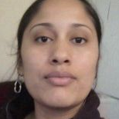

Motivating observation: detector responses shift under transformation
Original (adversarial)
Center crop (256x256 → 192×192)
Face crop
Detector | Original | Center crop | Face crop
NPR | 0.00 | 0.00 | 1.00
DistilDIRE | 0.05 | 0.99 | 1.00
aide_genimage | 0.05 | 0.86 | 0.54
Xception | 0.01 | 0.01 | 0.01
SigLIP+DINOv2 | 0.01 | 0.01 | 0.01
… | … | … | …
The detection rates are rising…
GTG @ ImageCLEF 2026
5 / 14

Slide 6
Generation Results
Internal validation (17 detectors on our 1,002 submission images)
Official Score
White-box (12 attack targets)
Detector | Rate
sdxl_det, effort, haywood, npr | 100%
xception, dfdc_b7 | 99.9%
ateeq | 99.8%
umm_maybe | 97.9%
f3net | 97.3%
siglip_dino | 96.9%
freqnet | 96.0%
srm | 83.4%
Image Quality Score | 0.6188
Evasion, Organizer | 0.9019
Evasion, Participant | 0.5762
Final = 0.6188 × (0.3·0.9019 + 0.7·0.5762)
2nd
= 0.4170
Held-out (5 transfer-verification groups)
Detector | Rate
AIDE (3 ckpts) | 100%
UCF | 100%
RECCE | 99.8%
DistilDIRE | 95.1%
SIDA-7B | 89.1%
The 90% → 58% gap reflects a
transferability limit to unknown architectures — not tuning.
GTG @ ImageCLEF 2026
6 / 14

Slide 7
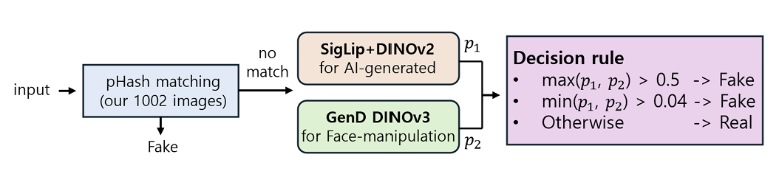
Detection Pipeline: Specialist Ensemble
Two specialists
• SigLIP+DINOv2 for AI-generated content (global artifacts)
• GenD-DINOv3 for face manipulation (local artifacts)
[Detection Pipeline]
Combined via max-probability rule
Fake if max(p₁, p₂) > 0.5, or min(p₁, p₂) > 0.04(calibrated)
pHash short-circuit for our own submissions
GTG @ ImageCLEF 2026
7 / 14

Slide 8
Detection Results
τ_min was miscalibrated
Metric | Score
Baseline Deepfakes | 0.9939
Organizers Real | 0.4324
Curated Real GT | 0.5729
Participant Deepfakes (realism-weighted) | 0.8171
• Calibration set (7,000):
2,000 Real (FF++ + refs)
4,000 Face manip (FF++)
1,000 AI-gen (ours + BitMind)
→ Real : Fake = 1 : 2.5
• Optimized count-based net gain (TP − FP)
• Rates: TPR 16.5% < FPR 19.6% → net loss
Final = 0.1·0.9939 + 0.1·0.4324 + 0.4·0.5729 + 0.4·0.8171
2nd
= 0.6986
Rate-based metrics
would lift accuracy > 90%...
Correct threshold alone is expected to lift accuracy > 90% — the classifier was not the bottleneck.
GTG @ ImageCLEF 2026
8 / 14

Slide 9
Further Experiments
Can these detectors flag adversarial inputs?
Three sequential approaches
Sec 1
Multi-detector response instability
→ failed
(JPEG confound)
Sec 2
Mahalanobis feature-space outlier
→ failed
(deployment scale mismatch)
Sec 3
Input-space purification
→ works
Setup
Data: our submissions | BitMind (SDXL / FLUX) | FaceForensics++
Deployment: 24,404 ImageCLEF images Attacks: PGD + FGSM + BIM (ε ∈ {2, 4, 8}/255)
GTG @ ImageCLEF 2026
9 / 14

Slide 10
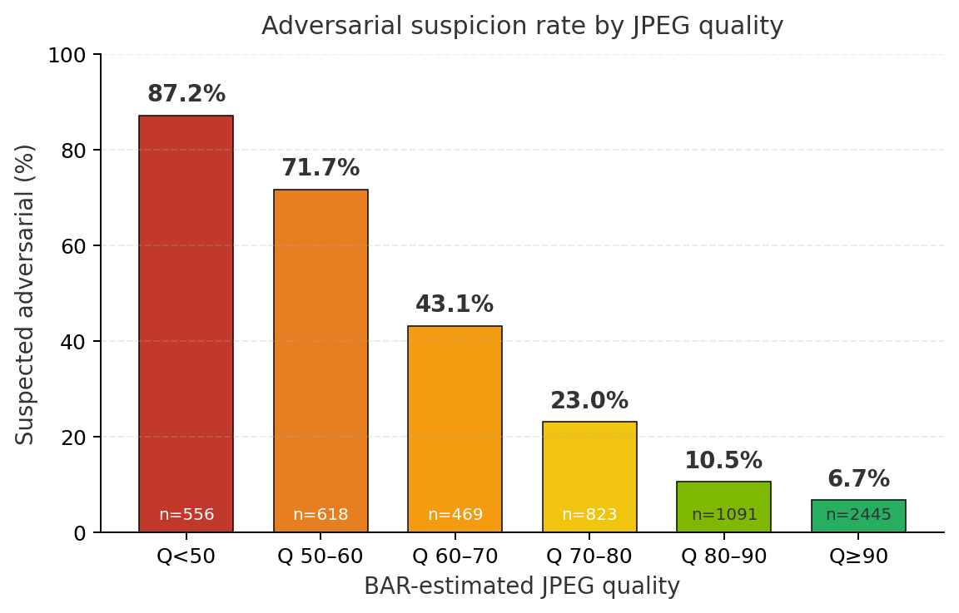
Sec 1 · Multi-Detector Response Instability
How it works
Why it failed
Input image
Center crop
Random crop
Face crop
8 detectors (SigLIP+DINOv2, AIDE ×3, DistilDIRE, NPR, Xception, Haywood)
24-dim Δp vector (8 × 3)
LR / RF
Adversarial or Clean
Data: CLEF competition test set + multi-source deepfakes with JPEG-only processing
Pilot RF AUROC: 0.98
GTG @ ImageCLEF 2026
10 / 14

Slide 11
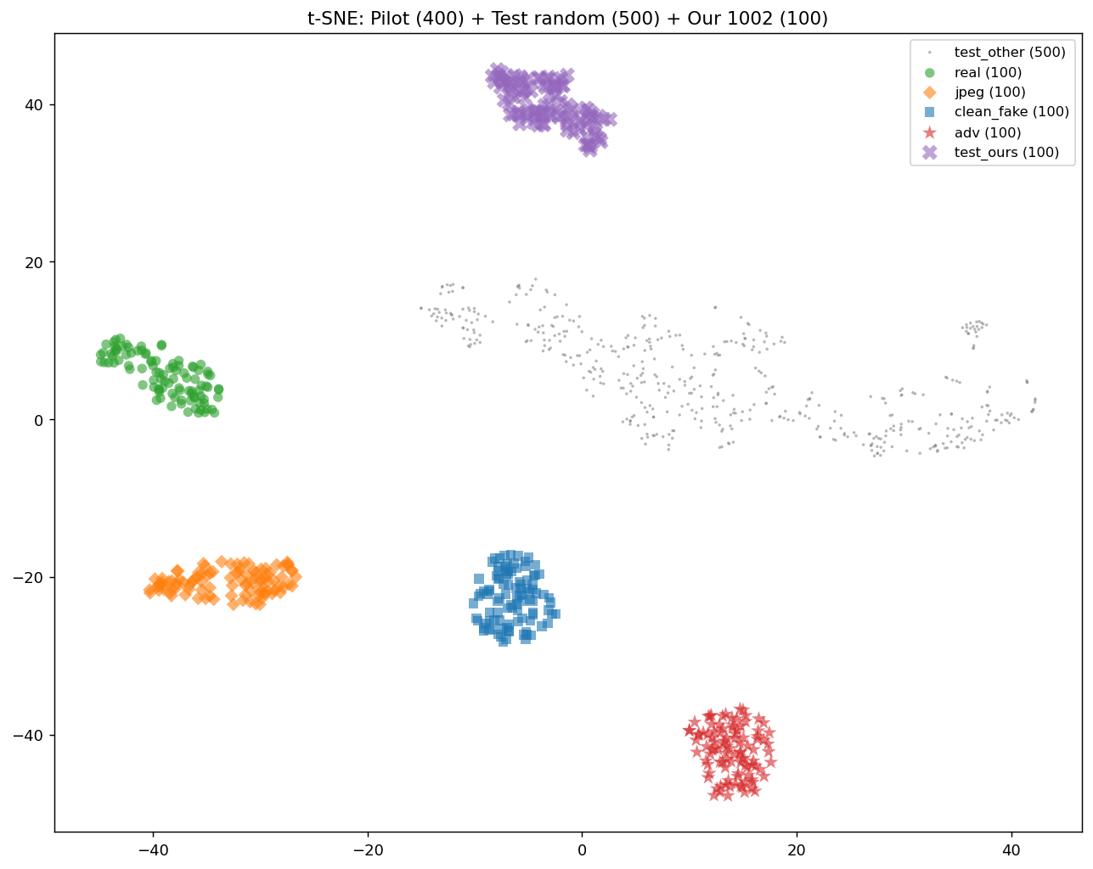
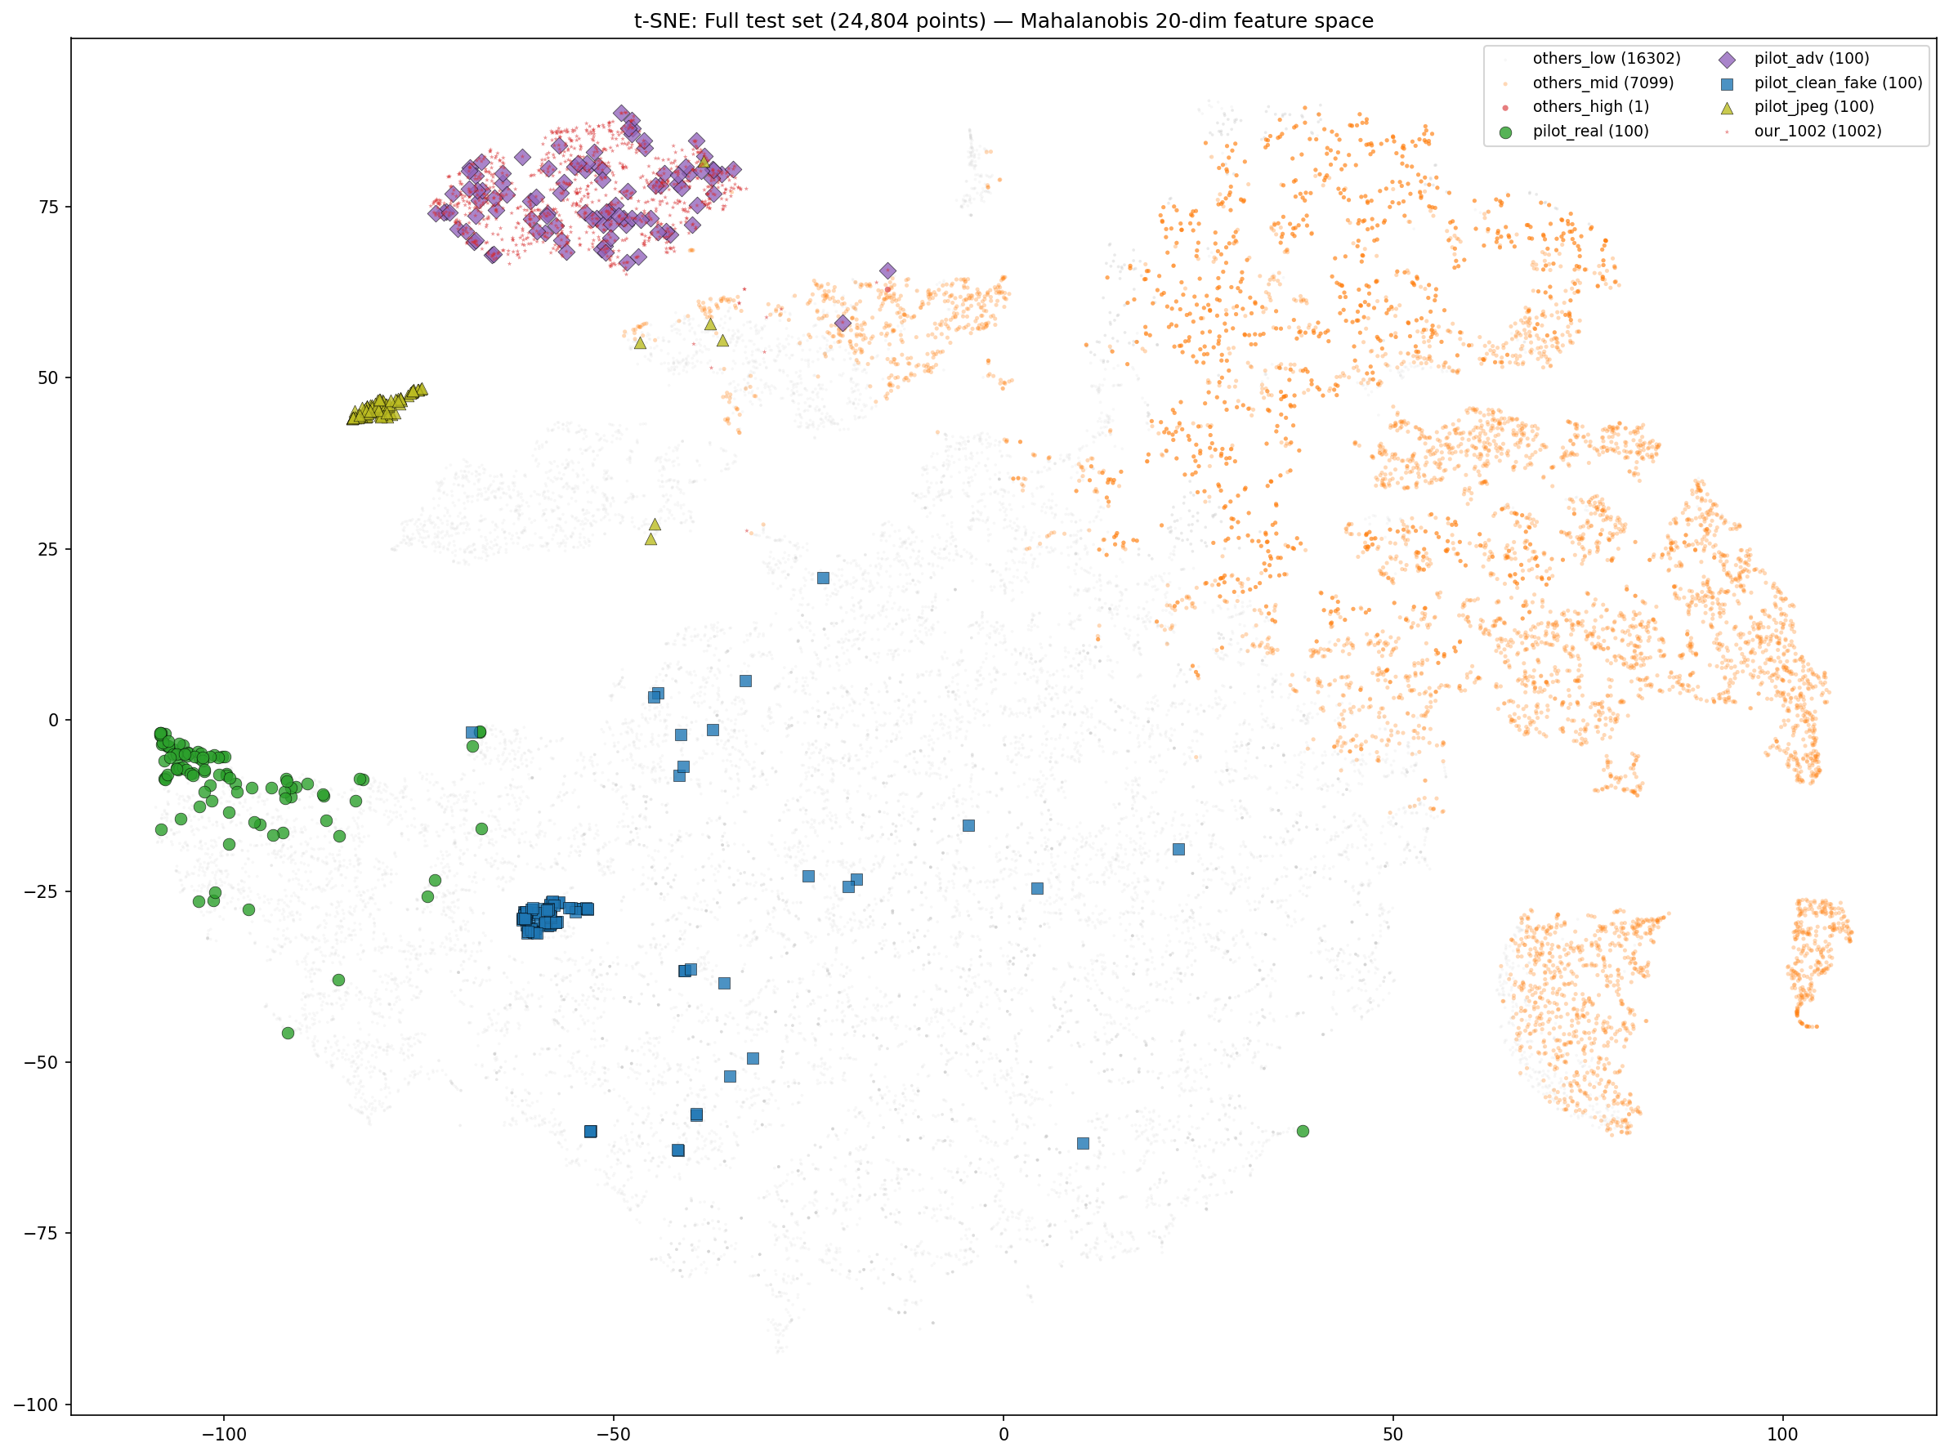
Sec 2 · Mahalanobis Feature-Space Outlier Detection
Pilot
Deployment
x6.75
Mean Mahalanobis distance grew 6.75 times larger
GTG @ ImageCLEF 2026
11 / 14

Slide 12
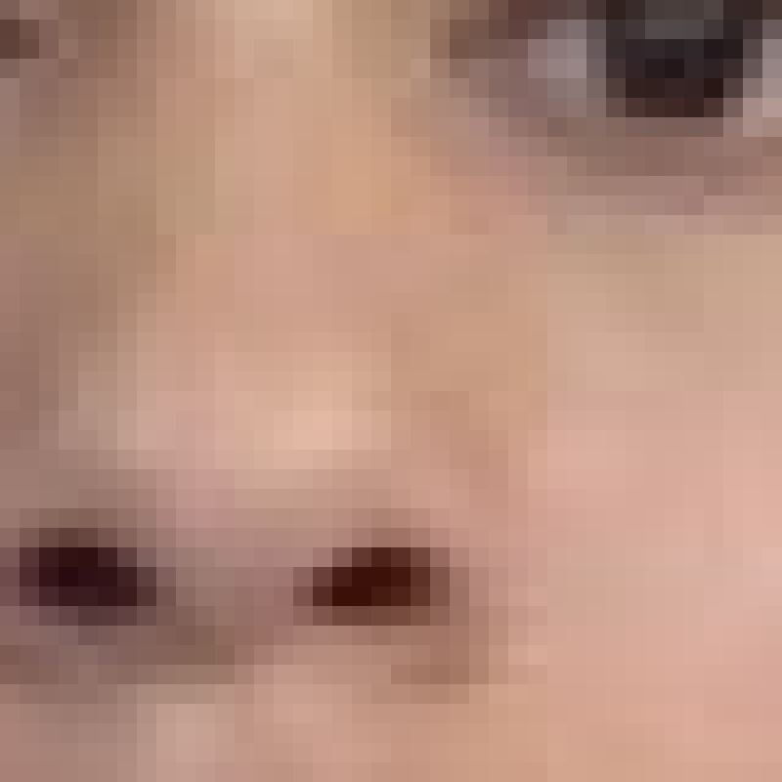
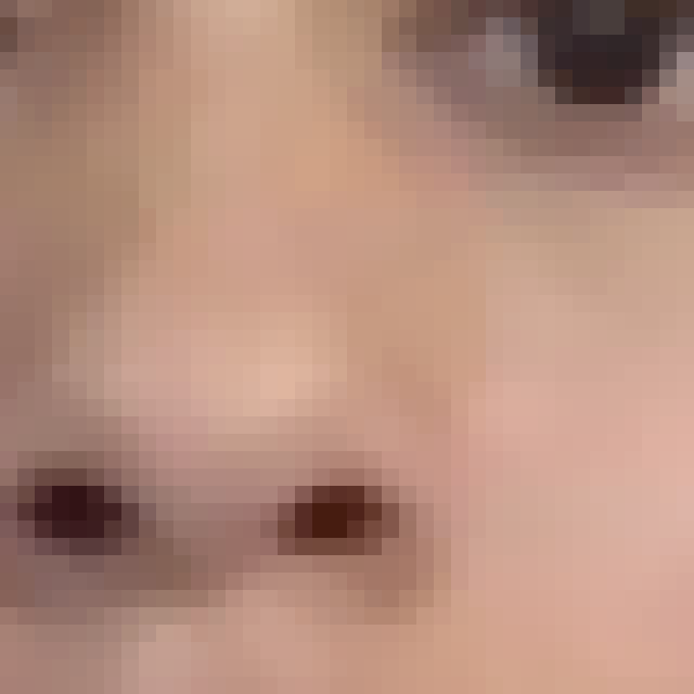
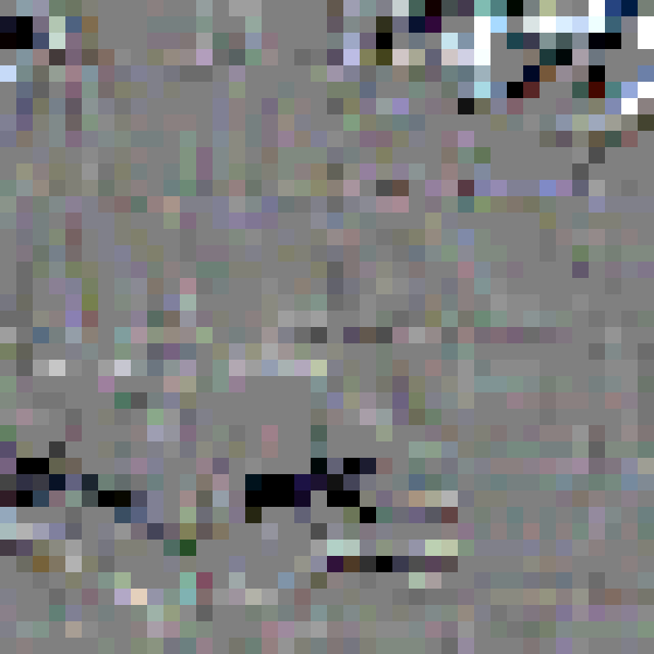

Sec 3 · Input-space purification
Adversarial noise is fragile under smoothing filters. Detector's output shift after purification is our signal.
Zoomed (original)
After median 3×3
Difference (×10)
Multi-filter LR weights
Adversarial image
(our submission)
Different filters destroy noise in different ways:
• Median – spatial outliers
• Bit-depth – amplitude quantization
• Gaussian – frequency smoothing
Combined via LR -> JPEG-Q80 VS adv AUROC 0.998
Feature | Coefficient
Δ_L19 (median 5×5) | −2.01
Δ_L19 (bit-depth 4-bit) | −1.96
Δ_L19 (Gaussian σ=1) | +1.41
Δ-logit (raw) | +1.21
GTG @ ImageCLEF 2026
12 / 14

Slide 13
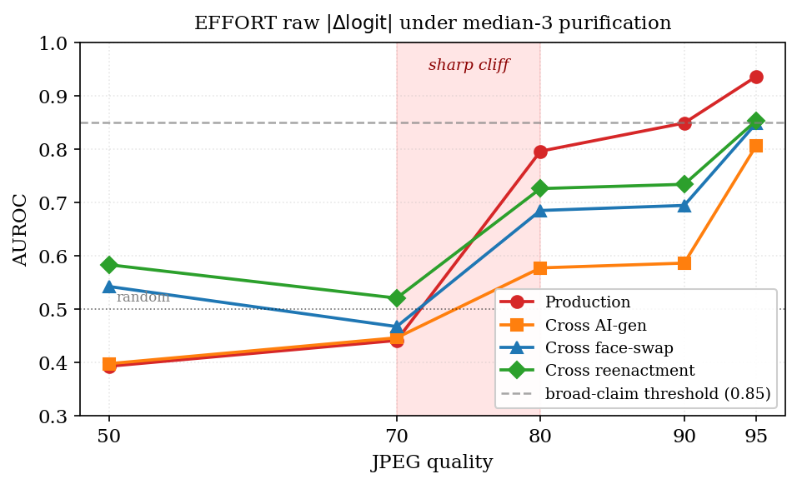
Sec 3 · Weight-free purification — EFFORT + median-3
6 detectors share the same CLIP ViT-L/14 backbone, differ only in fine-tuning method.
AUROC | 4 adversarial sources (each 1K) × 2 input degradations
JPEG quality sweep (EFFORT × median-3)
Detector | Raw input |  |  |  | JPEG Q80
 | Prod | AIg | FSw | Reen | Prod | AIg | FSw | Reen
LP | 0.91 | 0.78 | 0.77 | 0.78 | 0.71 | 0.62 | 0.56 | 0.58
LoRA | 0.53 | 0.66 | 0.64 | 0.61 | 0.44 | 0.56 | 0.53 | 0.51
FullFT | 0.61 | 0.75 | 0.76 | 0.78 | 0.44 | 0.62 | 0.64 | 0.69
GenD-CLIP | 0.65 | 0.65 | 0.66 | 0.65 | 0.65 | 0.60 | 0.63 | 0.62
ForAda | 0.41 | 0.50 | 0.66 | 0.55 | 0.44 | 0.48 | 0.65 | 0.54
EFFORT | 0.98 | 0.81 | 0.89 | 0.89 | 0.79 | 0.58 | 0.68 | 0.72
Prod = production | AIg = cross AI-gen | FSw = cross face-swap | Reen = cross reenactment
EFFORT + median-3: broadest cross-source generalization
GTG @ ImageCLEF 2026
13 / 14

Slide 14
Take-aways
Generation
score 0.4170
adversarial pipeline; 90% / 58% evasion
Detection
score 0.6986
specialist ensemble; calibration-limited
Input-space purification
AUROC 0.81 – 0.98
EFFORT + median-3; broadest cross-source
Thank you. Questions?
jhyeun1020@gmail.com
GTG @ ImageCLEF 2026
14 / 14

