Slide 1
Machine Learning : Basic
2015.00.00(월) - 2015.00.00(화)
박지현

Slide 3
=
상세 내용
What is Machine Learning
Easy Answer
Machine Learning은 컴퓨터에게 사람이 직접 명시적으로 Logic을 지시하지 않아도 데이터를 통해 컴퓨터가 ‘학습’을 하고 그것을 사용해 컴퓨터가 자동으로 문제를 해결하도록하는 것을 의미
Deep Answer
Machine Learning이 하는 일은 주어진 ‘데이터’ X=(x1,x2,x3,…,xn)와 각 데이터에 대응하는 실제 ‘현상’ Y=(y1,y2,…,yn)에 대한 ‘관계’ function f를 찾는 과정
정확한 함수 f를 찾기 위해 Machine Learning 알고리즘들은 데이터에 대한 가정을 하고, 그 가정에 따라 주어진 데이터를 ‘최대한 잘 설명할 수 있는’, 함수 f′을 찾는다. 이때 이런 f′을 Hypothesis라고 한다.

Slide 4
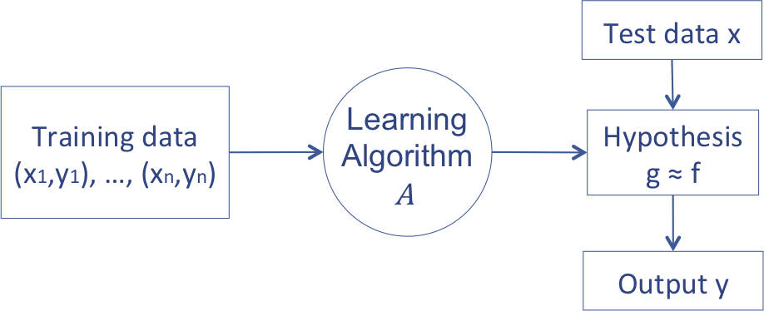
=
상세 내용
Basic Concept of Machine Learning
Set of possible instance(domain): X
Output: Y
Unknown target function f:X→Y
Set of hypothesis function space H⊂{h|h:X→Y}
Input
Training example {⟨xi,yi⟩}
Output
h∈H that best approximates target function f with some performance measure

Slide 5
=
상세 내용
Class of Machine Learning
Machine Learning
Supervised Learning
Unsupervised Learning
Reinforcement
learning
<Task Driven>
Regression
Classification
<Data Driven>
Clustering
<Algorithm learns to
react to an environment>

Slide 6
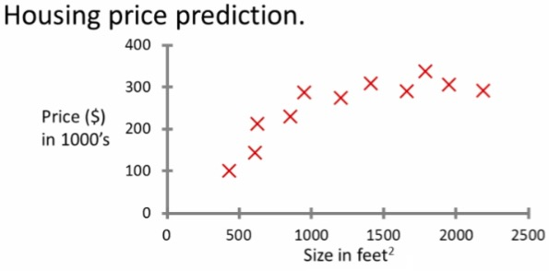
=
상세 내용
Supervised learning - introduction : regression problem
Example problem: "Given this data, a friend has a house 750 square feet - how much can they be expected to get?”
The idea is we can learn what makes the price a certain value from the training data
The algorithm should then produce more right answers based on new training data where we don't know the price already.

Slide 7
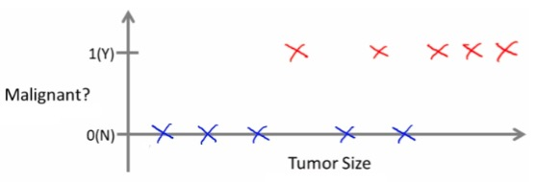

=
상세 내용
Supervised learning - classification
Example problem: " Can we definer breast cancer as malignant or benign based on tumor size?”
Classify data into one of two discrete classes - no in between, either malignant or not
In classification problems, can have a discrete number of possible values for the output

Slide 8
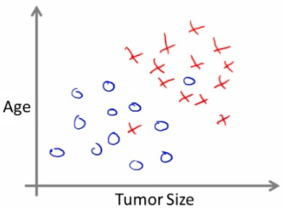
=
상세 내용
Supervised learning - classification
Use only one attribute (size)
In other problems may have multiple attributes
We may also, for example, know age and tumor size

Slide 9
=
상세 내용
Unsupervised learning - introduction : Clustering algorithm
In unsupervised learning, we get unlabeled data
Just told - here is a data set, can you structure it
One way of doing this would be to cluster data into to groups
This is a clustering algorithm
Example of clustering algorithm
Google news
Groups news stories into cohesive groups
Social network analysis
Customer data
Run algorithm to cluster individuals into types of people
Basically,
Can you automatically generate structure
Because we don't give it the answer, it's unsupervised learning

Slide 10
=
상세 내용
Linear Regression
Housing price data example used earlier
Supervised learning regression problem
What do we start with?
Training set (this is your data set)
Notation (used throughout the course)
m = number of training examples
x's = input variables / features
y's = output variable "target" variables
(x,y) - single training example
(xi, yj) - specific example (i_th training example)
i is an index to training set

Slide 11
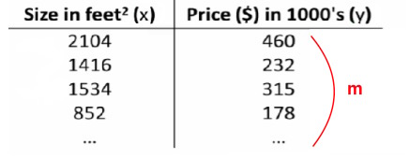
=
상세 내용
Linear Regression

Slide 12

=
상세 내용
Linear Regression
With our training set defined - how do we used it?
Take training set
Pass into a learning algorithm
Algorithm outputs a function (denoted h ) (h = hypothesis)
This function takes an input (e.g. size of new house)
Tries to output the estimated value of Y
How do we represent hypothesis h ?
Going to present h as; (θi are parameters)
So in summary
A hypothesis takes in some variable
Uses parameters determined by a learning system
Outputs a prediction based on that input

Slide 13
=
상세 내용
Linear regression - implementation (cost function)
A cost function lets us figure out how to fit the best straight line to our data
Think of hθ(x) as a "y imitator"
it tries to convert the x into y, and considering we already have y we can evaluate how well hθ(x) does this

Slide 14
=
상세 내용

Slide 15
=
상세 내용

Slide 16
=
상세 내용

Slide 17
=
상세 내용

Slide 18
=
상세 내용

Slide 19
=
상세 내용

Slide 20
=
상세 내용

Slide 21
=
상세 내용

Slide 22
=
상세 내용

Slide 23
=
상세 내용

Slide 24
=
상세 내용

Slide 25
=
상세 내용

Slide 26
=
상세 내용
참고
http://sanghyukchun.github.io

