Slide 1
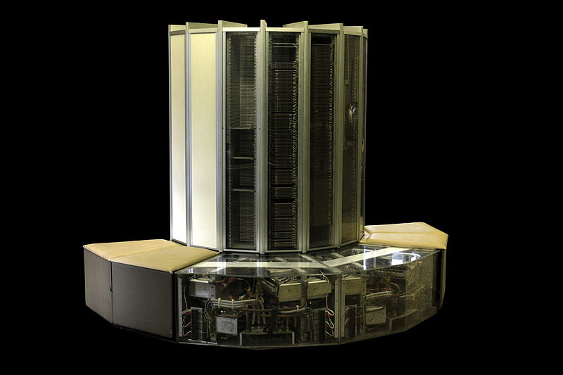
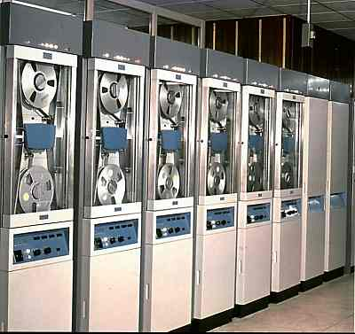
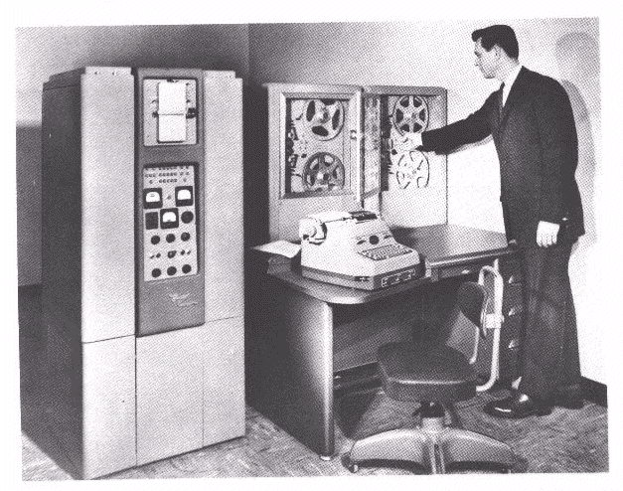
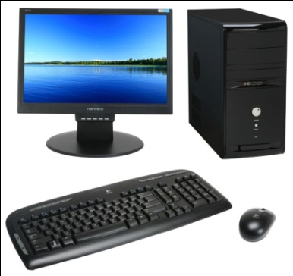
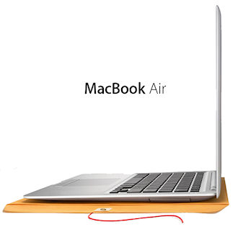
A Short Review on Computers
In this video, we will briefly review the history of computers.
CPE205/CSC205 Operating Systems

Slide 2
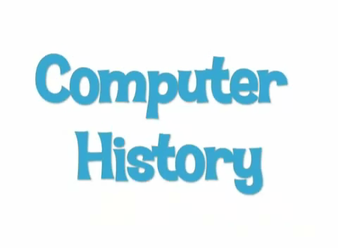
Computer History Museum
CPE205/CSC205 Operating Systems

Slide 3
Summary of Hardware Review
Computer hardware has evolved significantly over decades.
We are facing a number of challenging problems on using the hardware.
  How to write and execute user programs?
  How to make the computer system convenient to use?
  How to use the computer hardware in an efficient manner?
The solution is Operating System.
CPE205/CSC205 Operating Systems

Slide 4
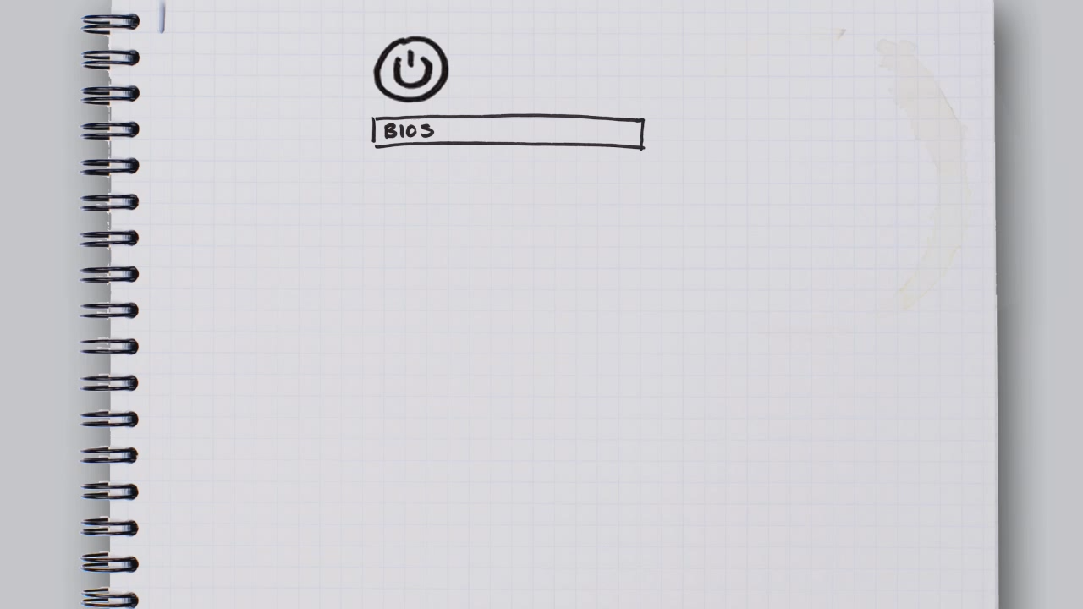
New Trend in OS
CPE205/CSC205 Operating Systems

Slide 5
Future Operating Systems
Operating systems are not limited to Windows/Linux/MacOS etc.
Operating system development and research never stops.
  Hardware evolvement.
  User requirements.
CPE205/CSC205 Operating Systems

Slide 6

Virtualization
CPE205/CSC205 Operating Systems

Slide 7
Virtualization
Virtualization is a very hot research topic in operating system.
Virtualization have various advantages:
  Make IT easier.
  Enables cloud computing
CPE205/CSC205 Operating Systems

Slide 8
Notes
Public holidays in the coming week
  August 29 (new!)
  August 30
Teaching feedbacks
  Lecture and tutorial
  Your comments are appreciated.
CPE205/CSC205 Operating Systems

