Slide 1
CE/CZ2005 and CPE205/CSC205: Operating Systems – Lab Experiment 1
Contact: Bingsheng He (bshe@ntu.edu.sg)

Slide 2
Outline
Overview of NachOS
Thread Management and Scheduling in NachOS
Discussion of Experiment 1

Slide 3
Overview of NachOS

Slide 4
NachOS – Background
Real operating systems are very complex
  Difficult to see how OS concepts are realized
  Too time intensive to be part of an OS course
  Therefore not so suitable for educational purposes
NachOS is an educational operating system
  Developed at UC Berkeley in C++
  Freely available: http://www.cs.washington.edu/homes/tom/nachos
  Idea: use the simplest possible implementation for each subsystem
  Simple but complete
Advantages of NachOS
  Easier to read and understand the code
  Easier to understand OS concepts
  Easier to make changes and experiment
  “Hands on” learning

Slide 5
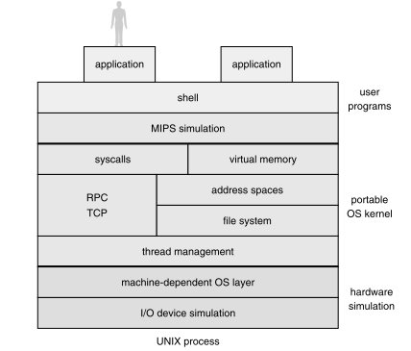
NachOS – Architecture
Approach in NachOS
  Applications, kernel, and hardware simulator run in one UNIX process
  NachOS uses a hardware simulation (virtual machine)
Advantages:
System behavior is repeatable
Easier to debug
Shorter edit-compile-debug cycles

Slide 6
NachOS – Architecture
User Application
NachOS Process
Host Operating System (e.g., Linux)
Hardware

Slide 7
NachOS – How does it work?
Start NachOS binary
(./nachos)
Interrupt handling,
scheduler, file system, networking, etc...
NachOS kernel
main() {
Initialize()
Call Testproc()
}
Machine
while(1) {
Execute
}
Shutdown
NachOS
User
Application
(.noff file)
Run()
Instructions
print
Stats()
Halt()
Return to host
OS shell

Slide 8
NachOS – How does it work?
NachOS kernel
Exception
Handler()
Machine
while(1) {}
Raise
Exception()
User
Application
(.noff file)
syscall()
trap

Slide 9
Thread Management and Scheduling in NachOS

Slide 10
NachOS – Thread Management
Thread management is explicit
  It is possible to trace statement for statement
  See and understand what happens during a context switch
Two things are important to understand how NachOS performs thread management
  Scheduler
  Threads

Slide 11
NachOS – Scheduler
Maintains a list of threads that are ready to run: ready list (ready queue)
The scheduler is invoked whenever the current thread gives up the CPU (non-preemptive)
Simple scheduling policy is used
  Assume equal priority for all threads
  Select threads in FCFS fashion
  Append at the end and remove from the front
The scheduler code can be found in threads/scheduler.cc
  ReadyToRun()
  FindNextToRun()
  Run()

Slide 12
NachOS – Scheduler
ReadyToRun(thread)
  Makes a thread ready to run (set state to READY)
  Adds it to the ready list
  Does not start the thread yet!
FindNextToRun() : thread
  Simply returns the thread at the front of the ready list
Run(thread)
  Switches from one thread to another:
    Check whether the current thread overflowed its stack
    Change the state of the new thread to RUNNING
    Perform the actual context switch (by calling Switch())
    Terminate previous thread (if applicable)

Slide 13
NachOS –Thread
A thread can be in either of these states
  READY: eligible to run
  RUNNING: only one thread can be in this state
  BLOCKED: waiting for some external event
  JUST_CREATED: temporary state used during creation
Implementation can be found in threads/thread.cc
  Fork()
  Yield()
  Sleep()
  Finish()
You will use them in Experiment 2

Slide 14
NachOS –Thread
Fork(function, arg, flag)
  Turns a thread into one that can be executed
  Calls readyToRun()
Yield()
  Finds the next thread to run using findNextToRun()
  If a another thread has been found
    Call readyToRun() for the old thread
    Run the new thread using Run()
Sleep()
  Set status to BLOCKED
  Find another thread to run using findNextToRun()
  If a another thread has been found
    Run the new thread using Run()
Finish()
  Called at the end of execution
  Marks a thread for termination

Slide 15
Discussion of Experiment 1

Slide 16
Experiment 1 – Overview
Objective
  Understand how context switches work
  Trace the execution flow of a thread
Tasks
  Make a complete copy of NachOS
  Build it & Run it
  Analyze the output and the source code
  Figure out what is happening and why

Slide 17
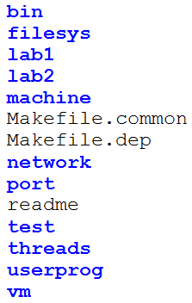
Directory Structure
For generating NachOS format files, DO NOT CHANGE!
NachOS kernel related to file system, DO NOT CHANGE!
Experiment 1, no coding is required.
Experiment 2, process synchronization.
MIPS H/W simulation, DO NOT CHANGE unless asked.
For compilation of NachOS,
DO NOT CHANGE!
NachOS kernel related to network, DO NOT CHANGE!
Additional experiment for students registered with CPE205/CSC205
Short description of OS labs and assessments
NachOS format files for testing virtual memory, DO NOT CHANGE!
NachOS kernel related to thread management, DO NOT CHANGE!
NachOS kernel related to running user applications, DO NOT CHANGE!
Experiment 3, coding virtual memory (TLB, page replacement)

Slide 18
Experiment 1 – User program
User program for Experiment 1 can be found in lab1/threadtest.cc
  SimpleThread()
  ThreadTest() ← this is the test procedure called from within main()

Slide 19
Experiment 1 – ThreadTest()
void ThreadTest() {
DEBUG('t', "Entering SimpleTest");
Thread *t1 = new Thread("child1");
t1->Fork(SimpleThread, 1, 0);
Thread *t2 = new Thread("child2");
t2->Fork(SimpleThread, 2, 0);
SimpleThread(0);
}
Thread constructor does only minimal initialization
Turns a thread into one that can be scheduled and executed by the CPU
After starting two new threads execute the SimpleThread function
Fork(function, arg, join)
  “function”: the procedure to be executed concurrently
    Here: SimpleThread
  “arg”: a single parameter which is passed to the procedure
    Here: the id of the thread (0,1,2)
  “join”: a flag which indicates whether the thread can be joined
    Not important for the lab

Slide 20
Experiment 1 – SimpleThread()
Remember the only argument passed by fork? This is it. Here:
‘which’ tells you which thread
void SimpleThread(_int which) {
int num;
for (num = 0; num < 3; num++) {
printf("*** thread %d looped %d times\n", (int) which, num);
currentThread->Yield();
}
}
Causes the current thread to give up the CPU
Each thread is executing this function
The function does nothing but prints a status line three times
  Check your program output

Slide 21
Experiment 1 – Task description
8.6 Fill in the scheduling table whenever
  the ready list is changed, or
  the current thread is changed, or
  a new message is printed in method SimpleTest()
8.7 List all context switches
  For each switch: indicate from/to thread
8.10 Describe what and how a CPU scheduler is implemented in NachOS
  Does the output reflect this behavior? Justify your answer
ready list | current thread | printf message
Empty | main
child1 | main
child1, child2 | main
child2, main | child1 | thread 0 looped 0 times

Slide 22
Experiment 1 – Summary
Objective:
  Understand how thread management and scheduling works
Assessment:
  Oral assessment in Lab 3
Where:
  Multimedia Lab 1 (N4-01a-02)
Documents:
  Can be found in edveNTUre

Slide 23
Acknowledgement
The slides are revised from the previous versions created by Dr. Heiko Aydt.

