Slide 1
CE2005/CZ2005
Operating Systems
2016/2017 First Semester
Asst/Prof Arvind Easwaran
Prof CAI Wentong
{arvinde, aswtcai}@ntu.edu.sg
CE2005/CZ2005 and CPE205/CSC205 Operating Systems
Notes:
Good morning, everyone. Welcome to the first lecture of operating systems. I am Bingsheng He, from SCE. I joined SCE in August 2010. Before joining NTU, I worked for Microsoft Research. As you all know, Microsoft makes Windows, one of the most popular operating systems nowadays. In this course, you may also learn the other Oses such as linux and unix.
We have two batches of students under old curriculum and the new BRC curriculum. Due to the AU difference, the old batch on CPE/CSC205 will have additional materials.
The lecture is divided into two parts. The first part is given by me; the second part will be given by Prof. Sun Chengzheng. The best way of contacting us is via email. You can get the detailed contact information about Prof Cai and about me on the school web site.

Slide 2
Course Components
Lectures:12 weeks, 2 hours/week
  +1 week for revision
Tutorials: 11 tutorials
  +1 buffer week
Labs: 4 lab sessions, 2 hours/session
Assessment: Exam (70%) + Coursework (30%)
Coursework Assessment
  Lab report(s)
  Oral assessment
CE2005/CZ2005 and CPE205/CSC205 Operating Systems
Notes:
The operating system course is given almost every semester. These are the basic components of this course. We will have lectures, tutorials, and labs. There are 12 weeks in the lectures in total; each week we will have two hours. We have one additional week for revision.
There are 11 tutorials, plus one buffer week.
There are four lab sessions, 2 hours each. In the lab, we will exercise the key concepts in the lecture using an instructional operating system, called nachos.
The assessment includes two parts: final exam and coursework. The course work includes lab reports and one oral assessment. Students under old curriculum will submit two lab reports and students under new BRC curriculum will submit only one lab report.
I will give the details of each of these components in the coming slides.

Slide 3
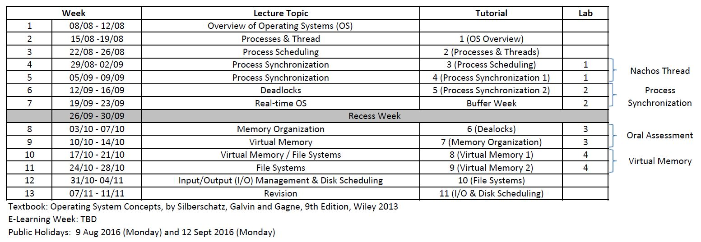
Schedule
Tutorial starts from Week 2
Lab starts from Week 4
CE2005/CZ2005 and CPE205/CSC205 Operating Systems
Notes:
This is the overall schedule for the course. I will be responsible for the first half, from Introduction to Deadlocks. We will cover the main concepts in operating system: computer system structure, OS structures; next, we will move to the concepts of process, thread and scheduling; then we will cover process synchronization and deadlocks. Another half will be given by Prof. Cai. In that part, we will cover memory management, virtual memory, file systems, I/O and protection and security.
E-learning will be in week 7. btw, if you are puzzled by some of the concepts or terms, just keep them in mind, and we will describe them in details in the future lectures.
Tutorials start at week 2. The content of the tutorial basically follows the lecture in the previous week.
The lab starts at week 4 or week 5. Please pay attention to the lab schedule.

Slide 4
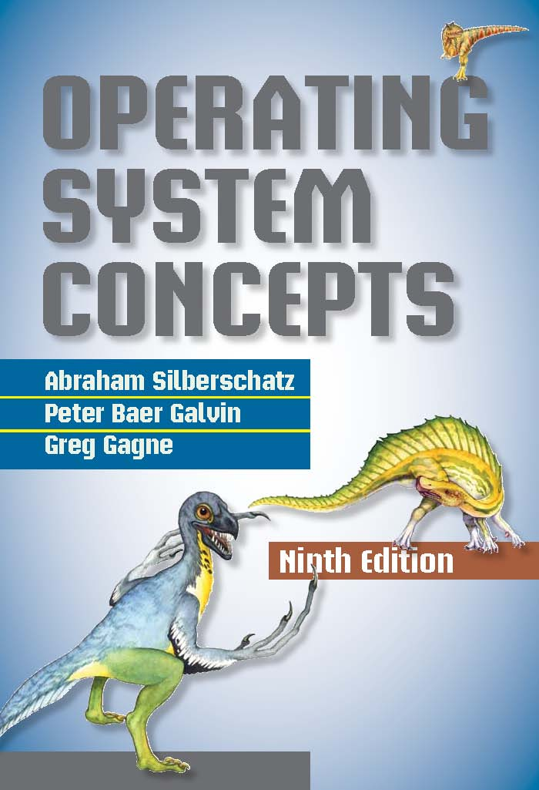
Lectures
Textbook – The Dinosaur Book
Textbook: Operating System Concepts,
by Silberschatz, Galvin and Gagne
9th Edition, Wiley 2013
Textbook vs. Slides
Operating Systems
Notes:
We will use this text book, operating system concepts, by Silberchatz. It is currently at its ninth edition. The book is also called the dinosaur book.
One question is whether you need to buy a textbook. i encourage you to buy one. This is one of the most classic textbooks in computer science and engineering. the text book is new and includes many latest information and references. this is good for your future professional career. and you can refer to the book, even after this course. Therefore, I encourage you to buy the textbook, if you can afford it.
Another question is whether the lecture slides have sufficient details for final exams. The answer is yes. the slides are carefully prepared to balance the details and the key points. Some slides may have many texts.
The book has a supporting web site, http://os-book.com/. It includes the solution to the questions in the book. You are encouraged to read more beyond the slides and the text book.

Slide 5
Tutorials
Starts from Week 2
Attendance is important
All tutorial questions are available in NTULearn
Necessary to attempt questions before tutorial
Some questions are from the previous exams.
Feedback channel is always open
CE2005/CZ2005 and CPE205/CSC205 Operating Systems
Notes:
All tutorial questions are available in NTULearn.
You are encouraged to attend the tutorial. Tutors will give explanations to the questions in details. I personally will give four tutorial sessions. From the feedback of the previous year, OS is a difficult course. Attending the tutorial can help you to understand the key concepts in this course.
Also, it will be good if you attempt questions before the tutorial. Also, some questions are from the previous exams.
Finally, you are always welcome to contact us via email, or with meeting by appointment. Actually, the comments obtained from the last semester help me to improve a lot.

Slide 6
Labs
Starts from Week 4
  Using Software Lab 1 (N4-01a-02), remote access available
3 lab experiments, 1 per lab session
  Nachos thread, process synchronization, virtual memory
  Briefing Videos will be made available for each lab experiment
Lab Session 3 is for oral assessment
Lab Report needs to be submitted for experiment 3 only
  Requirements for lab report can be found in lab manuals
  Lab report is due one week after the last lab session
Lab manuals and other supplement documents are available in NTULearn
For each experiment, watch the briefing video and read the manual first.
CE2005/CZ2005 and CPE205/CSC205 Operating Systems
Notes:
Based on instructional OS – Nachos
Written by Tom Anderson and his students at UC Berkeley in C++, running on Unix/Linux
http://www.cs.washington.edu/homes/tom/nachos/
The lab starts at week 4. we will use Software Lab 1B. The remote accesses are available in the non-office hour. We have put a manual on how to make connection to the servers in the NTULearn for reference.
The labs are based on Nachos. It is written by Tom Anderson in UCB (now in UW) and his students.
You may ask, why not choose windows or linux?
We choose Nachos for its simplicity. It is a running example for us to understand the basic features in a modern operating system. It allows us to modify and debug some key components in the operating system. Nachos contains around 2500 lines of source code.
We will do the programming on thread, process synchronization, virtual memory in the lab. A briefing will be given for each lab experiment. Attendance of the lab will be recorded. So do attend.
Two things you should pay attention to. First, lab session 3 is for oral assessment. The questions are about the first and the second lab sessions. Second, the lab report is required to submit for experiment 3 only. It will be due one weeks after the last lab session. Please keep in mind that you may have different due days, according to the date for your last lab session.
At each experiment, watch the briefing video and manual first. It contains very important information and instructions about the lab.
Finally, all lab manuals and supplementN4-01a-02 documents are available in NTULearn. Please read them carefully.

Slide 7
Learning Outcomes
Identify the functions and services provided by an operating system.
Understand the basic concepts and mechanisms of operating system design and implementations.
Explain the interactions between different components of an operating system.
CPE205/CSC205 Operating Systems
Notes:
After taking this course, you should be able to achieve the following three learning outcomes.
Identify the functions and services provided by an operating system. We will talk about them one by one in our lectures.
Understand the basic concepts and mechanisms of operating system design and implementations. After this course, you are able to explain the key designs in an existing OS.
Explain the interactions between different components of an operating system. When I was in Microsoft, I used to have an interview question on OS: can you explain the details on what happens in computing systems from the moment that you key in a character till the moment the character is displayed on the screen? I hope that after this course, you should be able to give me the answer. If you cannot answer this question well after this course, let me know ☺

