Slide 1
Part 1: Introduction
What is an operating system?
Mainframe Systems
Desktop Systems
Multiprocessor Systems
Real-Time Systems
Handheld Systems
Computer System Structures
Operating System Services
Operating Systems
Notes:
After introducing the outline of the entire course, we now start the first chapter. In this chapter, we will introduce “what is an operating system” and some representative types of operating system in the computer history, from mainframe systems in the old days to Multiprocessor systems in the recent years. We will also discuss some special-purpose systems such as real-time systems, and handheld systems. Finally, we will look at computer system structures.
we will introduce lots of basic concepts in operating systems. if you are puzzled, fine, you can keep them in mind, until we describe them carefully in the future lectures.
Also, the comments in the comment box are more details for you. I usually key in more information when I prepare the lecture. If the contents are beyond the slide, they are *not* examinable.

Slide 2
What is an Operating System?
A program that acts as an intermediary between a user and the computer hardware.
Two major goals: user convenience and efficiency.
  Make the computer system convenient to use.
  Use the computer hardware in an efficient manner.
Operating Systems
Notes:
So, what is the definition of an operating system? It is defined to be a program that acts as an intermediary between a user and the computer hardware.
In the definition, we need to pay attention to two points. First, operating system is a program. That means, operating system is a piece of software. Not hardware. Second, operating system is an intermediate software between user and computer hardware. That means, when users want to run their jobs, their jobs need to go through operating system, and then executed on hardware. On the other hand, when computer hardware needs to return the results to the users, the results are first transferred to the operating system, and then back to the users.
The design of operating systems have two goals: user convenience and efficiency.
Convenience: From the user’s perspective, the operating system execute user programs and make solving user problems easier, and also makes the computer easier to use.
Efficiency: from the hardware’s perspective, the operating system manages the computer hardware in an efficient manner.
These two goals are very important to understand the design decisions in OS.
Usually, OS design needs to consider both goals. These two goals sometimes can be conflict. For example, GUI sacrifices efficiency for user convenience.

Slide 3
Computer System Components
1. Hardware – provides basic computing resources (CPU, memory, I/O devices).
2. Operating system – controls and coordinates the use of the hardware among the various application programs for the various users.
3. Application programs – define the ways in which the system resources are used to solve the computing problems of the users (compilers, database systems, video games, business programs).
4. Users (people, machines, other computers).
Operating Systems
Notes:
Let’s look at the position of an operating system in a computer system. A computer system can be roughly divided into four components: the hardware, the operating system, the application programs and the users.
The hardware provides the basic computing resources such as CPU, memory, and I/O devices. Computers can have quite different hardware, as we will see in the computer history.
The application programs define the ways how the system resources are used to solve the problems. Example application programs include word processors, spreadsheets, video games etc.
The users can be people, or machines, or other computers in a networked system.
Among hardware, application programs, users, there is a gap: how to control the resource usage among different application programs for different users. This is the role of the operating system. The operating system controls and coordinates the use of the hardware among the various application programs for different users.

Slide 4

Abstract View of System Components
Operating Systems
Notes:
In this figure, we have the illustration of an abstract view of system components. From bottom up, we have hardware, operating system, application programs, and users. The operating system is in the middle layer of the abstract view.

Slide 5
Operating System Definitions
Resource allocator – manages and allocates resources.
Control program – controls the execution of user programs and operations of I/O devices.
Kernel – the one program running at all times (all else being application programs).
Operating Systems
Notes:
Based on the abstract view, we can see what an operating system does.
The operating system is a resource allocator. It allocates resources to different application programs.
The operating system is a control program. It controls the execution of user programs and operations on devices.
We also call operating system Kernel. Also, it is the one program that is running at all times, and are always ready to accept new commands. In comparison, all other programs are referred as programs.

Slide 6
Mainframe Systems
Batch systems
Multiprogrammed systems
Time-sharing systems
Operating Systems
Notes:
Now, we give some examples on different types of operating systems. Mainframe systems were the first operating systems used to solve many commercial and scientific problems. There are three types of mainframe systems: batch, multiprogrammed, time-sharing. We will introduce them one by one.

Slide 7
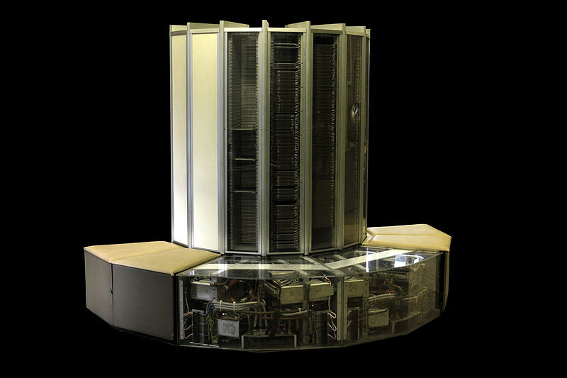
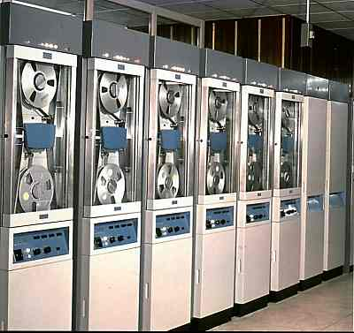
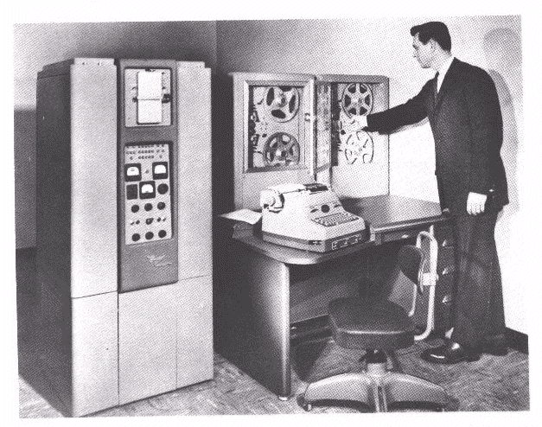
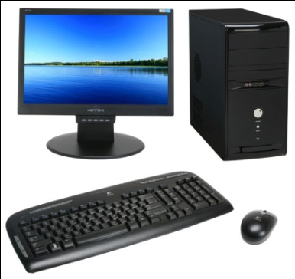
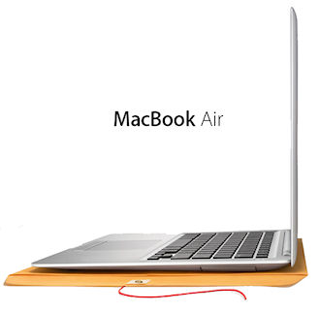
A Short Review on Computers
In this video, we will briefly review the history of computers.
Operating Systems
Notes:
We will have a short review on computers with a video.

Slide 8
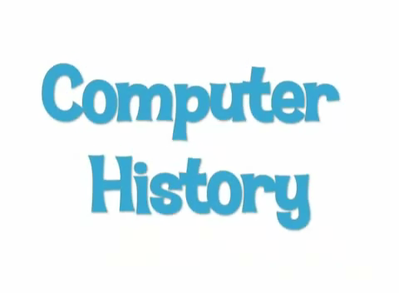
Computer History Museum
Source:
http://www.youtube.com/watch?v=7e6EAAY-WfA
Operating Systems
Notes:
In this video, we can have a brief on the computer history.

Slide 9

Simple Batch Systems
Reduce setup time by batching similar jobs.
Automatic job sequencing – automatically transfers control from one job to another.
Simple memory layout
Operating Systems
Notes:
In the first generation of mainframe systems, each job has a setup cost, for example, loading the data into the main memory and figure out the memory layout. To reduce the setup cost, the operator often batch the jobs with similar needs. We set up once and runs multiple jobs in a batch.
The batch system needs to figure out which job to run in the batch. It has a functionality called automatic job sequencing, order the jobs from one job to another automatically.
Finally, the batch system initially has very simple memory layout (or the data layout in the main memory). Only allow one user program in the main memory. In this figure, the memory is divided into two parts: operating system and the one for user program, only one user program.
What is the problem for simple batch system? A job usually has I/O and CPU computation. Imagine the job is waiting for I/O. The major problem of running a job at one time is efficiency. When a job is waiting for I/O, the CPU has nothing to do, and become idle.

Slide 10

Multiprogrammed Systems
Several jobs are kept in main memory at the same time, and the CPU is multiplexed among them.
Operating Systems
Notes:
The cpu is multiplexed among the jobs. When a job is waiting for I/O, we will give the CPU to other jobs. For example, we can allow job 1 to run some time and then switch to job 2. Job 2 takes the CPU for some time. later Job 3 and so on.
The memory layout is different from the simple batch system. As you can see, the program data of multiple jobs are stored in the main memory at the same time, instead of a single job in simple batch system.
One question: why are multiprogrammed systems more advanced than simple batch systems? Efficiency. In multiprogrammed systems, the CPU utilization is higher.

Slide 11
OS Features Needed for Multiprogramming
Memory management – to allocate memory to several jobs.
CPU scheduling –to choose among several jobs ready to run.
Allocation of devices.
Operating Systems
Notes:
In order to support multiprogramming, what features should the operating system provide? The key point is on scheduling the usage of shared resources: memory, CPU and devices.
First, memory management. The operating system should have the capability of allocating memory to multiple jobs. We need to allocate the memory for new jobs, and deallocate the memory when a job ends.
The second feature is to decide which job to run. There are many criteria for scheduling. We discuss the topic of CPU scheduling in the later lecture.
Third, the operating system should know how to allocate the devices to jobs, since the devices are now shared by multiple jobs.

Slide 12
Time-Sharing Systems
The CPU is multiplexed among several jobs that are in memory.
A job is swapped in and out of memory to the disk.
On-line communication between the user and the system is provided; when the operating system finishes the execution of one command, it seeks the next command from the user.
Operating Systems
Notes:
Time sharing systems (or multi-tasking systems) are a logical extension from multi-programmed system. in a time sharing system, the CPU executes multiple jobs by switching from one to another. The switching is so frequent that the users can interact with the system while the other jobs are running.
There are two unique features that are beyond multiprogrammed systems of earlier generations:
In order to support a larger number of jobs, the time sharing systems can swap the job in and out of memory to the disk. This is called the functionality of virtual memory. We will discuss the concept of virtual memory in details in the future lectures.
Another feature that are stronger than the batch system is user interaction. The time sharing system allows users to input the command, and get the command running in an online manner. The system needs to be interactive, since the user submits the command and waits for the results.
**Time sharing is a kind of multi-programmed systems. There are many forms of multi-programmed systems. Nowadays, almost every OS that you see is a multiprogramming system.
There is no such a strict definition for time sharing systems. However, in my course, we consider time sharing systems are a natural extension to initial multiprogramming systems, with focus on virtual memory support and user experience.

Slide 13
Desktop Systems
Personal computers – computer system dedicated to a single user.
I/O devices – keyboards, mice, display screens, small printers.
User convenience and responsiveness.
May run several different types of operating systems (Windows, MacOS, UNIX, Linux)
Operating Systems
Notes:
The batch and time sharing systems are already far away from us. We are already familiar with Windows, MacOS, Unix, Linux etc. Every day, we are using them. I want to highlight two points here:
First, each PC has many I/O devices: keyboards, mouse, small printer etc. this is different from the main frame systems. What is the impact? Hardware driver can be a huge part in the code base.
Second, user convenience and responsiveness is on the top goal. Remember that we have two goals for operating system: efficiency and user convenience. Here, desktop systems favors user convenience, for example, desktop systems can have very fancy GUI. Main frame systems (like multiprogrammed systems) have better efficiency.

Slide 14

A Dual-Core CPU Design
Operating Systems
Notes:
First of all, let’s have a quick review on our last lecture.
In the last lecture, we have learnt the basic concept of operating system and the computer history. Operating system is a program as the intermediary between users and computer hardware. Operating system is software, not hardware. We have briefly introduce the history of computer systems. from mainframe systems: the simple batch system, which can handle a single job at a time.
Later, the system has the capability of running multiple jobs. Multiproramming is to keep several jobs in the main memory at the same time. We have also talked about two kinds of multiprogramming systems: time sharing systems and desktop systems.
Operating system development can be also driven by computer hardware. Recently, we have witnessed that the CPUs can have multiple cores. For example, in this figure, we have a CPU with two cores. The two cores share the main memory. Each core has its local registers, and caches.
As the cpu has multiple cores, how the operating system is adapted to the multi-core design?

Slide 15
Multiprocessor Systems
Multiprocessor systems with more than one CPU, or CPU with multiple cores.
Tightly coupled system – communication usually takes place through the shared memory.
Advantages of parallel system:
  Increased system throughput
  Economical in sharing memory and I/O devices (as compared to multiple single systems)
  Increased reliability
Operating Systems
Notes:
The multiprocessor systems target at more than one CPU, or CPU with multiple cores.
Multiprocessor systems are also known as tightly coupled system: communication are performed on shared memory. In comparison, loosely coupled systems are OS running on distributed computers. You will learn them in other courses at higher level.
Multi-programming: the system can run multiple programs.
Multi-processing: the system can run on multiple CPUs or CPU with multiple cores.
There are multiple advantages of using the parallel systems:
First, of course, it can increase the system throughput.
The second one is economical. Memory and I/O components are shared.
finally, the system is more reliable. The failure of one processor will not halt the entire system.

Slide 16



Real-Time Operating Systems
Used as a control device in a dedicated application such as controlling scientific experiments, medical imaging systems, industrial control systems, and some display systems.
Well-defined fixed-time constraints.
Some popular systems: LynxOS, RTLinux, VxWorks etc.
Operating Systems
Notes:
In the next two slides, we will briefly introduce two special purpose systems, real-time systems and handheld systems.
The real-time systems have well defined fixed-time constraints on the job execution. Operations must be finished within the defined time constraints, otherwise the system will fail. The real time systems are widely used as a control device in special applications. For example, some scientific experiments, medical imaging, industrial control and display systems. Can you think of any example in your daily life?
One example is the GPS system in the car. The GPS system should give the car location very fast, otherwise, the position is outdated, since the car is moving.
Some popular Oses are given here. you may not be familiar with those names. The e-learning is about real-time OS. That can help you to know more about those operating systems.

Slide 17
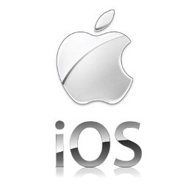

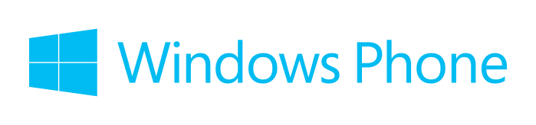
Handheld Systems
Mobile phones, Pads
Issues:
  Limited memory
  Slow processors
  Small display screens.
Popular systems: iOS, Android, Windows Phone
CPE205/CSC205 Operating Systems
Notes:
The handheld systems are also called embedded system. They are widely used in mobile phones and pads. The popular handheld systems include iOS, Android and windows Phone. Compared with the desktop operating systems, the handheld devices have some special issues:
The memory. Unlike the PC with several GB of main memory, the handheld devices have limited memory.
The second issue is that the processor speed is slow.
Finally, the display screens are small. The system needs to do some clipping in order to fit the content to the display.

Slide 18
Computer System Structures
Computer System Operation
Storage Hierarchy
Hardware Protection
Operating Systems
Notes:
Now, we will start to introduce the computer system structures and operating system services. In computer system structures, we will introduce computer system operation, then storage hierarchy and then hardware protection.

Slide 19
Computer-System Operation
I/O devices and the CPU can execute concurrently.
Each device controller is in charge of a particular device type.
Each device controller has a local buffer.
Device controller moves data to/from local buffer and then to/from memory
Device controller informs CPU that it has finished its operation by causing an interrupt.
Operating Systems
Notes:
The following concepts are important in computer system operation. We will explain them one by one using a figure.

Slide 20

Computer-System Operation
Buffer
Buffer
Buffer
Interrupt
Bus
Operating Systems
Notes:
A modern computer system consists of a CPU and a number of devices , for example, disks, printer etc. these devices are usually connected with a common system bus.
A device controller is in charge of the operations on a specific type of devices. The CPU and the device controllers can execute concurrently, and compete for the bus cycles. The device controller usually has a local buffer. The buffer is used to store the data from/to the main memory temporarily.
After the CPU issues the I/O instruction, how does the CPU know the operation is done or not? in operating system, this event is called interrupt. The device controller issues an interrupt to the CPU when the operation is done. In hardware, it is an electronic signal via the CPU pin. When the CPU receives the interrupt, it stops the current execution, and immediately handles the interrupt.
You can see there are other variations in the computer system architecture, for example, multiple CPUs and dedicated bus for device. But the basic concepts of this chapter apply.

Slide 21
Common Functions of Interrupts
Interrupts transfers control to the interrupt service routine generally, through the interrupt vector, which contains the addresses of all the service routines.
Incoming interrupts are disabled while another interrupt is being processed to prevent a lost interrupt.
A trap is a software-generated interrupt caused either by an error or a user request.
  Java program exceptions
  Unhandled exceptions in user program
An operating system is interrupt driven.
  If the OS is not interrupt driven, it would require to poll for the task/event completion.
Operating Systems
Notes:
Interrupt is a very important concept in OS. Different operating systems have different interrupt handling mechanisms. But there are multiple common functions for interrupt handling. First, all the interrupt handling routines are fixed, and their addresses are stored in an array called interrupt vector.
Second, to prevent a lost interrupt, the incoming interrupts are disabled while another interrupt is being handled. That means, we process the interrupt one by one.
Third, the interrupt can be generated from hardware or software. A software generated interrupt is called a trap. Usually, the software has an error (or exception) or issue a request to the operating system service (via system call, we will talk about this in later lectures). For example, an exception in a java program, or an unhandled exception in a user program.
Finally, all operating systems are interrupt driven. That means, if there is no interrupt generated, OS will idle. One more issue to consider: if the OS is not interrupt driven, it would require to poll for the task/event completion from time to time. That is extremely inefficient. Interrupt is more efficient than poll.

Slide 22
Interrupt Handling
The operating system preserves the state of the CPU by storing registers and the program counter.
Determines which type of interrupt has occurred.
Separate segments of code determine what action should be taken for each type of interrupt.
Example: interrupt driven I/O
  Only for low-speed I/O devices.
Operating Systems
Notes:
There are multiple steps for an interrupt handling.
First, the operating system must save the state of the current execution: the address of the next instruction (the program counter), the state of the CPU including the registers. You will know more details when we talk about the concept of processes.
Second, we determine which type of interrupt has occurred. The system needs to read the CPU register to see the interrupt type.
Third, the interrupt service routine is executed according to each type of interrupt. How can we find the target interrupt service routine? Interrupt vector.
One typical usage of interrupt is interrupt I/O, usually for low-speed I/O devices.

Slide 23

Interrupt-Driven I/O Timeline
Job 1
Job 2
OS
Notes:
Let’s see one example. In this figure, we have the timeline of interrupt handling.
We consider two states for CPU: executing the user process or handling I/O interrupt
Two states for I/O device: idle (nothing to do) or transferring data.
Initially, the I/O device is idle and the CPU is executing the user process, say Job 1. Now, an I/O request is issued, and the CPU continues the execution for another job, say Job 2 (recalled multiprogrammed system). After some time, the I/O complete, and an interrupt is issued to the CPU. The disk becomes idle. Then, CPU starts the I/O interrupt handling, that is, to execute the interrupt service routine in OS. After that, the CPU resumes the execution on user process. And so on and so on. You can see that I/O and CPU execution happen at the same time.

Slide 24
Direct Memory Access (DMA) Structure
Used for high-speed I/O devices able to transmit information at close to memory speeds.
Device controller transfers blocks of data from buffer storage directly to main memory without CPU intervention.
Only one interrupt is generated per block, rather than the one interrupt per byte.
Operating Systems
Notes:
Interrupt driven I/O may cause too many interrupts. Consider that you want to copy 1 TB of data, and each byte causes an interrupt in the worst case. On the other hand, interrupt has considerable overhead in saving the state and resuming execution. The overhead can be larger for high-speed I/O devices such as solid state drives. There must be some mechanism to reduce the number of interrupts. Directed memory access, DMA is a common technique.
in DMA, the operating system sets up the buffer, pointers, and counters once. And then, the device controller transfer blocks of data from the buffer directly to the memory without CPU intervention. Therefore, only one interrupt is generated per block, and the CPU is free to perform other tasks.

Slide 25

How a Modern Computer Works
Operating Systems
Notes:
With the concept of interrupt, let’s see how a modern computer works. We have three parties: CPU, memory, and device. The memory stores the instructions and data. A job execution fetches instructions from the memory, and read/write data from/to the memory. After the CPU issues an I/O request to the device, the devices will notify the CPU when the data is ready. Depending on whether interrupt driven I/O or DMA is used, the data buffer location is different. If DMA is used, the data is stored in the memory. Otherwise, the CPU can get the data directly from the device buffer.

Slide 26
Storage Hierarchy
Hierarchy: CPU registers, CPU caches, main memory, hard disk …
Storage systems organized in hierarchy.
  speed
  cost
  volatility
  size
Caching – copying information into faster storage system; main memory can be viewed as a last cache for secondary storage.
This slide is not examinable.
Operating Systems
Notes:
In our last lecture, we stopped here. First of all, let’s review our previous lecture. We started with multiprogramming systems. Multiprogramming means that the system can run multiple jobs at the same time. We then talk about multi-processing systems. Multiprocessing means the system can run on multiple CPUs or CPU with multiple cores. Then, we talk about two special-purpose systems: real time systems and hand held systems. The unique feature of real-time systems is that they have well-defined fix-time constraints. Then, we learnt one important concept: interrupt.
About the interrupt, you should know about the steps on how OS handles an interrupt. Also, the difference between interrupt driven I/O and DMA. Here, I will not repeat.
We have a quick introduction on the memory hierarchy.
the modern computer system has a storage hierarchy: CPU registers, CPU caches, main memory, hard disk.
because the storage media has different speeds, costs, volatility and sizes. Volatile memory means, once the power is off the data is lost. Non-volatile memory means, the data is there even after the power is off.
One key concept in the storage hierarchy is caching. We copy the frequent accesses data to the faster storage and hope that the CPU accesses those data frequently. Memory can be considered as the last cache for secondary storage. Consider how CPU accesses the data. First on the register. If there, return. Otherwise, look for the cache. If the data is found in the cache, return. Otherwise, main memory. Level by level. There is a rule in the computer systems: locality, also called 80/20 rule, the 80% of the memory accesses go to the 20% of the data items. That’s why caching is effective for computing system.

Slide 27

Storage Hierarchy
Size increases
Speed decreases
Cost/price decreases
This slide is not examinable.
Operating Systems
Notes:
This figure shows the storage device hierarchy in modern computer. From top down, we have registers, cache, memory, disk, tapes etc. From top down, the cost decreases, the speed also decreases, the size increases. The levels above main memory (including main memory itself) are volatile; the layer below is non-volatile.

Slide 28
Hardware Protection
Dual-Mode Operation
I/O Protection
Memory Protection
Operating Systems
Notes:
Hardware resources need to be protected. Recall that OS must control and coordinate the access to hardware. However, in practice, a malfunction program may issue illegal I/O instructions, accessing memory locations of the operating systems. The operating system should provide protections on hardware. so, we will first introduce the dual-mode operation. and then, see how the concept of dual-mode operation can be used to implement I/O protection and memory protection.

Slide 29
Dual-Mode Operation
Provide hardware protection to differentiate between at least two modes of operations.
  1. User mode – execution of user process.
  2. Monitor mode (also supervisor mode or system mode or kernel mode) – execution of operating system process.
Operating Systems
Notes:
Because there can be illegal accesses, for example, virus from applications, we should distinguish the execution whether it is simple normal execution from user process, or whether the execution will access the hardware or other important data structures in OS. In the latter case, we must make sure the execution does not issue illegal operations to hardware and data structures of OS.
Therefore, the operating system should at least provide hardware protections in two different modes: the user mode and the monitor mode (or system mode).
In the user mode, we execute the user process; in the monitor mode, the cpu executes the operating system process (or kernel). Interrupt handling is executing the operating system process.

Slide 30
Dual-Mode Operation (Cont.)
Mode bit added to computer hardware to indicate the current mode: monitor (0) or user (1).
When an interrupt or fault occurs hardware switches to monitor mode.
Interrupt/fault
monitor
user
set user mode
Privileged instructions can be used only in monitor mode.
Operating Systems
Notes:
Modern hardware supports a bit named mode bit to indicate the two modes. The bit of zero means monitor mode; the bit of one means user mode.
Let’s see how the two modes transits from one to another. Suppose we are in the user mode, executing the user process. When a trap or interrupt occurs, the system will switch to the monitor mode. Because the CPU will execute the interrupt service routines, which is the code in operating system and assess the data structure in OS, like interrupt vector. After handling the trap or the interrupt, the system switches to the user mode.
There are some special instructions are only allowed to be executed in the monitor mode. These instructions are called privileged instructions. In the following, we will see how to use the concept of privileged instructions to support hardware protections on I/O and memory.

Slide 31
I/O Protection
A user program may issue illegal I/O operation. Hence I/O must be protected.
  Case 1: read a file that does not exist.
  Case 2: unauthorized accesses to the devices.
All I/O instructions are privileged instructions.
I/O operations must go thru OS to ensure its correctness and legality.
  OS handles a trap for illegal I/O operations (e.g., Java exceptions).
Operating Systems
Notes:
I give you a concrete example on the two modes. Suppose we have a program with computation and I/O. the normal computation are in the user mode. After some time, the process issue an I/O request, the process waits for I/O and the other job needs the execution. After the I/O is done, the interrupt service routine is executed. That is the OS code, and thus, it is the monitor mode. After the interrupt service routine is done, we resume the computation from the user process.
So I/O must be protected. All I/O instructions are privileged instructions. That means, all the I/O instructions must go through the operating system to ensure its correctness and legality. For example, OS handles a trap for illegal I/O operations in java.
%%% details about those key points ☺ in case where you want to know more.
Modern operating systems are interrupt driven. When I/O finishes on a device, the device controller issues an interrupt to the CPU. The OS will store the state of the CPU execution, and executes the interrupt service routine. After handling the interrupt, the execution of the user process resumes.
Hardware protection is to protect the important resources such as I/O and memory in the operating system. Current operating system support two modes: user mode and kernel mode. Privileged instructions are used to implement the protection on I/O and memory.

Slide 32
Memory Protection
Must provide memory protection at least for the interrupt vector and the interrupt service routines.
In order to have memory protection, add two registers that determine the range of legal addresses a program may access:
  base register – holds the smallest legal physical memory address.
  Limit register – contains the size of the range
Memory outside the defined range is protected.
Operating Systems
Notes:
We need to protect the memory in many ways. For example, we must protect the interrupt vector and the interrupt service routines in OS. If those data and instructions are changed, the operating system will go wrong. For example, a virus can intentionally change those data structure to do the wrong things.
The functionality of memory protection is to protect the memory space of a process from being modified by other processes.
The basic idea is to define the memory area for each program. In particular, add two special registers that determine the range of the memory addesses that a program can access: the base and the limit registers. The base register holds the starting address, the limit holds the range. That means, a job can only access the memory region defined in base and limit. accesses to the memory outside the range is considered to be illegal.

Slide 33

Memory Protection (Cont.)
Operating Systems
Notes:
Let’s look at one example of memory protection. We consider this memory layout. Btw, is it a simple batch system? No. it is multiprogrammed system.
Here, the base is 300040, the limit is 120900. therefore, the memory range for job 2 is from 300040 to 420940.

Slide 34

Memory Protection (Cont.)
e.g., Load/Store
(address)
The load instructions for the base and limit registers are privileged instructions.
A trap is issued to operating system if either instruction fails.
Operating Systems
Notes:
let’s see how the memory protection is performed. Given an memory address to access, we first check whether it is larger than the base registers. If failed, a trap is issued to the operating system. the addressing error is a segmentation fault in Linux. Then check whether the address is smaller than the sum of (base and limit) registers. Again, if failed, a trap is generated. If both tests are passed, the memory access is issued to the main memory.
why the loading instructions for base and limit are privileged instructions? loading means loading the values from main memory to CPU registers. OS controls the value of base and base+limit, not the application itself.

Slide 35

A View of Operating System Services
CPE205/CSC205 Operating Systems
Notes:
We will have a quick introduction on operating system services. In this figure, we look into the internal of operating system. Operating system have multiple layers: user interfaces, system calls, and services. To allow users to access the operating system services, a set of API is offered. Those APIs are called system calls. The services include program execution, file system etc. Again, if you are puzzled about some terms, no worry, we will introduce them in later lectures.
One set of operating-system services provides functions that are helpful to the user:
User interface - Almost all operating systems have a user interface (UI)
Varies between Command-Line (CLI), Graphics User Interface (GUI), Batch
Program execution - The system must be able to load a program into memory and to run that program, end execution, either normally or abnormally (indicating error)
I/O operations - A running program may require I/O, which may involve a file or an I/O device
File-system manipulation - The file system is of particular interest. Obviously, programs need to read and write files and directories, create and delete them, search them, list file Information, permission management.

Slide 36
System Calls
System calls provide the interface between a user program and the operating system.
  Generally available as assembly-language instructions.
  Languages defined to replace assembly language for systems programming to allow system calls to be made directly (e.g., C/C++.)
The execution of a system call requires the switch between user mode and kernel mode.
CPE205/CSC205 Operating Systems
Notes:
We now focus on the system calls.
They are generally available as assembly language instructions, and now system calls in high level languages such as C is available. For example, those system calls in UNIX and windows can be directly invoked in C and C++.
The execution of a system call requires the switch between user mode and kernel mode.

Slide 37

API – System Call – OS Relationship
#include <stdio.h>
main()
{
FILE *fp;
…
fp = fopen(…);
…
}
FILE *fopen(…)
{
Int fd;
…
fd = open(…);
…
}
API
(standard C library)
System Call
CPE205/CSC205 Operating Systems
Notes:
Let’s see one example on the details of executing a system call. This is a C program, which opens a file. It uses fopen(). It is similar to open a file in java. The implementation actually consists of a system call, open. Now, before the system call is executed, we set the mode from user mode to kernel mode. Why? All the I/O instructions are privileged instructions, and they must be executed in the kernel mode. Then, we allocate the instructions of open() and execute the open() system call. when it is done, we need to get back to user mode and continue the execution of user process. In summary, how many mode switches do we have? This is an exam question in the last semester. Two.
Typically, a number associated with each system call
System-call interface maintains a table indexed according to these numbers
The system call interface invokes intended system call in OS kernel and returns status of the system call and any return values
The caller need know nothing about how the system call is implemented
Just needs to obey API and understand what OS will do as a result call
Most details of OS interface hidden from programmer by API
Managed by run-time support library (set of functions built into libraries included with compiler)
In a c/C++ code, when we call fopen to open a file, actually we invoke a system call open(). This involves a mode switch from user mode to kernel mode.
Then, we get the starting address of the open system call. After the open completes, the execution returns to the user program.

Slide 38
Advanced Readings
Mobile operating systems
  Apple iOS, http://en.wikipedia.org/wiki/IOS
  Google Android, http://en.wikipedia.org/wiki/Android_(operating_system)
  Microsoft Windows Phone, http://en.wikipedia.org/wiki/Windows_Phone
“History of Operating Systems”, by Ayman Moumina (pdf in NTULearn)
Operating Systems
Notes:
Those are advanced readings, if you want to know more beyond the text book.

Slide 39
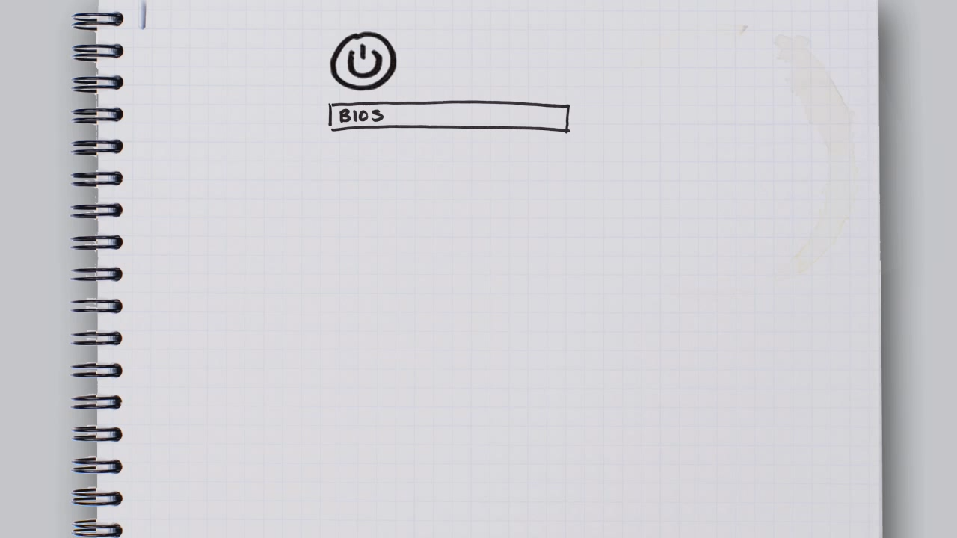
New Trend in OS
Source:
http://www.youtube.com/watch?v=0QRO3gKj3qw
Operating Systems

Slide 40
Future Operating Systems
Operating systems are not limited to Windows/Linux/MacOS etc.
Operating system development and research never stops.
  Hardware evolvement.
  User requirements.
Examples:
  Microkernel (also known as μ-kernel), https://en.wikipedia.org/wiki/Microkernel
  Formally verified OS kernel, https://sel4.systems/
Operating Systems

