Slide 1
EE394V Project Learning for DC-OPF: Classifying active sets using neural nets
-
Park, JeeHyun
06 MAY 20

Slide 2
Contents
This project is based on the contents covered in “Learning for DC-OPF: Classifying active sets using neural nets” [1].
Motivation & Context
Problem Formulation
Proposed Method
Experiments and Results
This project can be found in the following git repository.
https://github.com/jhyun0919/OPF_Porject_EE394V_SPR2020
Notes:
I did my project based on the paper ”Learning for DC-OPF: Classifying active sets using neural nets”, and my presentation contents are as follows.
(Also, I uploaded all the materials for my project to my git, so I think you can check it at any time.)

Slide 3
1. Motivation & Context
Optimal power flow is used in power system operational planning to estimate the most economical efficiency solution while satisfying demand and safety margins.
Due to increasing uncertainty and variability in energy sources and demand, the optimal solution needs to be updated near real-time to respond to observed uncertainty realizations.
The existing method of solving the optimal problem could not cope with frequent updating due to the low computational efficiency.
➔ A new approach is required to solve the optimal power flow problem accurately with high computational efficiency.
Notes:
Well, we all know that OPTIMAL POWER FLOW is used in power system operational planning to estimate the most optimal point, which is the most economically efficient solution.
However, due to increasing uncertainty, such as renewable generation and EVs,
nowadays, the optimal solution is required to be updated in real time
to respond to observed uncertainty realizations.
But the problem here is that, because of the low computational efficiency in traditional methods,
it is not possible to update the optimal solution as fast as we want.
So, the paper proposed a new approach to obtaining an optimal solution with high computational efficiency.
Of course, satisfactory accuracy must be guaranteed.

Slide 4
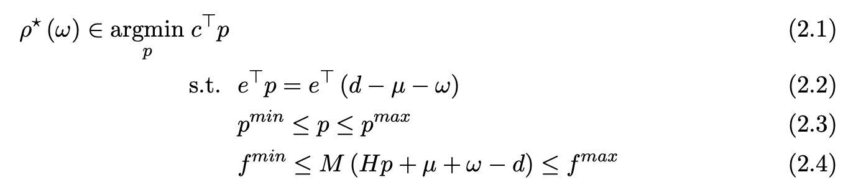
2. Problem Formulation
DC-OPF
ρ(ω): Control policy
A mapping adjusts the generation in response to uncertainty realization.
parameter (given)
uncertainty realization (ω)
ω ~ Multivariate Normal Distribution (𝜇 = 0, 𝜎_{i} = 0.03*d_{i})
unknown variable (wanted)
optimal solution (p*)
Notes:
In this paper, to simplify the problem, DC PF was assumed.
They set up a function called “CONTROL POLICY”,
mapping adjusts the generation in response to uncertainty realization.
It takes w(omega) as an input argument, which is an uncertainty realization vector
follows multivariate normal distribution
mu=0 and std are proportional to the load elements.
And as an output, it returns an optimal solution of the system.

Slide 5
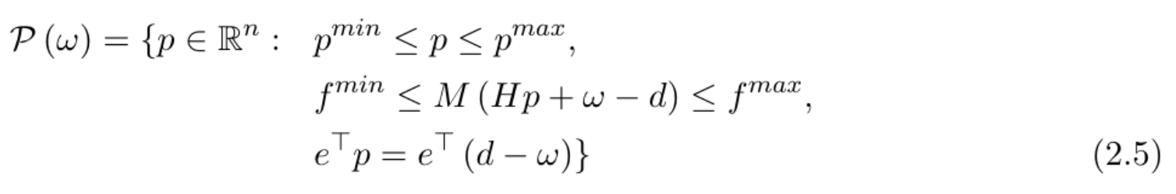
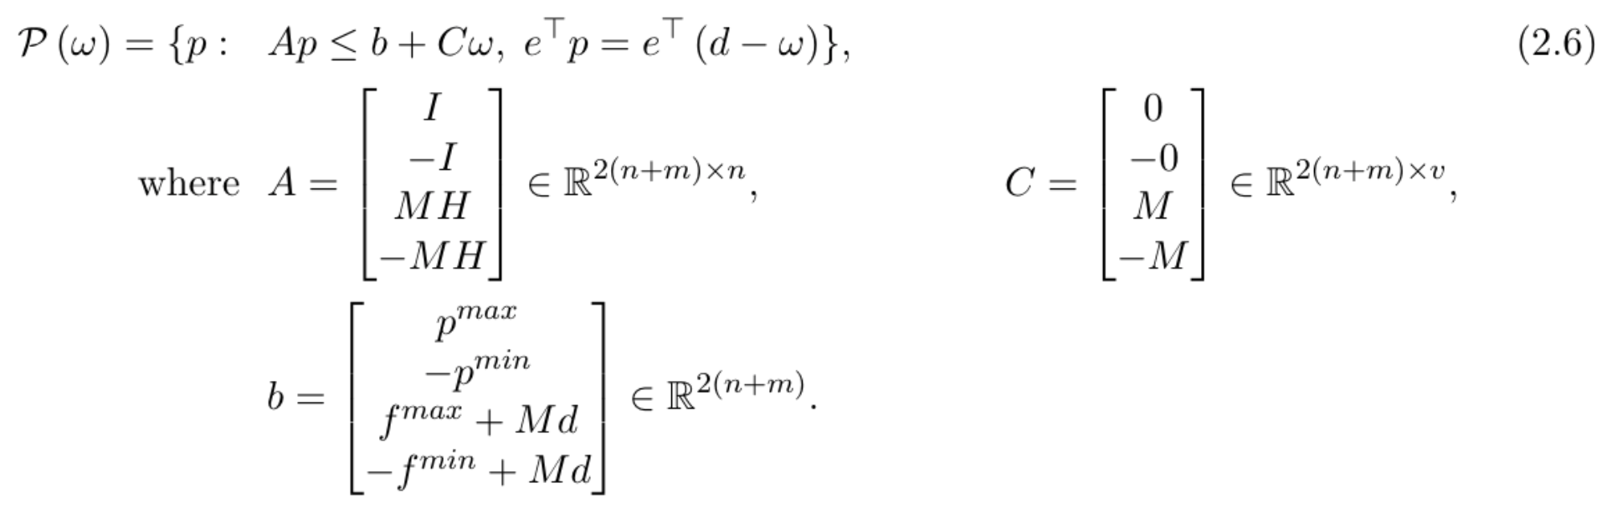
2. Problem Formulation
DC-OPF
The feasible set (linear constraints → polytope) can be represented in matrix form.
Notes:
Since the given constraints are all in linear,
we can represent the feasible set, polytope, in the following matrix form.
To explain the notation,
M is PTDF (Power Transfer Distribution Factor),
H is mapping matrix between generators and buses,
w is uncertainty realization vector,
and d is load vector.
n = num of gens
m = num of lines
v = num of buses
mu = vector of forecast non-dispatchable active power
Since all the constraints are in linear and cost function is linear (or quadratic )function,
this problem is an easy problem.
However, the focus of this paper is computational efficiency.
기존 방식의 복잡도가 높다는 내용 필요.
Bisection → 3^N solutions
- exhaustive search → 2^NT
Branch and Bound (recursive method) → complexity depends on (I, u)

Slide 6
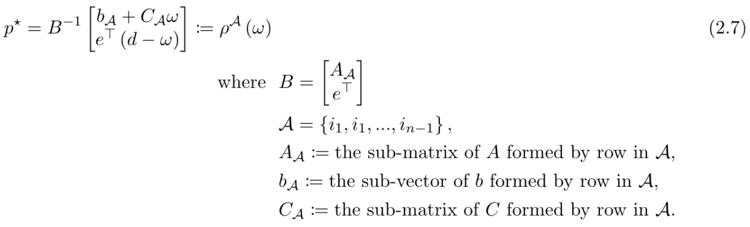
2. Problem Formulation
Machine learning method (direct mapping)
Uncertainty realization → [ML Predict Model] → Optimal solution.
Ensemble control policy [3][4]
Uncertainty realization → [Searching Algorithm] → Active constraints → Optimal solution.
The active set approach for optimal solution relies on two observation.
For typical uncertainty distributions of the random vector ω, only a few of the active sets are realized.
The optimal solutions to linear programs lie at extreme points of the feasible polytope.
Notes:
Before explaining the method proposed in this paper, I think it is necessary to look at the two traditional approaches.
The first one is ML METHOD.
The main feature of this approach is that
a model is trained to learn direct mapping between uncertainty realization and optimal solutions.
Due to the nature of ML, training stage requires a lot of computation, and it might take a long time.
But once we have the trained model, in other words, when we are in inference step, extremely high computational efficiency is guaranteed.
However, the drawback of this approach is that the performance of the model depends on the size of training dataset.
The second one is ENSEMBLE CONTROL POLICY.
The important feature of this method is that it maps active constraints instead of optimal solutions.
Once we obtain the active constraints, we can estimate the optimal solution through the following two observations.
By the way, the key point of obtaining active constraints is that we can drastically reduce the size of the matrix used in the matrix expression below.
This approach allows accurate estimation, but the disadvantage of this method is that it still uses an exhaustive searching algorithm.
Searching algor → entails solving 2^NT

Slide 7
3. Proposed Method
 | ML method (direct mapping) | Ensemble control policy
Advantages | High computational efficiency at inference stage. | High accuracy by identifying the relevant constraints at the optimal.
Disadvantages | Low performance when the size of training data is not large enough. | Low computational efficiency due to the exhaustive searching algorithm.
Proposed Method | Use a NNs classifier for identifying the relevant constraints at the optimal. Use a NNs classifier instead of the exhaustive searching algorithm. ➔ High computational efficiency. Map from the uncertainty realization to the active constraints set at optimality instead of the optimal solution (direct mapping). ➔ Guarantee the satisfactory performance.
Notes:
So, in this paper, they proposed a new method that took advantage of the above two methods.
They proposed to learning the mapping between uncertainty realization and active constraints through a Neural Network Classification model.
Which will allow us to have high computational efficiency and satisfactory performance.

Slide 8
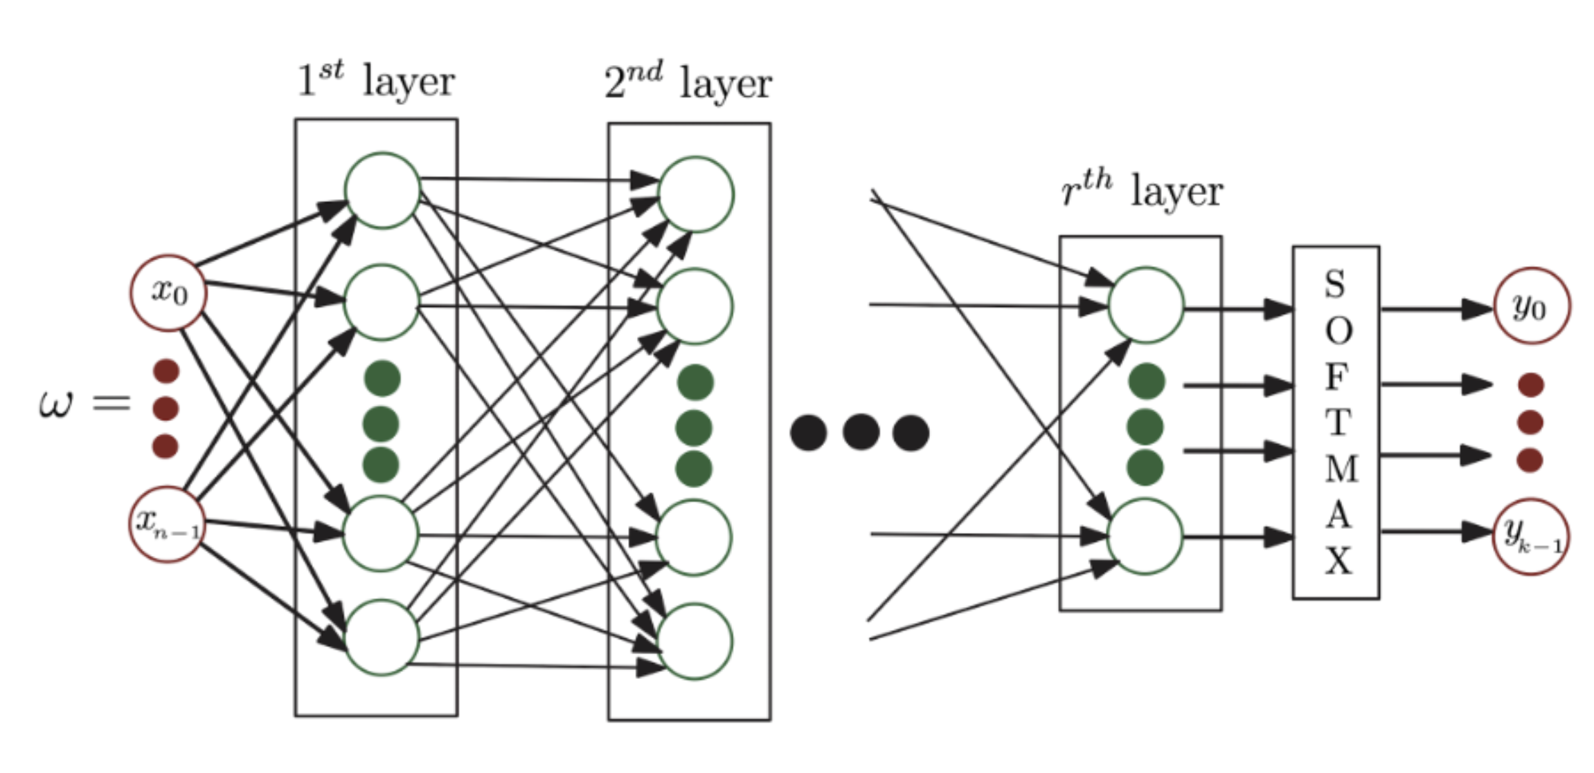
4. Experiments and Results
NN architecture
Input: x_{n}
Uncertainty realization.
Output: y_{k}
{active constraints → 0 ~ 1}
Probability for each active constraints.
Further study
Build a set of parallel binary classifiers to predict the status of each individual constraint separately.
It will be an approach to develop a deeper understanding of various operational patterns, such as clustering of constraints.
[Personal project]
Input: x_{n}
Uncertainty realization.
Output: y_{k}
{all constraints → 0 or 1}
Decides the constraints are active or not.
SIGMOID
Notes:
In the paper, they focused on active constraints.
The classifier they proposed returns probability for each active constraints.
Also, they left it as a further study to figure out the relationship between the constraints.
The paper suggest to add a set of parallel binary classifiers for this further study.
However, I figured out that I could obtain the relationship between the constraints
by just changing the output layer from SOFTMAX to SIGMOID, instead of adding binary classifier for each constraints.
(Of course, the number of nodes in the output layer will increase from the number of active constraints to the number of all constraints. )

Slide 9
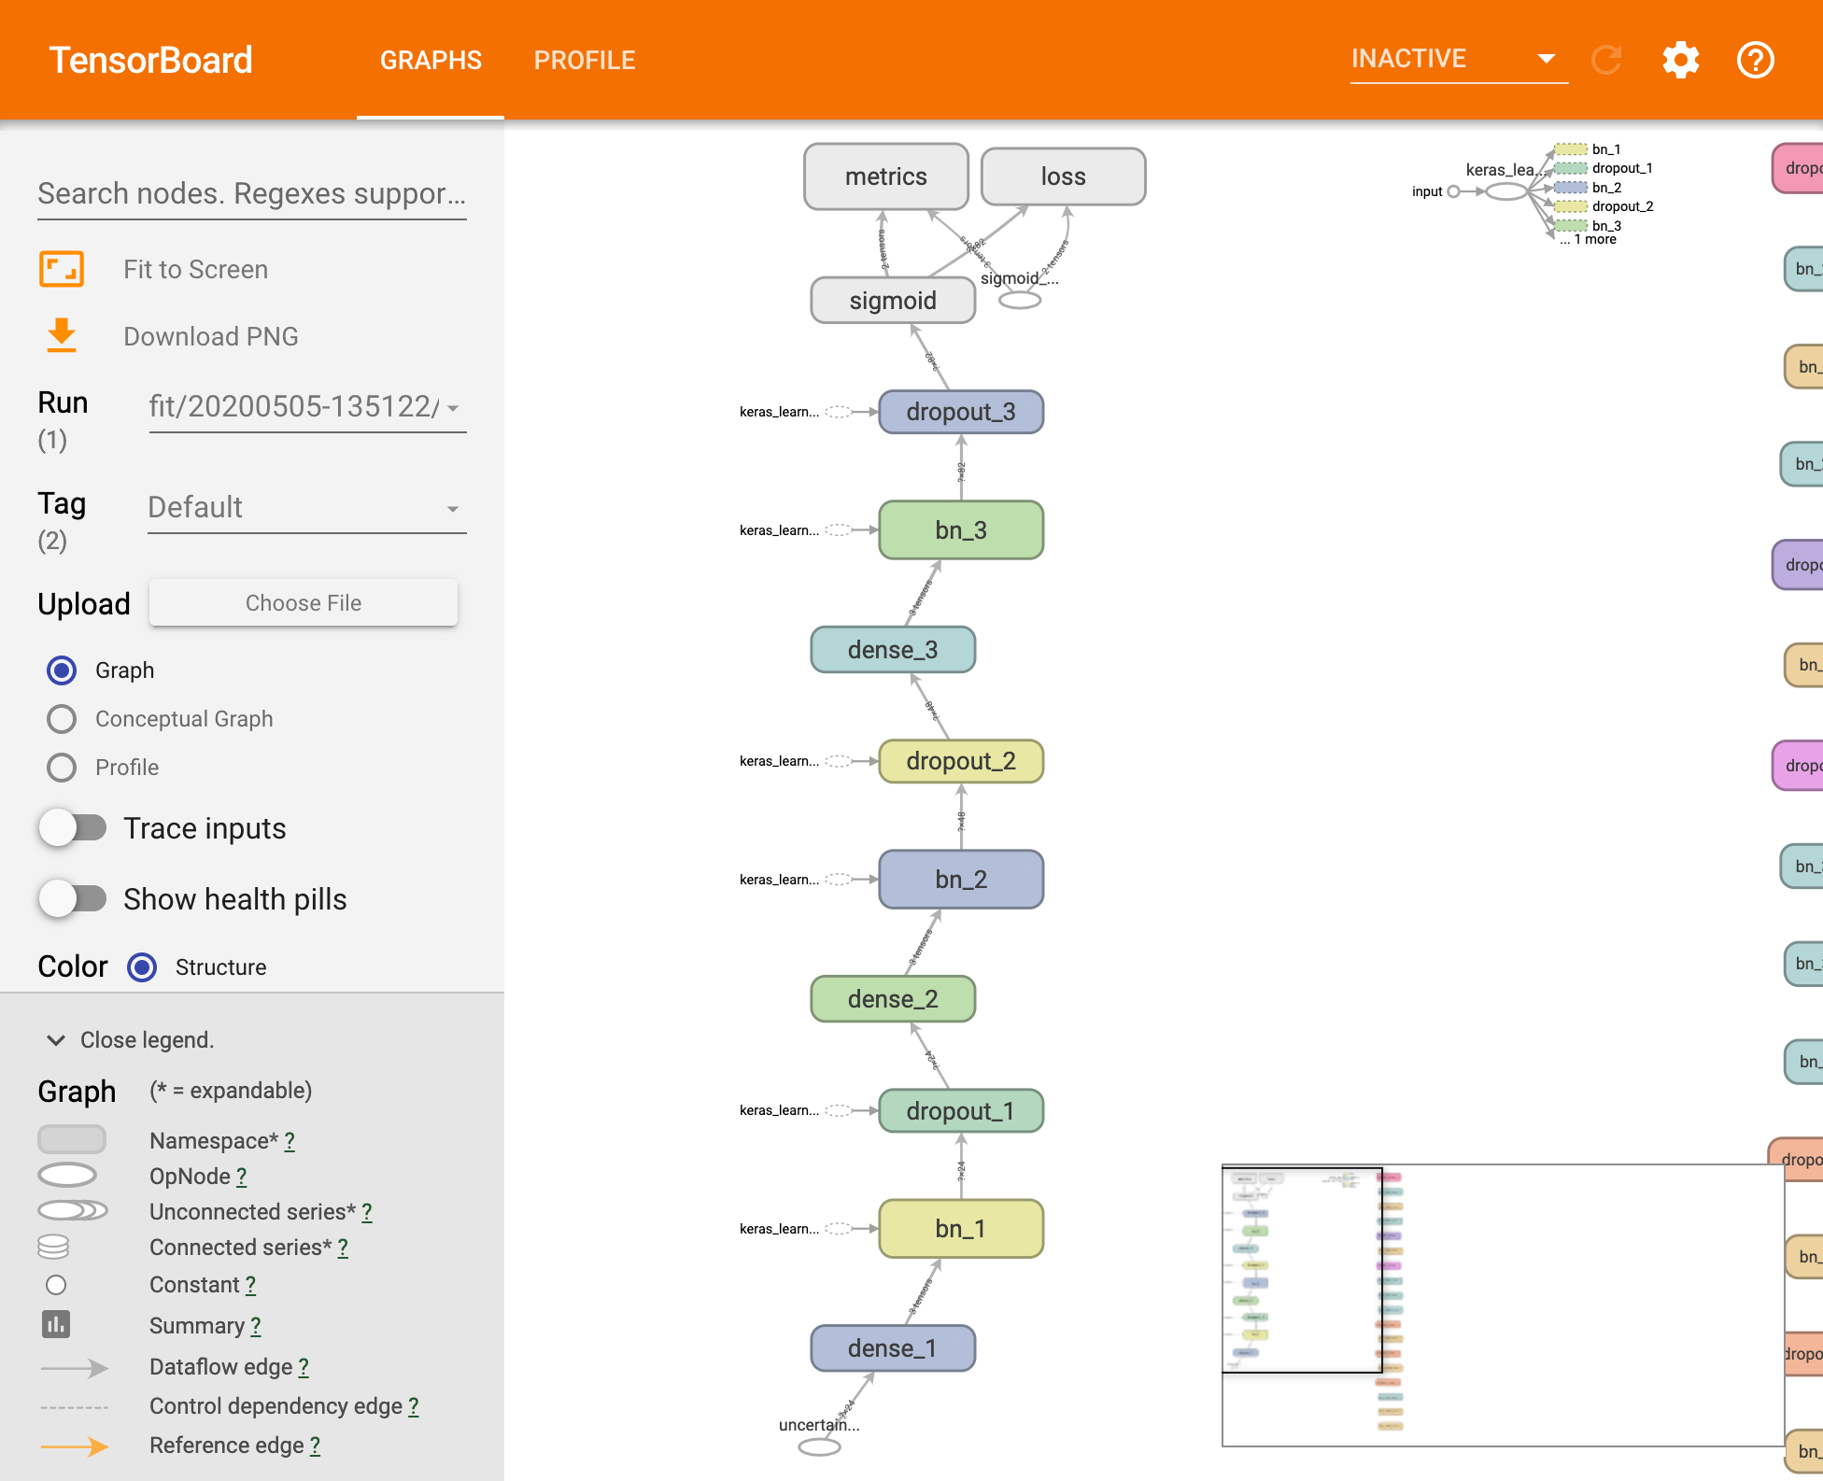
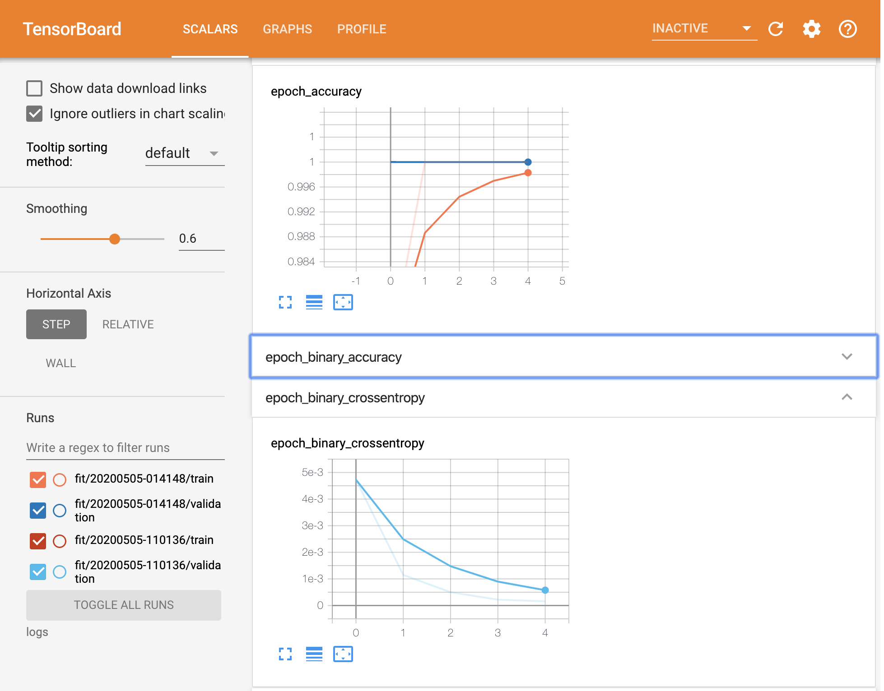
4. Experiments and Results
Classification model
Architecture
{Dense layer + Batch normalization[5] + Dropout[6] + ReLUs} x layer_num
Sigmoid
Loss
BinaryCrossEntropy[7]
Optimizer
Adam[8]
Metrics
BinaryAccuracy
BinaryCrossEntropy
Experiment results
 | BinaryAccuracy | BinaryCrossEntropy
24 buses | 0.99 | 0.00116
73 buses | 0.99 | 0.00046
162 buses | 0.99 | 0.00039
300 buses | 1.00 | 0.00026
Notes:
The following is the structure of my model,
and which loss function, optimizer, and metrics I choose to use.
[animation]
And through the training, I could get pretty good performance results from the model.

Slide 10
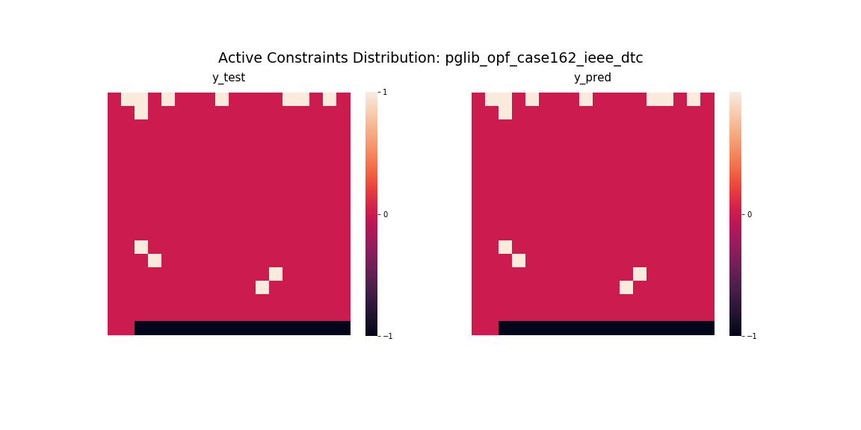
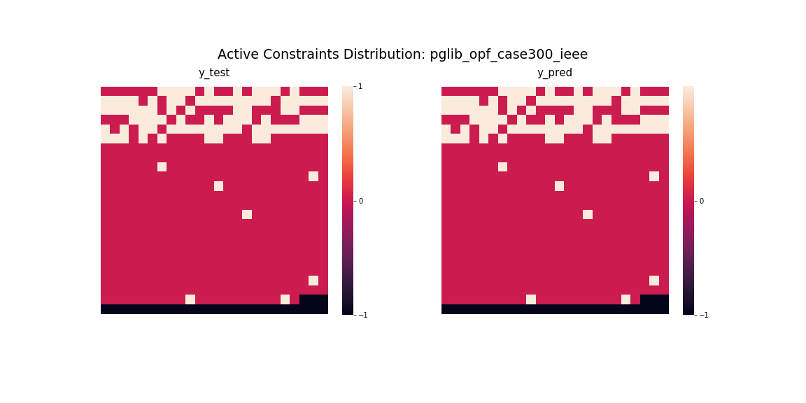
4. Experiments and Results
Constraints cluster visualization
+1: active constraint
0: inactive constraint
-1: meaningless data (added cells to make the array as a square matrix)
Notes:
And finally, I visualized the output of the model to check the relationship between the constraints.
[animation]
Through the heatmaps, as you can see,
we could check the clustering of constraints.

Slide 11
References
[1] D. Deka and S. Misra. “Learning for DC-OPF: Classifying active sets using neural nets,” 2019 IEEE Milan PowerTech,2019.
[2] R. D. Christie, B. F. Wollenberg, and I. Wangensteen, “Transmission management in the deregulated environment,” Proceedings of the IEEE, vol. 88, no. 2, pp. 170–195, 2000.
[3] Y. Ng, S. Misra, L. A. Roald, and S. Backhaus, “Statistical learning for DC optimal power flow,” Jan. 2018.
[4] S. Misra, L. Roald, and Y. Ng, “Learning for convex optimization,” arXiv preprint arXiv:1802.09639, 2018.
[5] S. Ioffe and C. Szegedy, “Batch normalization: Accelerating deep network training by reducing internal covariate shift,” arXiv preprint arXiv:1502.03167, 2015.
[6] N. Srivastava, G. Hinton, A. Krizhevsky, I. Sutskever, and R. Salakhut- dinov, “Dropout: a simple way to prevent neural networks from over- fitting,” The Journal of Machine Learning Research, vol. 15, no. 1, pp. 1929–1958, 2014.
[7] “Binary crossentropy loss function: Peltarion Platform,” Peltarion.com. [Online]. Available: https://peltarion.com/knowledge-center/documentation/modeling-view/build-an-ai-model/loss-functions/binary-crossentropy. [Accessed: 05-May-2020].
[8] D. P. Kingma and J. Ba, “Adam: A method for stochastic optimization,” arXiv preprint arXiv:1412.6980, 2014.
Notes:
Thank you for listening.

