Slide 1
EE394V Project Learning for DC-OPF: Classifying active sets using neural nets
-
Park, JeeHyun
06 MAY 20

Slide 2
Contents
This project is based on the contents covered in “Learning for DC-OPF: Classifying active sets using neural nets” [1].
Motivation & Context
Problem Formulation
Proposed Method
Experiments and Results
Further Studies
This project can be found in the following git repository.
https://github.com/jhyun0919/OPF_Porject_EE394V_SPR2020

Slide 3
1. Motivation & Context
Optimal power flow is used in power system operational planning to estimate the most economical efficiency solution while satisfying demand and safety margins.
Due to increasing uncertainty and variability in energy sources and demand, the optimal solution needs to be updated near real-time to respond to observed uncertainty realizations.
The existing method of solving the optimal problem could not cope with frequent updating due to the low computational efficiency.
➔ A new method is required to solve the optimal power flow problem accurately with high computational efficiency.

Slide 4
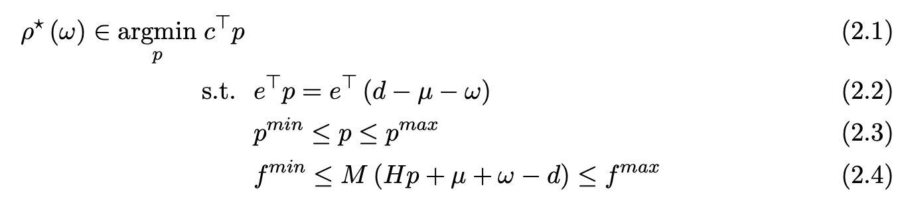
2. Problem Formulation
DC-OPF
ρ(ω): Control policy
A mapping adjusts the generation in response to uncertainty realization.
parameter (given)
uncertainty realization (ω)
ω ~ Multivariate Normal Distribution (𝜇 = 0, 𝜎 = 0.03*d_{i})
unknown variable (wanted)
optimal solution (p*)

Slide 5
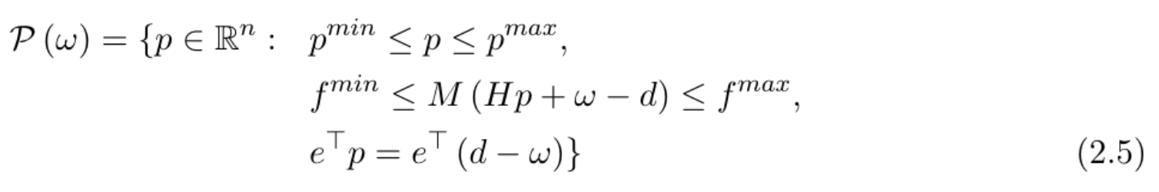
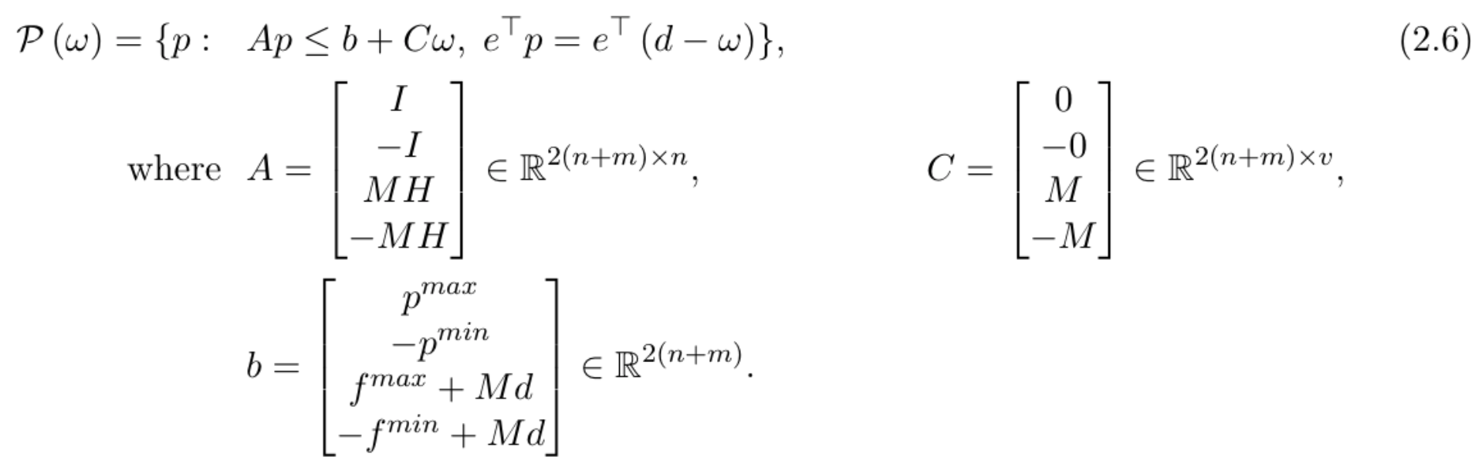
2. Problem Formulation
DC-OPF
The feasible set (polytope) can be represented in matrix form.

Slide 6
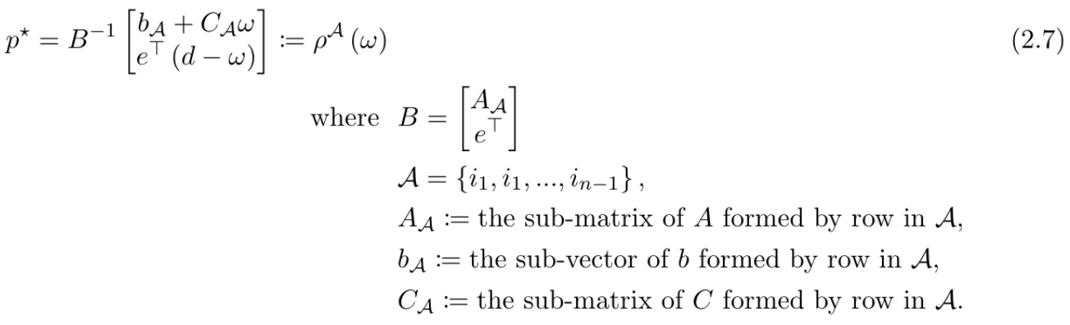
2. Problem Formulation
Machine learning method (direct mapping)
Uncertainty realization → [ML Predictor] → Optimal solution.
Ensemble control policy [3][4]
Uncertainty realization → [Searching Algorithm] → Active constraints → Optimal solution.
The active set approach for optimal solution relies on two observation.
For typical uncertainty distributions of the random vector ω, only a few of the active sets are realized.
The optimal solutions to linear programs lie at extreme points of the feasible polytope.

Slide 7
3. Proposed Method
 | ML method (direct mapping) | Ensemble control policy
Advantages | High computational efficiency at inference stage. | High accuracy by identifying the relevant constraints at the optimal.
Disadvantages | Low performance when the size of training data is not large enough. | Low computational efficiency due to the exhaustive searching algorithm.
Proposed Method | Use a NNs classifier for identifying the relevant constraints at the optimal. Use a NNs classifier instead of the exhaustive searching algorithm. ➔ High computational efficiency. Map from the uncertainty realization to the active constraints set at optimality instead of the optimal solution (direct mapping). ➔ Guarantee the satisfactory performance.

Slide 8
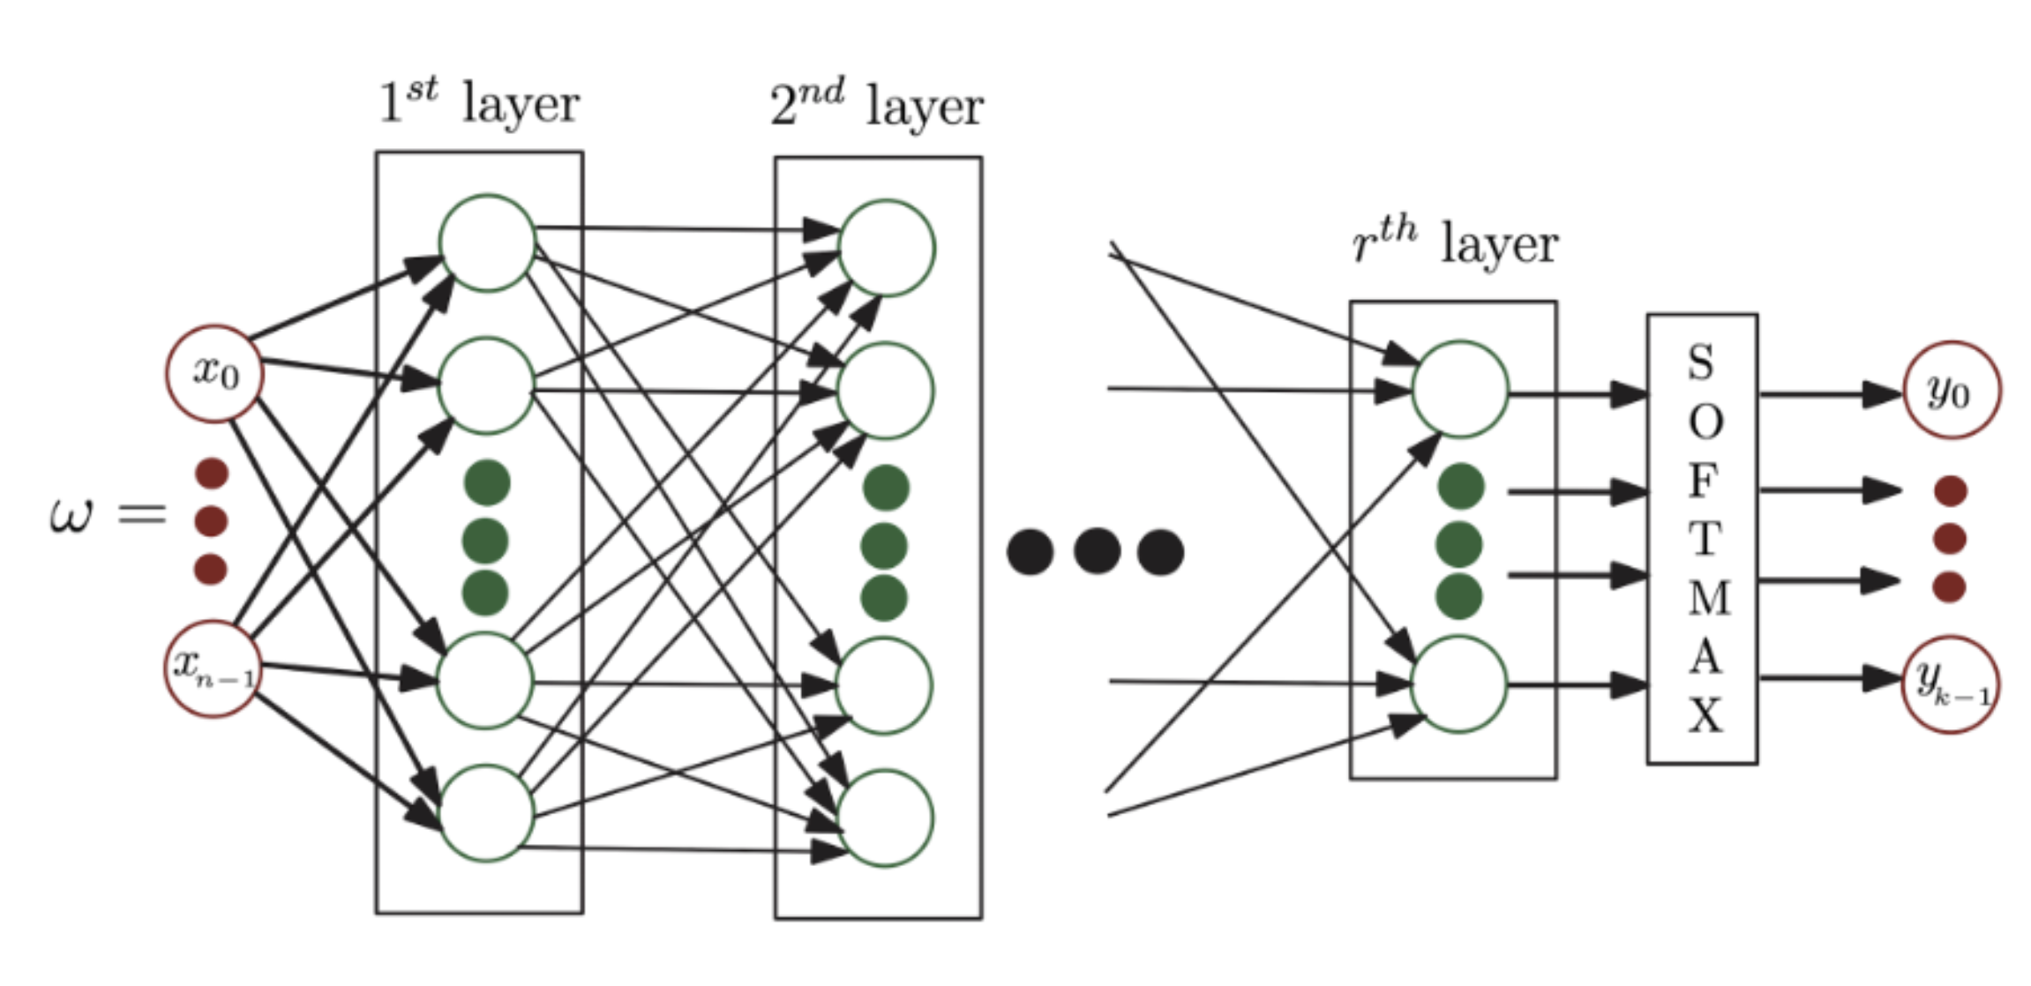
4. Experiments and Results
NN architecture
Input: x_{n}
Uncertainty realization.
Output: y_{k}
{active constraints → 0 ~ 1}
Probability for each active constraints.
Further study
Build a set of parallel binary classifiers to predict the status of each individual constraint separately.
It will be an approach to develop a deeper understanding of various operational patterns, such as clustering of constraints.
[Personal project]
Input: x_{n}
Uncertainty realization.
Output: y_{k}
{all active constraints → 0 or 1}
Decides the constraints are active or not.
SIGMOID

Slide 9
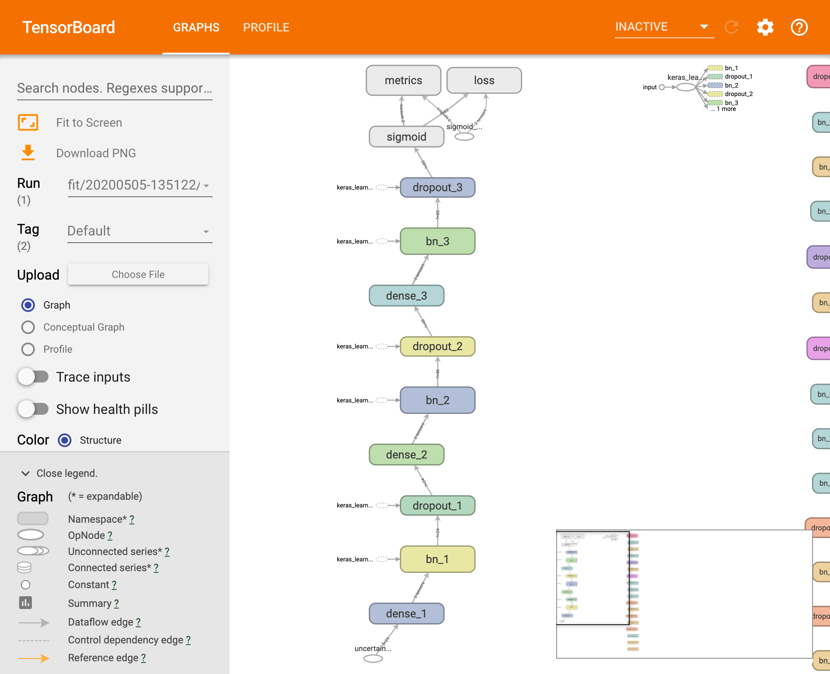
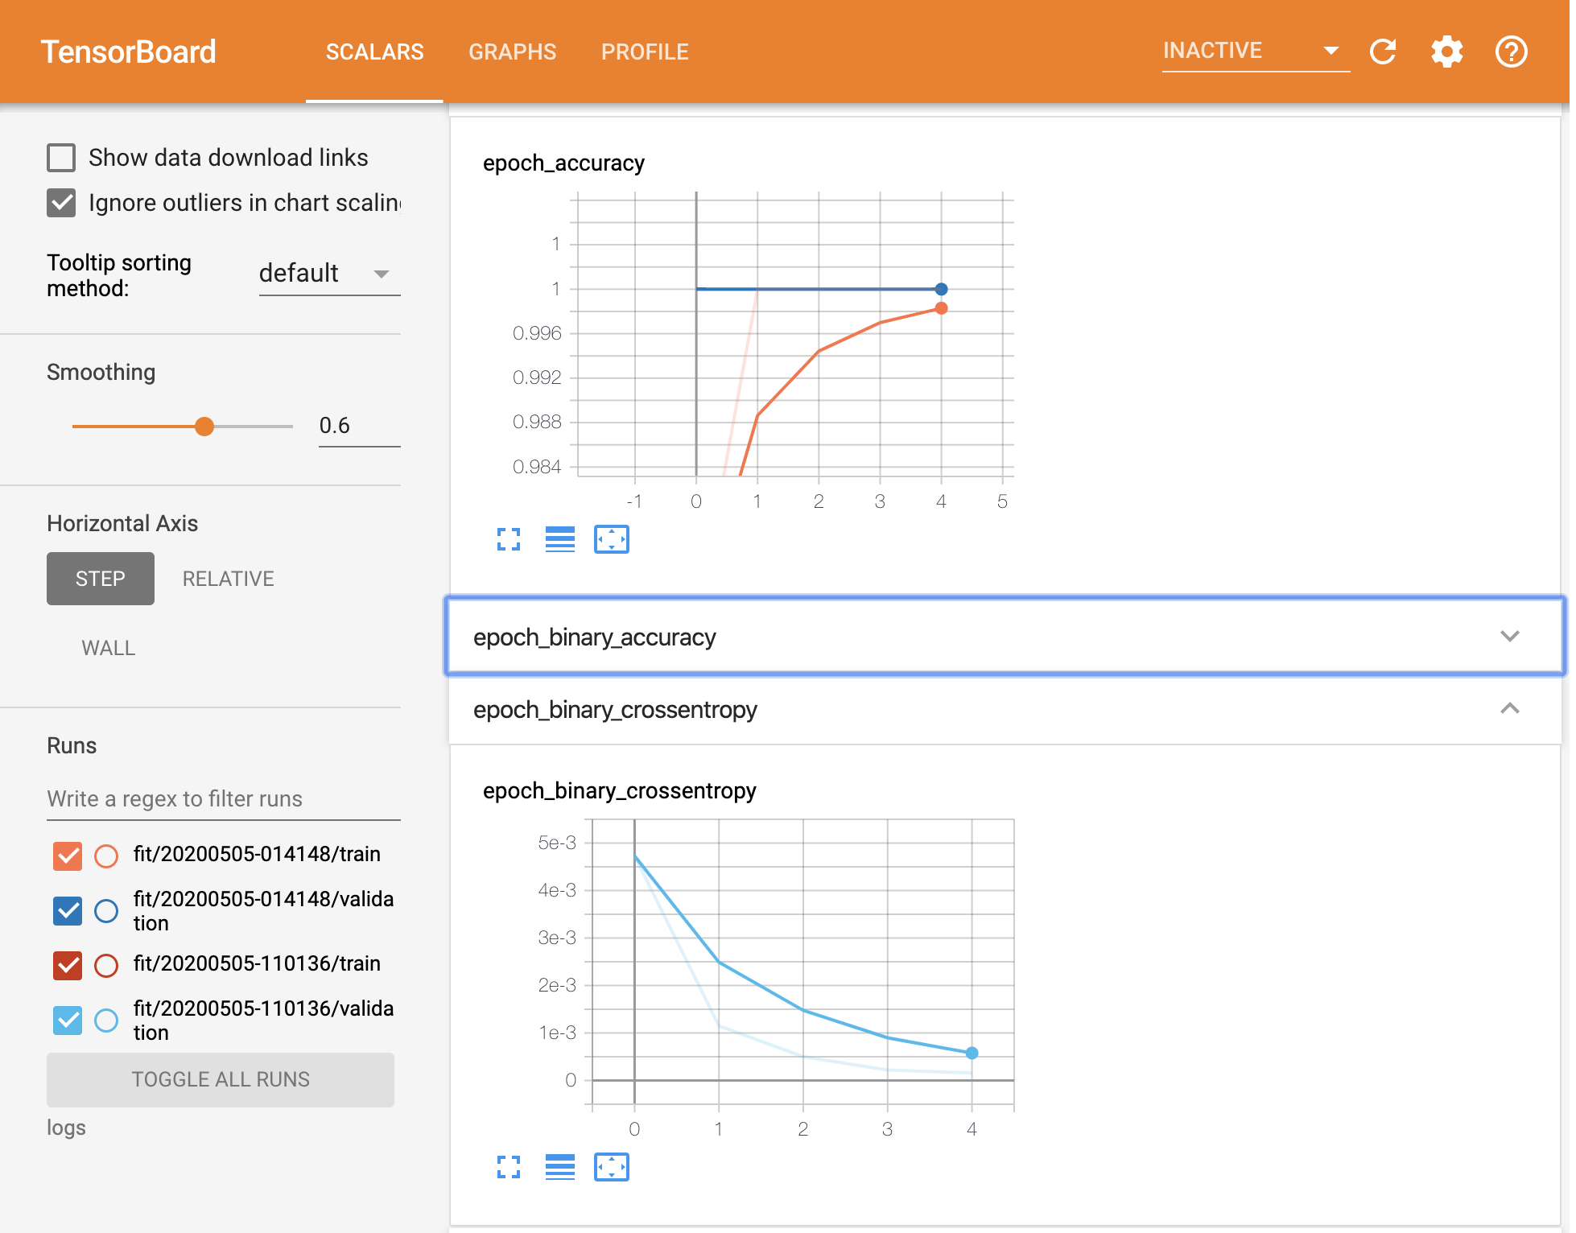
4. Experiments and Results
Classification model
Architecture
{Dense layer + Batch normalization[5] + Dropout[6] + ReLUs} x layer_num
Sigmoid
Loss function
BinaryCrossEntropy[7]
Optimizer
Adam[8]
Metrics
BinaryAccuracy
BinaryCrossEntropy
Experiment results
 | BinaryAccuracy | BinaryCrossEntropy
24 buses | 0.99 | 0.00116
73 buses | 0.99 | 0.00046
162 buses | 0.99 | 0.00039
300 buses | 1.00 | 0.00026

Slide 10
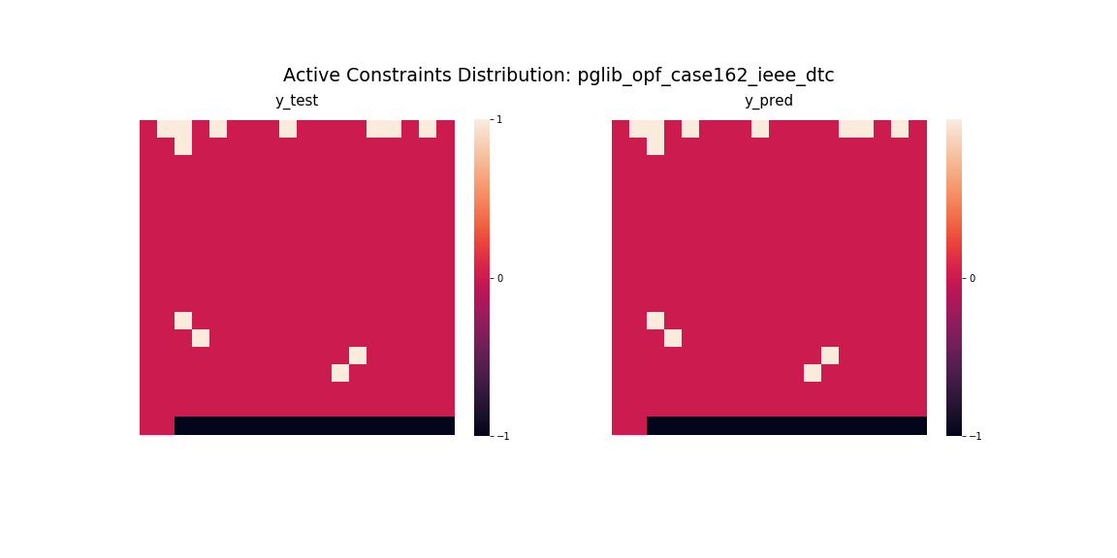
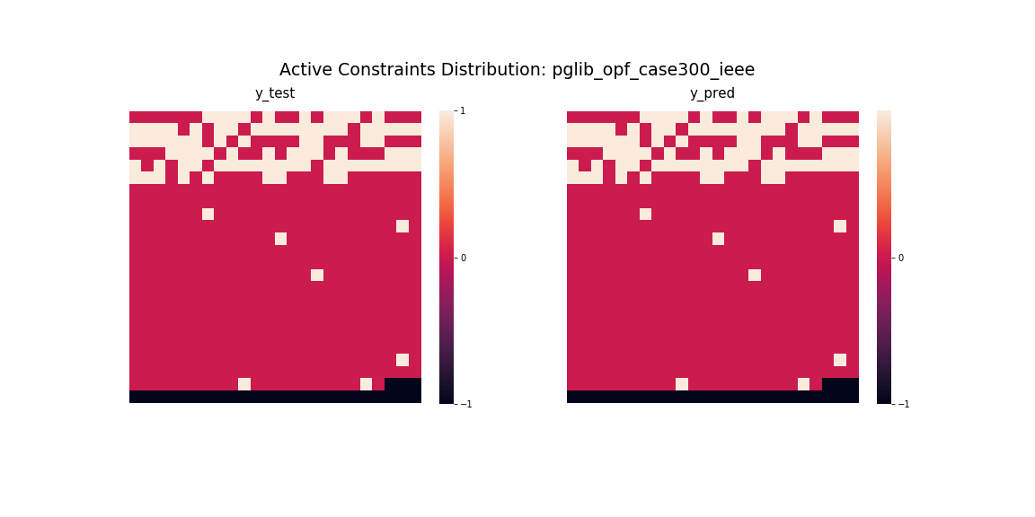
4. Experiments and Results
Constraints cluster visualization
+1: active constraint
0: inactive constraint
-1: meaningless data (added cells to make the array as a square matrix)

Slide 11
References
[1] D. Deka and S. Misra. “Learning for DC-OPF: Classifying active sets using neural nets,” 2019 IEEE Milan PowerTech,2019.
[2] R. D. Christie, B. F. Wollenberg, and I. Wangensteen, “Transmission management in the deregulated environment,” Proceedings of the IEEE, vol. 88, no. 2, pp. 170–195, 2000.
[3] Y. Ng, S. Misra, L. A. Roald, and S. Backhaus, “Statistical learning for DC optimal power flow,” Jan. 2018.
[4] S. Misra, L. Roald, and Y. Ng, “Learning for convex optimization,” arXiv preprint arXiv:1802.09639, 2018.
[5] S. Ioffe and C. Szegedy, “Batch normalization: Accelerating deep network training by reducing internal covariate shift,” arXiv preprint arXiv:1502.03167, 2015.
[6] N. Srivastava, G. Hinton, A. Krizhevsky, I. Sutskever, and R. Salakhut- dinov, “Dropout: a simple way to prevent neural networks from over- fitting,” The Journal of Machine Learning Research, vol. 15, no. 1, pp. 1929–1958, 2014.
[7] “Binary crossentropy loss function: Peltarion Platform,” Peltarion.com. [Online]. Available: https://peltarion.com/knowledge-center/documentation/modeling-view/build-an-ai-model/loss-functions/binary-crossentropy. [Accessed: 05-May-2020].
[8] D. P. Kingma and J. Ba, “Adam: A method for stochastic optimization,” arXiv preprint arXiv:1412.6980, 2014.

