Slide 1
EE394V Project Learning for DC-OPF: Classifying active sets using neural nets
-
Park, JeeHyun
06 MAY 20

Slide 2
Contents
This slides are about a project that is based on the content covered in “Learning for DC-OPF: Classifying active sets using neural nets” [1].
Motivation & Context
Problem Formulation
Proposed Method
Experiments and Results
This project can be found in the following git repository.
https://github.com/jhyun0919/OPF_Porject_EE394V_SPR2020

Slide 3
1. Motivation & Context

Slide 4
2. Problem Formulation

Slide 5
3. Proposed Method

Slide 6
4. Experiments and Results

Slide 7
Main

Slide 8
1.Motivation & Context
Due to increasing uncertainty and variability in energy sources and demand, the optimal solution needs to be updated near real-time to respond to observed uncertainty realizations.
The existing method of solving the optimal problem could not cope with frequent updating due to the high computational complexity.

Slide 9
1.Traditional methods
Affine control policy [2][3][4]
Mimics the behavior of the widely utilized automatic generation control (AGC).
Advantages
Affine policies are simple to handle computationally.
Affine policies can be sub-optimal in terms of cost and constraint enforcement [5].
➔ Re-solving the OPF at a much faster time.
Disadvantages
It is still not good enough for the tight latency requirements and large system size.

Slide 10
1.2) Traditional methods
Machine learning method (direct mapping)
Uncertainty realization → [ML Predictor] → Optimal solution.
Using machine learning to learn the mapping from the uncertainty realization to the optimal solution of the OPF.
Advantages
The model, trained with historical data, can be used to predict the optimal solution in real-time efficiency.
Disadvantages
With small size of training data, the trained model will suffer to produce predictions satisfying the hard constraints in the OPF accurately.

Slide 11
1.2) Traditional methods
Ensemble control policy [6][7]
Uncertainty realization → [Searching Algorithm] → Active constraints → Optimal solution.
Use an exhaustive searching algorithm, identifying the active constraints relevant for the OPF problem, as an intermediate training step.
Advantages
Since only a few of possible optimal active constraints are relevant for the OPF problem, the accuracy is remarkably improved.
Disadvantages
The computational efficiency is compromised when the number of active sets is large since the exhaustive search requires one linear operation per candidate active set.

Slide 12
2. Proposed Method
Neural Nets classifier
Uncertainty realization → [NNs classifier] → Active constraints → Optimal solution.
Choose to learn the mapping from uncertainty realization to active constraints set at optimality instead of directly map to the adjustment in the generation. ➔ Better accuracy.
Replace the exhaustive searching algorithm with NNs classifier. ➔ Improved computational efficiency.

Slide 13
2. Proposed Method
 | ML method (direct mapping) | Ensemble control policy [6][7]
Advantages | High computational efficiency at inference stage. | High accuracy by identifying the relevant constraints at the optimal.
Disadvantages | Low performance when the size of training data is not large enough. | Low computational efficiency due to the exhaustive searching algorithm.
Proposed Method [1] | Use a NNs classifier for identifying the relevant constraints at the optimal. Use a NNs classifier instead of the exhaustive searching algorithm. ➔ High computational efficiency. Map from the uncertainty realization to the active constraints set at optimality instead of the optimal solution (direct mapping). ➔ Guarantee the satisfactory performance.

Slide 14
3. Numerical Experiments
Set up OPF test-cases for the learning.
Check probability distribution of active sets of different OPF test-cases.
Observation of the change of accuracy according to the number of layers of fully connected (FCN) layers.
Check accuracy of active set top-K classification for different test cases with change in training data set size.

Slide 15
3.1) Set up OPF test-cases for the learning

Slide 16
3.2) Probability distribution of active sets of different OPF test-cases

Slide 17
3.3) Acc of NN with different FCN layers

Slide 18
3.4) Accuracy of active set top-K classification for different test cases with change in training data set size

Slide 19
4. (Optional) Additional Experiments
Add a set of parallel binary classifiers to predict the status of individual constraints separately.
It which will be an approach to develop a deeper understanding of various operational patterns, such as clustering of constraints.
We will add Tensor-to-Tensor Nets [8] instead of a set of parallel binary classifiers.
This will allow us to more effectively represent and understand the relationships between the constraints.
This allows the relationships between constraints to be represented numerically.

Slide 20
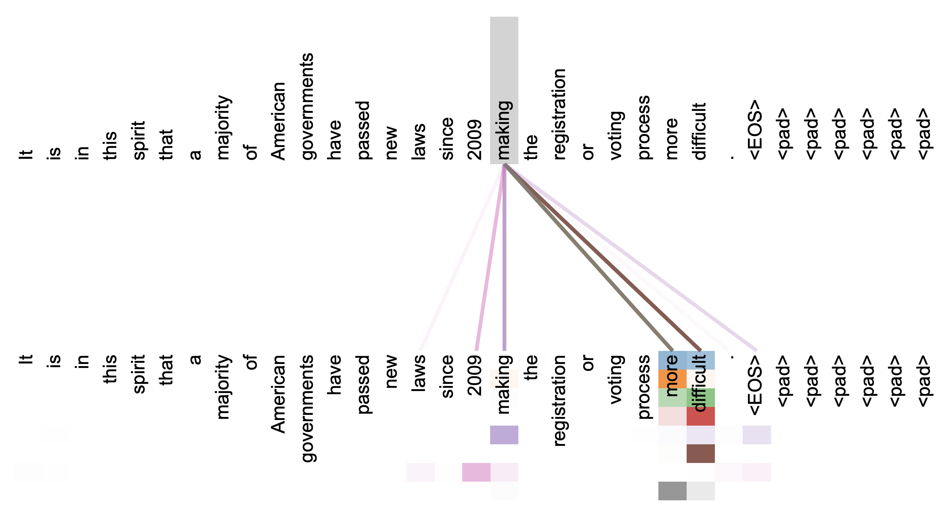
4. Tensor-to-Tensor
Attention is All You Need
In Natural Language Processing (NLP), this is one of the most powerful and effective methods used to learn relationships between words.

Slide 21
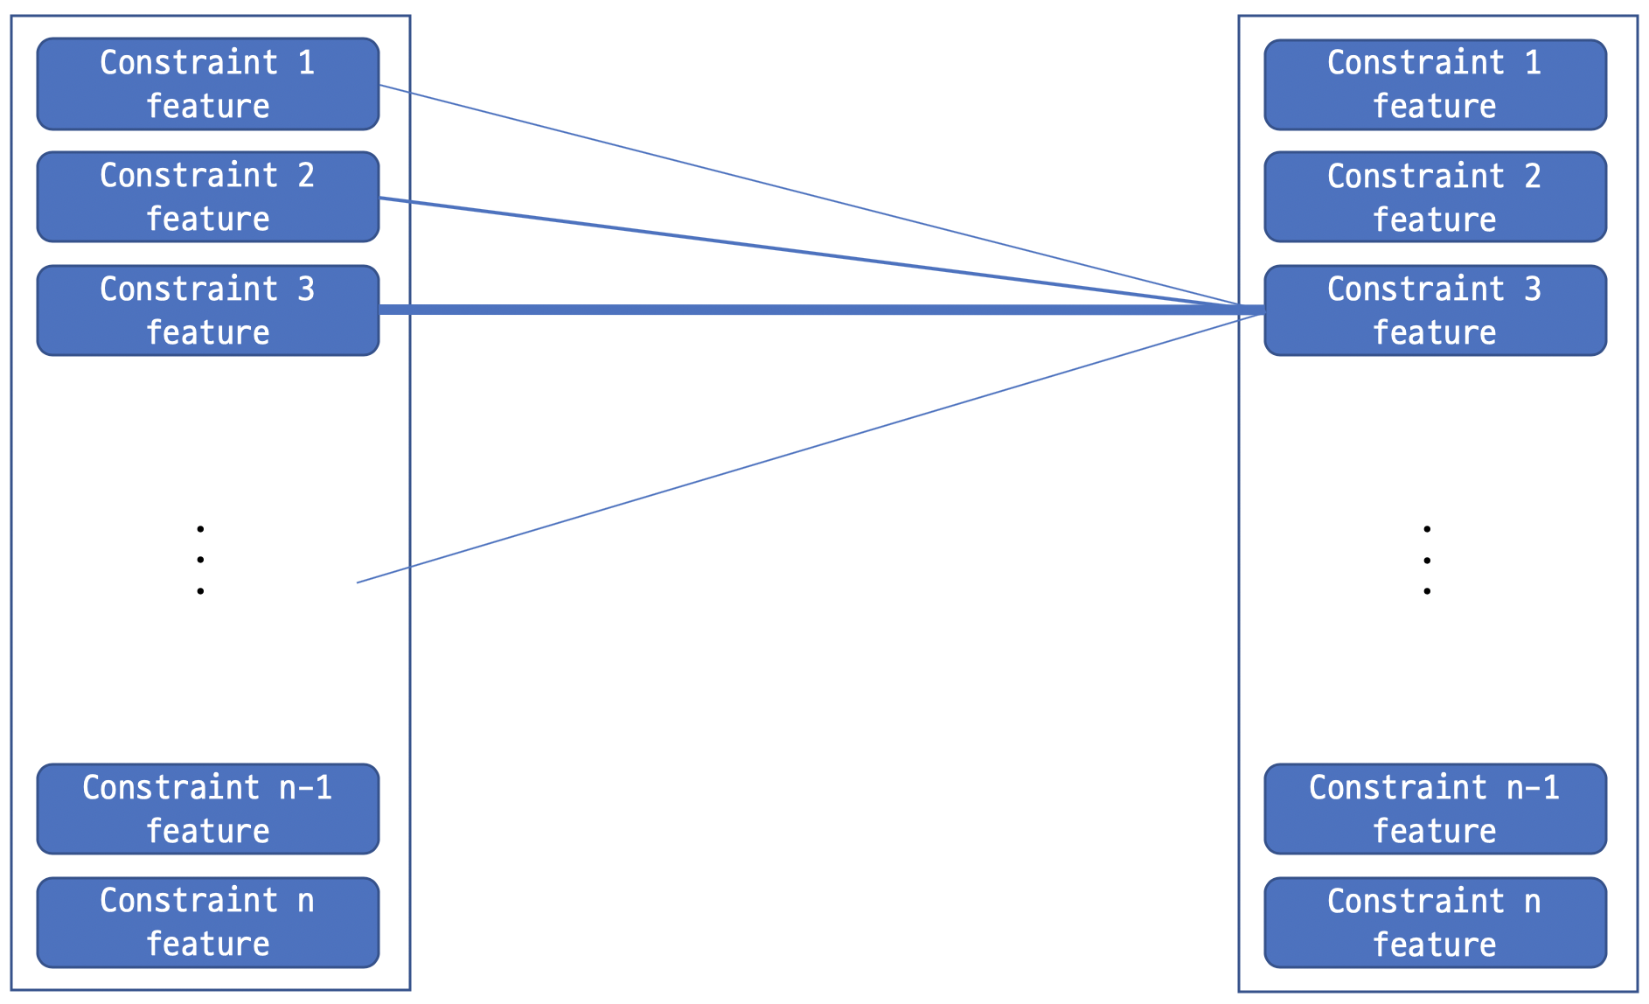
4. Tensor-to-Tensor
It will be trained to learn the relationships between the constraints of the system.
Constraint feature
nx1 vector, where n is the number of the constraints.
Constraint feature i-th element := The degree of deviation that occurs in the variable of the i-th constraint after accepting uncertainty realization.

Slide 22
4. Tensor-to-Tensor

Slide 23
4. Tensor-to-Tensor

Slide 24
5. Conclusion

Slide 25
References
[1] D. Deka and S. Misra. “Learning for DC-OPF: Classifying active sets using neural nets,” 2019 IEEE Milan PowerTech,2019.
[2] B. Borkowska, “Probabilistic load flow,” IEEE Transactions on Power App. Syst., vol. PAS-93, no. 3, pp. 752–759, 1974.
[3] M. Vrakopoulou, K. Margellos, J. Lygeros, and G. Andersson, “Probabilistic Guarantees for the N-1 Security of Systems with Wind Power Generation,” in Probabilistic Methods Applied to Power Systems (PMAPS), Istanbul, Turkey, 2012.
[4] L. Roald, S. Misra, T. Krause, and G. Andersson, “Corrective control to handle forecast uncertainty: A chance constrained optimal power flow,” IEEE Trans. Power Systems, vol. 32, no. 2, pp. 1626–1637, 2017.
[5] L. Roald, S. Misra, M. Chertkov, and G. Andersson, “Optimal power flow with weighted chance constraints and general policies for generation control,” in IEEE Conference on Decision and Control (CDC). IEEE, 2015, pp. 6927–6933.
[6] Y. Ng, S. Misra, L. A. Roald, and S. Backhaus, “Statistical learning for DC optimal power flow,” Jan. 2018.
[7] S. Misra, L. Roald, and Y. Ng, “Learning for convex optimization,” arXiv preprint arXiv:1802.09639, 2018.
[8] Vaswani, Ashish, Shazeer, Noam, Parmar, Niki, Jakob, Jones, Gomez, A. N., Kaiser, Lukasz, Polosukhin, and Illia, “Attention Is All You Need,” arXiv.org, 06-Dec-2017. [Online]. Available: https://arxiv.org/abs/1706.03762. [Accessed: 23-Apr-2020].

Slide 27
Main

Slide 28
sub

