Slide 1
Evaluation of demand power prediction performance based on deep learning algorithm and data preprocessing
Park Jee Hyun
26 MAY 2017
-
SungKyunGwan University
Nanyang Technological University

Slide 2
Contents
Purpose
Experiments
Training & Testing Algorithm
Raw vs. Preprocessed
Results
Single Layer Perceptron
Multiple Layer Perceptron
Convolutional Neural Network
Recurrent Neural Network
Conclusions

Slide 3
Purpose
Accurate load forecasting is pivotal for the economic and secure operation of the power system
Goal: Achieving high load forecasting accuracy
Two main way to do this:
improvement of the performance of the learning algorithm
how well the data features are extracted through the pre-processing process.
➔ In this paper, we will going to evaluate of demand power
prediction performance based on deep learning algorithm
and data preprocessing

Slide 4
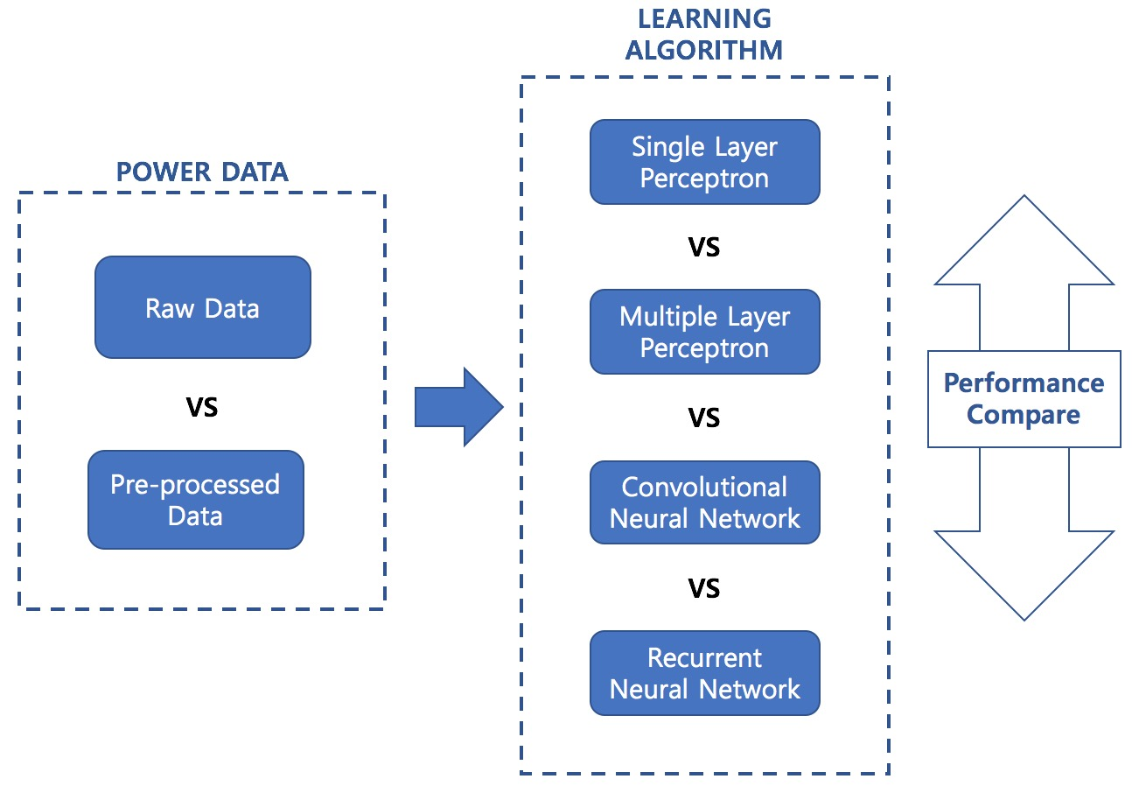
Experiments

Slide 5
Training & Testing Algorithm
a) Training
Training Algorithm
Input Vector
feature data
Target Vector
transplant trained
model
b) Testing
Training Algorithm
Input Vector
feature data
predicting
Predict Vector

Slide 6
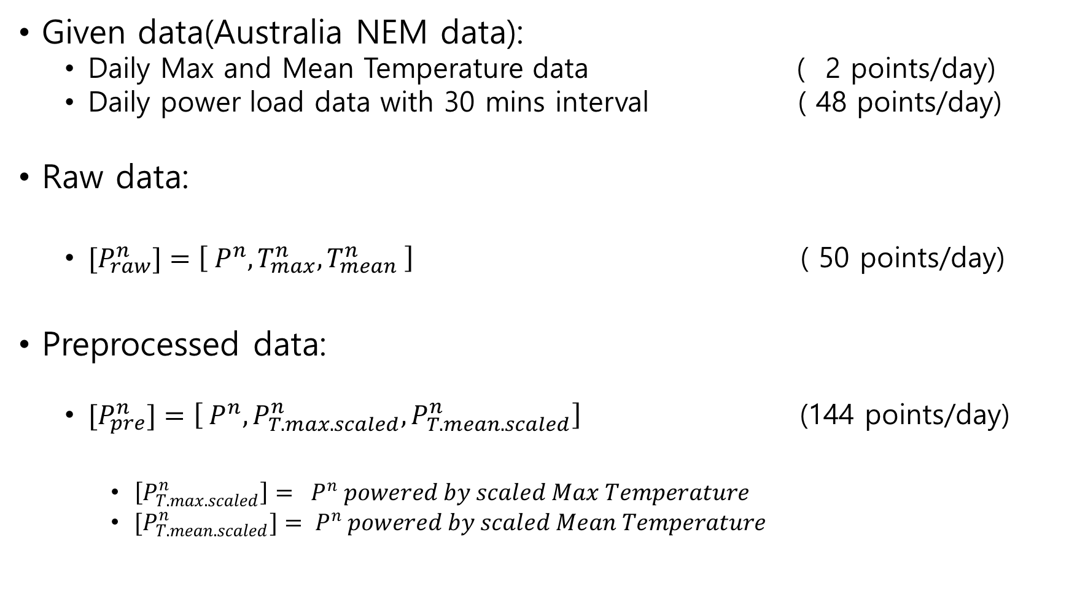
Raw vs. Preprocessed
Given data(Australia NEM data):
Daily Max and Mean Temperature data ( 2 points/day)
Daily power load data with 30 mins interval ( 48 points/day)
Raw data:
${[P}_{raw}^{n}]=\left[{ P}^{n}, T_{max}^{n}, T_{mean}^{n} \right]$ ( 50 points/day)
Preprocessed data:
$[P_{pre}^{n}]=\left[ P^{n}, P_{T.max.scaled}^{n}, P_{T.mean.scaled}^{n}\right]$ (144 points/day)
$\left[P_{T.max.scaled}^{n}\right]= P^{n} powered by scaled Max Temperature$
$[P_{T.mean.scaled}^{n}]= P^{n} powered by scaled Mean Temperature$

Slide 7
Results
RMSE & standard deviation score
 | Raw [RMSE / std] | Preprocessed [RMSE / std]
Single Layer Perceptrons | 6.30388 / 1.0803 | 1.86425 / 0.314612
Multiple Layer Perceptrons | 27.0591 / 23.0247 | 2.2562 / 3.21933
Convolutional Neural Network | 4.61754 / 3.52584 | 2.63669 / 1.11987
Recurrent Neural Network | 0.0964969 / 0.00310329 | 0.0696449 / 0.00145637

Slide 8
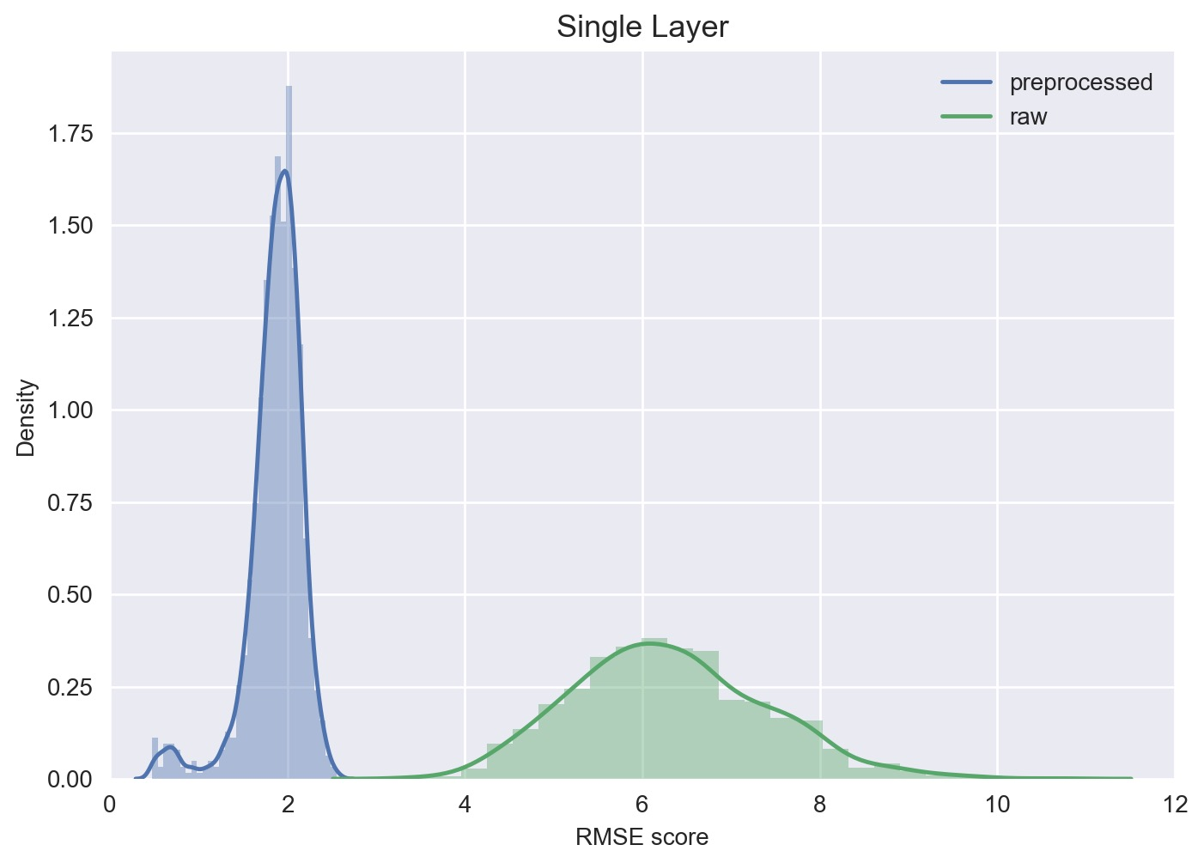
Single Layer Perceptron

Slide 9
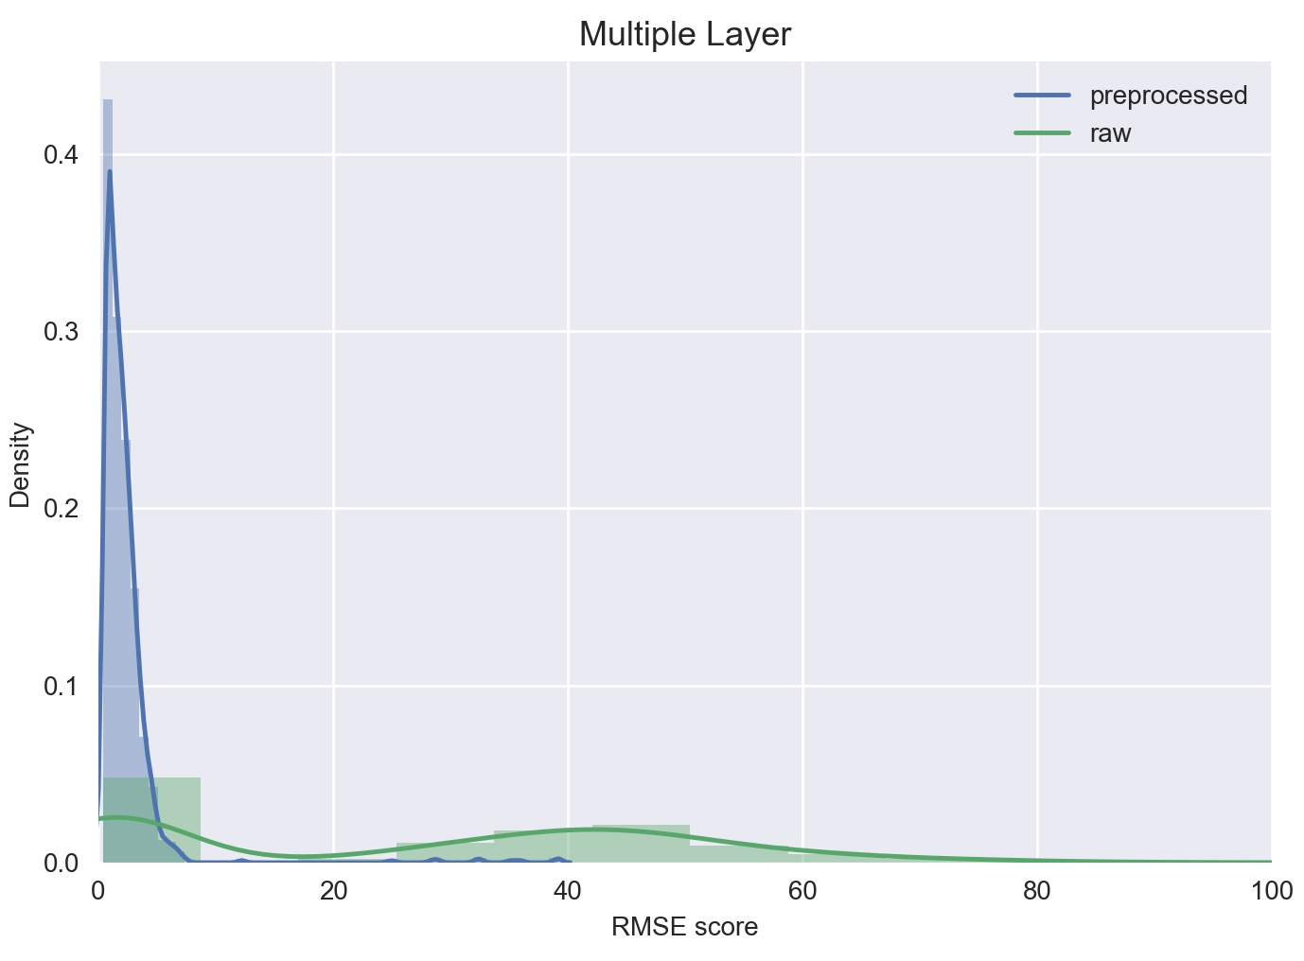
Multiple Layer Perceptron

Slide 10
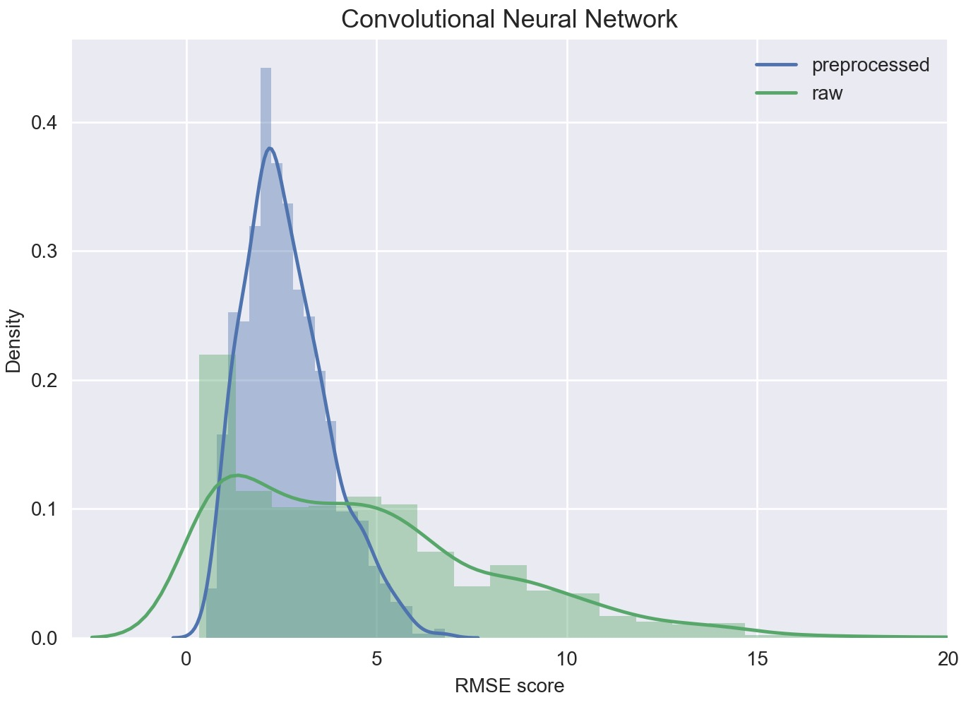
Convolutional Neural Network

Slide 11
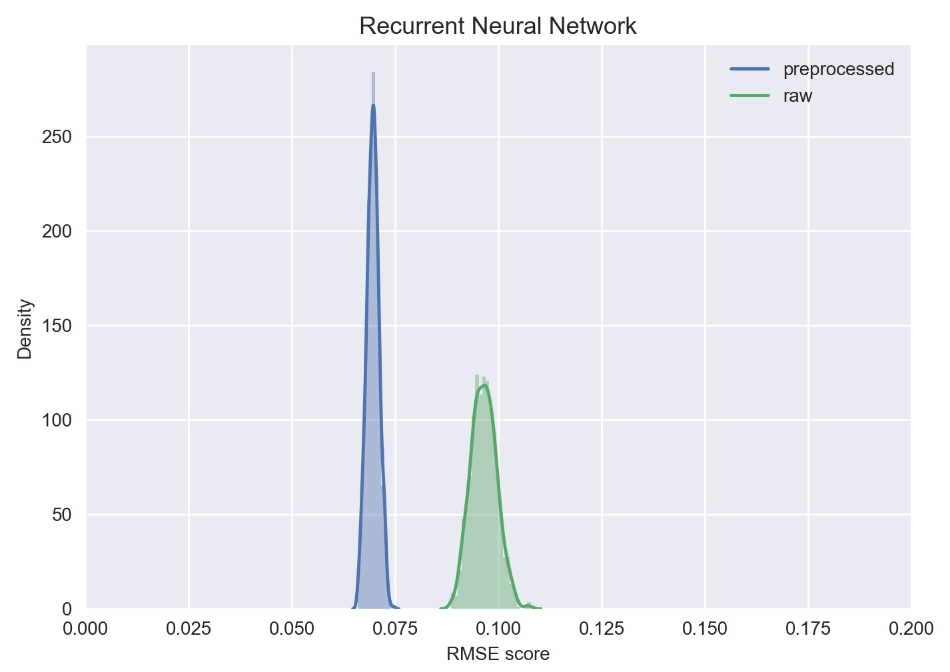
Recurrent Neural Network

Slide 12
Conclusions
All algorithms show better and stable RMSE score with preprocessed data.
RNN model shows the best performance among four learning algorithm designed.
→ We checked that it is able to get better performance from the same predictive model with only limited data if the data preprocessing process is used.
→ The results show that the RNN model is most suitable for the power demand forecasting.

