Slide 1
Short-term load forecasting of Australian National Electricity Market by hierarchical extreme learning machine
Park Jee Hyun
29 MAY 2017
-
SungKyunGwan University – undergraduate student
Nanyang Technological University – exchange student

Slide 2
Contents
Introduction
Hierarchical extreme learning machine (H-ELM)
Pros & cons of ELM
Comparison between ELM & H-ELM
Implemented structure
Pearson’s Correlation Coefficient
Developed structure in this paper
Experiments
Load data
Learning algorithm : ELM vs. H-ELM
Performance comparing measurements
Results
Conclusion
References

Slide 3
Introduction
With machine learning, we can effectively approach for short-term electricity load forecasting (STLF).
Accurate load forecasting is pivotal for the economic and secure operation of the power system.
There have been continuous efforts to achieve high load forecasting accuracy.
improvement of the performance of the learning algorithm model
how well the data features are extracted through the pre-processing process
Notes:
# 앞에 무슨 내용으로 이야기를 시작할 지…..

Slide 4
Introduction
In this paper…
We designed Hierarchical extreme learning machine (H-ELM) based model for predicting the electricity load using Australian National Electricity Market (NEM) data [5] and the historical weather data are obtained from [6].
Owing to the very fast training/tuning speed of feed-forward neural network and multilayer concept, H-ELM show that the training efficiency and the forecasting accuracy are superior over the competitive algorithms and able to overcome overcome instability which is characteristic of ELM algorithm.
Also, we checked whether the HELM-based prediction algorithm can perform better due to the data preprocessing process.
Notes:
# ELM을 기반으로한 예측 알고리즘이 있다
# ELM기반의 알고리즘은 gradient descent 방식과 비교하여 여러 장점을 가진다
# 하지만 ELM기반은 안정성에 문제가 있다 – 그 근거는 randomly selected~
# HELM은 ELM의 발전된 형태, ELM의 장점을 그대로 유지하면서 단점을 보완할 수 있다
# HELM을 기반으로 예측 알고리즘을 만든다면 보다 정확한 예측으로 ~에 기여할 수 있을 것이다

Slide 5
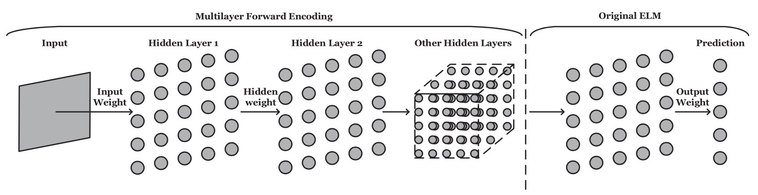
Hierarchical extreme learning machine
H-ELM is built in a multilayer manner [1]
H-ELM training architecture is divided into two separate phases :
Phase (1) unsupervised hierarchical feature representation
A new ELM-based autoencoder is developed to extract multilayer sparse features of the input data, which is to be discussed in the next section.
Phase (2) supervised feature classification
The original ELM-based regression is performed for final decision making.

Slide 6
Hierarchical extreme learning machine
Phase (1) unsupervised hierarchical feature representation
Before unsupervised feature learning, the input raw data should be transformed into an ELM random feature space, which can help to exploit hidden information among training samples.
Then, a N-layer unsupervised learning is performed to eventually obtain the high-level sparse features.
Phase (2) supervised feature classification
The resultant outputs of the last layer of phase 1 are randomly perturbed, and then utilized as the inputs of the supervised ELM-based regression to obtain the final results of the whole network.

Slide 7
Pros & cons of ELM
According to ANN theory [3] [4], for feed-forward neural networks reaching smaller training error, the smaller the norm of weights is, the better generalization performance the networks tend to have. {✓}
Unlike with traditional ANN learning algorithms, ELM requires no iteratively adjustments (back-propagation) of network parameters during the training; therefore its training speed can be thousands times faster. {✓} → feed-forward neural network
ELM has efficient tuning mechanism: given an activation function, only the hidden neuron nodes number needs to be tuned, which can be efficiently achieved via a linear validation procedure. {✓}
Besides, ELM can avoid difficulties such as stopping criteria, learning rate, learning epochs and local minima that can be commonly encountered by traditional algorithms. {✓}
ELM randomly selects the input weights and biases for hidden nodes, and it cause a crux in the stability of the forecasting results. {✗}

Slide 8
ELM vs. H-ELM
The major difference[1] between H-ELM and the original ELM is that before ELM-based regression.
The ELM sparse autoencoder of H-ELM helps to generate a better performance by providing more robust features extract from the data itself.
H-ELM uses hierarchical training to obtain multilayer sparse representation of the input raw data.
While in ELM scheme, the raw data is used for regression or classification.
Generally speaking, the compact features can help to remove redundancy of the original inputs, and thus improve the overall learning performance.

Slide 9
Implemented structure
Training & Testing Algorithm
a) Training
Learning Algorithm
Feature Vector
feature data
label data
Label Vector
transplant trained
model
b) Testing
Learning Algorithm
Feature Vector
feature data
“forecasting”
Forecasted Vector

Slide 10
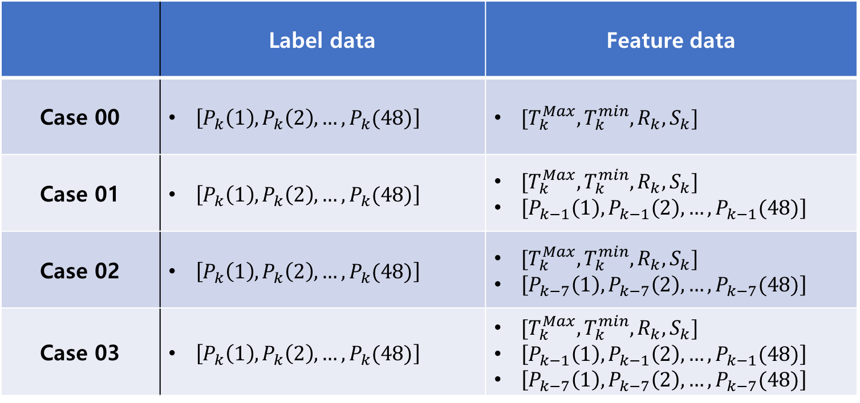
Developed structure in this paper
Pre-processing processes :
 | Label data | Feature data
Case 00 | $\left[P_{k}\left(1\right),P_{k}\left(2\right),…,P_{k}(48)\right]$ | $[T_{k}^{Max}, T_{k}^{min}, R_{k}, S_{k}]$
Case 01 | $\left[P_{k}\left(1\right),P_{k}\left(2\right),…,P_{k}(48)\right]$ | $[T_{k}^{Max}, T_{k}^{min}, R_{k}, S_{k}]$ $\left[P_{k−1}\left(1\right),P_{k−1}\left(2\right),…,P_{k−1}(48)\right]$
Case 02 | $\left[P_{k}\left(1\right),P_{k}\left(2\right),…,P_{k}(48)\right]$ | $[T_{k}^{Max}, T_{k}^{min}, R_{k}, S_{k}]$ $\left[P_{k−7}\left(1\right),P_{k−7}\left(2\right),…,P_{k−7}(48)\right]$
Case 03 | $\left[P_{k}\left(1\right),P_{k}\left(2\right),…,P_{k}(48)\right]$ | $[T_{k}^{Max}, T_{k}^{min}, R_{k}, S_{k}]$ $\left[P_{k−1}\left(1\right),P_{k−1}\left(2\right),…,P_{k−1}(48)\right]$ $\left[P_{k−7}\left(1\right),P_{k−7}\left(2\right),…,P_{k−7}(48)\right]$

Slide 11
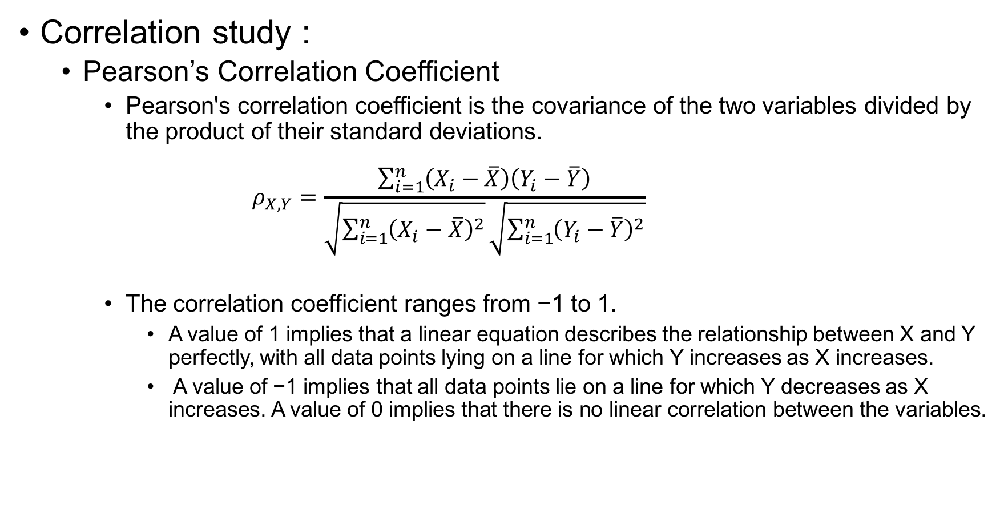
Developed structure in this paper
Correlation study :
Pearson’s Correlation Coefficient
Pearson's correlation coefficient is the covariance of the two variables divided by the product of their standard deviations. $ρ_{X, Y}=\frac{\sum_{i=1}^{n}{\left(X_{i}−\overline{X}\right)\left(Y_{i}−\overline{Y}\right)}}{\sqrt{\sum_{i=1}^{n}{{\left(X_{i}−\overline{X}\right)}^{2}}}\sqrt{\sum_{i=1}^{n}{{\left(Y_{i}−\overline{Y}\right)}^{2}}}}$
The correlation coefficient ranges from −1 to 1.
A value of 1 implies that a linear equation describes the relationship between X and Y perfectly, with all data points lying on a line for which Y increases as X increases.
A value of −1 implies that all data points lie on a line for which Y decreases as X increases. A value of 0 implies that there is no linear correlation between the variables.

Slide 12
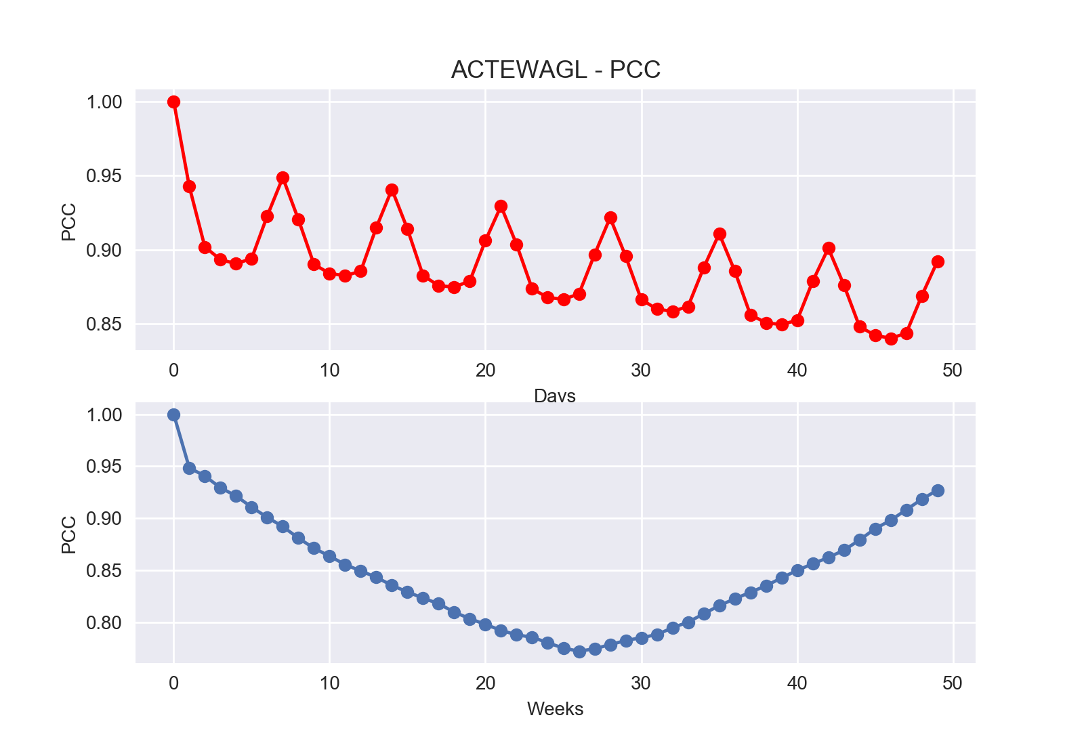
Developed structure in this paper
Correlation study
Pearson’s Correlation Coefficient

Slide 13
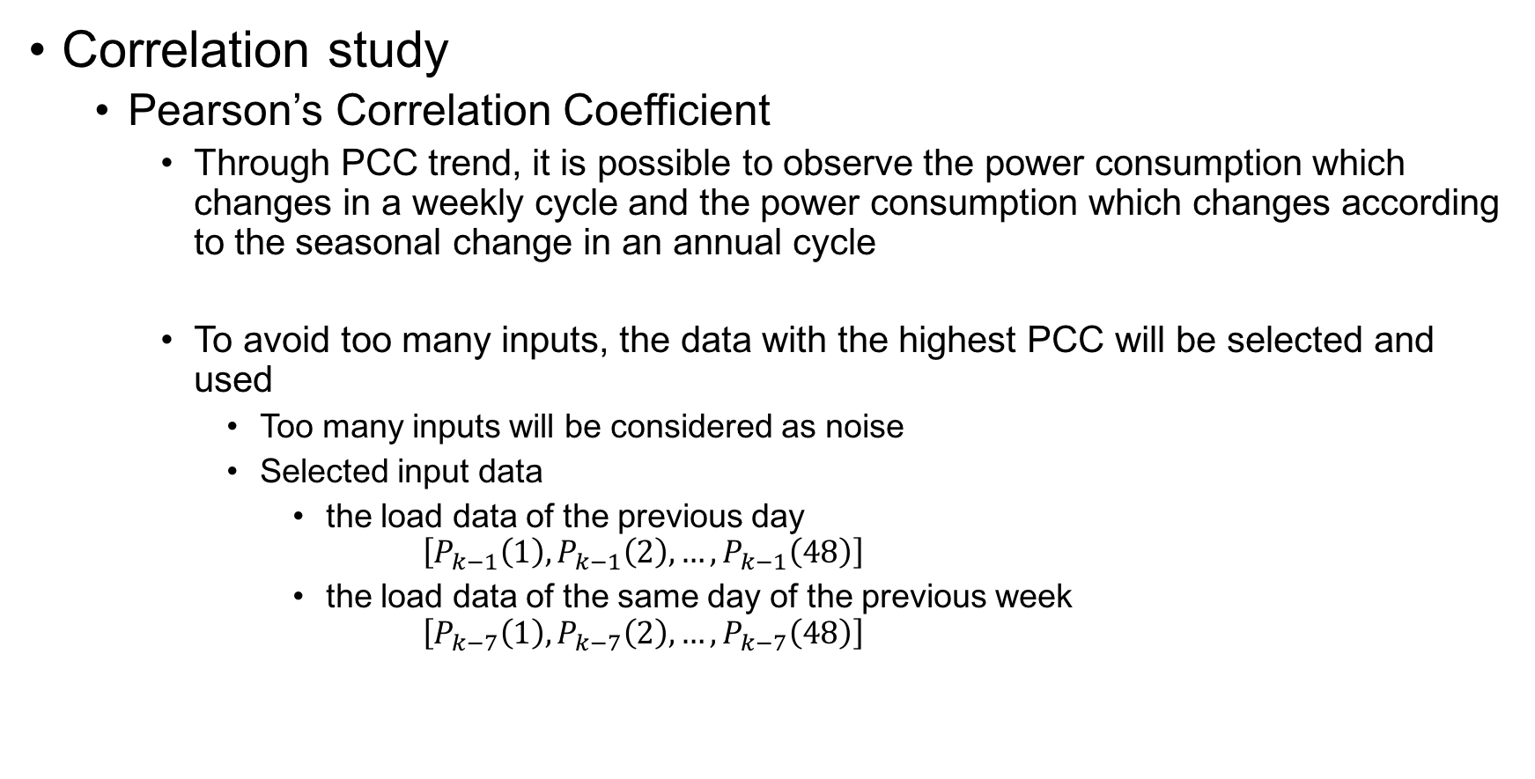
Developed structure in this paper
Correlation study
Pearson’s Correlation Coefficient
Through PCC trend, it is possible to observe the power consumption which changes in a weekly cycle and the power consumption which changes according to the seasonal change in an annual cycle
To avoid too many inputs, the data with the highest PCC will be selected and used
Too many inputs will be considered as noise
Selected input data
the load data of the previous day $\left[P_{k−1}\left(1\right),P_{k−1}\left(2\right), …,P_{k−1}\left(48\right)\right]$
the load data of the same day of the previous week $\left[P_{k−7}\left(1\right),P_{k−7}\left(2\right), …,P_{k−7}\left(48\right)\right]$

Slide 14
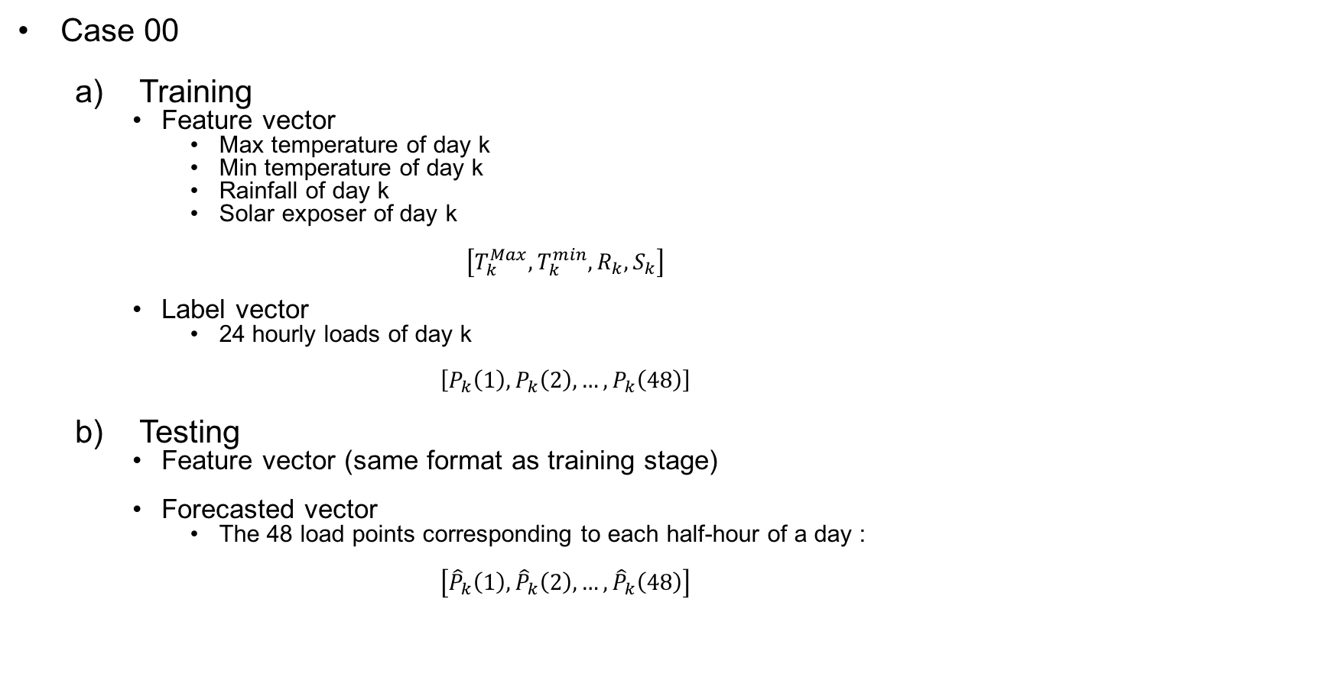
Developed structure in this paper
Case 00
Training
Feature vector
Max temperature of day k
Min temperature of day k
Rainfall of day k
Solar exposer of day k $\left[T_{k}^{Max},T_{k}^{min}, R_{k},S_{k}\right]$
Label vector
24 hourly loads of day k $\left[P_{k}\left(1\right),P_{k}\left(2\right), …,P_{k}\left(48\right)\right]$
Testing
Feature vector (same format as training stage)
Forecasted vector
The 48 load points corresponding to each half-hour of a day : $\left[{\hat{P}}_{k}\left(1\right),{\hat{P}}_{k}\left(2\right), …,{\hat{P}}_{k}\left(48\right)\right]$
Because the number of input features is too small, the predicted result always outputs the same result, which are not valuable and not accurate, at all times.

Slide 15
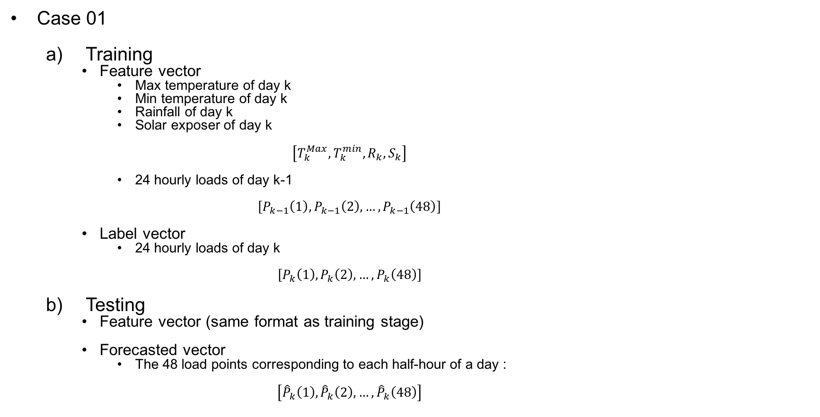

Developed structure in this paper
Case 01
Training
Feature vector
Max temperature of day k
Min temperature of day k
Rainfall of day k
Solar exposer of day k $\left[T_{k}^{Max},T_{k}^{min}, R_{k},S_{k}\right]$
24 hourly loads of day k-1 $\left[P_{k−1}\left(1\right),P_{k−1}\left(2\right), …,P_{k−1}\left(48\right)\right]$
Label vector
24 hourly loads of day k $\left[P_{k}\left(1\right),P_{k}\left(2\right), …,P_{k}\left(48\right)\right]$
Testing
Feature vector (same format as training stage)
Forecasted vector
The 48 load points corresponding to each half-hour of a day : $\left[{\hat{P}}_{k}\left(1\right),{\hat{P}}_{k}\left(2\right), …,{\hat{P}}_{k}\left(48\right)\right]$
In order to increase the number of input features, the load data of the previous day ($P_{k−1}(i)$) is input together with the weather data of the corresponding day.
The load data of the previous day ($P_{k−1}(i)$) acts as a hint in the forecasting process.

Slide 16
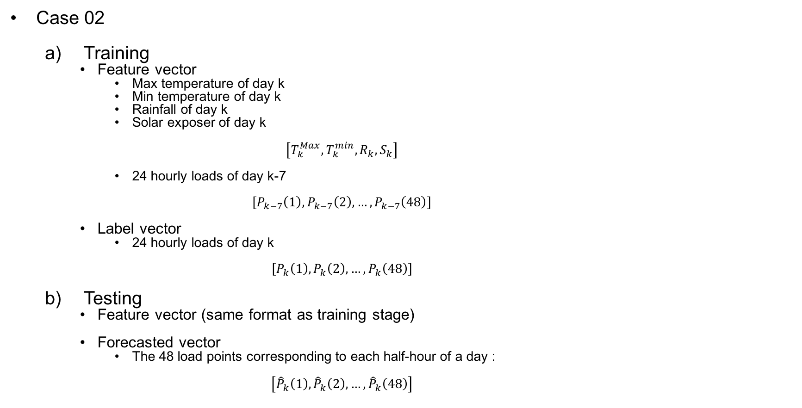

Developed structure in this paper
Case 02
Training
Feature vector
Max temperature of day k
Min temperature of day k
Rainfall of day k
Solar exposer of day k $\left[T_{k}^{Max},T_{k}^{min}, R_{k},S_{k}\right]$
24 hourly loads of day k-7 $\left[P_{k−7}\left(1\right),P_{k−7}\left(2\right), …,P_{k−7}\left(48\right)\right]$
Label vector
24 hourly loads of day k $\left[P_{k}\left(1\right),P_{k}\left(2\right), …,P_{k}\left(48\right)\right]$
Testing
Feature vector (same format as training stage)
Forecasted vector
The 48 load points corresponding to each half-hour of a day : $\left[{\hat{P}}_{k}\left(1\right),{\hat{P}}_{k}\left(2\right), …,{\hat{P}}_{k}\left(48\right)\right]$
In order to increase the number of input features, the load data of the same day of the previous week ($P_{k−7}(i)$) is input together with the weather data of the corresponding day.
The load data of the same day of the previous week ($P_{k−7}(i)$) acts as a hint in the forecasting process.

Slide 17
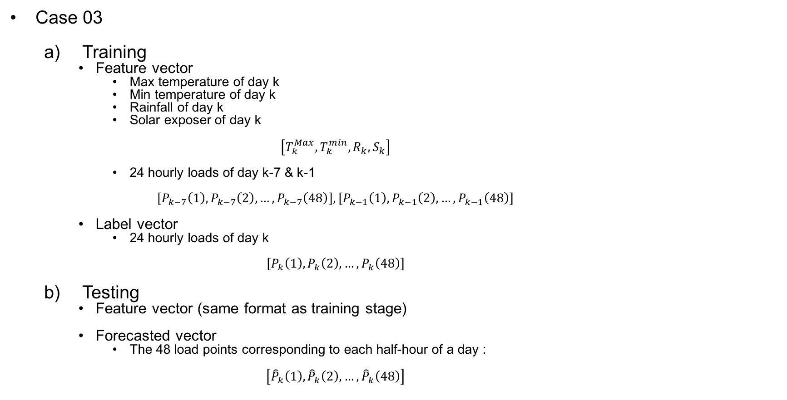

Developed structure in this paper
Case 03
Training
Feature vector
Max temperature of day k
Min temperature of day k
Rainfall of day k
Solar exposer of day k $\left[T_{k}^{Max},T_{k}^{min}, R_{k},S_{k}\right]$
24 hourly loads of day k-7 & k-1 $\left[P_{k−7}\left(1\right),P_{k−7}\left(2\right), …,P_{k−7}\left(48\right)\right],\left[P_{k−1}\left(1\right),P_{k−1}\left(2\right), …,P_{k−1}\left(48\right)\right]$
Label vector
24 hourly loads of day k $\left[P_{k}\left(1\right),P_{k}\left(2\right), …,P_{k}\left(48\right)\right]$
Testing
Feature vector (same format as training stage)
Forecasted vector
The 48 load points corresponding to each half-hour of a day : $\left[{\hat{P}}_{k}\left(1\right),{\hat{P}}_{k}\left(2\right), …,{\hat{P}}_{k}\left(48\right)\right]$
In order to increase the number of input features, the load data of the same day of the previous week ($P_{k−7}(i)$) and the load data of the previous day ($P_{k−1}(i)$) are input together with the weather data of the corresponding day.
The load data of the same day of the previous week ($P_{k−7}(i)$) and the load data of the previous day ($P_{k−1}(i)$) act as a hint in the forecasting process.

Slide 18
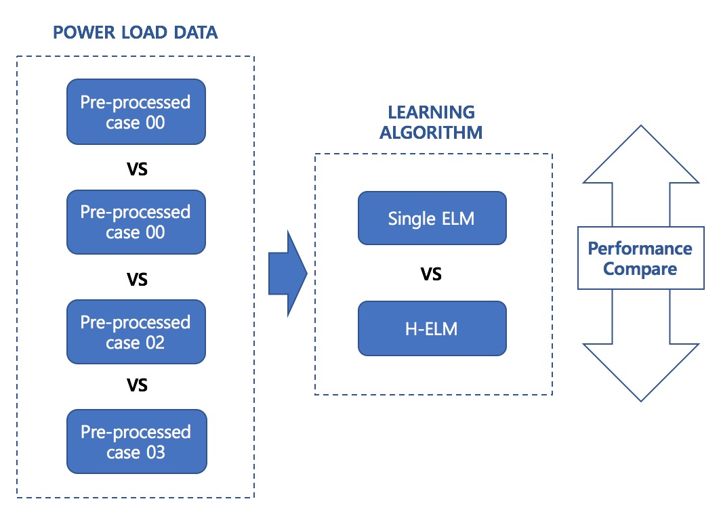
Experiments

Slide 19
Load data
Input load data types :
 | Label data | Feature data
Case 00 | $\left[P_{k}\left(1\right),P_{k}\left(2\right),…,P_{k}(48)\right]$ | $[T_{k}^{Max}, T_{k}^{min}, R_{k}, S_{k}]$
Case 01 | $\left[P_{k}\left(1\right),P_{k}\left(2\right),…,P_{k}(48)\right]$ | $[T_{k}^{Max}, T_{k}^{min}, R_{k}, S_{k}]$ $\left[P_{k−1}\left(1\right),P_{k−1}\left(2\right),…,P_{k−1}(48)\right]$
Case 02 | $\left[P_{k}\left(1\right),P_{k}\left(2\right),…,P_{k}(48)\right]$ | $[T_{k}^{Max}, T_{k}^{min}, R_{k}, S_{k}]$ $\left[P_{k−7}\left(1\right),P_{k−7}\left(2\right),…,P_{k−7}(48)\right]$
Case 03 | $\left[P_{k}\left(1\right),P_{k}\left(2\right),…,P_{k}(48)\right]$ | $[T_{k}^{Max}, T_{k}^{min}, R_{k}, S_{k}]$ $\left[P_{k−1}\left(1\right),P_{k−1}\left(2\right),…,P_{k−1}(48)\right]$ $\left[P_{k−7}\left(1\right),P_{k−7}\left(2\right),…,P_{k−7}(48)\right]$

Slide 20
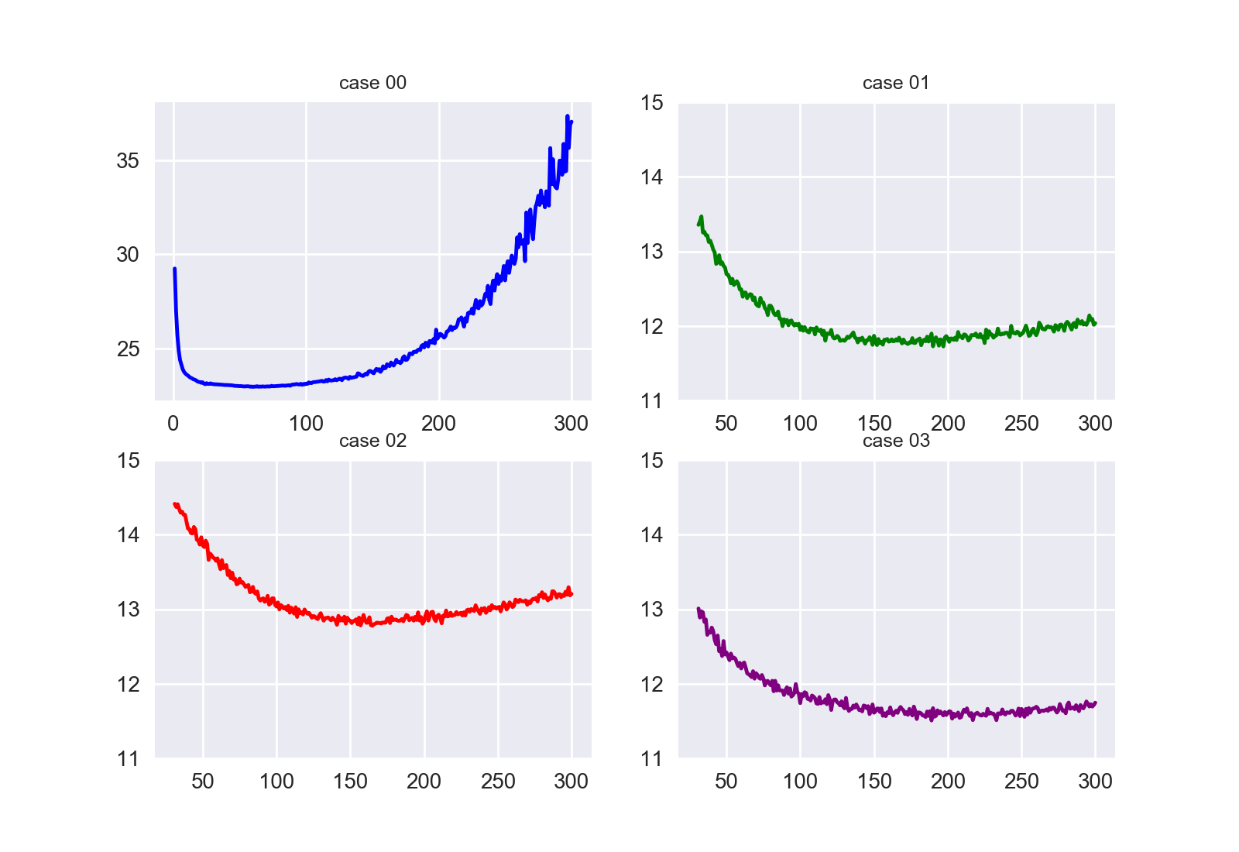

Learning Algorithm
Single ELM
Optimization algorithm :
Optimal hidden node range
$\left[L_{1}, L_{2}\right]$ : determined range of hidden nodes yielding lowest validation errors
the MAPE at each node number is the average value of 20 trails

Slide 21
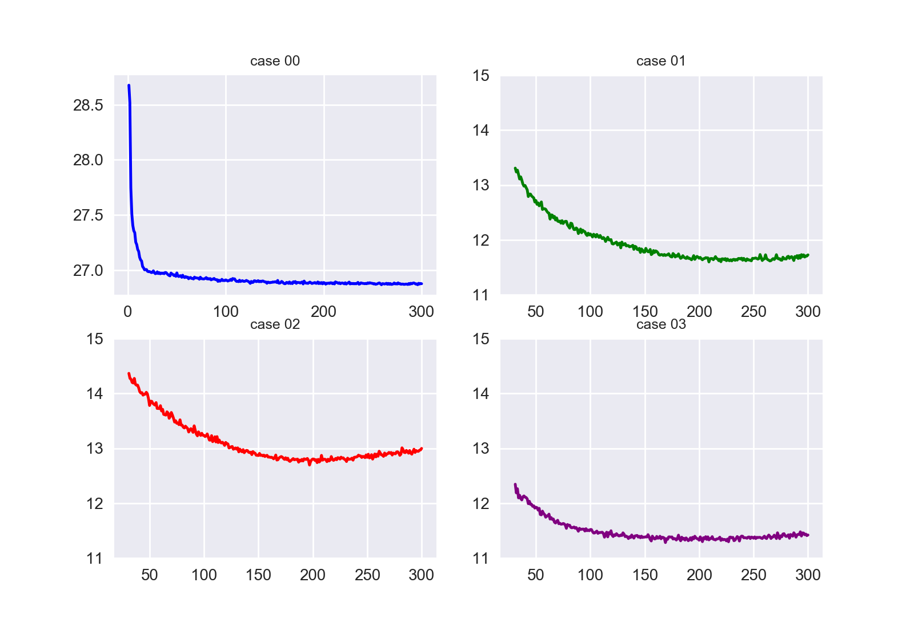

Learning Algorithm
Hierarchical ELM
Optimization algorithm :
Optimal hidden node range for each layers
$\left[L_{1}^{k},L_{2}^{k}\right]$ : determined range of hidden nodes on $k−th$ layer
the MAPE at each node number is the average value of 20 trails
Notes:
# RELM은 하나의 층만 구성되어 있는 상태
# RELM 층이 추가로 구성되면 성능이 저하된다
# 그 이유는 …
# case 00의 결과값의 그래프는 좀 이상해 보이는데 무시 가능하다
# 그 이유는 …

Slide 22
Performance comparing measurements
Accuracy
MAPE (mean absolute percentage error)
MAE (mean absolute error)
Stability
Standard deviation of MAPE of 1,000 trails
Standard deviation of MAE of 1,000 trails
Efficiency
Average of training time of 1,000 trails

Slide 23
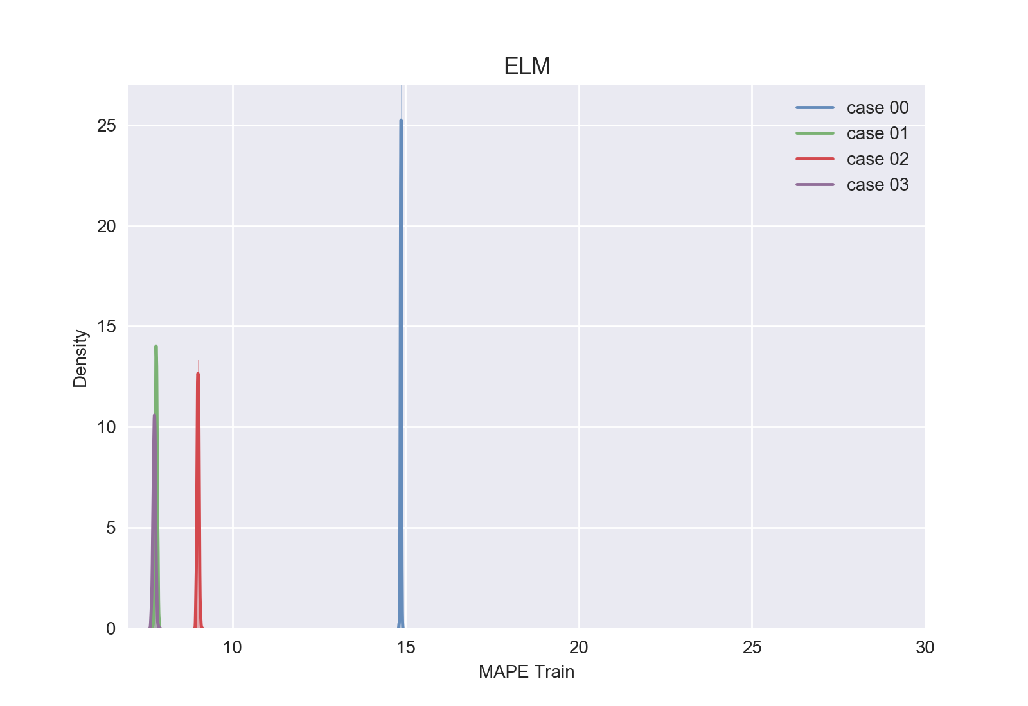
Results
Training : ELM
MAPE

Slide 24
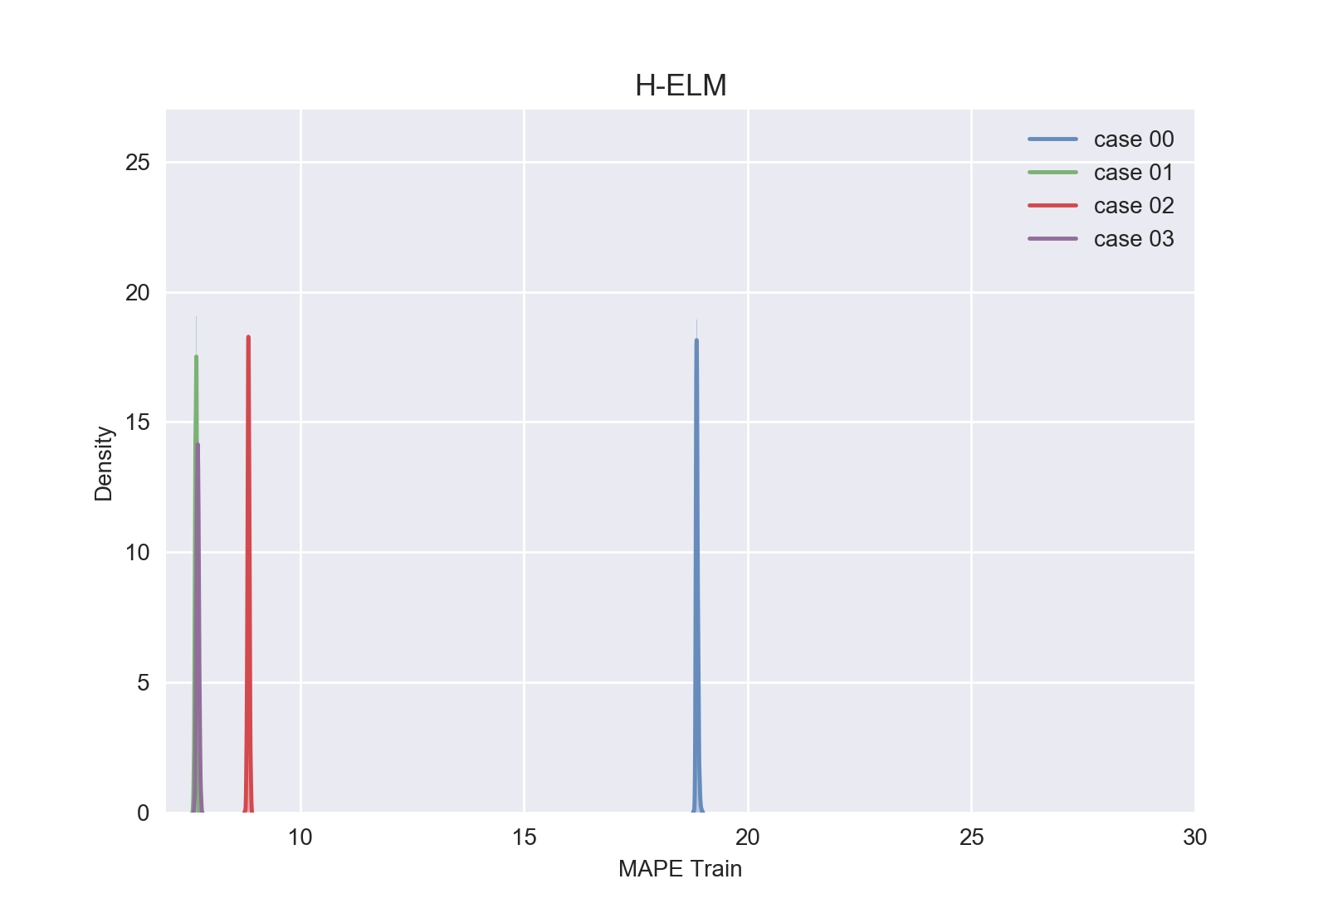
Results
Training : H-ELM
MAPE
Notes:
# training MAPE를 보면 ELM에서 HELM으로 변화를 줌에 따라 case01~03은 MAPE가 떨어지지만 case00의 MAPE는 증가하는 것을 보면 feature의 갯수가 문제였음을 알 수 잇음

Slide 25
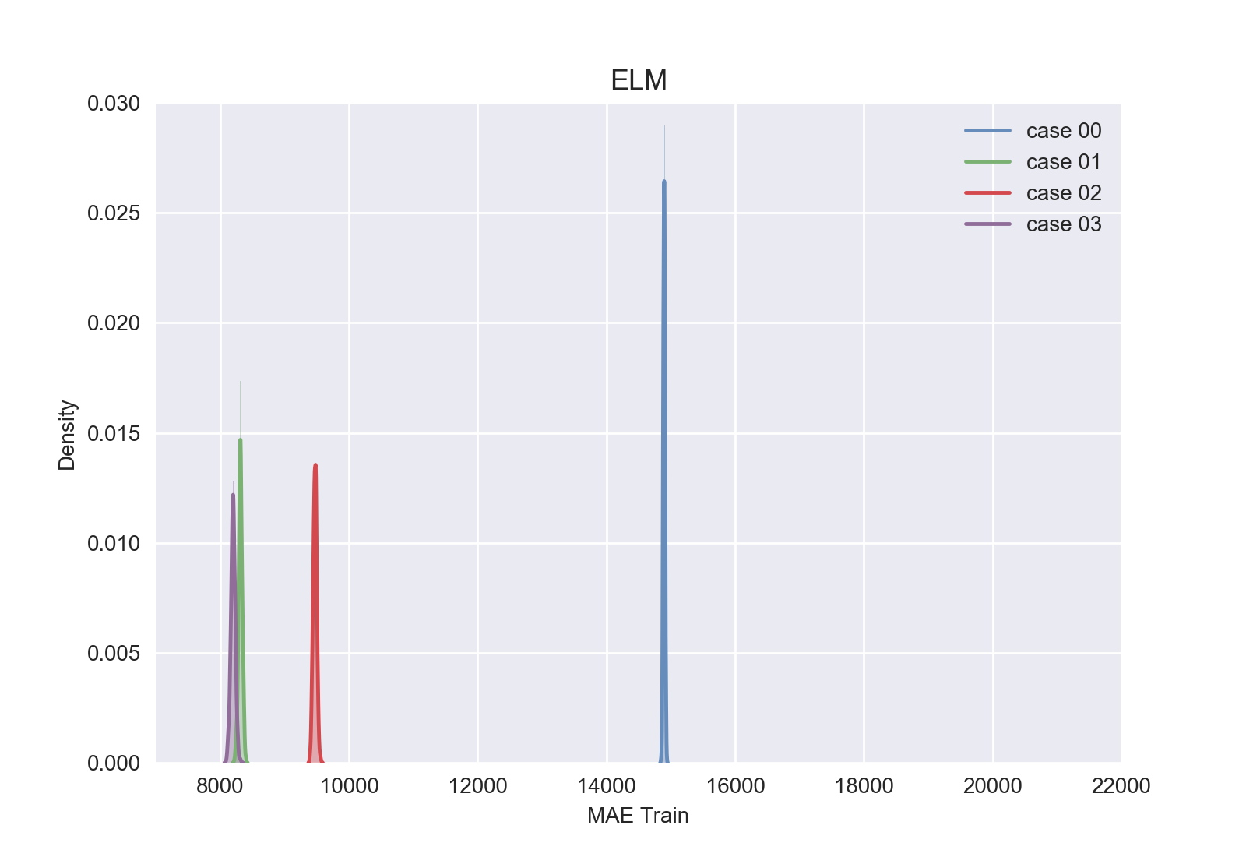
Results
Training : ELM
MAE

Slide 26
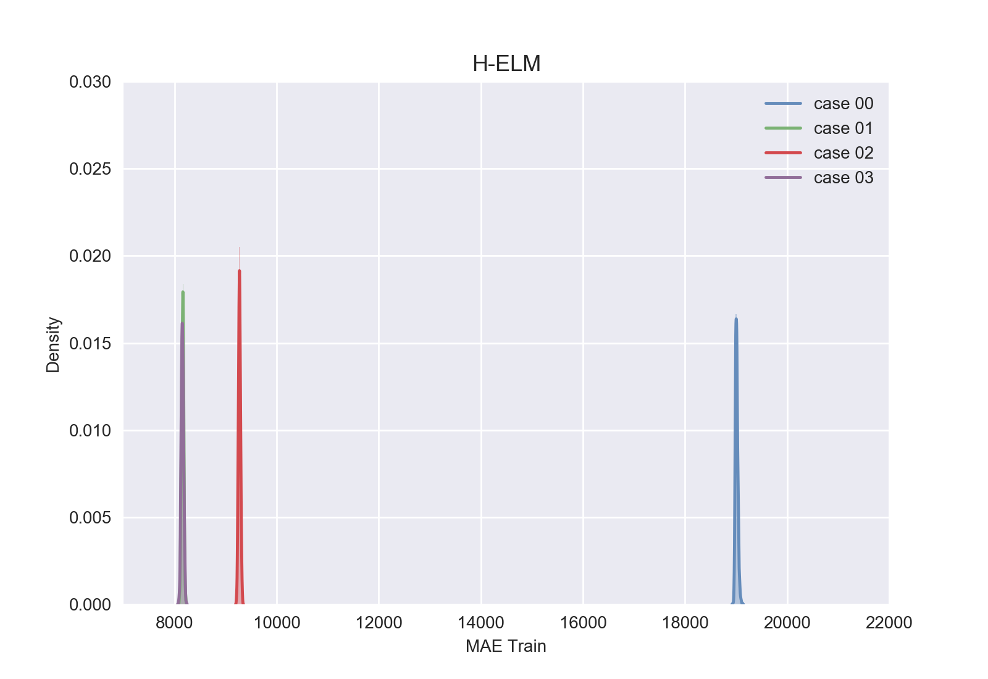
Results
Training : H-ELM
MAE
Notes:
# trainingMAE를 보면 ELM에서 HELM으로 변화를 줌에 따라 case01~03은 MAE가 떨어지지만 case00의 MAE는 증가하는 것을 보면 feature의 갯수가 문제였음을 알 수 잇음

Slide 27
Results
Training :
Data pre-processing
As the number of input features increases through the data preprocessing process, the MAPE & MAE tends to decrease
Data pre-processing allows extract more valuable features from input data
Data pre-processing allows accurate learning
ELM vs. H-ELM
HELM shows a smaller value of MAPE than ELM
➔ Compared to ELM, HELM allows accurate learning
HELM shows dense MAPE distribution compared to ELM
➔ Compared to ELM, HELM shows stable MAPE & MAE distribution

Slide 28
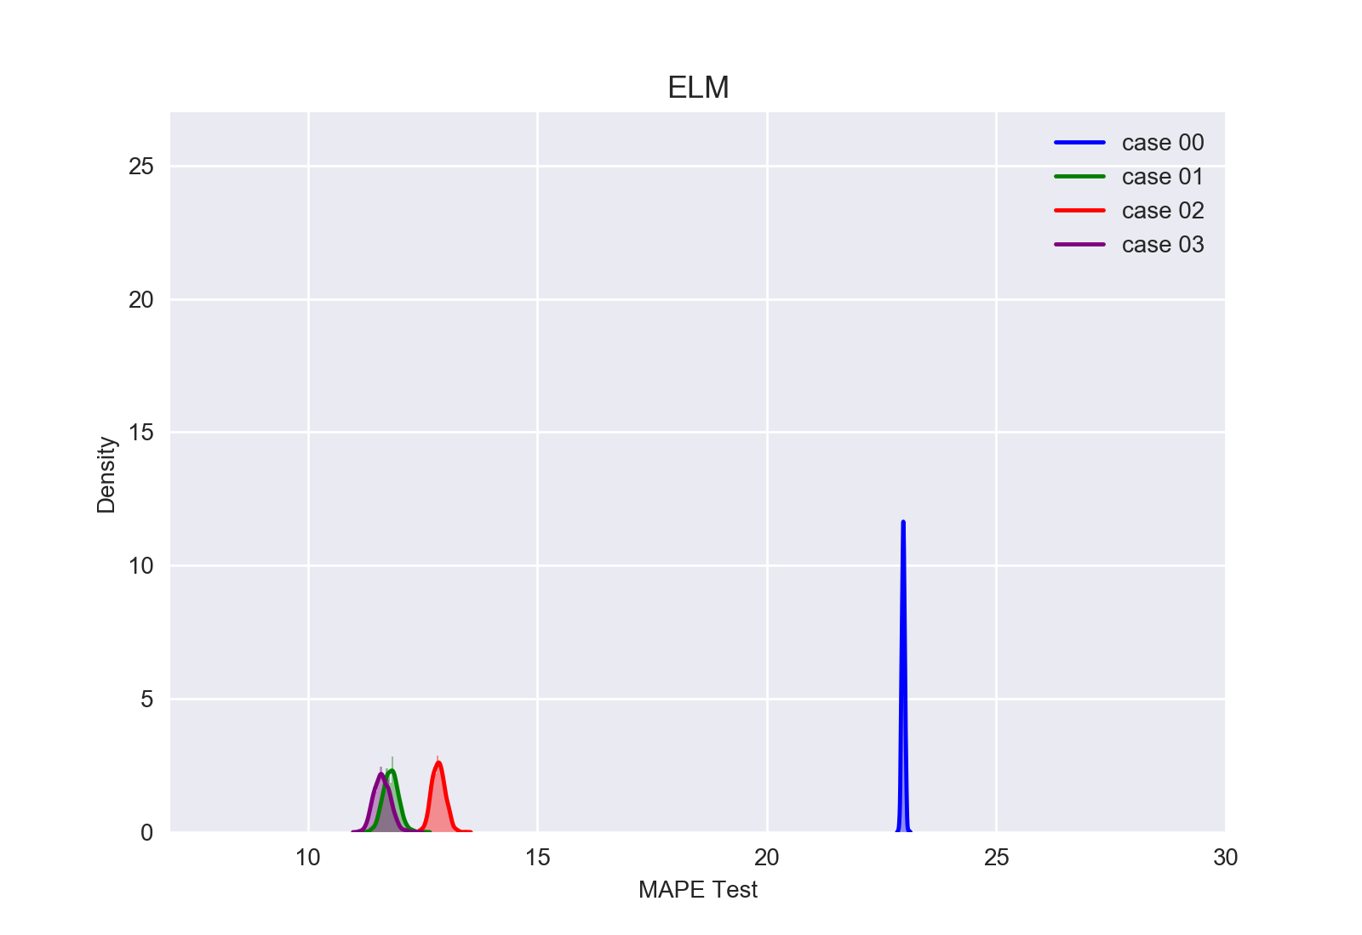
Results
Testing : ELM
MAPE

Slide 29
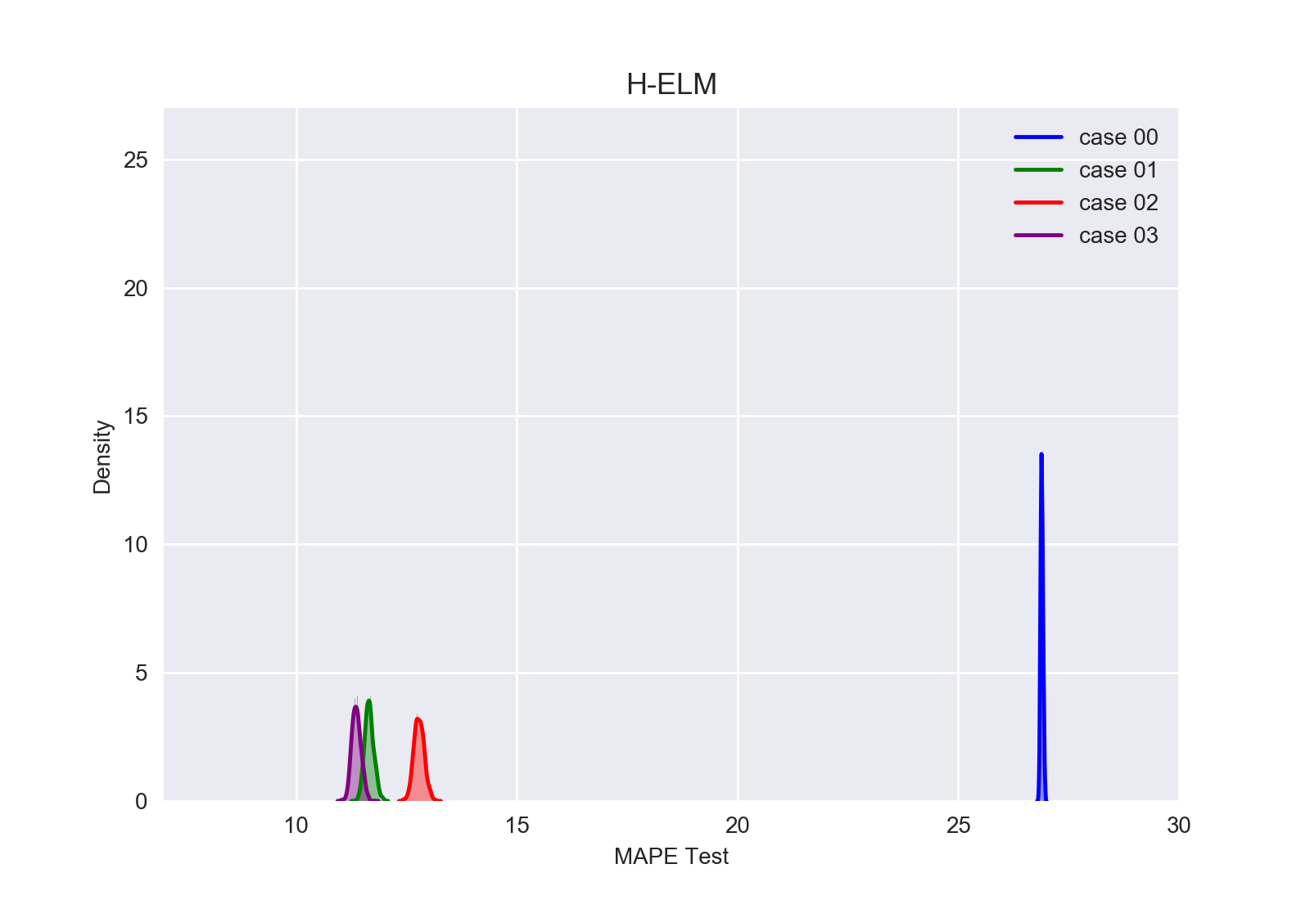
Results
Testing : H-ELM
MAPE

Slide 30
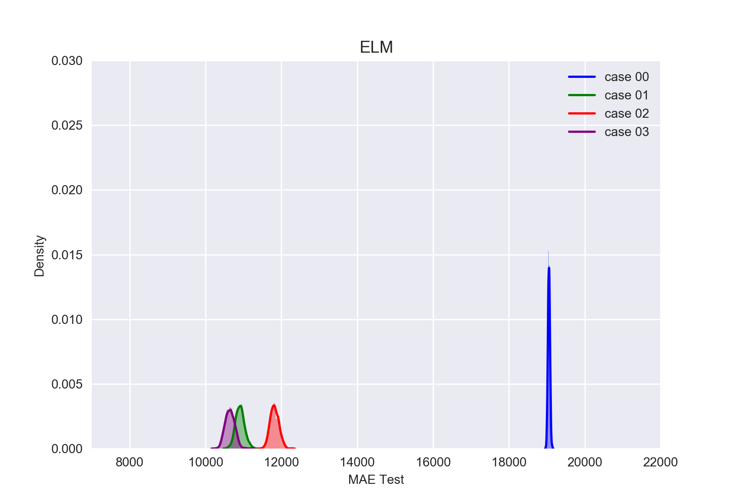
Results
Testing : ELM
MAE

Slide 31
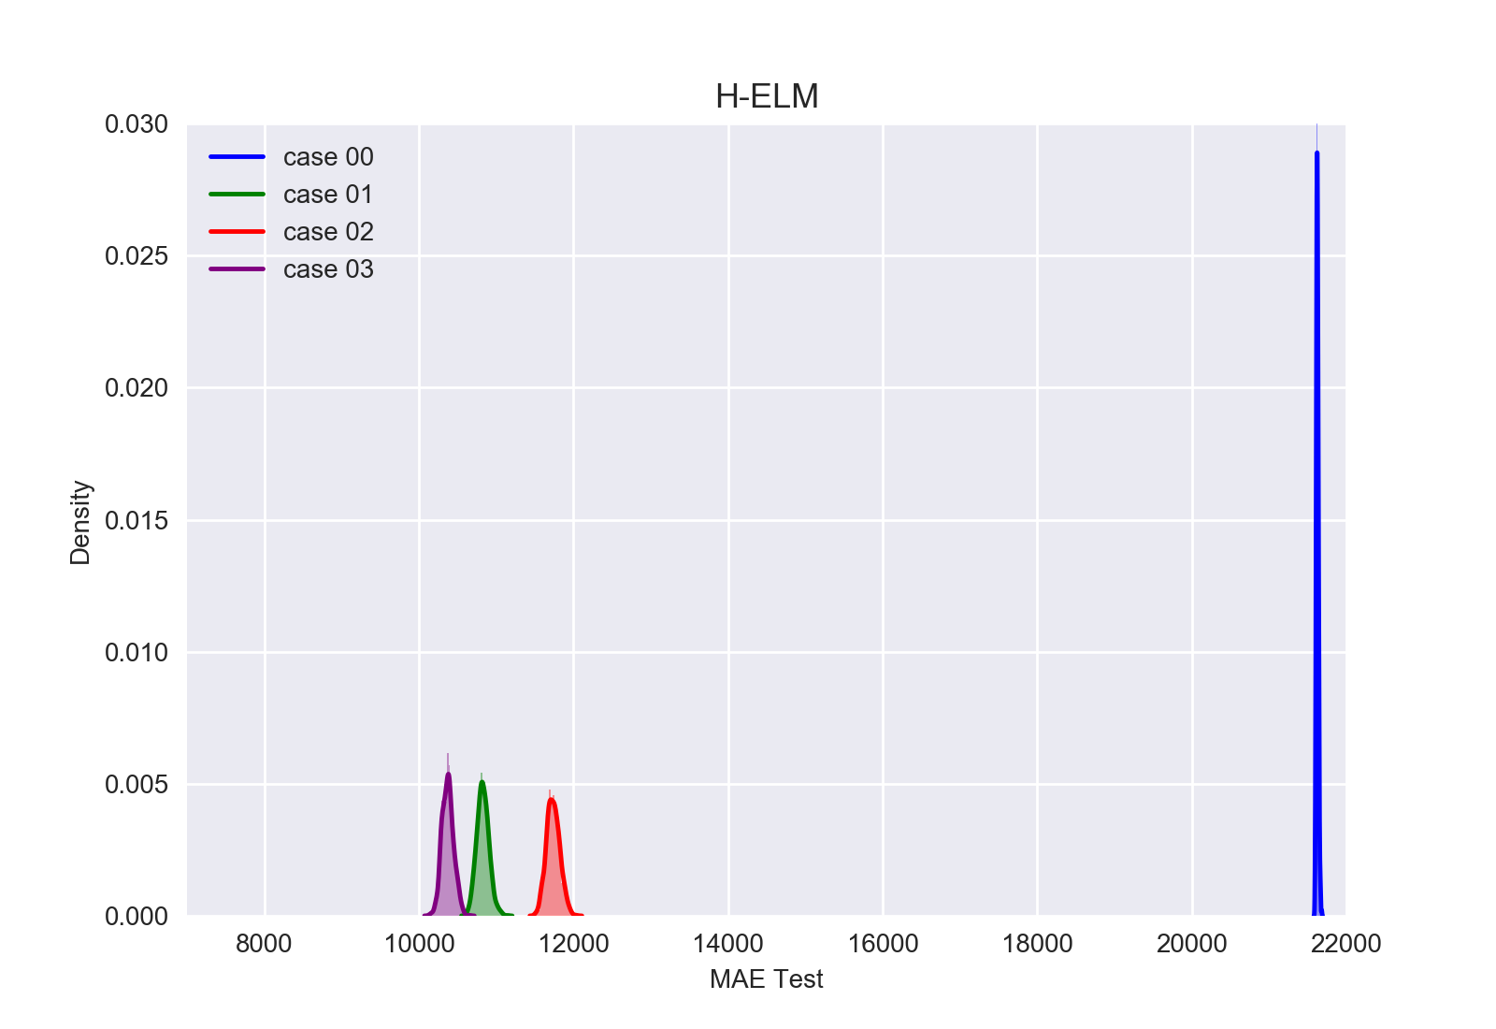
Results
Testing : H-ELM
MAE

Slide 32
Result of case 00
Testing :
Data-preprocessing
It seems to show stable predicted values, but it outputs inaccurate predictions each time because the feature types of the input data are too small
ELM vs. H-ELM
ELM shows a prediction with a smaller MAPE & MAE than HELM, but this is not meaningful because it is an inaccurate prediction
Method | MAPE [%] | Standard deviation (MAPE) | MAE [MW] | Standard deviation (MAE) | Training time [sec]
Single ELM | 22.973061 | 0.0336759154144 | 19056.307 | 26.8281335728 | 0.0681
H-ELM | 26.892541 | 0.0286463665933 | 21624.653 | 13.8147237034 | 0.0581

Slide 33
Result of case 01
Testing :
Data-preprocessing
The number of types of features input through the data preprocessing has been increased, and as a result more accurate prediction has become possible
ELM vs. H-ELM
ELM and HELM show similar MAPE & MAE results, but HELM performs more stable predictions
Method | MAPE [%] | Standard deviation (MAPE) | MAE [MW] | Standard deviation (MAE) | Training time [sec]
Single ELM | 11.807609 | 0.168111879768 | 10909.385 | 117.971109917 | 0.1383
H-ELM | 11.657106 | 0.103974760226 | 10828.877 | 78.9932773785 | 0.1030

Slide 34
Result of case 02
Testing :
Data-preprocessing
Similar to the result of case01, the number of types of features input through the data preprocessing has been increased, and as a result more accurate prediction has become possible
ELM vs. H-ELM
Similar to the result of case01, ELM and HELM show similar MAPE & MAE results, but HELM performs more stable predictions
Method | MAPE [%] | Standard deviation (MAPE) | MAE [MW] | Standard deviation (MAE) | Training time [sec]
Single ELM | 12.846329 | 0.145121675704 | 11819.954 | 113.70928671 | 0.1173
H-ELM | 12.784406 | 0.116388595507 | 11737.837 | 85.2619283796 | 0.1244

Slide 35
Result of case 03
Testing :
Data-preprocessing
Data preprocessing has provided enough types of features to be input, resulting in accurate and stable prediction
ELM vs. H-ELM
HELM performed more accurate predictions than ELM
HELM performed more stable predictions than ELM
Method | MAPE [%] | Standard deviation (MAPE) | MAE [MW] | Standard deviation (MAE) | Training time [sec]
Single ELM | 11.618014 | 0.177854591743 | 10645.320 | 123.732960847 | 0.1400
H-ELM | 11.364907 | 0.103866743239 | 10373.912 | 74.8755918574 | 0.0970

Slide 36
Conclusion
Data pre-processing
All experiments with various methods show that data preprocessing can help to get better performance in load forecasting
Learning algorithm
H-ELM showed better prediction accuracy compared to ELM
More accurate forecasting result than single ELM
Eliminating the problem of stability, which was a disadvantage of ELM
Similar training time compare to ELM

Slide 37
References
[1] Jiexiong Tang, Chenwei Deng, Guang-Bin Huang, Extreme Learning Machine for Multilayer Perceptron, IEEE transactions on neural Network and learning systems, Vol. 27, No. 4, April 2016
[2] Rui Zhang, Zhao Yang Dong, Yan Xu, Ke Meng, Kit Po Wong, Short-term load forecasting of Australian National Electricity Market by an ensemble model of extreme learning machine, December 2012
[3] Bartlett, P.L.: ‘The sample complexity of pattern classification with neural networks: the size of the weights is more important than the size of the network’, IEEE Trans. Inf. Theory, 1998, 44, (2), pp. 525–536
[4] Huang, G.-B., Zhu, Q.-Y., Siew, C.-K.: ‘Extreme learning machine: theory and applications’, Neurocomputing, 2006, 70, pp. 489–501
[5] Australian Energy Market Operator [Online]. Available at http://www.aemo.com.au/
[6] Bureau of Meteorology of Australian Government [Online]. Available at http://www.bom.gov.au/index.shtml

