Slide 1

May 2021
Learning for DC-OPF: Classifying Active GEN Constraints using Graph Attention Networks
EE 394V DAPS Final Project Presentation
Jeehyun park
M.S. Student, The University of Texas at Austin

Slide 2
Motivation
Optimal Power Flow (OPF) problem.
Increasing uncertainty and variability in energy sources and demands. → Increasing uncertainty realizations [1].
To respond to the observed uncertainty realizations
The optimal solution needs to be updated near real-time.
Utilize Neural Nets (Fully Connected) for fast OPF solving [1].

Slide 3
Problem Formulation
Limitations of Fully Connected Neural Nets (FCNN).
Requires too many training parameters for sufficient performance.
No interpretability.
Utilize attention algorithms to have better performance and interpretability of the model.

Slide 4
Proposed Approach
Utilize Graph Conv Nets and Graph Attention Nets to solve OPF problems.
Graph Conv Networks [2]
Training the parameters based on the power system’s topology. → Less training parameters. → Allows us to utilize attention algorithms.
Graph Attention Networks [3]
Better performance.
Model’s interpretability.

Slide 5
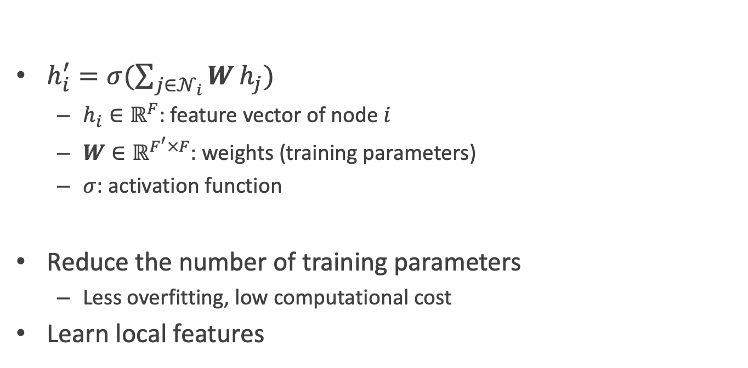
Graph Conv Networks
$h_{i}^{′}=σ(\sum_{j∈𝒩_{i}}{W}h_{j})$
$h_{i}∈ℝ^{F}$: feature vector of node $i$
$W∈ℝ^{F^{′}×F}$: weights (training parameters)
$σ$: activation function
Reduce the number of training parameters
Less overfitting, low computational cost
Learn local features

Slide 6
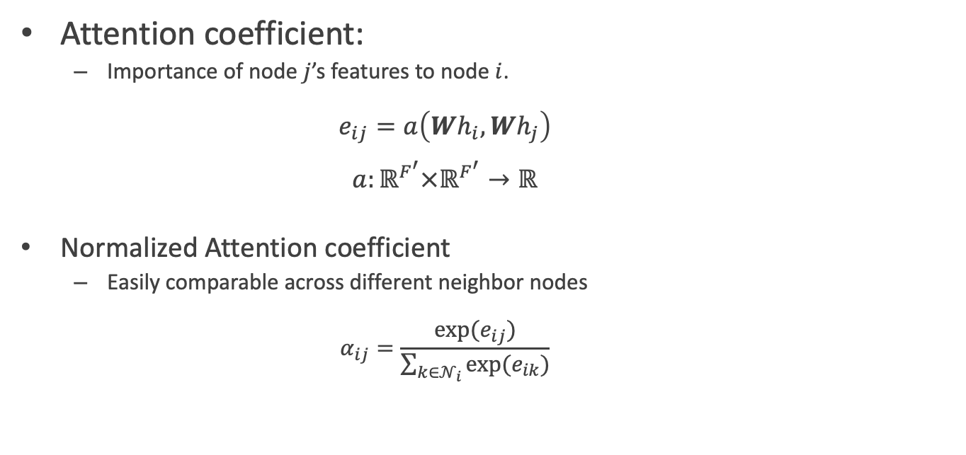
Graph Attention Networks
Attention coefficient:
Importance of node $j$’s features to node $i$. $e_{ij}=a\left(Wh_{i},Wh_{j}\right)$ $a:ℝ^{F^{′}}×ℝ^{F^{′}}→ℝ$
Normalized Attention coefficient
Easily comparable across different neighbor nodes $α_{ij}=\frac{exp⁡(e_{ij})}{\sum_{k∈𝒩_{i}}{exp⁡(e_{ik})}}$

Slide 7
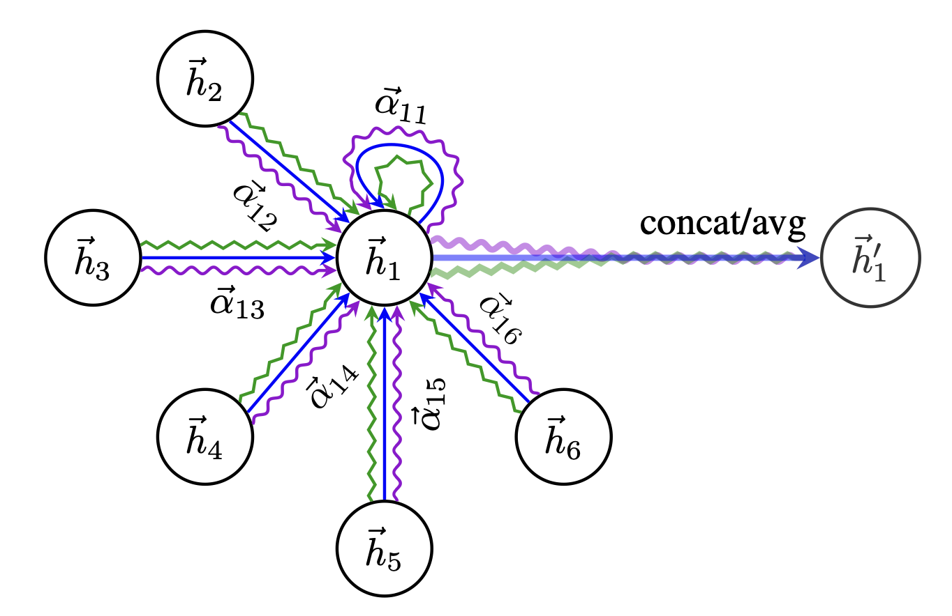
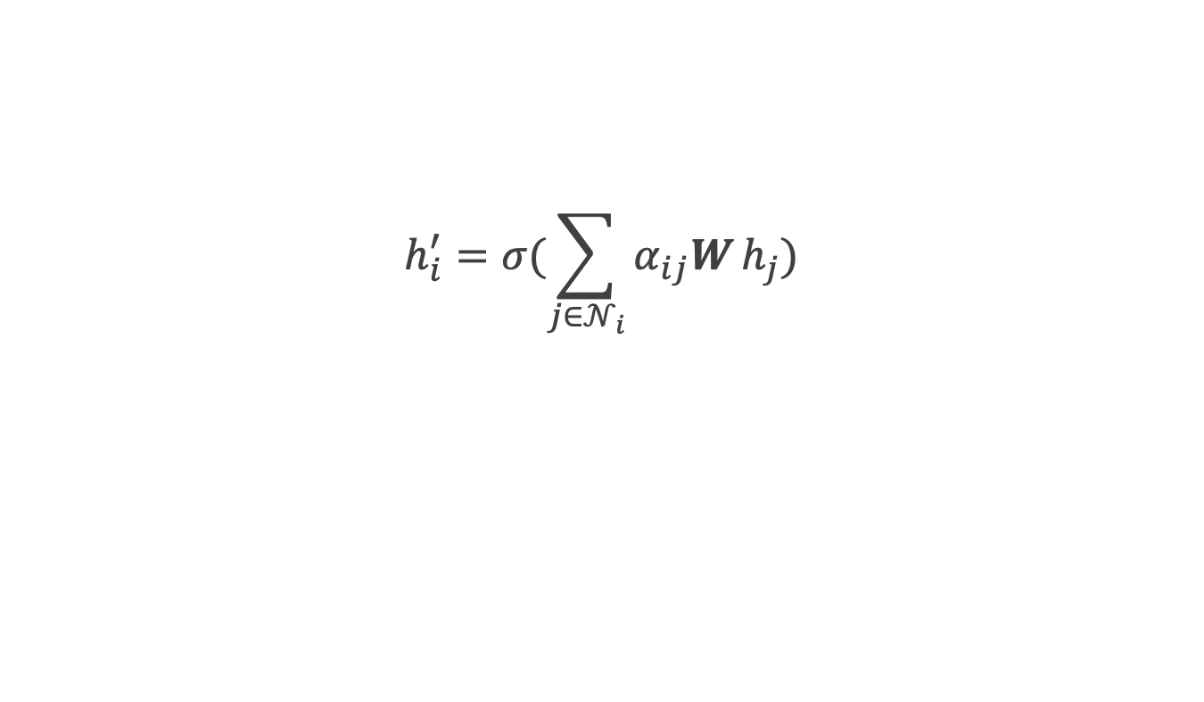
Graph Attention Networks
$$h_{i}^{′}=σ(\sum_{j∈𝒩_{i}}{α_{ij}W}h_{j})$$

Slide 8
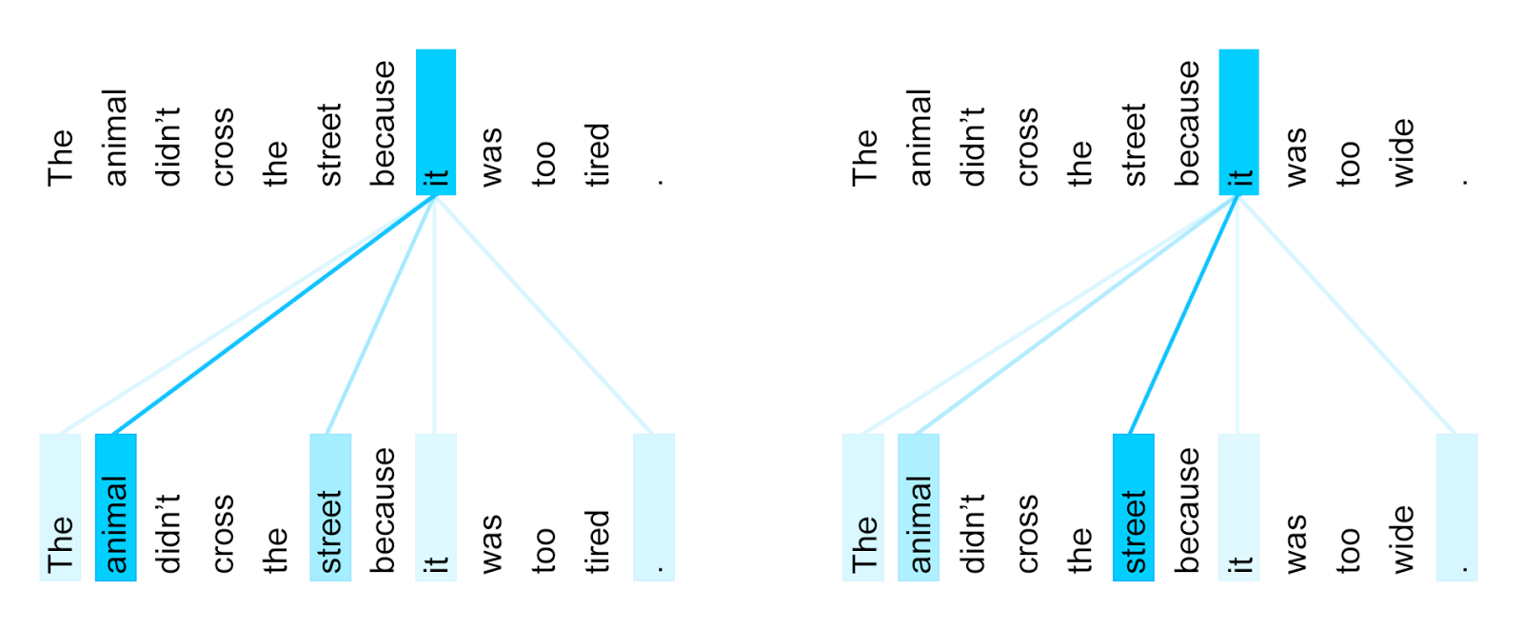
Attention in Natural Language Process
Interpretability in NLP [4]

Slide 9
Experiments
Dataset
IEEE PES PGLib-OPF benchmark library [5]
Generating datasets for the learning
Input features
Demand loads + uncertainty realization
Output targets
OPF solution (solved by Matpower7.1): Generators in active constraint condition.

Slide 10
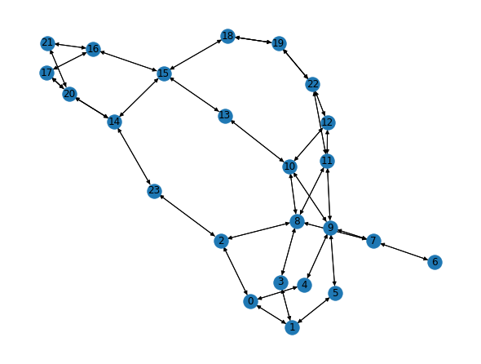
Experiments
Examples of data
pglib_opf_case24_ieee_rts: graph

Slide 11
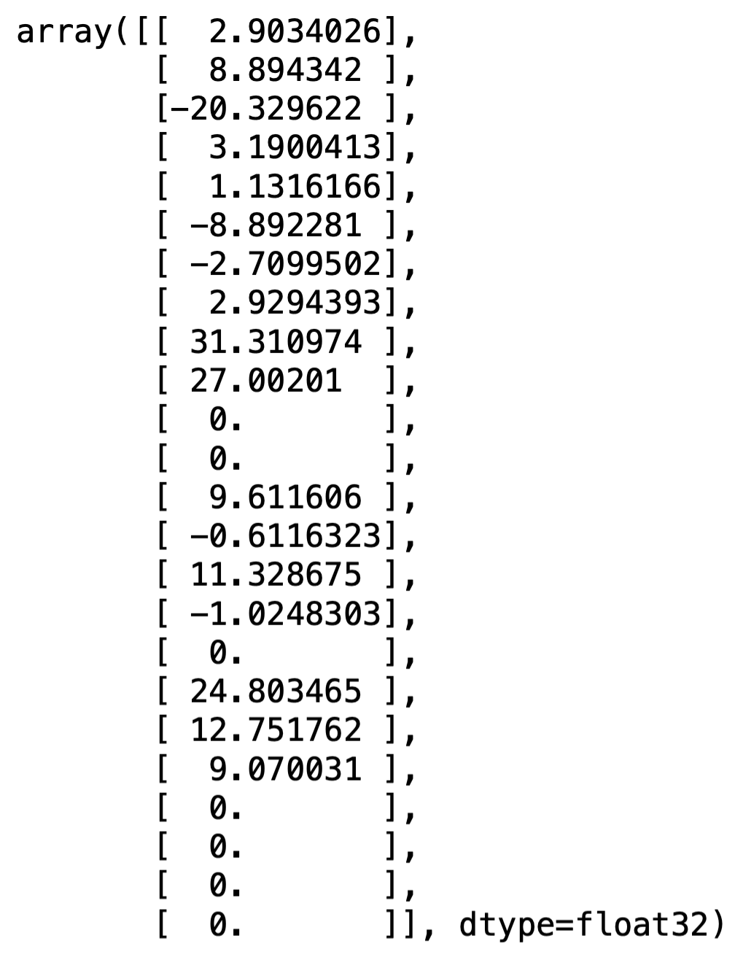
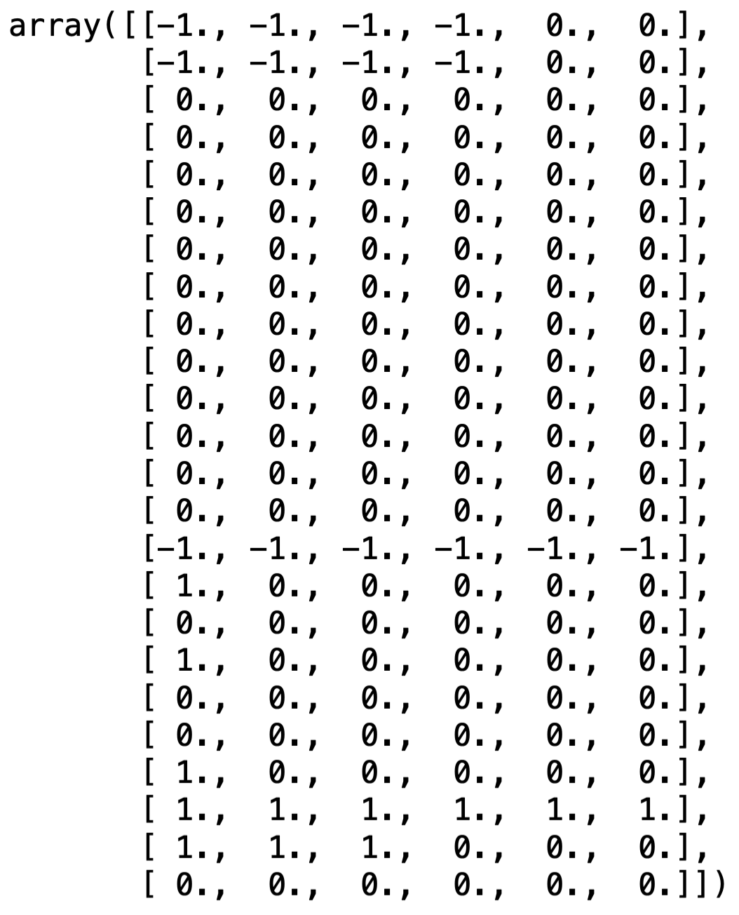
Experiments
Examples of data
pglib_opf_case24_ieee_rts: input features & output targets

Slide 12
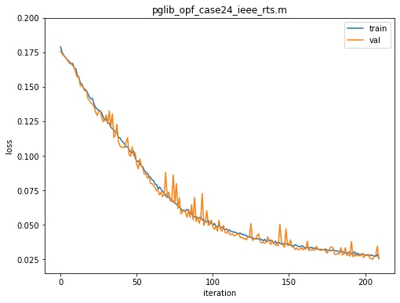
Results
Case: pglib_opf_case24_ieee_rts
GCN: min loss = 0.0254

Slide 13
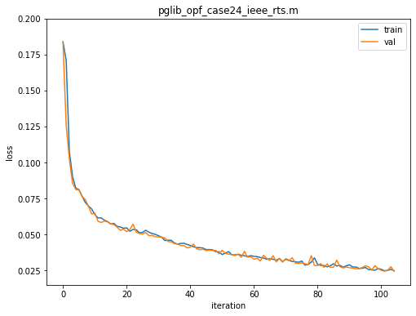
Results
Case: pglib_opf_case24_ieee_rts
GAT: min loss = 0.0206

Slide 14
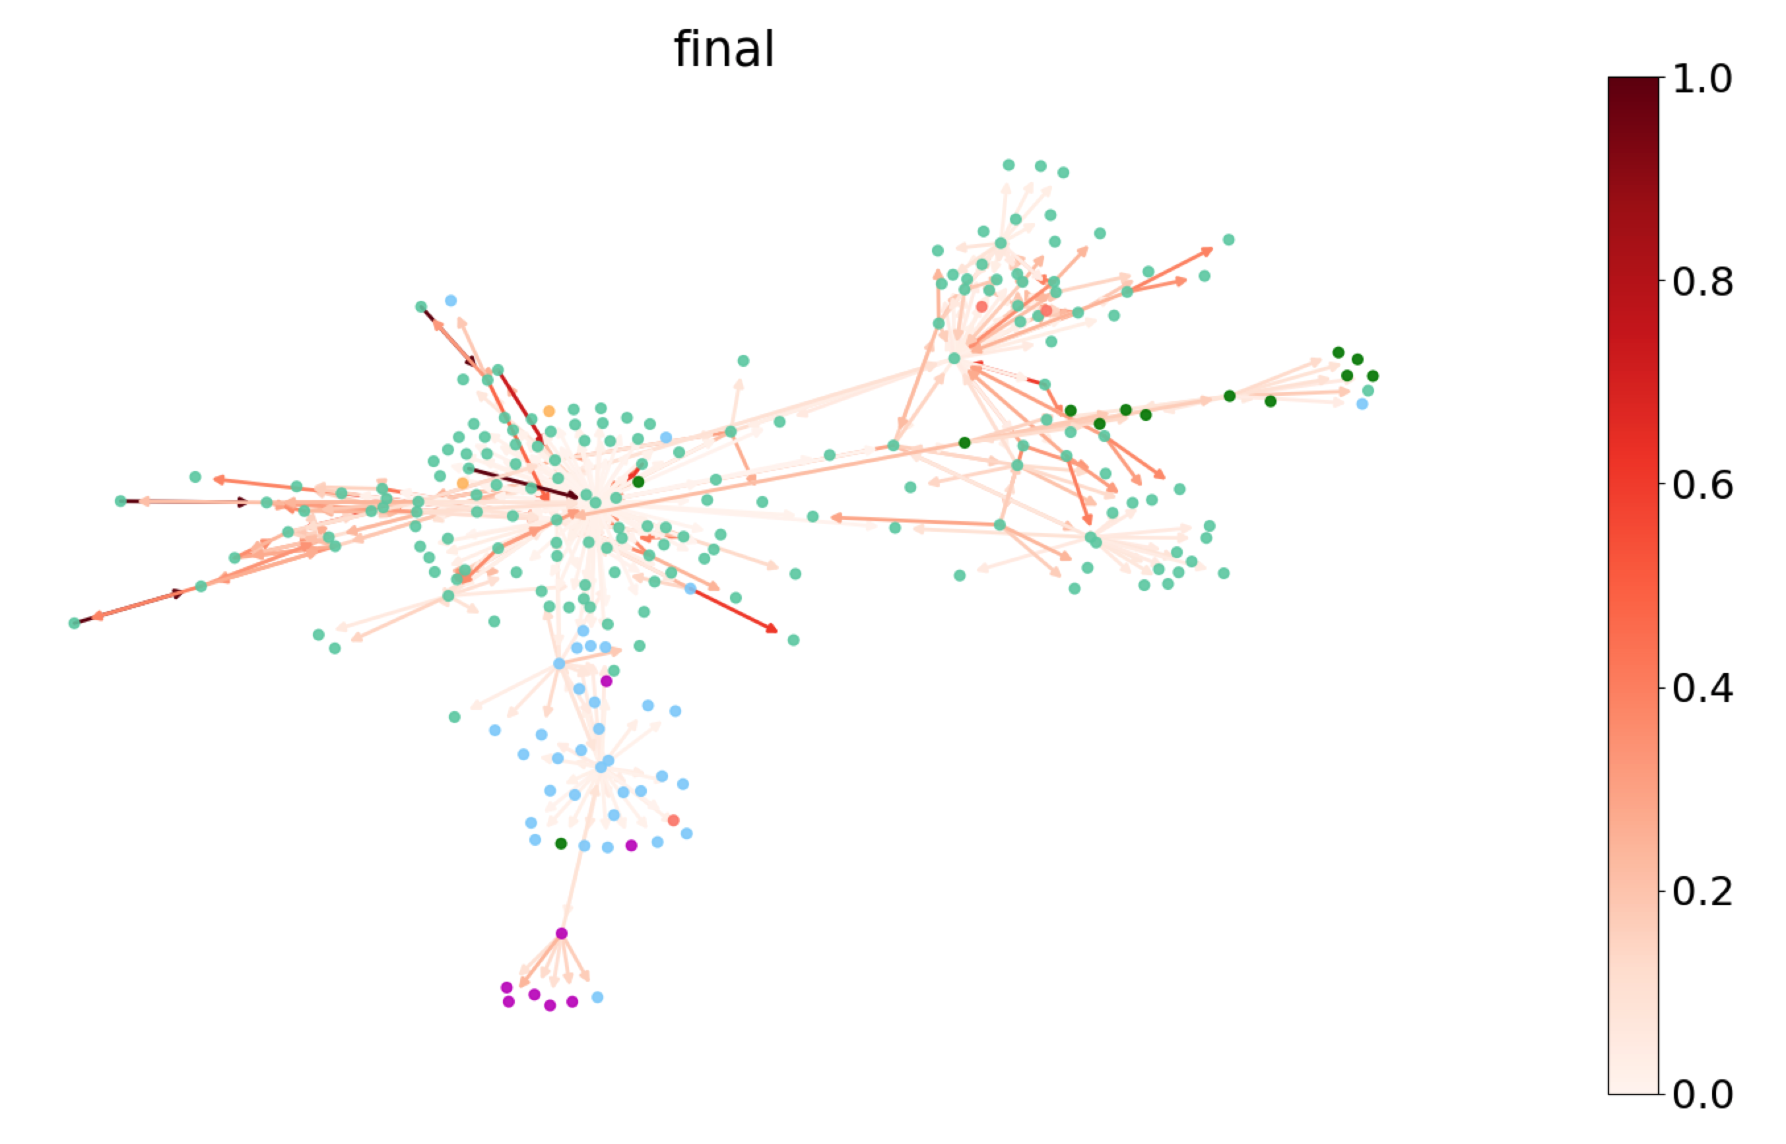
Results
Interpretability (attention weights visualization)
Attention weights visualization figure captured from Deep Graph Library documentation page.

Slide 15
Conclusion
Attention algorithm in graph nets helps improve performance.
Visualizing the attention weights allows interpretation of the model.
Future Study
Utilize features from the edges (e.g. line flow) by Edge enhanced Graph Neural Nets [6]

Slide 16
Reference
[1] D. Deka and S. Misra, “Learning for DC-OPF: Classifying active sets using neural nets,” 2019 IEEE Milan PowerTech, Milan, Italy, 2019, pp. 1-6.
[2] T. Kipf and M. Welling, "Semi-Supervised Classification with Graph Convolutional Networks", arXiv.org, 2021. [Online]. Available: https://arxiv.org/abs/1609.02907. [Accessed: 13- May- 2021].
[3] P. Veličković, G. Cucurull, A. Casanova, A. Romero, P. Liò and Y. Bengio, "Graph Attention Networks", arXiv.org, 2021. [Online]. Available: https://arxiv.org/abs/1710.10903. [Accessed: 13- May- 2021].
[4] T. Understanding, "Transformer: A Novel Neural Network Architecture for Language Understanding", Google AI Blog, 2021. [Online]. Available: https://ai.googleblog.com/2017/08/transformer-novel-neural-network.html. [Accessed: 13- May- 2021].
[5] The IEEE PES Task Force on Benchmarks for Validation of Emerging Power System Algorithms, “PGLib Optimal Power Flow Bench-marks,” Published online at https://github.com/power-grid-lib/pglib-opf, [Accessed: 3- Apr- 2020].
[6] L. Gong and Q. Cheng, "Exploiting Edge Features in Graph Neural Networks", arXiv.org, 2021. [Online]. Available: https://arxiv.org/abs/1809.02709. [Accessed: 29- Apr- 2021].

