Slide 1

Month 20xx
Learning for DC-OPF: Classifying Active Constraints using Graph Attention Networks
Insert your subtitle or any additional description text here up to two lines of text or you can delete this text box
Jeehyun park
M.S. Student, The University of Texas at Austin

Slide 2
Contents
Motivation
Proposed Approach
Graph Neural Network
Attention Method
Experiments & Results
Conclusion

Slide 3
Motivation
Optimal Power Flow (OPF) problem.
Increasing uncertainty and variability in energy sources and demand. → Increasing uncertainty realizations.
To respond to observed uncertainty realizations → The optimal solution needs to be updated near real-time. → Neural Nets for fast
Neural Nets works well, but it is like a black box. → No interpretability.
We want to figure out which sources or demand loads (uncertainty elements) keep causing the OPF update.

Slide 4
Proposed Approach
Graph Neural Network
What is it?
Why?
Training the parameters based on the power system topology.
Less training parameters.
Topology based training → allows us to utilize attention algorithm.
Attention
What is it?
Why?
Interpretability, it is not like a black box.

Slide 5
Graph Neural Network
What

Slide 6
Graph Neural Network
Why

Slide 7
Attention
What

Slide 8
Attention
Why

Slide 9
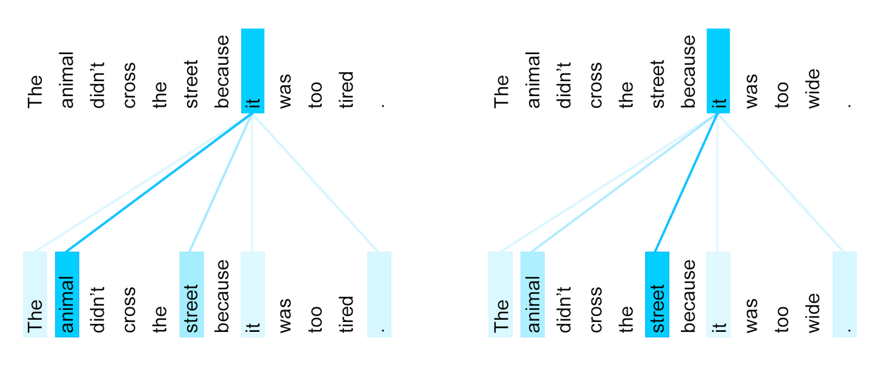
Attention
Interpretability in NLP

Slide 10
Experiments
Dataset

Slide 11
Experiments
Experiment settings

Slide 12
Results
Performance
NNs (baseline)
GNN
GAT

Slide 13
Results
Interpretability (weights visualization)

Slide 14
Conclusion

Slide 15
Reference

