Slide 1
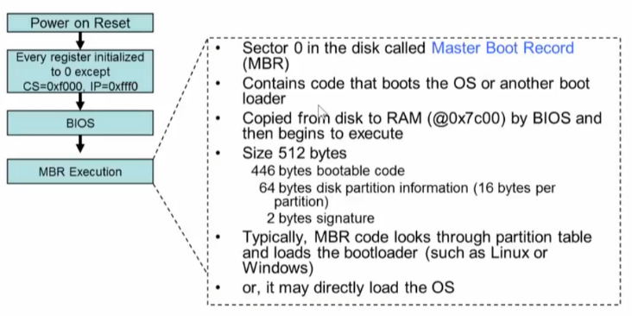
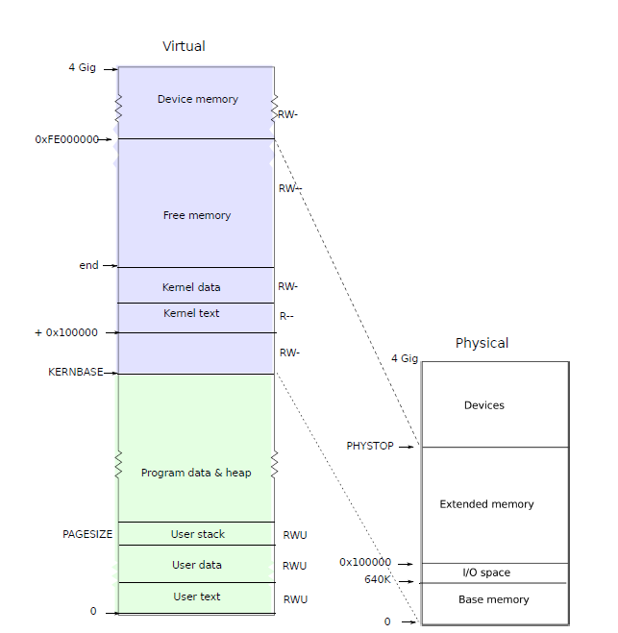
boot->MBR
bootblock.asm
bootmain.c
00007c00 <start>:
# with %cs=0 %ip=7c00.
.code16 # Assemble for 16-bit mode
.globl start
start:
7c00: fa cli
…
# Set up the stack pointer and call into C.
movl $start, %esp
7c43: bc 00 7c 00 00 mov $0x7c00,%esp
call bootmain
7c48: e8 fc 00 00 00 call 7d49 <bootmain>
#define SECTSIZE 512
void bootmain(void)
{
struct elfhdr *elf;
struct proghdr *ph, *eph;
void (*entry)(void);
uchar *pa;
elf = (struct elfhdr *)0x10000; // scratch space
// Read 1st page off disk
readseg((uchar *)elf, 4096, 0);
// Is this an ELF executable?
if (elf->magic != ELF_MAGIC)
return; // let bootasm.S handle error
// Call the entry point from the ELF header.
// Does not return!
entry = (void (*)(void))(elf->entry);
entry();
}
# The boot block (bootasm.S and bootmain.c) jumps to entry below.
# Using GRUB 2 … copying kernel or kernelmemfs to /boot
# and then adding this menu entry:
# menuentry "xv6" {
# insmod ext2
# set root='(hd0,msdos1)'
# set kernel='/boot/kernel'
# multiboot ${kernel} ${kernel}
# boot
# }
entry.S
가자!! 커널
main.c
// Bootstrap processor starts running C code here.
// Allocate a real stack and switch to it, first
// doing some setup required for memory allocator to work.
int main(void)
{
kinit1(end, P2V(4 * 1024 * 1024)); // phys page allocator
kvmalloc(); // kernel page table
mpinit(); // detect other processors
…..
userinit(); // first user process
mpmain(); // finish this processor's setup
}
# Entering xv6 on boot processor, with paging off.
.globl entry
entry:
# Turn on page size extension for 4Mbyte pages
# Set page directory
# Turn on paging.
# Set up the stack pointer.
# Jump to main(), and switch to executing at
# high addresses. The indirect call is needed because
# the assembler produces a PC-relative instruction
# for a direct jump.
mov $main, %eax
jmp *%eax
user
process

Slide 2
Application (echo.c)
C-library
user.h
#include "types.h"
#include "stat.h"
#include "user.h"
int main(int argc, char *argv[])
{
int i;
for(i = 1; i < argc; i++)
printf(1, "%s%s", argv[i], i+1 < argc ? " " : "\n");
exit();
}
ULIB = ulib.o usys.o printf.o umalloc.o
// system calls
int fork(void);
int write(int, const void*, int);
int read(int, void*, int);
int close(int);
int kill(int);
…..
static void
putc(int fd, char c)
{
write(fd, &c, 1);
}
void printf(int fd, const char *fmt, ...)
{ …
while(*s != 0){
putc(fd, *s); s++;
}
}
usys.S
<syscall.h>
#define SYS_fork 1
#define SYS_exit 2
#define SYS_wait 3
#define SYS_pipe 4
#define SYS_read 5
…
#define SYS_write 16
#include "syscall.h"
#include "traps.h"
#define SYSCALL(name) \
.globl name; \
name: \
movl $SYS_ ## name, %eax; \
int $T_SYSCALL; \
ret
SYSCALL(fork)
SYSCALL(open)
SYSCALL(write)
SYSCALL(read)
SYSCALL(close)
int sys_write(void)
{
struct file *f;
int n;
char *p;
if(argfd(0, 0, &f) < 0 || argint(2, &n) < 0 || argptr(1, &p, n) < 0)
return -1;
return filewrite(f, p, n);
}
syscall.c
static int (*syscalls[])(void) = {
[SYS_fork] sys_fork,
[SYS_read] sys_read,
[SYS_open] sys_open,
[SYS_write] sys_write,
….
};
<traps.h>
#define T_SYSCALL 64
// system call
interrupt
void syscall(void)
{
int num;
struct proc *curproc = myproc();
num = curproc->tf->eax;
if (num > 0 && num < NELEM(syscalls) && syscalls[num])
{ curproc->tf->eax = syscalls[num]();
}
else
{ cprintf("%d %s: unknown sys call %d\n", …);
curproc->tf->eax = -1;
}
}
trap.c
trapasm.S
void trap(struct trapframe *tf)
{
if (tf->trapno == T_SYSCALL)
{
if (myproc()->killed) exit();
myproc()->tf = tf;
syscall();
if (myproc()->killed) exit();
return;
}
# vectors.S sends all traps here.
.globl alltraps
alltraps:
# Build trap frame.
….
# Call trap(tf), where tf=%esp
pushl %esp
call trap
addl $4, %esp

Slide 3
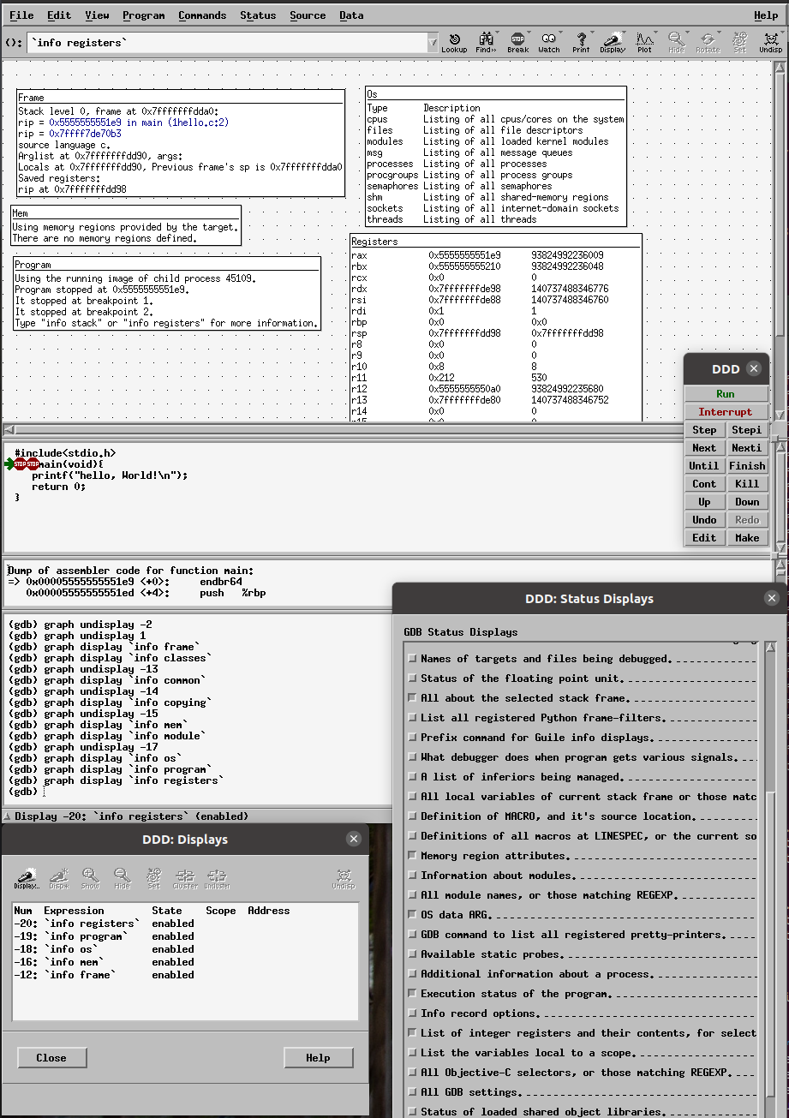
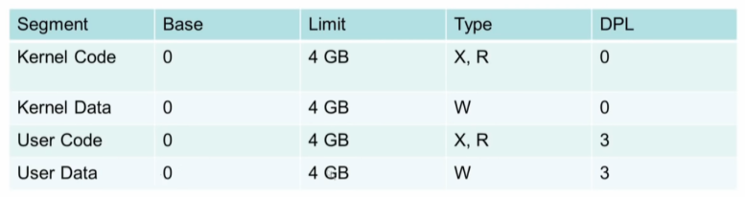

Application (echo.c)
DDD
Application syscall()
#include "types.h"
#include "stat.h"
#include "user.h"
int main(int argc, char *argv[])
{
int i;
for(i = 1; i < argc; i++)
printf(1, "%s%s", argv[i], i+1 < argc ? " " : "\n");
exit();
}
#include<sys/syscall.h>
#include<unistd.h>
int main(void){
syscall(SYS_write, 1,"hello, World!\n",14);
return 0;
}
C-library
int $T_SYSCALL;
ELF
trap
인터럽트 처리 (IDT와 GDT 활용)
trapasm.S
# vectors.S sends all traps here.
.globl alltraps
alltraps:
# Build trap frame.
….
# Call trap(tf), where tf=%esp
pushl %esp
call trap
addl $4, %esp
syscall.c
GDTR
GDT(Global Descript table)
static int (*syscalls[])(void) = {
[SYS_fork] sys_fork,
[SYS_read] sys_read,
[SYS_open] sys_open,
[SYS_write] sys_write,
….
};
CPU
IDTR
IDT(interrupt descriptor table)
trap.c
vector.S
kernel boot 절차
interrupt 처리
void tvinit(void) {
for (i = 0; i < 256; i++)
SETGATE(idt[i], 0, SEG_KCODE << 3, vectors[i], 0);
SETGATE(idt[T_SYSCALL], 1, SEG_KCODE << 3, vectors[T_SYSCALL], DPL_USER);
initlock(&tickslock, "time");
}
.globl vector0
vector0: => jmp alltraps
.globl vector1
vector1: => jmp alltraps
...
vector255:
vector255: => jmp alltraps
0 ~ 256

Slide 4
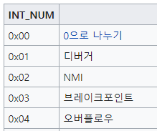
Application (echo.c)
Application syscall()
#include "types.h"
#include "stat.h"
#include "user.h"
int main(int argc, char *argv[])
{
printf(1, "%s%s", argv[i], i+1 < argc ? " " : "\n");
}
int $T_SYSCALL;
#include<sys/syscall.h>
#include<unistd.h>
int main(void){
syscall(SYS_write, 1,"hello, World!\n",14);
return 0;
}
C-library
Trap
syscall.c
인터럽트 처리 (IDT와 GDT 활용)
static int (*syscalls[])(void) = {
[SYS_fork] sys_fork,
[SYS_read] sys_read,
[SYS_open] sys_open,
[SYS_write] sys_write,….
};
trapasm.S
# vectors.S sends all traps here.
.globl alltraps
alltraps:
# Build trap frame.
….
# Call trap(tf), where tf=%esp
pushl %esp
call trap
addl $4, %esp
GDTR
GDT(Global Descript table)
CPU
trap.c
exception
void trap(struct trapframe *tf)
{
if (tf->trapno == T_SYSCALL)
{ syscall(); } switch (tf->trapno) {
case T_IRQ0 + IRQ_TIMER:
wakeup(&ticks); break;
case T_IRQ0 + IRQ_IDE:
lapiceoi(); break;
case T_IRQ0 + IRQ_KBD:
kbdintr(); break;
case T_IRQ0 + IRQ_COM1:
uartintr();
...
Fault: 복구가능
Abort: 복구불가
IDTR
IDT(interrupt descriptor table)
0 ~ 256
단순하게 잠깐 끼워 든다는 것 보다는 HW 관리 방법
Interrupt
polling
INT
APIC
Timer
키보드
IDE
SCSI
NIC
(advanced Programmable Interrupt)

Slide 5
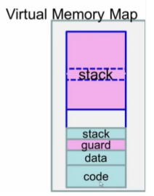
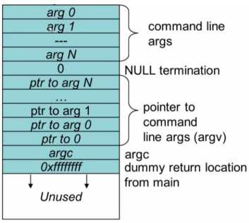
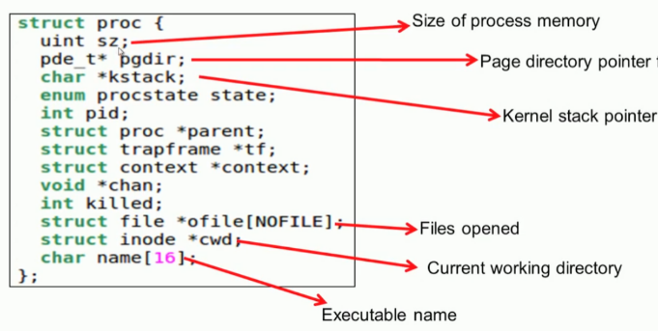
Exec()
namei(path)=>Inode
kmem.freelist
int exec(char *path, char **argv)
{
begin_op();
if ((ip = namei(path)) == 0) {… }
pgdir = setupkvm()
// Load program into memory.
for (i = 0, off = elf.phoff; i < elf.phnum; i++, off += sizeof(ph)) {
sz = allocuvm(pgdir, sz, ph.vaddr + ph.memsz)
loaduvm(pgdir, (char *)ph.vaddr, ip, ph.off, ph.filesz)
}
// Allocate two pages at the next page boundary.
// Make the first inaccessible. Use the second as the user stack.
sz = PGROUNDUP(sz);
sz = allocuvm(pgdir, sz, sz + 2 * PGSIZE)
clearpteu(pgdir, (char *)(sz - 2 * PGSIZE));
// Push argument strings, prepare rest of stack in ustack.
for (argc = 0; argv[argc]; argc++)
{
if (argc >= MAXARG) goto bad;
sp = (sp - (strlen(argv[argc]) + 1)) & ~3;
copyout(pgdir, sp, argv[argc], strlen(argv[argc]) + 1)
ustack[3 + argc] = sp;
}
ustack[3 + argc] = 0;
ustack[0] = 0xffffffff; // fake return PC
ustack[1] = argc;
ustack[2] = sp - (argc + 1) * 4; // argv pointer
sp -= (3 + argc + 1) * 4;
copyout(pgdir, sp, ustack, (3 + argc + 1) * 4)
// Save program name for debugging.
for (last = s = path; *s; s++) if (*s == '/') last = s + 1;
safestrcpy(curproc->name, last, sizeof(curproc->name));
// Commit to the user image.
oldpgdir = curproc->pgdir;
curproc->pgdir = pgdir;
switchuvm(curproc);
freevm(oldpgdir);
kernel part page table
static struct kmap
kmap[] = {
{KERNBASE, 0, EXTMEM, PTE_W},
{KERNLINK, V2P(KERNLINK), V2P(data), 0},
{data, V2P(data), PHYSTOP, PTE_W},
{DEVSPACE, DEVSPACE, 0, PTE_W},
};
get 4096bytes
setupkvm()
kalloc()
*pgdir
allocate page table
memst(pgdir)
allocuvm()
mappages(pgdir, k->virt, k->phys_size, k->phys_start, k->perm )
walkpgdir(pgdir,va)
pde = &pgdir[PDX(va)];
있으면 pgtab = (pte_t *)P2V(PTE_ADDR(*pde));
없으면 (pgtab = (pte_t *)kalloc())
loaduvm()
kalloc()
*pgdir
memst(pgdir)
guard page
mappages(pgdir, (char *)a, PGSIZE, V2P(mem), PTE_W | PTE_U)
walkpgdir(pgdir,va)
a.out
walkpgdir()
readi(ip,P2V(pa)…)
*user stack
kernel
stack이 data 부분 침범하지 못하도록 guard page 설정, PTE_U 제거

Slide 6
DISK 주소 = 0x200*Block number (512*Block Number)
0 | 1(0x01) | 2 (0x02) ~ 31(0x1F) | 32(0x20) ~ 57(0x39) | 58(0x3A) | 59(0x3B) ~ 999(0x327)
boot (1) | super block | log block (30) | inode block (26) inode(64Bytes) IPB(512/64)=8 | used bitmap (1) | Data block (941)
#define FSSIZE 1000 // size of file system in blocks
#define MAXOPBLOCKS 10 // max # of blocks any FS op writes
#define LOGSIZE (MAXOPBLOCKS*3)
#define NINODES 200
#define BSIZE 512 // block size
#define IPB (BSIZE / sizeof(struct dinode)) // 512/64 =>8
int nlog = LOGSIZE; //30
int ninodeblocks = NINODES / IPB + 1; 200/9=> (200/8)+1=>26
nmeta = 2 + nlog + ninodeblocks + nbitmap; 2+30+26+1 => 59
nblocks = FSSIZE - nmeta;
struct superblock {
uint size; // Size of file system image (blocks)
uint nblocks; // Number of data blocks
uint ninodes; // Number of inodes.
uint nlog; // Number of log blocks
uint logstart; // Block number of first log block
uint inodestart; // Block number of first inode block
uint bmapstart; // Block number of first free map block
};
#define NDIRECT 12
struct dinode {
short type; // File type
short major; // Major device number (T_DEV only)
short minor; // Minor device number (T_DEV only)
short nlink; // Number of links to inode in file system
uint size; // Size of file (bytes)
uint addrs[NDIRECT+1]; // Data block addresses
}; //64Bytes

Slide 7
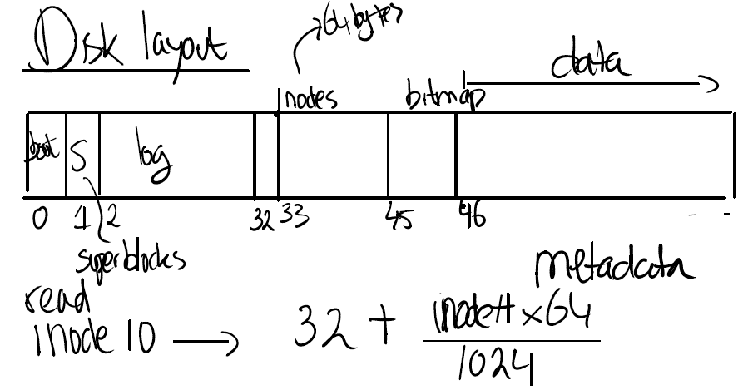
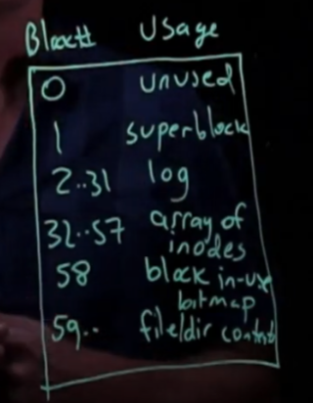
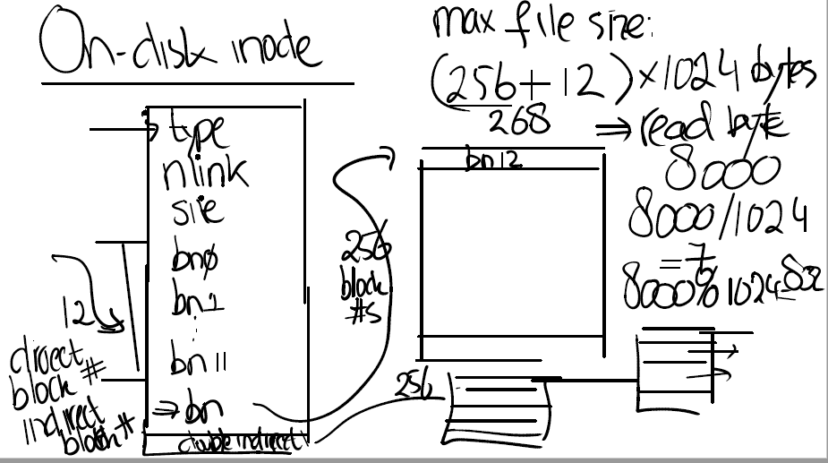

Slide 8
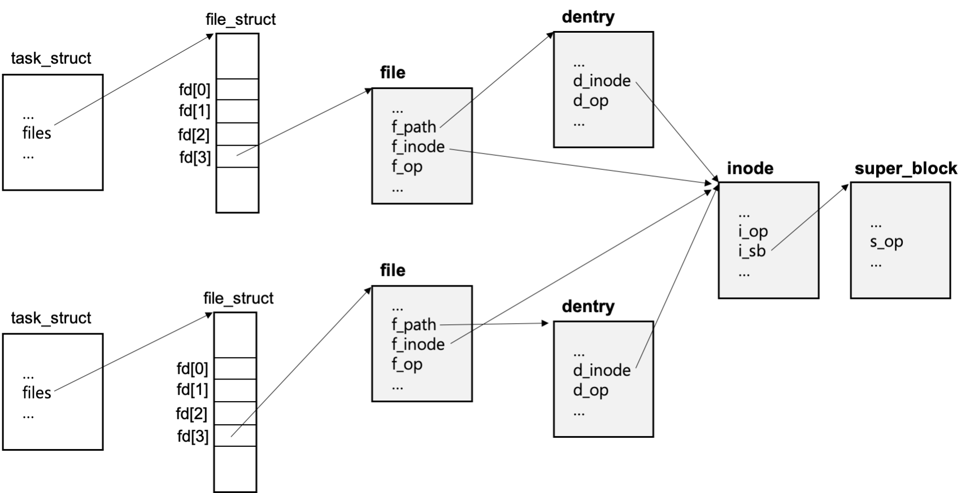

Slide 9
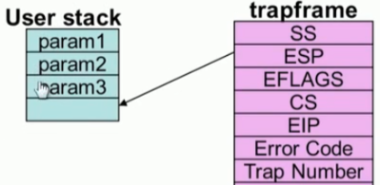
int link(const char*, const char*);
int $T_SYSCALL;
usys.S
trap
struct inode {
uint dev; uint inum; int ref;
struct sleeplock lock;
int valid;
short type, major, minor,nlink;
uint size;
uint addrs[NDIRECT+1];
};
IDT
trapasm.S
sys_link()
syscall.c
struct buf {
int flags;
uint dev, blockno;
struct sleeplock lock;
uint refcnt;
struct buf *prev, *next, *qnext;
uchar data[BSIZE];
};
argstr()
icache
inode
namei(old)
nameiparent(new,name)
struct {
struct spinlock lock;
struct inode inode[NINODE];
} icache;
namex(old)
namex(new)
순환적 파일 경로 탐색
dp(inode)
inode
dirlookup(ip, name, 0)
parent inode 찾기
Write a new directory entry (name, inum) into the directory dp.
iget(dev, inum)
dirlink(dp, name, ip->inum)
chek name exists
Look for an empty dirent.
bcache
buffer
ip->nlink++;
struct
{
struct spinlock lock;
struct buf buf[NBUF];
struct buf head;
} bcache;
writei()
iupdate(ip)
iupdate(ip)
bread(ip->dev, IBLOCK(ip->inum, sb));
bget(dev, blockno);
update(inode → dinode)

Slide 10
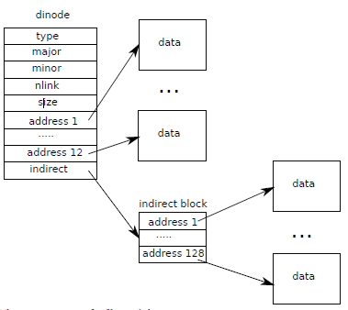
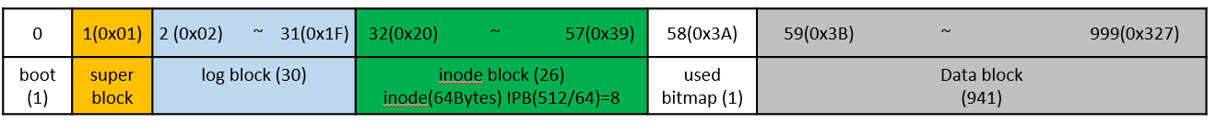
int open(const char*, int);
int mkdir(const char*);
int mknod(const char*, short, short);
int $T_SYSCALL;
trap
sys_open(void)
sys_mkdir(void)
sys_mknode(void)
if(omode & O_CREATE)
create(char *path, short type, short major, short minor)
nameiparent(path, name)
parent inode 찾기
namex(new)
directory 에서 entry 찾기
struct dirent {
ushort inum;
char name[DIRSIZ];
};
dirlookup(dp,name,0)
icache
inode
readi(dp, dirent, off,)
struct {
struct spinlock lock;
struct inode inode[NINODE];
} icache;
bread(ip->dev, bmap(ip,off/BSIZE)
return inode
name exist?
iget(dev,inum)
offset/BSIZE
bcache
buffer
ialloc(dp->dev, type)
struct
{
struct spinlock lock;
struct buf buf[NBUF];
struct buf head;
} bcache;
iupdate(ip)
bread(ip->dev, IBLOCK(inum,sb))
iupdate(dp)
free inode 찾기
parent nlink++
iget(dev,inum)

Slide 11
proc
proc
struct proc {
pde_t* pgdir;
char *kstack;
int pid;
struct proc *parent;
struct trapframe *tf;
struct context *context;
void *chan;
int killed;
struct file *ofile[NOFILE];
struct inode *cwd;
char name[16];
int open(const char*, int);
sys_open(void)
if(omode & O_CREATE)
create(char *path, short type, short major, short minor)
namei(path)
ftable
ftable
namex(old)
struct file * filealloc(void) {
struct file *f;
acquire(&ftable.lock);
for (f = ftable.file; f < ftable.file + NFILE; f++) {
if (f->ref == 0) {
f->ref = 1;
release(&ftable.lock);
return f;
}
}
}
struct
{
struct spinlock lock;
struct file file[NFILE];
} ftable;
inode
dirlookup(ip, name, 0)
iget(dev, inum)
icache
inode
f = filealloc()
free file 객체 할당
struct {
struct spinlock lock;
struct inode inode[NINODE];
} icache;
static int fdalloc(struct file *f){
int fd;
struct proc *curproc = myproc();
for(fd = 0; fd < NOFILE; fd++){
if(curproc->ofile[fd] == 0){
curproc->ofile[fd] = f;
return fd;
}
}
return -1;
}
fd = fdalloc(f)
curproc에 FD 할당
f->type = FD_INODE;
f->ip = ip;
f->off = 0;
f->readable = !(omode & O_WRONLY);
f->writable = (omode & O_WRONLY) || (omode & O_RDWR);
return fd;
bcache
buffer
struct
{
struct spinlock lock;
struct buf buf[NBUF];
struct buf head;
} bcache;

