Slide 1
Application (echo.c)
C-library
user.h
#include "types.h"
#include "stat.h"
#include "user.h"
int main(int argc, char *argv[])
{
int i;
for(i = 1; i < argc; i++)
printf(1, "%s%s", argv[i], i+1 < argc ? " " : "\n");
exit();
}
ULIB = ulib.o usys.o printf.o umalloc.o
// system calls
int fork(void);
int write(int, const void*, int);
int read(int, void*, int);
int close(int);
int kill(int);
…..
static void
putc(int fd, char c)
{
write(fd, &c, 1);
}
void printf(int fd, const char *fmt, ...)
{ …
while(*s != 0){
putc(fd, *s); s++;
}
}
<syscall.h>
#define SYS_fork 1
#define SYS_exit 2
#define SYS_wait 3
#define SYS_pipe 4
#define SYS_read 5
…
#define SYS_write 16
#include "syscall.h"
#include "traps.h"
#define SYSCALL(name) \
.globl name; \
name: \
movl $SYS_ ## name, %eax; \
int $T_SYSCALL; \
ret
SYSCALL(fork)
SYSCALL(open)
SYSCALL(write)
SYSCALL(read)
SYSCALL(close)
int sys_write(void)
{
struct file *f;
int n;
char *p;
if(argfd(0, 0, &f) < 0 || argint(2, &n) < 0 || argptr(1, &p, n) < 0)
return -1;
return filewrite(f, p, n);
}
syscall.c
static int (*syscalls[])(void) = {
[SYS_fork] sys_fork,
[SYS_read] sys_read,
[SYS_open] sys_open,
[SYS_write] sys_write,
….
};
<traps.h>
#define T_SYSCALL 64
// system call
interrupt
void syscall(void)
{
int num;
struct proc *curproc = myproc();
num = curproc->tf->eax;
if (num > 0 && num < NELEM(syscalls) && syscalls[num])
{ curproc->tf->eax = syscalls[num]();
}
else
{ cprintf("%d %s: unknown sys call %d\n", …);
curproc->tf->eax = -1;
}
}
trap.c
trapasm.S
void trap(struct trapframe *tf)
{
if (tf->trapno == T_SYSCALL)
{
if (myproc()->killed) exit();
myproc()->tf = tf;
syscall();
if (myproc()->killed) exit();
return;
}
# vectors.S sends all traps here.
.globl alltraps
alltraps:
# Build trap frame.
….
# Call trap(tf), where tf=%esp
pushl %esp
call trap
addl $4, %esp

Slide 2
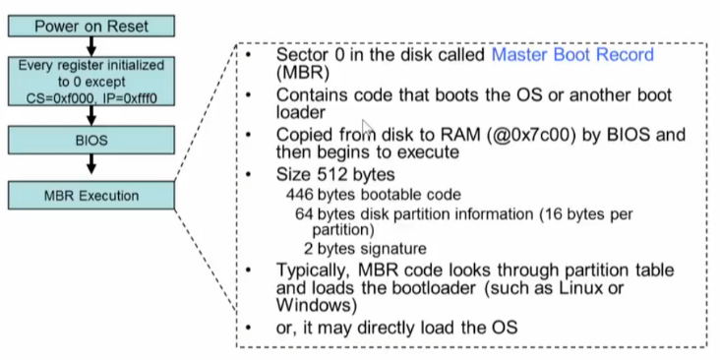
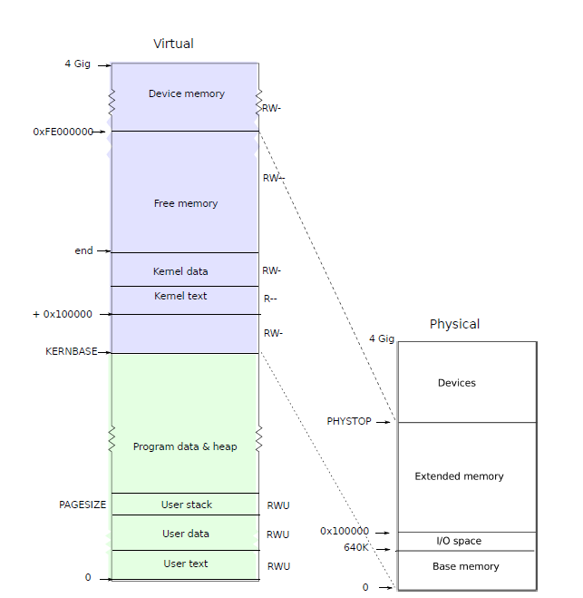
boot->MBR
bootblock.asm
bootmain.c
00007c00 <start>:
# with %cs=0 %ip=7c00.
.code16 # Assemble for 16-bit mode
.globl start
start:
7c00: fa cli
…
# Set up the stack pointer and call into C.
movl $start, %esp
7c43: bc 00 7c 00 00 mov $0x7c00,%esp
call bootmain
7c48: e8 fc 00 00 00 call 7d49 <bootmain>
#define SECTSIZE 512
void bootmain(void)
{
struct elfhdr *elf;
struct proghdr *ph, *eph;
void (*entry)(void);
uchar *pa;
elf = (struct elfhdr *)0x10000; // scratch space
// Read 1st page off disk
readseg((uchar *)elf, 4096, 0);
// Is this an ELF executable?
if (elf->magic != ELF_MAGIC)
return; // let bootasm.S handle error
// Call the entry point from the ELF header.
// Does not return!
entry = (void (*)(void))(elf->entry);
entry();
}
# The boot block (bootasm.S and bootmain.c) jumps to entry below.
# Using GRUB 2 … copying kernel or kernelmemfs to /boot
# and then adding this menu entry:
# menuentry "xv6" {
# insmod ext2
# set root='(hd0,msdos1)'
# set kernel='/boot/kernel'
# multiboot ${kernel} ${kernel}
# boot
# }
entry.S
가자!! 커널
main.c
// Bootstrap processor starts running C code here.
// Allocate a real stack and switch to it, first
// doing some setup required for memory allocator to work.
int main(void)
{
kinit1(end, P2V(4 * 1024 * 1024)); // phys page allocator
kvmalloc(); // kernel page table
mpinit(); // detect other processors
…..
userinit(); // first user process
mpmain(); // finish this processor's setup
}
# Entering xv6 on boot processor, with paging off.
.globl entry
entry:
# Turn on page size extension for 4Mbyte pages
# Set page directory
# Turn on paging.
# Set up the stack pointer.
# Jump to main(), and switch to executing at
# high addresses. The indirect call is needed because
# the assembler produces a PC-relative instruction
# for a direct jump.
mov $main, %eax
jmp *%eax
user
process

