Slide 1
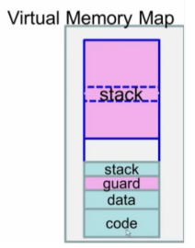
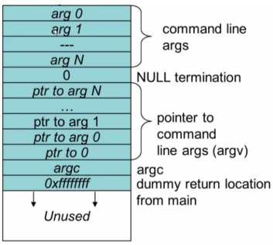
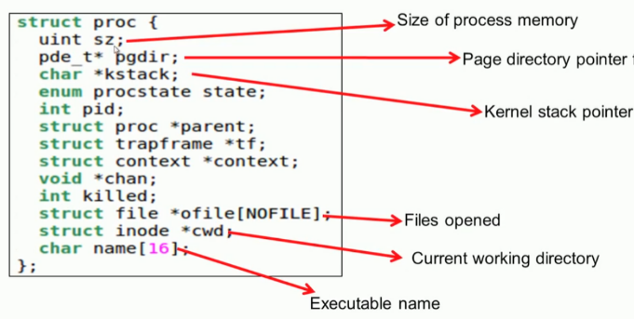
Exec()
namei(path)=>Inode
kmem.freelist
int exec(char *path, char **argv)
{
begin_op();
if ((ip = namei(path)) == 0) {… }
pgdir = setupkvm()
// Load program into memory.
for (i = 0, off = elf.phoff; i < elf.phnum; i++, off += sizeof(ph)) {
sz = allocuvm(pgdir, sz, ph.vaddr + ph.memsz)
loaduvm(pgdir, (char *)ph.vaddr, ip, ph.off, ph.filesz)
}
// Allocate two pages at the next page boundary.
// Make the first inaccessible. Use the second as the user stack.
sz = PGROUNDUP(sz);
sz = allocuvm(pgdir, sz, sz + 2 * PGSIZE)
clearpteu(pgdir, (char *)(sz - 2 * PGSIZE));
// Push argument strings, prepare rest of stack in ustack.
for (argc = 0; argv[argc]; argc++)
{
if (argc >= MAXARG) goto bad;
sp = (sp - (strlen(argv[argc]) + 1)) & ~3;
copyout(pgdir, sp, argv[argc], strlen(argv[argc]) + 1)
ustack[3 + argc] = sp;
}
ustack[3 + argc] = 0;
ustack[0] = 0xffffffff; // fake return PC
ustack[1] = argc;
ustack[2] = sp - (argc + 1) * 4; // argv pointer
sp -= (3 + argc + 1) * 4;
copyout(pgdir, sp, ustack, (3 + argc + 1) * 4)
// Save program name for debugging.
for (last = s = path; *s; s++) if (*s == '/') last = s + 1;
safestrcpy(curproc->name, last, sizeof(curproc->name));
// Commit to the user image.
oldpgdir = curproc->pgdir;
curproc->pgdir = pgdir;
switchuvm(curproc);
freevm(oldpgdir);
kernel part page table
static struct kmap
kmap[] = {
{KERNBASE, 0, EXTMEM, PTE_W},
{KERNLINK, V2P(KERNLINK), V2P(data), 0},
{data, V2P(data), PHYSTOP, PTE_W},
{DEVSPACE, DEVSPACE, 0, PTE_W},
};
get 4096bytes
setupkvm()
kalloc()
*pgdir
allocate page table
memst(pgdir)
allocuvm()
mappages(pgdir, k->virt, k->phys_size, k->phys_start, k->perm )
walkpgdir(pgdir,va)
pde = &pgdir[PDX(va)];
있으면 pgtab = (pte_t *)P2V(PTE_ADDR(*pde));
없으면 (pgtab = (pte_t *)kalloc())
loaduvm()
kalloc()
*pgdir
memst(pgdir)
guard page
mappages(pgdir, (char *)a, PGSIZE, V2P(mem), PTE_W | PTE_U)
walkpgdir(pgdir,va)
a.out
walkpgdir()
readi(ip,P2V(pa)…)
*user stack
kernel
stack이 data 부분 침범하지 못하도록 guard page 설정, PTE_U 제거

