Slide 1
DISK 주소 = 0x200*Block number (512*Block Number)
0 | 1(0x01) | 2 (0x02) ~ 31(0x1F) | 32(0x20) ~ 57(0x39) | 58(0x3A) | 59(0x3B) ~ 999(0x327)
boot (1) | super block | log block (30) | inode block (26) inode(64Bytes) IPB(512/64)=8 | used bitmap (1) | Data block (941)
#define FSSIZE 1000 // size of file system in blocks
#define MAXOPBLOCKS 10 // max # of blocks any FS op writes
#define LOGSIZE (MAXOPBLOCKS*3)
#define NINODES 200
#define BSIZE 512 // block size
#define IPB (BSIZE / sizeof(struct dinode)) // 512/64 =>8
int nlog = LOGSIZE; //30
int ninodeblocks = NINODES / IPB + 1; 200/9=> (200/8)+1=>26
nmeta = 2 + nlog + ninodeblocks + nbitmap; 2+30+26+1 => 59
nblocks = FSSIZE - nmeta;
struct superblock {
uint size; // Size of file system image (blocks)
uint nblocks; // Number of data blocks
uint ninodes; // Number of inodes.
uint nlog; // Number of log blocks
uint logstart; // Block number of first log block
uint inodestart; // Block number of first inode block
uint bmapstart; // Block number of first free map block
};
#define NDIRECT 12
struct dinode {
short type; // File type
short major; // Major device number (T_DEV only)
short minor; // Minor device number (T_DEV only)
short nlink; // Number of links to inode in file system
uint size; // Size of file (bytes)
uint addrs[NDIRECT+1]; // Data block addresses
}; //64Bytes

Slide 2
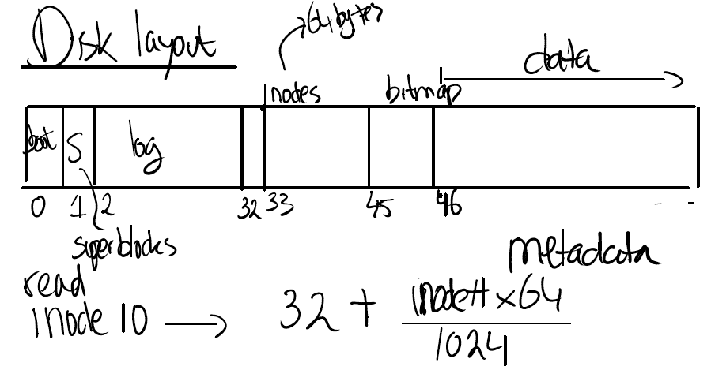
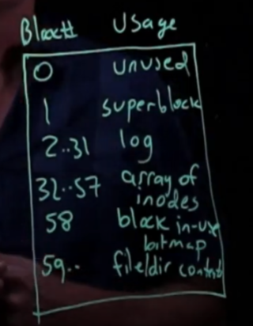
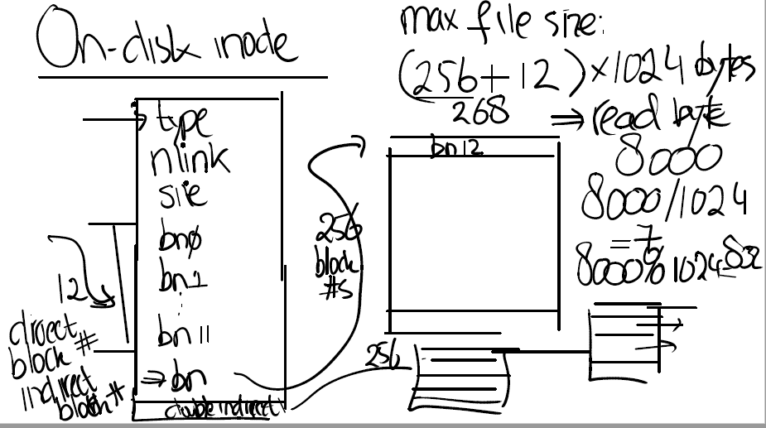

Slide 3
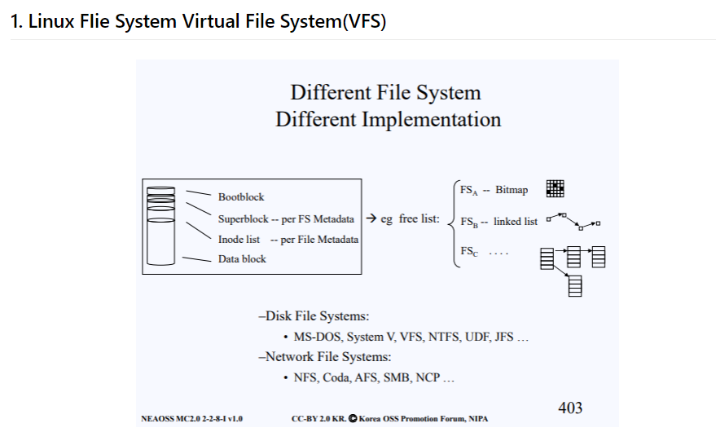
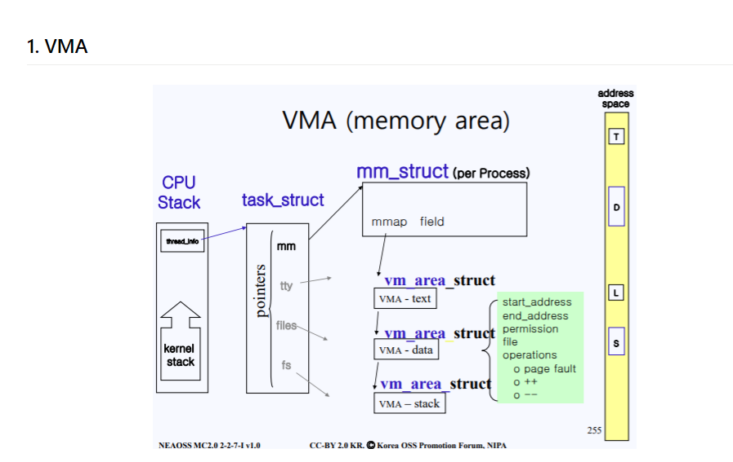
https://wogh8732.tistory.com/298?category=807175
https://wogh8732.tistory.com/299?category=807175

Slide 4


POSIX
VFS
https://blog.naver.com/n_cloudplatform/222384170516
https://blog.naver.com/n_cloudplatform/222481521174

