Slide 1
Application (echo.c)
C-library
user.h
#include "types.h"
#include "stat.h"
#include "user.h"
int main(int argc, char *argv[])
{
int i;
for(i = 1; i < argc; i++)
printf(1, "%s%s", argv[i], i+1 < argc ? " " : "\n");
exit();
}
ULIB = ulib.o usys.o printf.o umalloc.o
// system calls
int fork(void);
int write(int, const void*, int);
int read(int, void*, int);
int close(int);
int kill(int);
…..
static void
putc(int fd, char c)
{
write(fd, &c, 1);
}
void printf(int fd, const char *fmt, ...)
{ …
while(*s != 0){
putc(fd, *s); s++;
}
}
<syscall.h>
#define SYS_fork 1
#define SYS_exit 2
#define SYS_wait 3
#define SYS_pipe 4
#define SYS_read 5
…
#define SYS_write 16
#include "syscall.h"
#include "traps.h"
#define SYSCALL(name) \
.globl name; \
name: \
movl $SYS_ ## name, %eax; \
int $T_SYSCALL; \
ret
SYSCALL(fork)
SYSCALL(open)
SYSCALL(write)
SYSCALL(read)
SYSCALL(close)
int sys_write(void)
{
struct file *f;
int n;
char *p;
if(argfd(0, 0, &f) < 0 || argint(2, &n) < 0 || argptr(1, &p, n) < 0)
return -1;
return filewrite(f, p, n);
}
syscall.c
static int (*syscalls[])(void) = {
[SYS_fork] sys_fork,
[SYS_read] sys_read,
[SYS_open] sys_open,
[SYS_write] sys_write,
….
};
<traps.h>
#define T_SYSCALL 64
// system call
interrupt
void syscall(void)
{
int num;
struct proc *curproc = myproc();
num = curproc->tf->eax;
if (num > 0 && num < NELEM(syscalls) && syscalls[num])
{ curproc->tf->eax = syscalls[num]();
}
else
{ cprintf("%d %s: unknown sys call %d\n", …);
curproc->tf->eax = -1;
}
}
trap.c
trapasm.S
void trap(struct trapframe *tf)
{
if (tf->trapno == T_SYSCALL)
{
if (myproc()->killed) exit();
myproc()->tf = tf;
syscall();
if (myproc()->killed) exit();
return;
}
# vectors.S sends all traps here.
.globl alltraps
alltraps:
# Build trap frame.
….
# Call trap(tf), where tf=%esp
pushl %esp
call trap
addl $4, %esp

Slide 2
VM
Trap
GDT
IDT
CPU

Slide 3
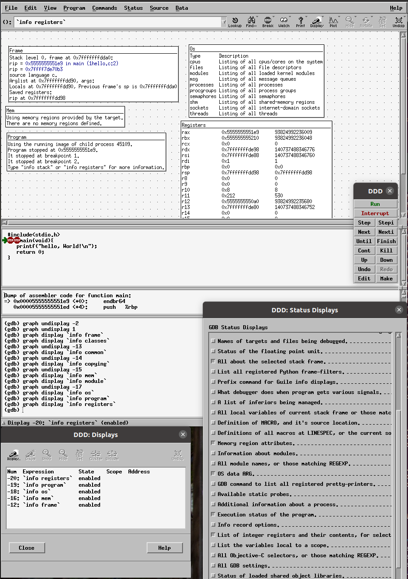
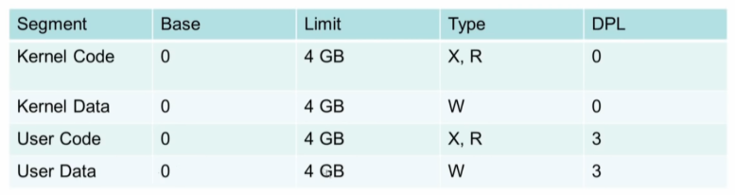

Application (echo.c)
DDD
Application syscall()
#include "types.h"
#include "stat.h"
#include "user.h"
int main(int argc, char *argv[])
{
int i;
for(i = 1; i < argc; i++)
printf(1, "%s%s", argv[i], i+1 < argc ? " " : "\n");
exit();
}
#include<sys/syscall.h>
#include<unistd.h>
int main(void){
syscall(SYS_write, 1,"hello, World!\n",14);
return 0;
}
C-library
int $T_SYSCALL;
ELF
trap
인터럽트 처리 (IDT와 GDT 활용)
trapasm.S
# vectors.S sends all traps here.
.globl alltraps
alltraps:
# Build trap frame.
….
# Call trap(tf), where tf=%esp
pushl %esp
call trap
addl $4, %esp
syscall.c
GDTR
GDT(Global Descript table)
static int (*syscalls[])(void) = {
[SYS_fork] sys_fork,
[SYS_read] sys_read,
[SYS_open] sys_open,
[SYS_write] sys_write,
….
};
CPU
IDTR
IDT(interrupt descriptor table)
trap.c
vector.S
kernel boot 절차
interrupt 처리
void tvinit(void) {
for (i = 0; i < 256; i++)
SETGATE(idt[i], 0, SEG_KCODE << 3, vectors[i], 0);
SETGATE(idt[T_SYSCALL], 1, SEG_KCODE << 3, vectors[T_SYSCALL], DPL_USER);
initlock(&tickslock, "time");
}
.globl vector0
vector0: => jmp alltraps
.globl vector1
vector1: => jmp alltraps
...
vector255:
vector255: => jmp alltraps
0 ~ 256

Slide 4
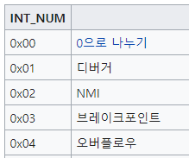
Application (echo.c)
Application syscall()
#include "types.h"
#include "stat.h"
#include "user.h"
int main(int argc, char *argv[])
{
printf(1, "%s%s", argv[i], i+1 < argc ? " " : "\n");
}
int $T_SYSCALL;
#include<sys/syscall.h>
#include<unistd.h>
int main(void){
syscall(SYS_write, 1,"hello, World!\n",14);
return 0;
}
C-library
Trap
syscall.c
인터럽트 처리 (IDT와 GDT 활용)
static int (*syscalls[])(void) = {
[SYS_fork] sys_fork,
[SYS_read] sys_read,
[SYS_open] sys_open,
[SYS_write] sys_write,….
};
trapasm.S
# vectors.S sends all traps here.
.globl alltraps
alltraps:
# Build trap frame.
….
# Call trap(tf), where tf=%esp
pushl %esp
call trap
addl $4, %esp
GDTR
GDT(Global Descript table)
CPU
trap.c
exception
void trap(struct trapframe *tf)
{
if (tf->trapno == T_SYSCALL)
{ syscall(); } switch (tf->trapno) {
case T_IRQ0 + IRQ_TIMER:
wakeup(&ticks); break;
case T_IRQ0 + IRQ_IDE:
lapiceoi(); break;
case T_IRQ0 + IRQ_KBD:
kbdintr(); break;
case T_IRQ0 + IRQ_COM1:
uartintr();
...
Fault: 복구가능
Abort: 복구불가
IDTR
IDT(interrupt descriptor table)
0 ~ 256
단순하게 잠깐 끼워 든다는 것 보다는 HW 관리 방법
Interrupt
polling
INT
APIC
Timer
키보드
IDE
SCSI
NIC
(advanced Programmable Interrupt)

Slide 5


POSIX
VFS
https://blog.naver.com/n_cloudplatform/222384170516
https://blog.naver.com/n_cloudplatform/222481521174

