Slide 1
NoSQL
Based on Slides from Michael Franklin and Dan Suciu
And MongoDB slides from Mohamed Eltabakh

Slide 2
Big Data (some old numbers)
Facebook:
130TB/day: user logs
200-400TB/day: 83 million pictures
Google: > 25 PB/day processed data
Gene sequencing: 100M kilobases per day per machine
Sequence 1 human cell costs Illumina $1k
10 trillion cells / human body
Total data created in 2010: 1.ZettaByte (1,000,000 PB)/year
~60% increase every year

Slide 3
Big data is not only databases
Big data is more about data analytics and on-line querying
Many components:
Storage systems
Database systems
Data mining and statistical algorithms
Visualization

Slide 4
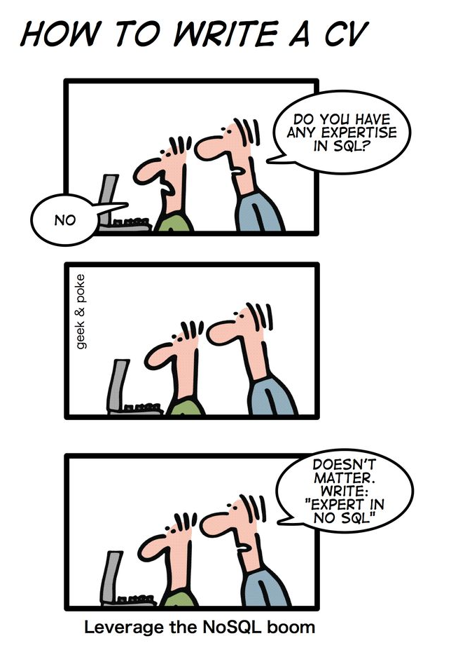
What is NoSQL?
from “Geek and Poke”

Slide 5
What is NoSQL?
An emerging “movement” around non-relational software for Big Data
Roots are in the Google and Amazon homegrown software stacks
Wikipedia: “A NoSQL database provides a mechanism for storage and retrieval of data that use looser consistency models than traditional relational databases in order to achieve horizontal scaling and higher availability. Some authors refer to them as "Not only SQL" to emphasize that some NoSQL systems do allow SQL-like query language to be used.”

Slide 6
Some NoSQL Components
Query Optimization
and Execution
Relational Operators
Access Methods
Buffer Management
Disk Space Management
Analytics Interface
(Pig, Hive, …)
Imperative Lang
(RoR, Java,Scala, …)
Data Parallel Processing
(MapReduce/Hadoop)
Distributed Key/Value or Column Store
(Cassandra, Hbase, Redis, …)
Scalable File System
(GFS, HDFS, …)

Slide 7
NoSQL features
Scalability is crucial!
load increased rapidly for many applications
Large servers are expensive
Solution: use clusters of small commodity machines
need to partition the data and use replication (sharding)
cheap (usually open source!)
cloud-based storage

Slide 8
NoSQL features
Sometimes not a well defined schema
Allow for semi-structured data
still need to provide ways to query efficiently
(use of index methods)
need to express specific types of queries easily

Slide 9
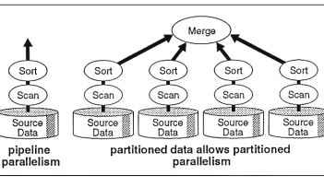
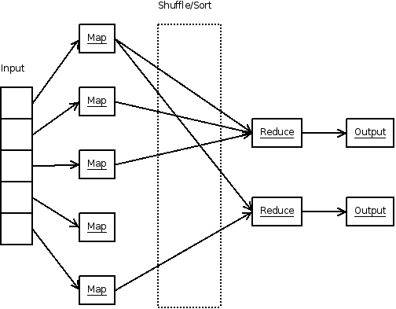
Scalability
Parallel Database
(circa 1990)
Map Reduce
(circa 2005)

Slide 10
The Structure Spectrum
Structured (schema-first)
Semi-Structured (schema-later)
Unstructured (schema-never)
Relational Database
DocumentsXML
Plain Text
Media
Formatted Messages
Tagged Text/Media

Slide 11
What is the Problem?
Single server DBMSs are too small for Big data
Solution: scale out to multiple servers
This is hard for the entire functionality of DMBS
NoSQL: reduce functionality for easier scaleup
– Simpler data model – Very restricted updates

Slide 12
Replicating the Database
How to improve performance for very large databases?
Two basic approaches:
– Scale up through partitioning
– Scale up through replication
Consistency is much harder to enforce

Slide 13
NoSQL Data Models
NoSQL Taxonomy based on data models:
• Key-value stores
– e.g., Redis, Memcached, DynamoDB
• Document stores
– e.g., SimpleDB, CouchDB, MongoDB
• Extensible Record Stores
– e.g., HBase, Cassandra, PNUTS

Slide 14
Key-Value Stores Features
Data model: (key, value) pairs – Key = string/integer, unique for the entire data
– Value = can be anything (very complex object)
• Operations – get(key), put(key,value) (getrange(key1, key2)) – Operations on value not supported
• Distribution/Partitioning–w/hash function
– No replication: key k is stored at server h(k) – 3-way replication: key k stored at h1(k),h2(k),h3(k)

Slide 15
Example
Flights(fid, date, carrier, flight_num, origin, dest, ...) Carriers(cid, name)
How would you represent the Flights data as (key, value) pairs?
Option 1: key=fid, value=entire flight record
Option 2: key=date, value=all flights that day
Option 3: key=(origin, dest), value=all flights between

Slide 16
Key-Value Stores Internals
Partitioning: – Use a hash function h – Store every (key,value) pair on server h(key)
• Replication:
– Store each key on (say) three servers
– On update, propagate change to the other servers; eventual consistency
– Issue: when an app reads one replica, it may be stale
Usually: combine partitioning+replication

Slide 17
Document stores
Extension of Key-Value stores but the Value is a document (and specific semantics)
Examples: SimpleDB, CouchDB, MongoDB

Slide 18
Document Stores Features
Data model: (key, document) pairs – Key = string/integer, unique for the entire data
– Document = JSon, BSON, or XML
Operations – Get/put document by key
– Query language over JSon
Distribution/Partitioning – Entire documents, as for key/value pairs
We will discuss MongoDB soon

Slide 19
MongoDB (An example of a Document Database)
-Data are organized in collections. A collection stores a set of documents.
Collection like table and document like record
but: each document can have a different set of attributes even in the same collection
Semi-structured schema!
Only requirement: every document should have an “_id” field
humongous => Mongo

Slide 20
MongoDB
Key features include:
• JSON-style documents
actually uses BSON (JSON's binary format)
• replication for high availability
• auto-sharding (partitioning) for scalability
• document-based queries
• can create an index on any attribute for faster reads

Slide 21
JSON
JSON is an alternative data model for
semi-structured data.
• JavaScript Object Notation
• Built on two key structures:
• an object, which is a sequence of name/value pairs
{ "id": "1000",
"name": "Sanders Theatre",
"capacity": 1000 }
• an array of values [ "123", "222", "333" ]
• A value can be:
• an atomic value: string, number, true, false, null
• an object
• an array

Slide 22
Example mongodb: JSON
{ "_id”:ObjectId("4efa8d2b7d284dad101e4bc9"),
"Last Name": ” Cousteau",
"First Name": ” Jacques-Yves",
"Date of Birth": ”06-1-1910" },
{ "_id": ObjectId("4efa8d2b7d284dad101e4bc7"),
"Last Name": "PELLERIN",
"First Name": "Franck",
"Date of Birth": "09-19-1983",
"Address": "1 chemin des Loges",
"City": "VERSAILLES" }

Slide 23
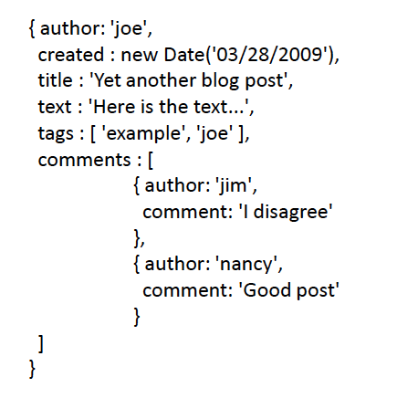
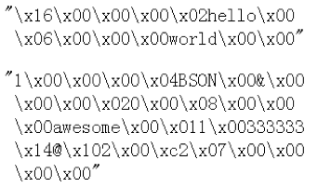
Another Example
Remember it is stored in binary formats (BSON)

Slide 24
JSon vs Relational
Relational data model – Rigid flat structure(tables)
– Schema must be fixed in advance
– Binary representation: good for performance, bad for exchange
– Query language based on Relational Calculus
Semistructured data model / JSon – Flexible, nested structure (trees) – Does not require predefined schema("self describing”) – Text representation: good for exchange, bad for performance
– Most common use: Language API; query languages emerging

Slide 25
JSon Terminology
Data is represented in name/value pairs.
• Curly braces hold objects – Each object is a list of name/value pairs separated by , (comma) – Each pair is a name is followed by :(colon) followed by the value
Square brackets hold ordered arrays and values are separated by ,(comma).

Slide 26
JSon Primitive Datatypes
Number
String – Denoted by double quotes
Boolean – Either true or false
nullempty
The document/database is actually a tree!

Slide 27
MongoDB: The _id Field
Every MongoDB document must have an _id field.
• its value must be unique within the collection
• acts as the primary key of the collection
• it is the key in the key/value pair
• If you create a document without an _id field:
• MongoDB adds the field for you
• assigns it a unique BSON ObjectID
• example from the MongoDB shell:
> db.test.save({ rating: "PG-13" })
> db.test.find()
{ "_id" :ObjectId("528bf38ce6d3df97b49a0569"), "rating" : "PG-13" }
• Note: quoting field names is optional (see rating above)

Slide 28
Data Modeling in MongoDB
Need to determine how to map
entities and relationships => collections of documents
• Could in theory give each type of entity:
• its own (flexibly formatted) type of document
• those documents would be stored in the same collection
• However, it can make sense to group different types of entities together.
• create an aggregate containing data that tends to be accessed together

Slide 29
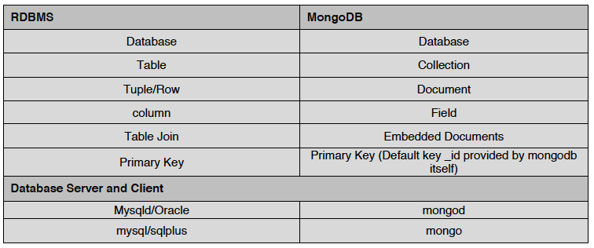
Terms Mapping (DB vs. MongoDB)
There’s no join in mongoDB because it’s too expensive. Instead, use embedded documents (inside 1 document, refer to another document; inside 1 document, have another document), see next slide

Slide 30
Capturing Relationships in MongoDB
Two options:
1. store references to other documents using their _id values
2. embed documents within other documents

Slide 31
Example relationships
Consider the following documents examples:
{
"_id":ObjectId("52ffc33cd85242f436000001"),
"name": "Tom Hanks",
"contact": "987654321",
"dob": "01-01-1991"
}
{
"_id":ObjectId("52ffc4a5d85242602e000000"),
"building": "22 A, Indiana Apt",
"pincode": 123456,
"city": "Los Angeles",
"state": "California"
}
Here is an example of embedded relationship:
{
"_id":ObjectId("52ffc33cd85242f436000001"),
"contact": "987654321",
"dob": "01-01-1991",
"name": "Tom Benzamin",
"address": [
{
"building": "22 A, Indiana Apt",
"pincode": 123456,
"city": "Los Angeles",
"state": "California"
},
{
"building": "170 A, Acropolis Apt",
"pincode": 456789,
"city": "Chicago",
"state": "Illinois"
}
]
}
Option 1
Option 2
And here an example of reference based
{
"_id":ObjectId("52ffc33cd85242f436000001"),
"contact": "987654321",
"dob": "01-01-1991",
"name": "Tom Benzamin",
"address_ids": [
ObjectId("52ffc4a5d85242602e000000"),
ObjectId("52ffc4a5d85242602e000001")
]
}

Slide 32
Queries in MongoDB
Each query can only access a single collection of documents.
• Use a method called
db.collection.find(<selection>, <projection>)
• Example: find the names of all R-rated movies:
> db.movies.find({ rating: 'R' }, { name: 1 })
1 means name is true
(want to see the projection of name)

Slide 33
CRUD
Create
db.collection.insert( <document> )
db.collection.save( <document> )
db.collection.update( <query>, <update>, { upsert: true } )
Read
db.collection.find( <query>, <projection> )
db.collection.findOne( <query>, <projection> )
Update
db.collection.update( <query>, <update>, <options> )
Delete
db.collection.remove( <query>, <justOne> )

Slide 34
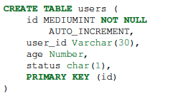


Examples
In RDBMS
In MongoDB
Either insert the 1st docuement
Or create “Users” collection explicitly

Slide 35
Projection
Specify the name of the fields that you want in the output with 1 ( 0 hides the value)
Example:
>db.movies.find({},{"title":1,_id:0})
(will report the title but not the id)
SELECT title
FROM Movies

Slide 36
Selection
You can specify the condition on the corresponding attributes using the find:
>db.movies.find({ rating: "R", year: 2000 },{ name: 1, runtime: 1 })
Operators for other types of comparisons:
MongoDB SQL equivalent
$gt, $gte >, >=
$lt, $lte <, <=
$ne !=
Example: find the names of movies with an earnings <= 200000
> db.movies.find({ earnings: { $lte: 200000 }})
SELECT title, runtime
FROM Movies
WHERE rating=“R” AND year=2000;

Slide 37
For logical operators $and, $or, $nor
use an array of conditions and apply the logical operator among the array conditions:
> db.movies.find({ $or: [ { rating: “R" }, { rating: "PG-13" } ] })
By default, comma means $and even if we don’t specify $and operator

Slide 38
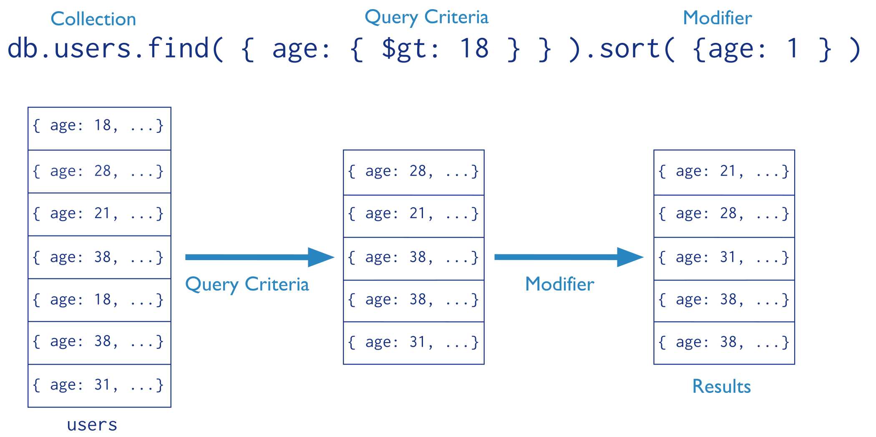
Find() Operator
Means ascending

Slide 39
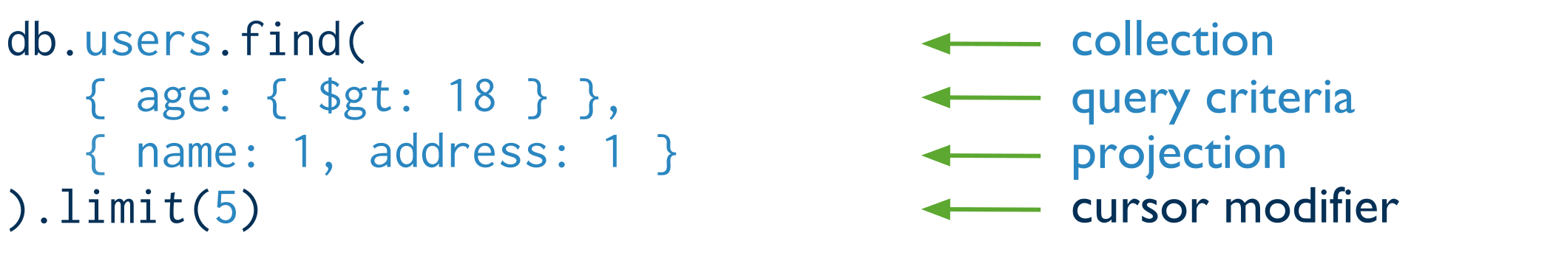
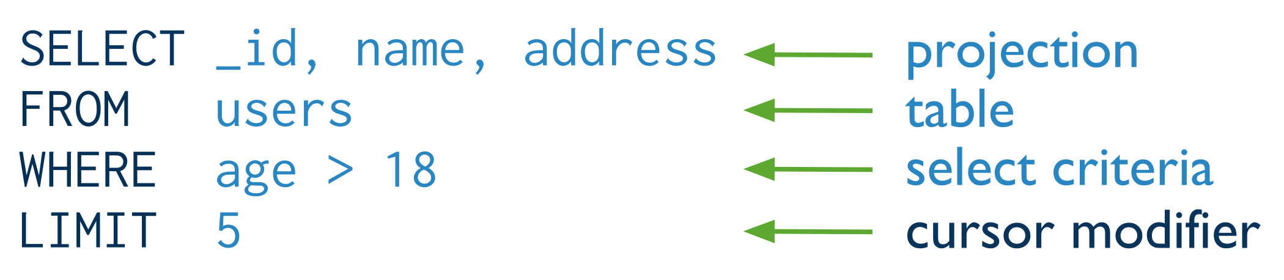
Find() + Projection
If you don’t want to see other attributes, clearly state that other attributes:0.
Means inclusion +
_id is always automatically included
Equivalent to in SQL:

Slide 40
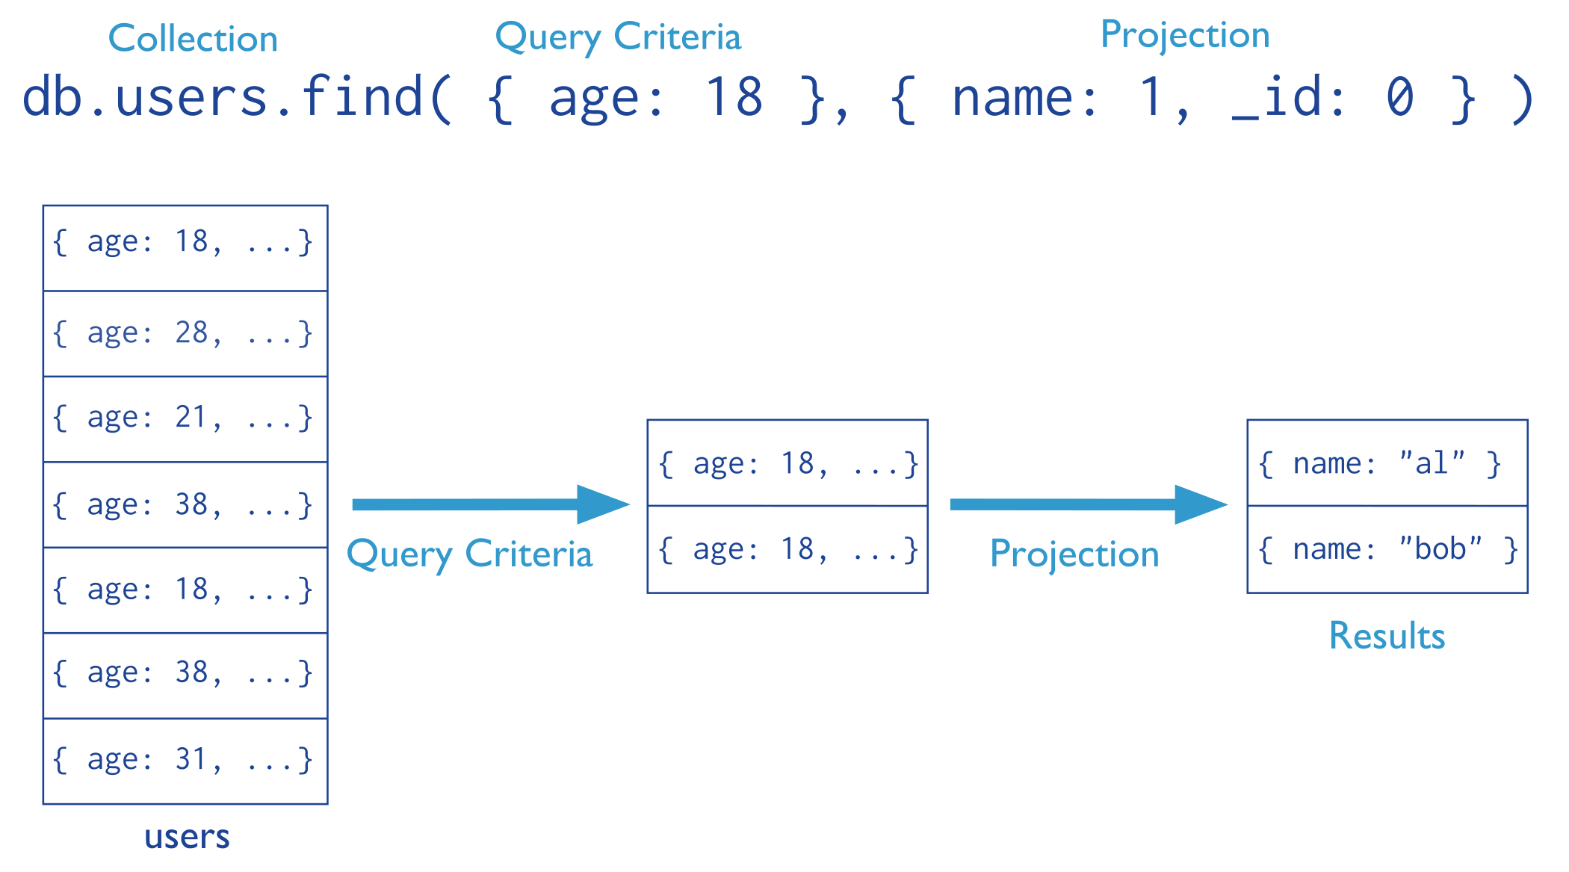
Find(): Exclude Fields
Means exclusion
Means equality
Cannot mix “inclusion & exclusion” in the same operator except for _id

Slide 41
Find() More Examples
Report all documents in the “inventory” collection
Equivalent to in SQL:
db.inventory.find( )
Select *
From inventory;
db.inventory.find( {} )
Equivalent to in SQL:
Report all documents in the “inventory” collection
Where type = ‘food’ or ‘snacks’
Select *
From inventory
Where type in
(‘food’, ‘snacks’);
db.inventory.find(
{ type: { $in: [ 'food', 'snacks' ] } })

Slide 42
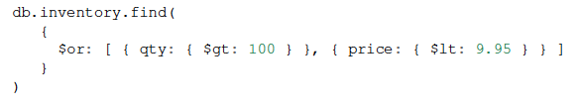
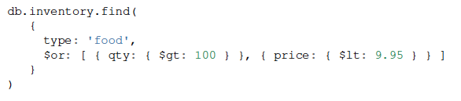
Find(): AND & OR
AND Semantics
OR Semantics
AND + OR Semantics
Type = ‘food’ and (qty > 100 or price < 9.95)

Slide 43
Aggregation
Recall the aggregate operators in SQL: AVG(), SUM(), etc.
More generally, aggregation involves computing a result
from a collection of data.
• MongoDB supports several approaches to aggregation:
- single-purpose aggregation methods
- an aggregation pipeline
- map-reduce
Aggregation pipelines are more flexible and useful (see next):
https://docs.mongodb.com/manual/core/aggregation-pipeline/

Slide 44
Simple Aggregations
• db.collection.count(<selection>)
returns the number of documents in the collection
that satisfy the specified selection document
Example: how may R-rated movies are shorter than 90 minutes?
>db.movies.count({ rating: "R”, runtime: { $lt: 90 }})
db.collection.distinct(<field>, <selection>)
returns an array with the distinct values of the specified field
in documents that satisfy the specified selection document
if omit the query, get all distinct values of that field
- which actors have been in one or more of the top 10 grossing movies?
>db.movies.distinct("actors.name”, { earnings_rank: { $lte: 10 }})

Slide 45
Aggregation Pipeline
A very powerful approach to write queries in MongoDB is to use pipelines.
We execute the query in stages. Every stage gets as input some documents, applies filters/aggregations/projections and outputs some new documents. These documents are the input to the next stage (next operator) and so on
Example for the zipcodes database:
> db.zipcodes.aggregate( [
{ $group: { _id: "$state", totalPop: { $sum: "$pop" } } },
{ $match: { totalPop: { $gte: 10*1000*1000 } } }
] )
Here we use group_by to group documents per state, compute sum of population and output documents with _id, totalPop (_id has the name of the state). The next stage finds a match for all states the have more than 10M population and outputs the state and total population.
More here: https://docs.mongodb.com/v3.0/tutorial/aggregation-zip-code-data-set/
Group by state
Output the state and the population of states that is >= 10million

Slide 46
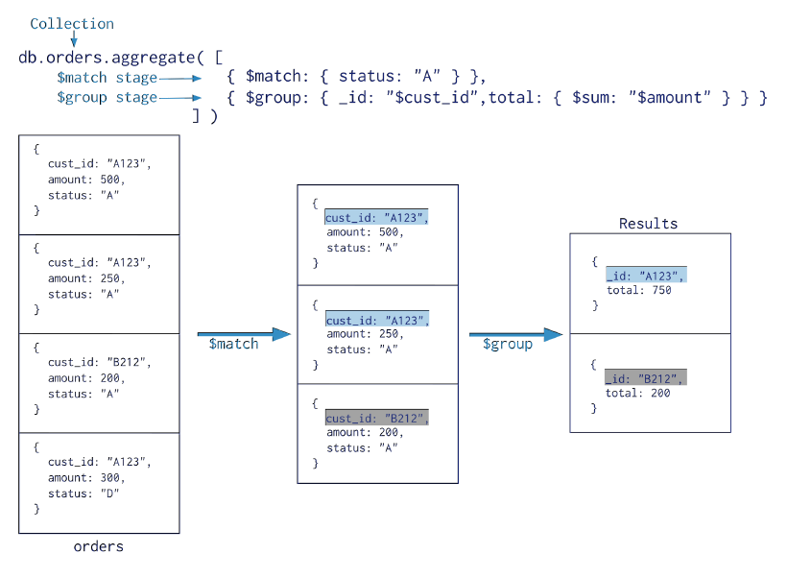
Aggregation Pipeline
Use “aggregate” operator
All predicates, e.g., AND & OR can go here
Defines the grouping column(s)
Aggregation fields

Slide 47
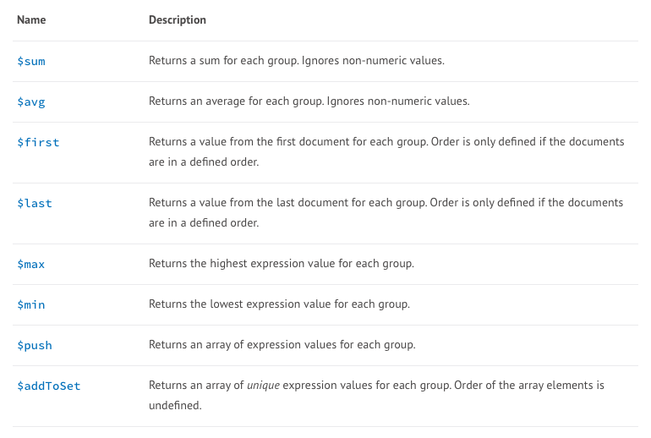
Aggregation Function

Slide 48
Example
{ "_id" : 1, "item" : "abc", "price" : 10, "quantity" : 2, "date" : ISODate("2014-03-01T08:00:00Z") }
{ "_id" : 2, "item" : "jkl", "price" : 20, "quantity" : 1, "date" : ISODate("2014-03-01T09:00:00Z") }
{ "_id" : 3, "item" : "xyz", "price" : 5, "quantity" : 10, "date" : ISODate("2014-03-15T09:00:00Z") }
{ "_id" : 4, "item" : "xyz", "price" : 5, "quantity" : 20, "date" : ISODate("2014-04-04T11:21:39.736Z") }
{ "_id" : 5, "item" : "abc", "price" : 10, "quantity" : 10, "date" : ISODate("2014-04-04T21:23:13.331Z") }
For each day, get the:
- TotalPrice ⬅ Sum (Price * Quantity)
- average quantity
- Count
Select date, Sum(Price*Quantity) AS TotalPrice, Avg(quantity), Count(*)
From Sales
Group By date

Slide 49
{ "_id" : 1, "item" : "abc", "price" : 10, "quantity" : 2, "date" : ISODate("2014-03-01T08:00:00Z") }
{ "_id" : 2, "item" : "jkl", "price" : 20, "quantity" : 1, "date" : ISODate("2014-03-01T09:00:00Z") }
{ "_id" : 3, "item" : "xyz", "price" : 5, "quantity" : 10, "date" : ISODate("2014-03-15T09:00:00Z") }
{ "_id" : 4, "item" : "xyz", "price" : 5, "quantity" : 20, "date" : ISODate("2014-04-04T11:21:39.736Z") }
{ "_id" : 5, "item" : "abc", "price" : 10, "quantity" : 10, "date" : ISODate("2014-04-04T21:23:13.331Z") }
db.sales.aggregate([
{$group : {_id : { month: { $month: "$date" },
day: { $dayOfMonth: "$date" },
year: { $year: "$date" } ,
totalPrice: { $sum: { $multiply: [ "$price", "$quantity" ] } },
averageQuantity: { $avg: "$quantity" },
count: { $sum: 1 }
}}])

Slide 50
Group By…Having
In MongoDB ➔ $match operator after the $group
{ "_id": "10280",
"country": "USA",
"city": "NEW YORK",
"state": "NY",
"pop": 5574,
"loc": [ -74.016323, 40.710537]
}
Select state, sum(pop)
From collection
Where country = “USA”
Group By state
Having sum(pop) > 10,000,000;
db.zipcodes.aggregate( [
{ $match: { country: "USA" }},
{ $group: { _id: "$state", totalPop: { $sum: "$pop" } } },
{ $match: { totalPop: { $gt: 10*1000*1000 } } }
] )

Slide 51
Fault Tolerance
DBs: coarse-grained FT – if trouble, restart transaction
Fewer, Better nodes, so failures are rare
Transactions allow you to kill a job and easily restart it
NoSQL: Massive amounts of cheap HW, failures are the norm and massive data means long running jobs
So must be able to do mini-recoveries
This causes some overhead (file writes)

