Slide 1
CAS CS 460
Introduction to Database Systems
Disks, Buffer Manager

Slide 2
DBMS architecture
Database app (SQL)
Query Optimization
and Execution
Relational Operators
These layers
must consider
concurrency
control and
recovery
Access Methods
Buffer Management
Disk Space Management
Student Records stored on disk

Slide 3
Why Not Store It All in Main Memory?
Costs too much. $300 will buy you either
~30 GB of RAM or around 10000 GB (10 TB) of disk today (also 2TB of SSD disk)
High-end Databases today can be in the Petabyte (1000TB) range.
Approx 60% of the cost of a production system is in the disks.
Main memory is volatile. We want data to be saved between runs. (Obviously!)
Note, some specialized systems do store entire database in main memory.
Vendors claim 10x speed up vs. traditional DBMS running in main memory.

Slide 4
Disks and Files
Today: Most data is stored on magnetic disks.
Disks are a mechanical anachronism!
Major implications!
No “pointer derefs”. Instead, an API:
READ: transfer “page” of data from disk to RAM.
WRITE: transfer “page” of data from RAM to disk.
Both API calls expensive, very slow
Plan carefully!
An explicit API can be a good thing
Minimizes the kind of pointer errors you see in C

Slide 5
The Storage Hierarchy
Main memory (RAM) for currently used data.
Disk for main database (secondary storage).
Tapes for archive, maybe (tertiary storage).
The role of Flash (SSD) still unclear
Registers
Small, Fast
On-chip Cache
On-Board Cache
RAM
SSD
Disk
Big, Slow
Tape

Slide 6
The Storage Hierarchy
1 ns = 10⁻⁹ secs
Main memory (RAM) for currently used data.
Disk for main database (secondary storage).
Tapes for archive, maybe (tertiary storage).
The role of Flash (SSD) still unclear
1 ms = 10⁻³ secs
Registers
On-chip Cache
0.5 ns
On-Board Cache
7 ns
RAM
100 ns
SSD
1 ms
Disk
15 ms
Tape

Slide 7
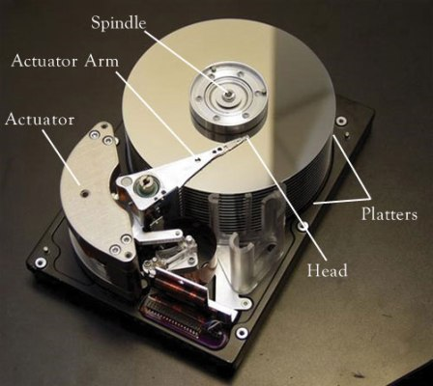
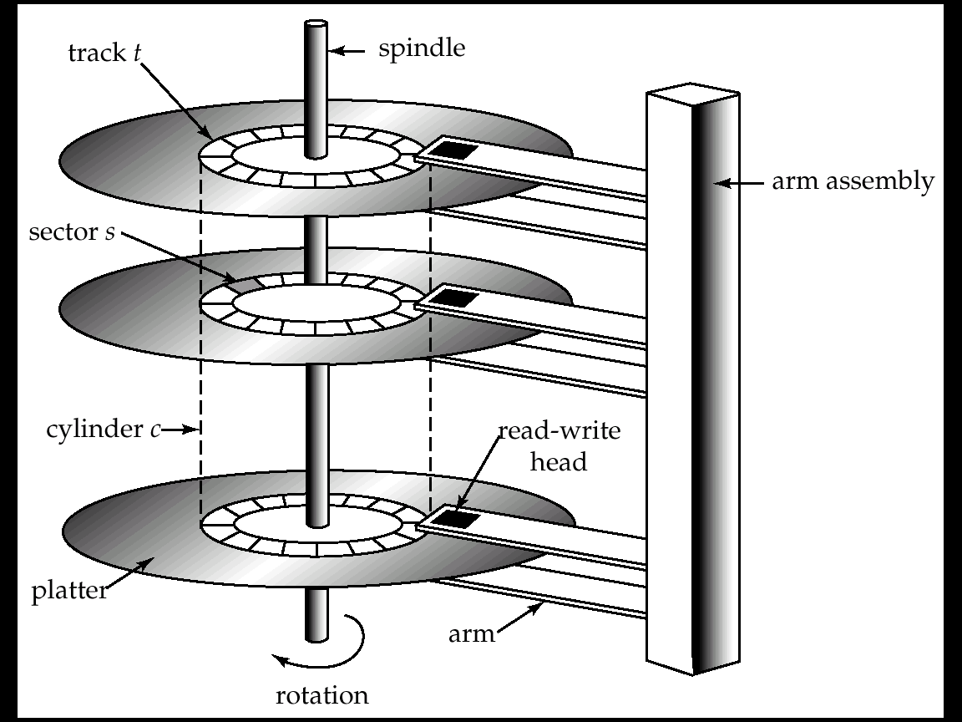

Slide 8
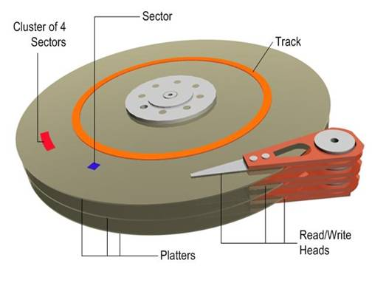
Anatomy of a Disk
The platters spin
The arm assembly is moved in or out to position a head on a desired track. Tracks under heads make a cylinder (imaginary!).
Only one head reads/writes at any one time.
Block size is a multiple of sector size (which is fixed)
Notes:
sector size: 512 bytes to new HDD 4KB (AF)
Block size: 4KB to 32KB

Slide 9
Accessing a Disk Page
Time to access (read/write) a disk block:
seek time (moving arms to position disk head on track)
rotational delay (waiting for block to rotate under head)
transfer time (actually moving data to/from disk surface)
Seek time and rotational delay dominate.
Seek time varies from about 2-3 msec
Rotational delay varies from 0 to 8 msec (7200rpm)
Transfer rate is < 0.1 msec per 8KB block
Key to lower I/O cost:
reduce seek/rotation delays! Hardware vs. software solutions?
Also note: For shared disks most time spent waiting in queue for access to arm/controller
Wait
Transfer
Transfer
Rotate
Rotate
Seek
Seek

Slide 10
Arranging Pages on Disk
`Next’ block concept:
blocks on same track, followed by
blocks on same cylinder, followed by
blocks on adjacent cylinder
Arrange file pages sequentially on disk
minimize seek and rotational delay.
For a sequential scan, pre-fetch
several pages at a time!
We use Block/Page interchangeably!!

Slide 11
Disk Space Management
Lowest layer of DBMS software manages space on disk (using OS file system or not?).
Higher levels call upon this layer to:
allocate/de-allocate a page
read/write a page
Best if a request for a sequence of pages is satisfied by pages stored sequentially on disk! Higher levels don’t need to know if/how this is done, or how free space is managed.

Slide 12
CPU
Typical
Computer
...
...
M
C
Secondary
Storage

Slide 13
Notes on Flash (SSD)
Various technologies, we focus on NAND
suited for volume data storage
alternative: NOR Flash
Read is random access and fast
E.g. 1-2 KBytes at a time
Write is coarser grained and slower
E.g. 16-512 KBytes at a time.
Can get slower over time
Some concern about write endurance
100K cycle lifetimes?
Still changing quickly

Slide 14
Storage Pragmatics & Trends
Many significant DBs are not that big.
Daily weather, round the globe, 1929-2009: 20GB
2000 US Census: 200GB
2009 English Wikipedia: 14GB
NYC Taxi Rides (~20GB per year)
Others are very BIG:
Walmart stores 1M transactions/hours
Maintains 2.5 PBytes data warehouse
But data sizes grow faster than Moore’s Law
What is the role of disk, flash, RAM?
The subject of much debate/concern!
Here we assume that all data are stored in hard disks!

Slide 15
DBMS architecture
Database app (SQL)
Query Optimization
and Execution
Relational Operators
Access Methods
Buffer Management
Disk Space Management
Student Records stored on disk

Slide 16
Buffer Management in a DBMS
Page Requests from Higher Levels
BUFFER POOL
disk page
free frame
MAIN MEMORY
choice of frame dictated
by replacement policy
DISK
DB
Data must be in RAM for DBMS to operate on it!
The query processor refers to data using virtual memory addresses.
Buffer Mgr hides the fact that not all data is in RAM

Slide 17
Some Terminology…
Disk Page – the unit of transfer between the disk and memory
Typically set as a config parameter for the DBMS.
Typical value between 4 KBytes to 32 KBytes.
Frame – a unit of memory
Typically the same size as the Disk Page Size
Buffer Pool – a collection of frames used by the DBMS to temporarily keep data for use by the query processor (CPU).
note: We will sometime use the term “buffer” and “frame” synonymously.

Slide 18
When a Page is Requested ...
pin means that the page is being used. need to be unpinned after use.
If requested page IS in the pool:
Pin the page and return its address.
Else, if requested page IS NOT in the pool:
If a free frame exists, choose it,
Else:
Choose a frame for replacement (only un-pinned pages are candidates)
If chosen frame is “dirty”, write it to disk
Read requested page into chosen frame
Pin the page and return its address.
if the page is dirty, it means that it was modified and needs to be mdifie in the disk.
only the pages are not pined can be removed
Q: What information about buffers and their contents must the system maintain?

Slide 19
Buffer Control Blocks (BCBs):
<frame#, pageid, pin_count, dirty>
A page may be requested many times, so a pin_count is used.
To pin a page, pin_count++
A page is a candidate for replacement iff pin_count == 0 (“unpinned”)
Requestor of page must eventually unpin it.
pin_count--
Must also indicate if page has been modified:
dirty bit is used for this.
Q: Why is this important?
one the pageid.
use hash map based on pageid
Q: How should BCB’s be organized?

Slide 20
Additional Buffer Mgr Notes
BCB’s are hash indexed by pageID
Concurrency Control & Recovery may entail additional I/O when a frame is chosen for replacement.
(Write-Ahead Log protocol; more later.)
If requests can be predicted (e.g., sequential scans) pages can be pre-fetched several pages at a time.
Also, can be done in parallel when CPU works on an existing page

Slide 21
Buffer Replacement Policy
Frame is chosen for replacement by a replacement policy:
Least-recently-used (LRU), MRU, Clock, etc.
This policy can have big impact on the number of disk reads and writes.
Remember, these are slooooooooooow.
BIG IDEA – throw out the page that you are least likely to need in the future.
Q: How do you predict the future?
temporal locality in software.

Slide 22
LRU Replacement Policy
Least Recently Used (LRU)
for each page in buffer pool, keep track of time last unpinned
2)Replace the frame that has the oldest (earliest) time
Most common policy: intuitive and simple
Based on notion of “Temporal Locality”
Works well to keep “working set” in buffers.
Implemented through doubly linked list
Requires list manipulation on unpin
the oldest one is at the tail of the double linked list

Slide 23
“Clock” Replacement Policy
A(1)
An approximation of LRU
Arrange frames into a cycle, store one reference bit per frame
Can think of this as the 2nd chance bit
When pin_count reduces to 0, turn on ref. bit
When replacement necessary do for each page in cycle { if (pin_count == 0 && ref bit is on) turn off ref bit; else if (pin_count == 0 && ref bit is off) choose this page for replacement; } until a page is chosen;
B(p)
D(1)
C(1)

Slide 24
Some issues with LRU
Problem: Sequential flooding
LRU + repeated sequential scans.
# buffer frames < # pages in file means each page request causes an I/O. MRU much better in this situation (but not in all situations, of course).
Problem: “cold” pages can hang around a long time before they are replaced.
mrru, most recently used

Slide 25
Sequential Flooding – Illustration
BUFFER POOL
LRU:
BUFFER POOL
MRU:
1
2
3
4
5
6
7
8
Repeated scan of file …

Slide 26
Sequential Flooding – Illustration
BUFFER POOL
LRU:
1
2
3
4
BUFFER POOL
MRU:
1
2
3
4
5
6
7
8
Repeated scan of file …

Slide 27
Sequential Flooding – Illustration
BUFFER POOL
LRU:
5
2
3
4
BUFFER POOL
MRU:
1
2
3
4
5
6
7
8
Repeated scan of file …

Slide 28
Sequential Flooding – Illustration
BUFFER POOL
LRU:
5
6
3
4
BUFFER POOL
MRU:
1
2
3
4
5
6
7
8
Repeated scan of file …

Slide 29
Sequential Flooding – Illustration
BUFFER POOL
LRU:
5
6
7
4
BUFFER POOL
MRU:
1
2
3
4
5
6
7
8
Repeated scan of file …

Slide 30
Sequential Flooding – Illustration
BUFFER POOL
LRU:
5
6
7
8
BUFFER POOL
MRU:
1
2
3
4
5
6
7
8
Repeated scan of file …

Slide 31
Sequential Flooding – Illustration
BUFFER POOL
LRU:
1
6
7
8
BUFFER POOL
MRU:
1
2
3
4
5
6
7
8
Repeated scan of file …

Slide 32
Sequential Flooding – Illustration
BUFFER POOL
LRU:
1
2
7
8
BUFFER POOL
MRU:
1
2
3
4
5
6
7
8
Repeated scan of file …

Slide 33
Sequential Flooding – Illustration
BUFFER POOL
LRU:
1
2
3
8
BUFFER POOL
MRU:
1
2
3
4
5
6
7
8
Repeated scan of file …

Slide 34
Sequential Flooding – Illustration
BUFFER POOL
LRU:
1
2
3
4
BUFFER POOL
MRU:
1
2
3
4
5
6
7
8
Repeated scan of file …

Slide 35
Sequential Flooding – Illustration
BUFFER POOL
LRU:
5
2
3
4
BUFFER POOL
MRU:
1
2
3
4
5
6
7
8
Repeated scan of file …

Slide 36
Sequential Flooding – Illustration
BUFFER POOL
LRU:
5
6
3
4
BUFFER POOL
MRU:
1
2
3
4
5
6
7
8
Repeated scan of file …

Slide 37
Sequential Flooding – Illustration
BUFFER POOL
LRU:
5
6
7
4
BUFFER POOL
MRU:
1
2
3
4
5
6
7
8
Repeated scan of file …

Slide 38
Sequential Flooding – Illustration
BUFFER POOL
LRU:
5
6
7
8
BUFFER POOL
MRU:
1
2
3
4
5
6
7
8
Repeated scan of file …

Slide 39
Sequential Flooding – Illustration
BUFFER POOL
LRU:
1
6
7
8
BUFFER POOL
MRU:
1
2
3
4
5
6
7
8
Repeated scan of file …

Slide 40
Sequential Flooding – Illustration
BUFFER POOL
LRU:
1
2
7
8
BUFFER POOL
MRU:
1
2
3
4
5
6
7
8
Repeated scan of file …

Slide 41
Sequential Flooding – Illustration
BUFFER POOL
LRU:
1
2
3
8
BUFFER POOL
MRU:
1
2
3
4
5
6
7
8
Repeated scan of file …

Slide 42
Sequential Flooding – Illustration
BUFFER POOL
LRU:
1
2
3
4
BUFFER POOL
MRU:
1
2
3
4
5
6
7
8
Repeated scan of file …

Slide 43
Sequential Flooding – Illustration
BUFFER POOL
LRU:
5
2
3
4
BUFFER POOL
MRU:
1
2
3
4
5
6
7
8
Repeated scan of file …

Slide 44
Sequential Flooding – Illustration
BUFFER POOL
LRU:
5
6
3
4
BUFFER POOL
MRU:
1
2
3
4
5
6
7
8
Repeated scan of file …

Slide 45
Sequential Flooding – Illustration
BUFFER POOL
LRU:
5
6
7
4
BUFFER POOL
MRU:
1
2
3
4
5
6
7
8
Repeated scan of file …

Slide 46
Sequential Flooding – Illustration
BUFFER POOL
LRU:
5
6
7
8
for 3 scans every page access
was a miss (had to go to disk)
3*8=24 disk accesses
BUFFER POOL
MRU:
1
2
3
4
5
6
7
8
Repeated scan of file …

Slide 47
Sequential Flooding – Illustration
BUFFER POOL
LRU:
BUFFER POOL
MRU:
1
2
3
4
1
2
3
4
5
6
7
8
Repeated scan of file …

Slide 48
Sequential Flooding – Illustration
BUFFER POOL
LRU:
BUFFER POOL
MRU:
1
2
3
5
1
2
3
4
5
6
7
8
Repeated scan of file …

Slide 49
Sequential Flooding – Illustration
BUFFER POOL
LRU:
BUFFER POOL
MRU:
1
2
3
6
1
2
3
4
5
6
7
8
Repeated scan of file …

Slide 50
Sequential Flooding – Illustration
BUFFER POOL
LRU:
BUFFER POOL
MRU:
1
2
3
7
1
2
3
4
5
6
7
8
Repeated scan of file …

Slide 51
Sequential Flooding – Illustration
BUFFER POOL
LRU:
BUFFER POOL
MRU:
1
2
3
8
1
2
3
4
5
6
7
8
Repeated scan of file …

Slide 52
Sequential Flooding – Illustration
BUFFER POOL
LRU:
BUFFER POOL
MRU:
1
2
4
8
1
2
3
4
5
6
7
8
Repeated scan of file …

Slide 53
Sequential Flooding – Illustration
BUFFER POOL
LRU:
BUFFER POOL
MRU:
1
2
5
8
1
2
3
4
5
6
7
8
Repeated scan of file …

Slide 54
Sequential Flooding – Illustration
BUFFER POOL
LRU:
BUFFER POOL
MRU:
1
2
6
8
1
2
3
4
5
6
7
8
Repeated scan of file …

Slide 55
Sequential Flooding – Illustration
BUFFER POOL
LRU:
BUFFER POOL
MRU:
1
2
7
8
1
2
3
4
5
6
7
8
Repeated scan of file …

Slide 56
Sequential Flooding – Illustration
BUFFER POOL
LRU:
BUFFER POOL
MRU:
1
2
7
8
1
2
3
4
5
6
7
8
Repeated scan of file …

Slide 57
Sequential Flooding – Illustration
BUFFER POOL
LRU:
BUFFER POOL
MRU:
1
2
7
8
1
2
3
4
5
6
7
8
Repeated scan of file …

Slide 58
Sequential Flooding – Illustration
BUFFER POOL
LRU:
BUFFER POOL
MRU:
1
3
7
8
1
2
3
4
5
6
7
8
Repeated scan of file …

Slide 59
Sequential Flooding – Illustration
BUFFER POOL
LRU:
BUFFER POOL
MRU:
1
4
7
8
1
2
3
4
5
6
7
8
Repeated scan of file …

Slide 60
Sequential Flooding – Illustration
BUFFER POOL
LRU:
BUFFER POOL
MRU:
1
5
7
8
1
2
3
4
5
6
7
8
Repeated scan of file …

Slide 61
Sequential Flooding – Illustration
BUFFER POOL
LRU:
BUFFER POOL
MRU:
1
6
7
8
1
2
3
4
5
6
7
8
Repeated scan of file …

Slide 62
Sequential Flooding – Illustration
BUFFER POOL
LRU:
BUFFER POOL
for the 2nd and 3nd scan we were
able to use 4 pages again, so we
had 4 disk accesses:
8+2*4 = 16 disk accesses
MRU:
1
6
7
8
1
2
3
4
5
6
7
8
Repeated scan of file …

Slide 63
DBMS vs. OS File System
OS does disk space & buffer mgmt: why not let OS manage these tasks?
Some limitations, e.g., files can’t span disks.
Note, this is changing --- OS File systems are getting smarter (i.e., more like databases!)
Buffer management in DBMS requires ability to:
pin a page in buffer pool, force a page to disk & order writes (important for implementing CC & recovery)
adjust replacement policy, and pre-fetch pages based on access patterns in typical DB operations.

