Slide 1
CAS CS 460 Data Base Design
Entity/Relationship Model
(Chapters 2 and 3.5)

Slide 2
Announcements
Gradescope is up! Code: 4PBG3D
Lab starts tomorrow, 1/26!
We will release the first Programming Assignment soon!

Slide 3
Describing Data: Data Models
Data model : collection of concepts for describing data.
Schema: description of a particular collection of data, using a given data model.
Relational model of data
Main concept: relation (table), rows and columns
Every relation has a schema
describes the columns
column names and domains

Slide 4
Levels of Abstraction
Views describe how users see the data.
Conceptual schema defines logical structure
Physical schema describes the files and indexes used.
View 1
View 2
View 3
Conceptual Schema
Physical Schema
DB

Slide 5
Example: University Database
Conceptual schema:
Students(sid text, name text, login text, age integer, gpa float)
Courses(cid text, cname text, credits integer)
Enrolled(sid text, cid text, grade text)
Physical schema:
Relations stored as unordered files.
Index on first column of Students.
External Schema (View):
Course_info(cid text, enrollment integer)

Slide 6


Data Independence
Insulate apps from structure of data
Logical data independence:
Protection from changes in logical structure
Physical data independence:
Protection from changes in physical structure
Q: Why particularly important for DBMS?
Because databases and their associated applications persist.

Slide 7


Data Models
Connect concepts to bits!
Many models exist
We will ground ourselves in the Relational model
clean and common
generalization of key/value
Entity-Relationship model also handy for design
Translates down to Relational
Student (sid: string, name: string, login: string, age: integer, gpa:real)
1010111101

Slide 8
Entity-Relationship Model
Relational model is a great formalism
and a clean system framework
But a bit detailed for design time
a bit fussy for brainstorming
hard to communicate to customers
Entity-Relationship model is a popular “shim” over relational model
graphical, slightly higher level

Slide 9
Steps in Traditional Database Design
Requirements Analysis
user needs; what must database do?
Conceptual Design
high level description (often done w/ER model)
Logical Design
translate ER into DBMS data model
Schema Refinement
consistency, normalization
Physical Design - indexes, disk layout
Security Design - who accesses what, and how

Slide 10
Conceptual Design
What are the entities and relationships?
What info about E’s & R’s should be in DB?
What integrity constraints (business rules) hold?
ER diagram is the “schema”
Can map an ER diagram into a relational schema.

Slide 11
ER Model Basics
name
ssn
lot
Employees
Entity:
A real-world object described by a set of attribute values.
Entity Set: A collection of similar entities.
E.g., all employees.
All entities in an entity set have the same attributes.
Each entity set has a key (underlined)
Each attribute has a domain

Slide 12
ER Model Basics (Contd.)
since
name
dname
ssn
lot
did
budget
Employees
Works_In
Departments
Relationship: Association among two or more entities.
E.g., Attishoo works in Pharmacy department.
relationships can have their own attributes.
Relationship Set: Collection of similar relationships.
An n-ary relationship set R relates n entity sets E₁ ... E_{n} ; each relationship in R involves entities e₁ ∈ E₁, ..., e_{n} ∈ E_{n}

Slide 13
ER Model Basics (Cont.)
name
ssn
lot
Employees
since
dname
super-visor
subor-dinate
did
budget
Reports_To
Departments
Works_In
Same entity set can participate in different relationship sets, or in different “roles” in the same relationship set.

Slide 14
Key Constraints
name
since
dname
ssn
lot
did
budget
Employees
Manages
Departments
An employee can work in many departments; a dept can have many employees.
Works_In
since
In contrast, each dept has at most one manager, according to the key constraint on Manages.
Many-to-Many
1-to-Many
1-to-1

Slide 15
Participation Constraints
Does every employee work in a department?
If so: a participation constraint
participation of Employees in Works_In is total (vs. partial)
What if every department has an employee working in it?
Basically means “at least one”
since
since
name
name
dname
dname
ssn
did
did
budget
lot
budget
Employees
Manages
Departments
Works_In
or
since

Slide 16
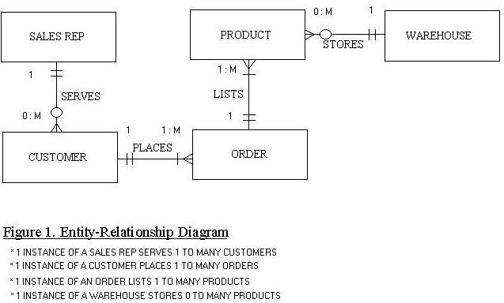
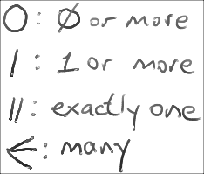
Alternative: Crow’s Foot Notation

Slide 17
Summary so far
Entities and Entity Set (boxes)
Relationships and Relationship sets (diamonds)
Key constraints (arrows)
Participation constraints (bold for Total)
These are enough to get started, but we’ll need more…

Slide 18
Weak Entities
A weak entity can be identified uniquely only by considering the primary key of another (owner) entity.
Owner entity set and weak entity set must participate in a one-to-many relationship set (one owner, many weak entities).
Weak entity set must have total participation in this identifying relationship set.
name
ssn
lot
cost
pname
age
Employees
Policy
Dependents
Weak entities have only a “partial key” (dashed underline)

Slide 19
Binary vs. Ternary Relationships
name
ssn
lot
pname
age
Employees
Covers
Dependents
If each policy is owned by just 1 employee:
Policies
Key constraint on Policies would mean policy can only cover 1 dependent!
policyid
cost
name
pname
age
ssn
lot
Dependents
Employees
Think through all the constraints in the 2nd diagram!
Purchaser
Beneficiary
Better design
Policies
policyid
cost

Slide 20
Binary vs. Ternary Relationships (Contd.)
Previous example:
2 binary relationships better than 1 ternary relationship.
An example in the other direction:
ternary relationship set Contracts relates entity sets Parts, Departments and Suppliers
relationship set has descriptive attribute qty.
no combo of binary relationships is a substitute!
See next slide…

Slide 21
Binary vs. Ternary Relationships (Contd.)
qty
Parts
Contract
Departments
VS.
Suppliers
Parts
needs
Departments
can-supply
Suppliers
deals-with
S “can-supply” P, D “needs” P, and D “deals-with” S does not imply that D has agreed to buy P from S.
How do we record qty?

Slide 22
Aggregation
name
ssn
lot
Employees
Monitors
until
started_on
since
dname
pid
pbudget
did
budget
Projects
Sponsors
Departments
Allows relationships with relationship sets.

Slide 23
E/R Data Model Extensions to the Model: Specialization and Generalization
An Example:
Customers can have checking and savings accts
Checking ~ Savings (many of the same attributes)
Old Way:
Customers
Has1
Savings Accts
acct_no
balance
interest
Has2
Checking Accts
acct_no
balance
overdraft

Slide 24
E/R Data Model Extensions to the Model: Specialization and Generalization
An Example:
Customers can have checking and savings accts
Checking ~ Savings (many of the same attributes)
New Way:
acct_no
balance
Customers
Has
Accounts
superclass
ISA
Savings Accts
Checking Accts
interest
overdraft
subclasses

Slide 25
Conceptual Design Using the ER Model
ER modeling can get tricky!
Design choices:
Entity or attribute?
Entity or relationship?
Relationships: Binary or ternary? Aggregation?
ER Model goals and limitations:
Lots of semantics can (and should) be captured.
Some constraints cannot be captured in ER.
We’ll refine things in our logical (relational) design

Slide 26

Entity vs. Attribute
“Address”:
attribute of Employees?
Entity of its own?
It depends! Semantics and usage.
Several addresses per employee?
must be an entity
atomic attribute types (no set-valued attributes!)
Care about structure? (city, street, etc.)
must be an entity!
atomic attribute types (no tuple-valued attributes!)

Slide 27
Entity vs. Attribute (Cont.)
from
to
name
dname
Works_In2: employee cannot work in a department for >1 period.
Like multiple addresses per employee!
ssn
lot
did
budget
Employees
Works_In2
Departments
name
dname
ssn
lot
did
budget
Employees
Works_In3
Departments
from
Duration
to

Slide 28
Entity vs. Relationship
Separate discretionary budget (dbudget) for each dept.
What if manager’s dbudget covers all managed depts
Could repeat value
But redundancy = problems
Better design:
since
dbudget
name
dname
ssn
lot
did
budget
Employees
Manages2
Departments
name
ssn
lot
dname
Employees
did
budget
Departments
is_manager
managed_by
since
apptnum
Mgr_Appts
dbudget

Slide 29
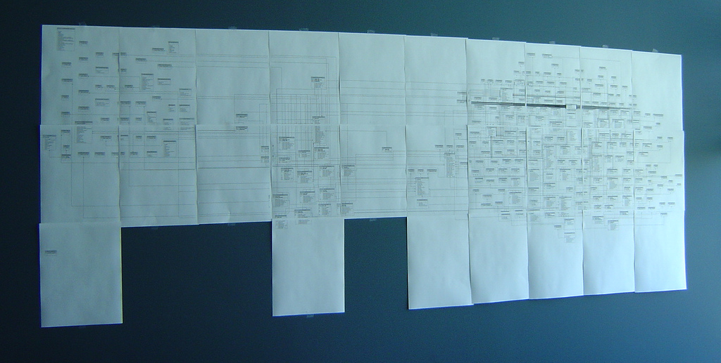
E-R Diagram as Wallpaper
Very common for them to be wall-sized

Slide 30
Converting ER to Relational
Fairly analogous structure
But many simple concepts in ER are subtle to specify in relations
since
name
dname
ssn
lot
did
budget
Employees
Works_In
Departments

Slide 31
Logical DB Design: ER to Relational
Entity sets to tables.
ssn
name
lot
123-22-3666
Attishoo
48
name
ssn
lot
231-31-5368
Smiley
22
131-24-3650
Smethurst
35
Employees
varchar - can have at most 11 characters, but use less.
Char- leaves 20 for this variabe or data, and the spaces will not be used is there is a shorter entry
CREATE TABLE Employees
(ssn VARCHAR(11),
name CHAR(20),
lot INTEGER,
PRIMARY KEY (ssn));

Slide 32
Primary Keys
A set of attributes is a key, if uniquely identifies a tuple in a table (relation)
e.g., no two distinct tuples that have the same values in the key attributes
A set that contains a key (and includes more attributes) is called superkey.
So, key is a minimal superkey!
If more than 1 keys in a table, we need to choose one to be the primary key
sid is a key for Students.
What about name?
The set {sid, gpa} is a superkey.

Slide 33
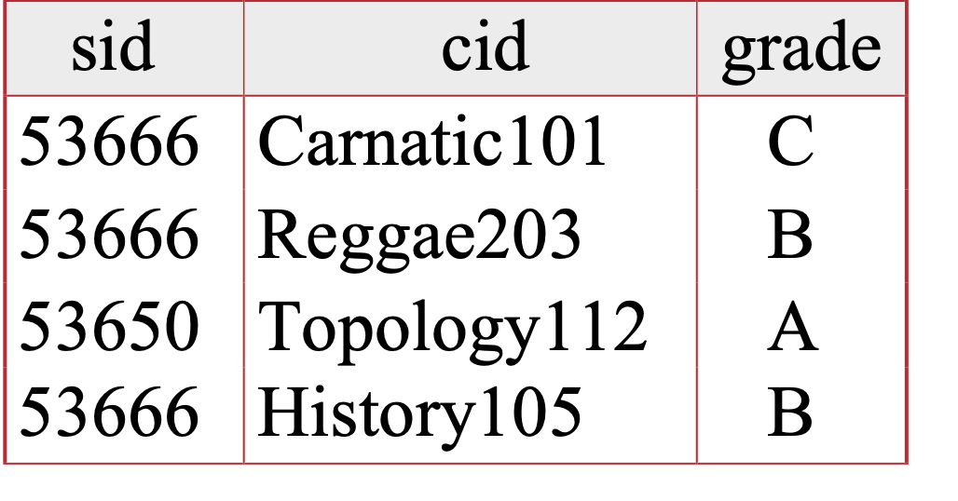
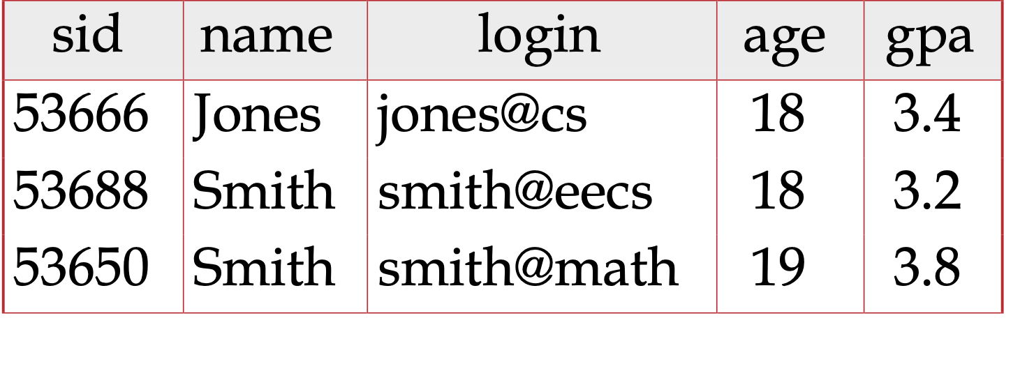
Foreign Keys
A Foreign Key is an attribute (or set of attributes) whose values are keys in another relation (think about them as “pointers”).
Enrolled
Students

Slide 34
Foreign Key, Referential Integrity
Foreign key : Set of fields in one relation that is used to `refer’ to a tuple in another relation.
Must correspond to primary key of the second relation.
Like a `logical pointer’.
E.g. sid is a foreign key referring to Students:
Enrolled(sid: string, cid: string, grade: string)
If all foreign key constraints are enforced, referential integrity is achieved (i.e., no dangling references.)

Slide 35
Relationship Sets to Tables
CREATE TABLE Works_In(
ssn VARCHAR(11),
did INTEGER,
since DATE,
PRIMARY KEY (ssn, did),
FOREIGN KEY (ssn)
REFERENCES Employees(ssn),
FOREIGN KEY (did)
REFERENCES Departments(did));
In translating a many-to-many relationship set to a relation, attributes of the relation must include:
1) Keys for each participating entity set (as foreign keys). This set of attributes forms a key for the relation.
2) All descriptive attributes.
ssn
did
since
123-22-3666
51
1/1/91
123-22-3666
56
3/3/93
231-31-5368
51
2/2/92

Slide 36
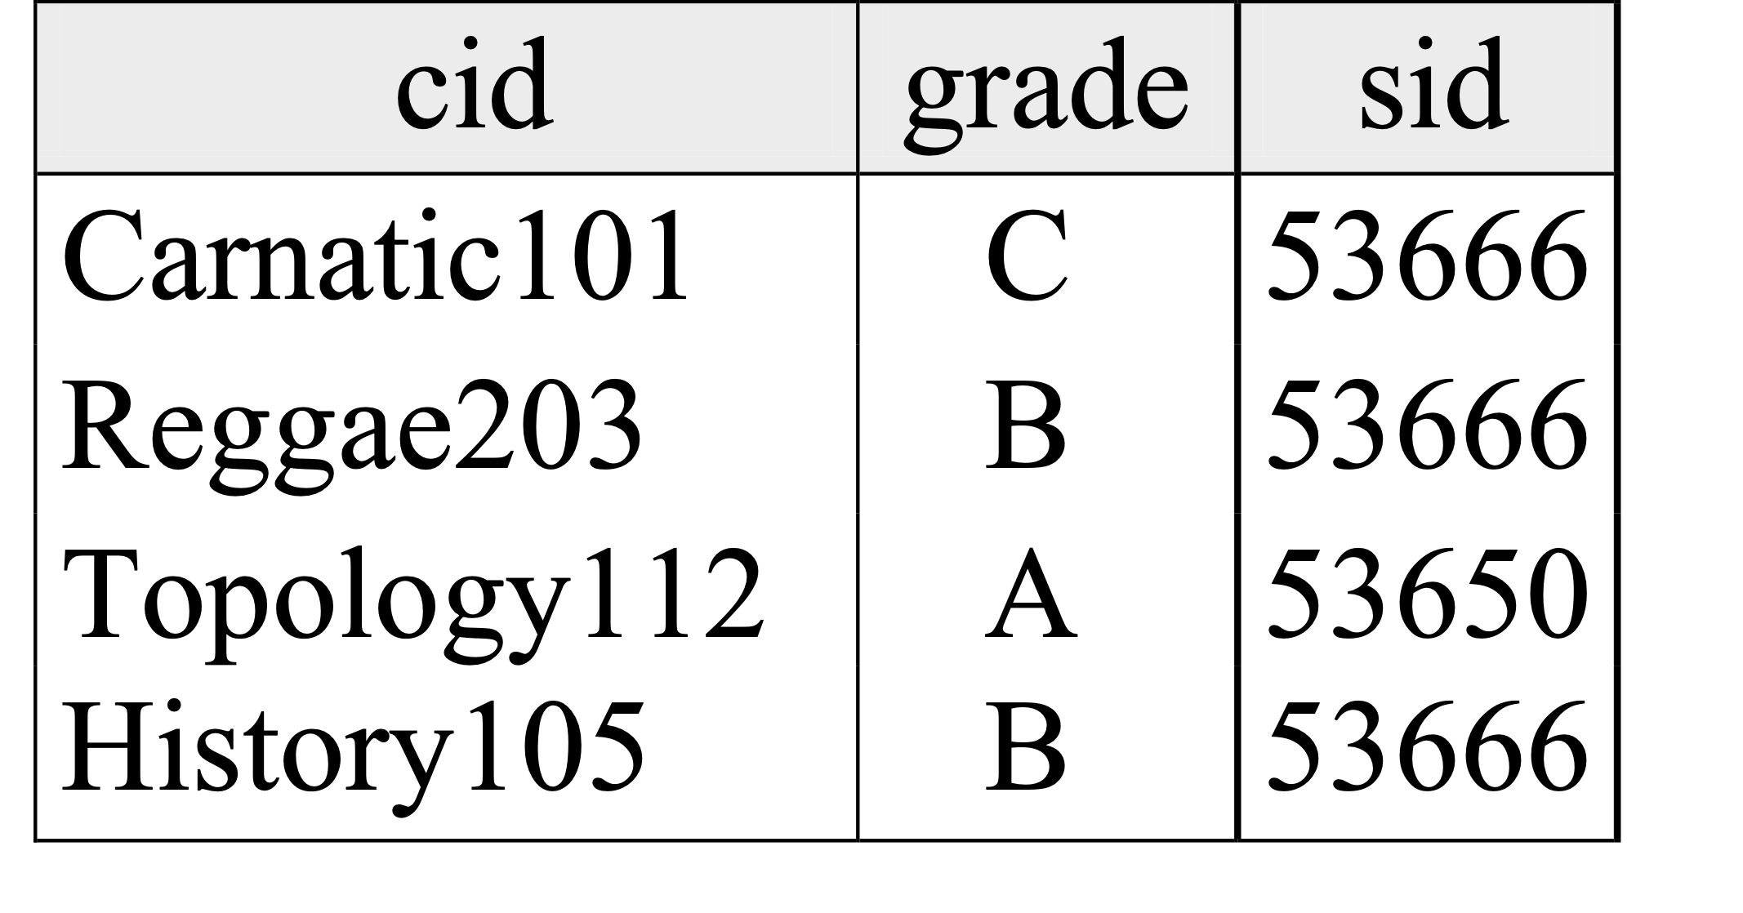
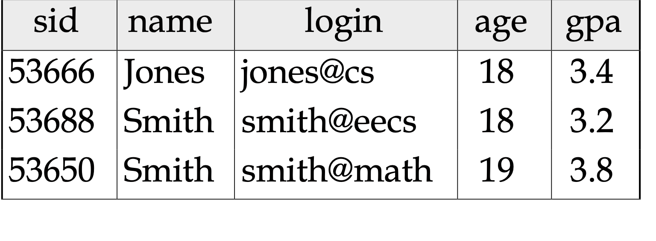
Example of Foreign Keys
CREATE TABLE Students
(sid CHAR(20),
name CHAR(20),
login CHAR(10),
age INTEGER,
gpa FLOAT);
CREATE TABLE Enrolled
(sid CHAR(20),
cid CHAR(20),
grade CHAR(2),
PRIMARY KEY (sid, cid),
FOREIGN KEY (sid)
REFERENCES Students(sid));
Enrolled
Students

Slide 37
Review: Key Constraints
Each dept has at most one manager, according to the key constraint on Manages.
since
name
dname
ssn
lot
did
budget
Employees
Manages
Departments
Translation to
relational model?
1-to-1
1-to Many
Many-to-1
Many-to-Many

Slide 38
Translating ER with Key Constraints
since
name
dname
ssn
lot
did
budget
Employees
Manages
Departments
Since each department has a unique manager,
we could instead combine Manages and Departments.

Slide 39
CREATE TABLE Employees
(ssn CHAR(11),
name CHAR(20),
lot INTEGER,
PRIMARY KEY (ssn));
CREATE TABLE Departments
(did INTEGER,
dname CHAR(20),
budget REAL,
PRIMARY KEY (did));
CREATE TABLE Manages(
ssn CHAR(11),
did INTEGER,
since DATE,
PRIMARY KEY (did),
FOREIGN KEY (ssn) REFERENCES Employees(ssn),
FOREIGN KEY (did) REFERENCES Departments(did));

Slide 40
OR
CREATE TABLE Employees
(ssn CHAR(11),
name CHAR(20),
lot INTEGER,
PRIMARY KEY (ssn));
CREATE TABLE Dept_Mgr(
did INTEGER,
dname CHAR(20),
budget REAL,
ssn CHAR(11),
since DATE,
PRIMARY KEY (did),
FOREIGN KEY (ssn)
REFERENCES Employees)

Slide 41
Review: Participation Constraints
Does every department have a manager?
If so, this is a participation constraint: the participation of Departments in Manages is said to be total (vs. partial).
Every did value in Departments table must appear in a row of the Manages table (with a non-null ssn value!)
since
since
name
name
dname
dname
ssn
did
did
budget
lot
budget
Employees
Manages
Departments
Works_In
since

Slide 42
Participation Constraints in SQL
We can capture participation constraints involving one entity set in a binary relationship, but little else (without resorting to CHECK constraints).
CREATE TABLE Dept_Mgr(
did INTEGER,
dname CHAR(20),
budget REAL,
ssn CHAR(11) NOT NULL,
since DATE,
PRIMARY KEY (did),
FOREIGN KEY (ssn) REFERENCES Employees(ssn)
ON DELETE NO ACTION)
Notes:
if the employee is deleted in employee table, the action is not allowed. can only delete the employee if the manger is changed in the above table.

Slide 43
Review: Weak Entities
A weak entity can be identified uniquely only by considering the primary key of another (owner) entity.
Owner entity set and weak entity set must participate in a one-to-many relationship set (1 owner, many weak entities).
Weak entity set must have total participation in this identifying relationship set.
name
ssn
lot
cost
pname
age
Employees
Policy
Dependents

Slide 44
Translating Weak Entity Sets
Weak entity set and identifying relationship set are translated into a single table.
When the owner entity is deleted, all owned weak entities must also be deleted.
CREATE TABLE Dep_Policy (
pname CHAR(20),
age INTEGER,
cost REAL,
ssn CHAR(11) NOT NULL,
PRIMARY KEY (pname, ssn),
FOREIGN KEY (ssn) REFERENCES Employees
ON DELETE CASCADE)
Notes:
on delete cascade delete employee deletes the dependece

Slide 45
Summary of Conceptual Design
Conceptual design follows requirements analysis,
Yields a high-level description of data to be stored
You may want to postpone it for read-only “schema on use”
ER model popular for conceptual design
Constructs are expressive, close to the way people think about their applications.
Note: There are many variations on ER model
Both graphically and conceptually
Basic constructs: entities, relationships, and attributes (of entities and relationships).
Some additional constructs: weak entities, ISA hierarchies, and aggregation.

Slide 46
Summary of ER (Cont.)
Several kinds of integrity constraints:
key constraints
participation constraints
Some foreign key constraints are also implicit in the definition of a relationship set.
Many other constraints (notably, functional dependencies) cannot be expressed.
Constraints play an important role in determining the best database design for an enterprise.

Slide 47
Summary of ER (Cont.)
ER design is subjective. There are often many ways to model a given scenario!
Analyzing alternatives can be tricky, especially for a large enterprise. Common choices include:
Entity vs. attribute, entity vs. relationship, binary or n-ary relationship, whether or not to use ISA hierarchies, aggregation.
Ensuring good database design: resulting relational schema should be analyzed and refined further.
Functional Dependency information and normalization techniques are especially useful.

Slide 48
Modern pattern: “Schema on Use”
What about more agile, less governed environments?
Don’t let the lack of schema prevent storing data!
Just use binary, text, CSV, JSON, xlsx, etc.
Can shove into a DBMS, or just a filesystem (e.g. HDFS)
Most database engines can query files directly these days
Wrangle the data into shape as needed
Essentially defining views over the raw data
This amounts to database design, at the view level
What about integrity constraints?
Instead, define “anomaly indicator” columns – or queries
Fits well with read/append-only data
E.g. Big Data, a la Hadoop
Less of a fit with update-heavy data
Analogies to strong vs. loose typing in PL

