Slide 1
CAS CS 460
Introduction to Database Systems
File Organization
Slides from based on a lecture from UC Berkeley

Slide 2
Context
Database app
Query Optimization
and Execution
Relational Operators
These layers
must consider
concurrency
control and
recovery
Files - Access Methods
Buffer Management
Disk Space Management
Student Records stored on disk

Slide 3
Files of Pages of Records
Tables are stored as logical files of pages containing records. files are collection of pages that contain records
Collection of pages, each page contains a set of records
Pages are managed by:
Disk space manager on disk
Buffer manager in memory (RAM)
Higher levels operate in memory

Slide 4
Files of Pages Records
FILE: A collection of pages, each containing a number of records.
The File API must support:
insert/delete/modify record
fetch a particular record (specified by record id)
scan all records (possibly with some conditions on the records to be retrieved)
Typically: file page size = disk block size = buffer frame size

Slide 5
“MetaData” - System Catalogs
How to impose structure on all those bytes??
MetaData: “Data about Data” describe the data
For each relation:
name, file location, file structure (e.g., Heap file)
attribute name and type, for each attribute
index name, for each index
integrity constraints
For each index:
structure (e.g., B+ tree) and search key fields
For each view: view name and definition
Plus statistics, authorization, buffer pool size, etc.
Notes:
Q: But how to store the catalogs????

Slide 6
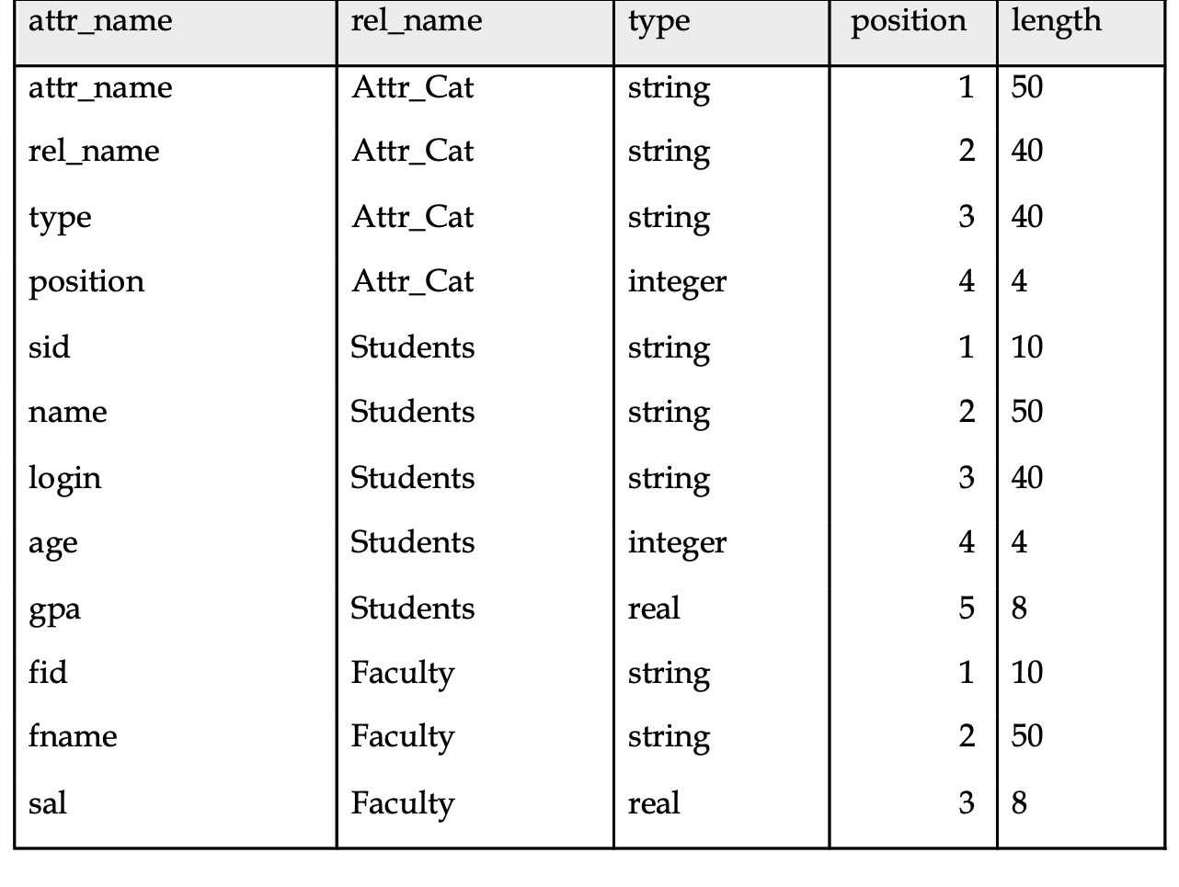
Catalogs are Stored as Relations!
it describes it self first
Attr_Cat(attr_name, rel_name, type, position, length)

Slide 7
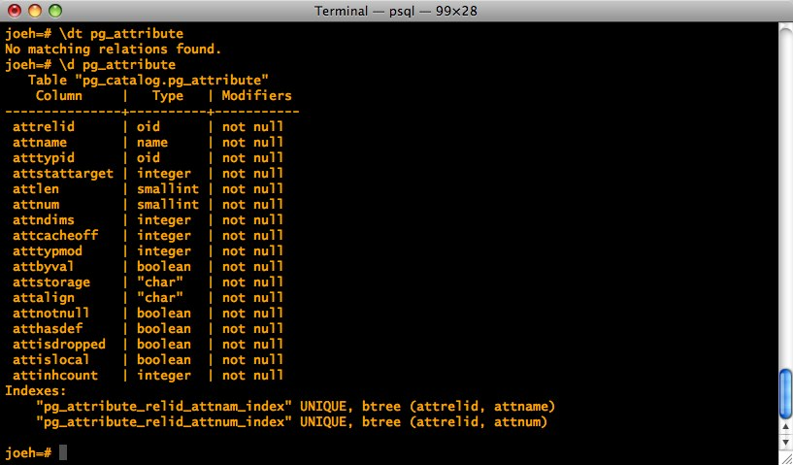
It’s a bit more complicated…

Slide 8
records
请在此处添加副标题

Slide 9
Record Formats: Fixed Length
F1
F2
F3
F4
L1
L2
L3
L4
Base address (B)
Address = B+L1+L2
Information about field types same for all records in a file; stored in system catalogs.
Finding i’th field done via arithmetic.
fixed length contain only one value

Slide 10
Record Formats:Variable Length
Two alternative formats (# fields is fixed):
$ are the ending, separators
F1 F2 F3 F4
$
$
$
$
Fields Delimited by Special Symbols
F1 F2 F3 F4
Array of Field Offsets pointers
Second offers direct access to i’th field, efficient storage
of nulls (special don’t know value); some directory overhead.

Slide 11
How to Identify a Record?
The Relational Model doesn’t expose “pointers”, but that doesn’t mean that the DBMS doesn’t use them internally.
Q: Can we use memory addresses to permanently “point” to records?
Systems instead use a “Record ID” or “RecID”
Typically: Record ID = <page id, slot #>

Slide 12
pages
请在此处添加副标题

Slide 13
Page Formats: Fixed Length Records
Slot 0
record
Slot 0
record
Slot 1
record
Slot 1
record
record
. . .
. . .
Free
Space
Slot N-1
record
record
Free
Space
Slot M-1
Slot M-1
record
N
1
0
0
1
. . .
0
1
1
M
number
of records
M-1 … 2 1 0
number
of slots
PACKED
UNPACKED, BITMAP
cannot mode records, they have fixed record id
bit map, 0 for not used, 1 for used, number of all slots
In first alternative, free space management requires record movement.
Changes RIds - may not be acceptable.
all records have a fixed size, rest of the pages will store slotes size of records.

Slide 14
“Slotted Page” for Variable Length Records
Rid = <i,1>
Page i
Data
Area
Rid = <i,N-1>
Rid = <i,0>
Free Space
Offset
to start
of free
space
[28,16]
[4,20]
[64,28]
3
92
2 1 0
# slots
SLOT ARRAY
Slot contains: [offset (from start of page), length]
both in bytes
Record id = <page id, slot #>
Page is full when data space and slot array meet.
Notes:
The end of the page stores information about the page.
From right to left, offset of rec and size of rec, number of slots used, and slot array.
From right to left in the slot array, the first record is stored followed by the rest.

Slide 15
Slotted Page (continued)
When need to allocate:
If enough room in free space, use it and update free space pointer.
Else, try to compact data area, if successful, use the freed space.
Else, tell caller that page is full.
Advantages:
Can move records around in page without changing their record ID
Allows lazy space management within the page, with opportunity for clean up later
Notes:
How does the record id not change, if the record id is composed of the page id and the position of the slot?
Wouldn’t the change of the position also change the positon of the slot?
By the record id not changing, does it mean it can only move colser to the previous slot, but not before the previous slot or the after the next slot?

Slide 16



Slotted page (continued)
0 |  |  |  |  |  |  |  | 8 |  |  |  |  |  |  | 15
Pointer
to start
of free
space
 |  |  |  |  |  |  |  |  |  |  |  | 8 | 9 | 0 | 4 | 2 | 17
Slot directory
# of slots
What’s the biggest record you can add to the above page without compacting?
Need 2 bytes for slot: [offset, length] plus record.

Slide 17
Slotted page (continued)
0 |  |  |  |  |  |  |  | 8 |  |  |  |  |  |  | 15
Pointer
to start
of free
space
 |  |  |  |  |  |  |  |  |  | 17 | 9 | 8 | 9 | 0 | 4 | 3 | X
Slot directory
# of slots
What’s the biggest record you can add to the above page without compacting?
Need 2 bytes for slot: [offset, length] plus record.

Slide 18
Slotted page (continued)
0 |  |  |  |  |  |  |  | 8 |  |  |  |  |  |  | 15
Pointer
to start
of free
space
 |  |  |  |  |  |  |  |  |  |  |  | 8 | 9 | 0 | 4 | 2 | 17
Slot directory
# of slots
What’s the biggest record you can add to the above page with compacting?
Need 2 bytes for slot: [offset, length] plus record.

Slide 19
Slotted page (continued)
0 |  |  |  |  |  |  |  | 8 |  |  |  |  |  |  | 15
Pointer
to start
of free
space
 |  |  |  |  |  |  |  |  |  | 13 | 13 | 4 | 9 | 0 | 4 | 3 | X
Slot directory
# of slots
What do you do if a record needs to move to a different page?
Leave a special “tombstone” object in place of record, pointing to new page & slot.
Record id remains unchanged
What if it needs to move again?
Update the original tombstone – so one hop max.

Slide 20
So far we’ve organized:
Fields into Records (fixed and variable length)
Records into Pages (fixed and variable length)
Now we need to organize Pages into Files
Notes:
pages into files?

Slide 21
Alternative File Organizations
Many alternatives exist, each good for some situations, and not so good in others:
Heap files: Unordered. Fine for file scan retrieving all records. Easy to maintain.
Sorted Files: Best for retrieval in search key order, or if only a `range’ of records is needed. Expensive to maintain.
Clustered Files (with Indexes): A compromise between the above two extremes.

Slide 22
Unordered (Heap) Files
Simplest file structure contains records in no particular order.
As file grows and shrinks, pages are allocated and de-allocated.
To support record level operations, we must:
keep track of the pages in a file
keep track of free space on pages
keep track of the records on a page
Can organize as a list, as a directory, a tree, …

Slide 23
Heap File Implemented as a List
Data
Page
Data
Page
Data
Page
Full Pages
Header
Page
Data
Page
Data
Page
Data
Page
Pages with
Free Space
The Heap file name and header page id must be stored persistently.
The catalog is a good place for this.
Each page contains 2 `pointers’ plus free space and data.

Slide 24
Heap File Using a Page Directory
Data
Page 1
Header
Page
Data
Page 2
Data
Page N
DIRECTORY
The entry for a page can include the number of free bytes on the page.
The directory is a collection of pages; linked list implementation is just one alternative.

Slide 25
Cost Model for Analysis
Average-case analysis; based on several simplistic assumptions.
Often called a “back of the envelope” calculation.
We ignore CPU costs, for simplicity:
B: The number of data blocks
R: Number of records per block
We simply count number of disk block I/O’s
ignores gains of pre-fetching and sequential access; thus, even I/O cost is only loosely approximated.
Notes:
Good enough to show some overall trends!
Not always:

Slide 26
Some Assumptions in the Analysis
Single record insert and delete.
Equality selection - exactly one match (what if more or less???).
For Heap Files we’ll assume:
Insert always appends to end of file.
Delete just leaves free space in the page.
Empty pages are not de-allocated.
If using directory implementation assume directory is in-memory.

Slide 27
Average Case I/O Counts for Operations (B = # disk blocks in file)
 | Heap File | Sorted File | Clustered File
Scan all records
Equality Search (1 match)
Range Search
Insert
Delete
B
0.5 B
B
2
0.5 B+1

Slide 28
Sorted Files
Heap files are lazy on update - you end up paying on searches.
Sorted files eagerly maintain the file on update.
The opposite choice in the trade-off
Let’s consider an extreme version
No gaps allowed, pages fully packed always
Q: How might you relax these assumptions?
Assumptions for our BotE Analysis:
Files compacted after deletions.
Searches are on sort key field(s).

Slide 29
Average Case I/O Counts for Operations (B = # disk blocks in file)
 | Heap File | Sorted File | Clustered File
Scan all records
Equality Search (1 match)
Range Search
Insert
Delete
B
0.5 B
B
2
0.5B+1
B
log₂ B (if on sort key) 0.5 B (otherwise)
(log₂ B) + selectivity * B
(log₂B)+ B
Same cost as Insert

