Slide 1
CAS CS 460
Introduction to Database Systems
Spring 2022

Slide 2
About the course – Administrivia
Instructor:
George Kollios, gkollios@bu.edu
MCS 104, Tue 12:30 -1:30 pm and Wed 12:30-2:00 pm, or by appointment
Teaching Fellows:
Lina Qiu, qlina@bu.edu, MCS 105C, Tue/Thu 10am-12:00 noon
Yuhao He, hey1@bu.edu, EMA 302, Wed 3:00-4:30pm/Thu 12:30-2:00pm
Home Page:
Piazza Page: https://piazza.com/bu/spring2022/cs460/
Check frequently! Syllabus, schedule, assignments, announcements…
Web page: http://www.cs.bu.edu/fac/gkollios/cs460s22

Slide 3

Textbook
Raghu Ramakrishnan and Johannes Gehrke, "Database Management Systems", McGraw-Hill, Third Edition. 2002.

Slide 4
Grading
Homeworks: 25%
Midterm: 20%
Final: 30%
Programming Assignments: 25%
examples:
Implement a Web application using a DBMS
Use a NoSQL system to analyze large datasets
(tentative) Use Cloud Services to perform data analysis on a large dataset
(tentative) Use Cloud services to implement the project!!

Slide 5
What is a Database?
Database:
A very large collection (of files) of related data
Examples: Accounts in a bank, BU’s students database, Airline reservations… also, facebook pictures and comments, web logs, etc…
Models a real world enterprise:
Entities (e.g., teams, games / students, courses)
Relationships (e.g., student takes CS460)
Even active components (e.g. “business logic”)

Slide 6
What is a Data Base Management System?
Data Base Management System (DBMS):
A software package/system that can be used to store, manage and retrieve data from databases that persist for long periods of time!
Examples: Oracle, IBM DB2, MS SQLServer, MySQL, PostgreSQL, SQLite,…
Database System: DBMS+data (+ applications)

Slide 7
Why Study Databases??
Shift from computation to data (information)
Always true for corporate computing
More and more true in the scientific world
and of course, Web
New trend: social media generate ever increasing amount of data, sensor devices generate also huge datasets
DBMS encompasses much of CS in a practical discipline
OS, languages, theory, AI, logic

Slide 8
Why Database Systems??
Why not store everything on flat files: use the file system of the OS, cheap/simple…
Name, Course, Grade
John Smith, CS112, B
Mike Stonebraker, CS234, A
Jim Gray, CS560, A
John Smith, CS560, B+
…………………
Yes, but has many problems…

Slide 9
Problem 1
Data Organization
redundancy and inconsistency
Multiple file formats, duplication of information in different files
Name, Course, Email, Grade
John Smith, js@cs.bu.edu, CS112, B
Mike Stonebraker, ms@cs.bu.edu, CS234, A
Jim Gray, CS560, jg@cs.bu.edu, A
John Smith, CS560, js@cs.bu.edu, B+
Why this is a problem?
Wasted space
Potential inconsistencies (multiple formats, John Smith vs Smith J.)

Slide 10
Problem 2
Data retrieval:
Find the students registered for CS460
Find the students with GPA > 3.5
For every query we need to write a program!
We need the retrieval to be:
Easy to write
Execute efficiently

Slide 11
Problem 3
Data Integrity
No (clear) support for sharing:
Prevent simultaneous modifications
No coping mechanisms for system crashes
No means of Preventing Data Entry Errors (checks must be hard-coded in the programs)
Security problems
Database systems offer solutions to all the above problems

Slide 12
Data Organization
Two levels of data modeling
Conceptual or Logical level: describes data stored in database, and the relationships among the data.
type customer = record name : string; street : string; city : integer;
end;
Physical level: describes how a record (e.g., customer) is stored.
Also, External (View) level: application programs hide details of data types. Views can also hide information (e.g., salary) for security purposes.

Slide 13
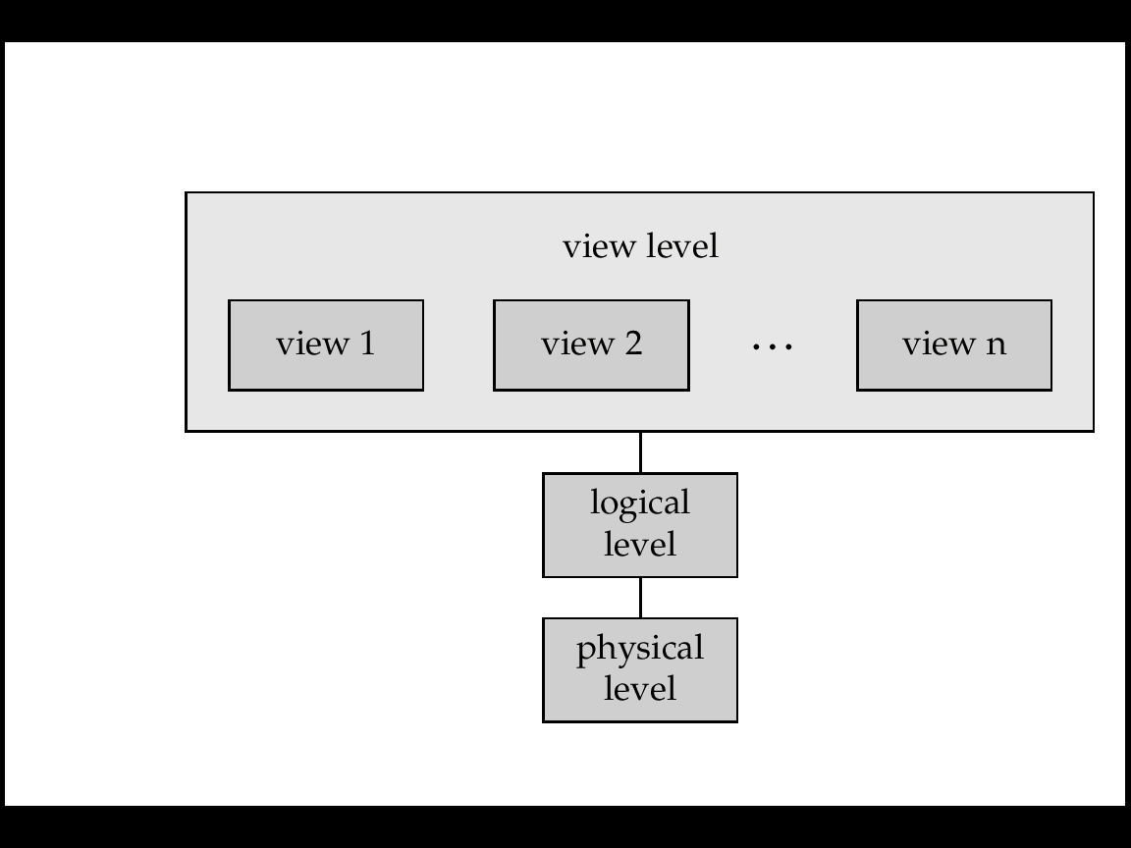
View of Data
A logical architecture for a database system

Slide 14
Database Schema
Schema – the structure of the database
e.g., the database consists of information about a set of customers and accounts and the relationship between them
Analogous to type information of a variable in a program
Physical schema: database design at the physical level
Logical schema: database design at the logical level

Slide 15
Data Organization
Data Models: a framework for describing
data
data relationships
data semantics
data constraints
Entity-Relationship model
We will concentrate on Relational model
Other models:
object-oriented model
semi-structured data models, XML

Slide 16
Relational Model
Attributes
Example of tabular data in the relational model
Customer-id
customer-
name
customer-
street
customer-
city
account-
number
192-83-7465
019-28-3746
192-83-7465
321-12-3123
019-28-3746
Johnson
Smith
Johnson
Jones
Smith
Alma
North
Alma
Main
North
Palo Alto
Rye
Palo Alto
Harrison
Rye
A-101
A-215
A-201
A-217
A-201

Slide 17
Data Organization
Data Storage
Where can data be stored?
Main memory
Secondary memory (hard disks)
Optical storage (DVDs)
Tertiary store (tapes)
Move data? Determined by buffer manager
Mapping data to files? Determined by file manager

Slide 18
Data retrieval
Queries
Query = Declarative data retrieval
describes what data, not how to retrieve it
Ex. Give me the students with GPA > 3.5 vs
Scan the student file and retrieve the records with gpa>3.5
Why?
Easier to write
Efficient to execute (why?)

Slide 19
SQL
SQL: widely used (declarative) non-procedural language
E.g. find the name of the customer with customer-id 192-83-7465 select customer.customer-name from customer where customer.customer-id = ‘192-83-7465’
E.g. find the balances of all accounts held by the customer with customer-id 192-83-7465 select account.balance from depositor, account where depositor.customer-id = ‘192-83-7465’ and depositor.account-number = account.account-number
Procedural languages: C++, Java, relational algebra

Slide 20
Data Retrieval
How to answer fast the query: “Find the student with SID = 101”?
One approach is to scan the student table, check every student, retrurn the one with id=101… very slow for large databases
Any better idea?
1st keep student record over the SID. Do a binary search…. Updates…
2nd Use a dynamic search tree!! Allow insertions, deletions, updates and at the
same time keep the records sorted! In databases we use the B+-tree (multiway
search tree)
3rd Use a hash table. Much faster for exact match queries… but cannot support
Range queries. (Also, special hashing schemes are needed for dynamic data)

Slide 21
B+Tree Example B=4, order 2
Root
120
30
100
150
180
3
5
11
100
101
110
150
156
179
30
35
120
130
180
200

Slide 22
Data Integrity Transaction processing
Why Concurrent Access to Data must be Managed?
John and Jane withdraw $50 and $100 from a common account…
Initial balance $300. Final balance=?
It depends…
John:
1. get balance
2. if balance > $50
3. balance = balance - $50
4. update balance
Jane:
1. get balance
2. if balance > $100
3. balance = balance - $100
4. update balance

Slide 23
Data Integrity Recovery
Transfer $50 from account A ($100) to account B ($200)
1. get balance for A
2. If balanceA > $50
3. balance_{A} = balance_{A} – 50
4.Update balance_{A} in database
5. Get balance for B
6. balance_{B} = balance_{B} + 50
7. Update balance_{B} in database
System crashes….
Recovery management

Slide 24
Database Architecture
DB Programmer
User
DBA
Code w/ embedded queries
Query
DDL Commands
DML Precompiler
Query Optimizer
DDL Interpreter
Query Processor
Query Evaluator
Transaction Manager
File Manager
Storage Manager
Buffer Manager
Recovery Manager
Secondary Storage
Indices
Data
Metadata
Statistics
Integrity Constraints
Schema

Slide 25
Big Data and NoSQL
Large amount of data are collected and stored everyday
Can come from different sources, huge amounts, large update rates
Examples: facebook needs to handle: 2.7 billion “likes”, 400 million images, 500+ TB per day!!, Google receives more than 1 billion queries per day!
Question: How to utilize these datasets in order to help us on our goals:
Data Analytics: Try to analyze the data in order to find useful, unknown and actionable information in the data
Cluster based data analytics:
Map-Reduce, shared nothing DBs
NoSQL: trade something for improved performance
(usually: ACID properties, flexibility, functionality)

Slide 26
Outline
1st half of the course: application-oriented
How to develop database applications: User + DBA
2nd part of the course: system-oriented
Learn the internals of a relational DBMS (developer for Oracle..)

