Slide 1
CAS CS 460
Introduction to Database Systems
Query Evaluation I
Slides from UC Berkeley

Slide 2
Introduction
We’ve covered the basic underlying storage, buffering, and indexing technology.
Now we can move on to query processing.
Some database operations are EXPENSIVE
Can greatly improve performance by being “smart”
e.g., can speed up 1,000x over naïve approach
Main weapons are:
clever implementation techniques for operators
exploiting “equivalencies” of relational operators
using statistics and cost models to choose among these.
SQL Query
Query Optimization
and Execution
Relational Operators
Files and Access Methods
Buffer Management
Disk Space Management
DB

Slide 3
Cost-based Query Sub-System
Queries
Select *
From Blah B
Where B.blah = blah
Usually there is a
heuristics-based
rewriting step before
the cost-based steps.
Query Parser
Query Optimizer
Plan Generator
Plan Cost Estimator
Catalog Manager
Schema
Statistics
Query Plan Evaluator
Notes:
query parser checks if the query is correct.
Catalog stores the schema of the database
take the query and generalte an equivalent linear algebra expression
see if you can generate a more efficient plan, check if the estimation is better than the other one
Evaluate the plan cost with the statistics of the plan.

Slide 4
Query Processing Overview
The query optimizer translates SQL to a special internal “language”
Query Plans
The query executor is an interpreter for query plans
Think of query plans as “box-and-arrow” dataflow diagrams
Each box implements a relational operator
Edges represent a flow of tuples (columns as specified)
For single-table queries, these diagrams are straight-line graphs
name, gpa
Distinct
SELECT DISTINCT name, gpa
FROM Students
name, gpa
Optimizer
Sort
name, gpa
HeapScan
Notes:
distinct: using sorting or hashing
heap scan -> linear scan .

Slide 5
Query Optimization
Distinct
A deep subject, focuses on multi-table queries
We will only need a cookbook version for now.
Build the dataflow bottom up:
Choose an Access Method (HeapScan or IndexScan)
Non-trivial, we’ll learn about this later!
Next apply any WHERE clause filters
Next apply GROUP BY and aggregation
Can choose between sorting and hashing!
Next apply any HAVING clause filters
Next Sort to help with ORDER BY and DISTINCT
In absence of ORDER BY, can do DISTINCT via hashing!
Sort
Filter
HashAgg
Filter
HeapScan
Notes:
filter is the WHERE clause.
how to evaluate different clauses.

Slide 6
Iterators
The relational operators are all subclasses of the class iterator:
class iterator { void init(); tuple next(); void close(); iterator inputs[];
// additional state goes here }
Note:
Edges in the graph are specified by inputs (max 2, usually 1)
Encapsulation: any iterator can be input to any other!
When subclassing, different iterators will keep different kinds of state information
iterator

Slide 7
Example: Scan
class Scan extends iterator { void init(); tuple next(); void close(); iterator inputs[1]; bool_expr filter_expr;
proj_attr_list proj_list; }
init():
Set up internal state
call init() on child – often a file open
next():
call next() on child until qualifying tuple found or EOF
keep only those fields in “proj_list”
return tuple (or EOF -- “End of File” -- if no tuples remain)
close():
call close() on child
clean up internal state
Note: Scan also applies “selection” filters and “projections”
(without duplicate elimination)

Slide 8
Example: Sort
class Sort extends iterator { void init(); tuple next(); void close(); iterator inputs[1]; int numberOfRuns;
DiskBlock runs[];
RID nextRID[]; }
init():
generate the sorted runs on disk
Allocate runs[] array and fill in with disk pointers.
Initialize numberOfRuns
Allocate nextRID array and initialize to NULLs
next():
nextRID array tells us where we’re “up to” in each run
find the next tuple to return based on nextRID array
advance the corresponding nextRID entry
return tuple (or EOF -- “End of File” -- if no tuples remain)
close():
deallocate the runs and nextRID arrays

Slide 9
Streaming through RAM
Simple case: “Map”. (assume many records per disk page)
Goal: Compute f(x) for each record, write out the result
Challenge: minimize RAM, call read/write rarely
Approach
Read a chunk from INPUT to an Input Buffer
Write f(x) for each item to an Output Buffer
When Input Buffer is consumed, read another chunk
When Output Buffer fills, write it to OUTPUT
Reads and Writes are not coordinated (i.e., not in lockstep)
E.g., if f() is Compress(), you read many chunks per write.
E.g., if f() is DeCompress(), you write many chunks per read.
Input
Buffer
Output
Buffer
f(x)
INPUT
RAM
OUTPUT

Slide 10
Rendezvous
Streaming: one chunk at a time. Easy.
But some algorithms need certain items to be co-resident in memory
not guaranteed to appear in the same input chunk
Time-space Rendezvous
in the same place (RAM) at the same time
There may be many combos of such items

Slide 11
Divide and Conquer
Out-of-core algorithms orchestrate rendezvous.
Typical RAM Allocation:
Assume B pages worth of RAM available
Use 1 page of RAM to read into
Use 1 page of RAM to write into
B-2 pages of RAM as workspace
B-2
INPUT
OUTPUT
IN
OUT

Slide 12
Divide and Conquer
Phase 1
“streamwise” divide into N/(B-2) megachunks
output (write) to disk one megachunk at a time
B-2
INPUT
OUTPUT
IN
OUT

Slide 13
Divide and Conquer
Phase 2
Now megachunks will be the input
process each megachunk individually.
B-2
INPUT
OUTPUT
IN
OUT

Slide 14
Sorting: 2-Way
Pass 0:
read a page, sort it, write it.
only one buffer page is used
a repeated “batch job”
I/O
Buffer
INPUT
sort
OUTPUT
RAM
Notes:
page by page read, the sort by page, output, then get the next page

Slide 15
Sorting: 2-Way (cont.)
Pass 1, 2, 3, …, etc. (merge):
requires 3 buffer pages
note: this has nothing to do with double buffering!
merge pairs of runs into runs twice as long
a streaming algorithm, as in the previous slide!
INPUT 1
Merge
OUTPUT
INPUT 2
RAM
Notes:
merge sort.

Slide 16


Two-Way External Merge Sort
Sort subfiles and Merge
How many passes?
N pages in the file => the number of passes =
Total I/O cost? (reads + writes)
Each pass we read + write each page in file. So total cost is:
3,4
6,2
9,4
8,7
5,6
3,1
2
Input file
PASS 0
3,4
2,6
4,9
7,8
5,6
1,3
2
1-page runs
PASS 1
2,3
4,7
1,3
2-page runs
4,6
8,9
5,6
2
PASS 2
2,3
4,4
1,2
4-page runs
6,7
3,5
8,9
6
PASS 3
1,2
2,3
3,4
8-page runs
4,5
6,6
7,8
9
Notes:
For each pass we read + write each page in file. So total cost is: 2N([Log_2 N] +1), where does the +1 come from? is it the input file pass? the input file layer or pass

Slide 17

General External Merge Sort
More than 3 buffer pages. How can we utilize them?
To sort a file with N pages using B buffer pages:
Pass 0: use B buffer pages. Produce sorted runs of B pages each.
INPUT 1
INPUT 2
sort
. . .
INPUT B
RAM
Disk
Pass 0 – Create Sorted Runs
Notes:
B is the number of pages that can be stored in RAM
split into files of B pages, they are sorted.

Slide 18
General External Merge Sort
Pass 1, 2, …, etc.: merge B-1 runs.
Creates runs of (B-1) * size of runs from previous pass.
INPUT 1
INPUT 2
. . .
Merge
OUTPUT
INPUT B-1
RAM
Disk
Merging Runs
Notes:
when a input is empty, read the next page of this file.

Slide 19
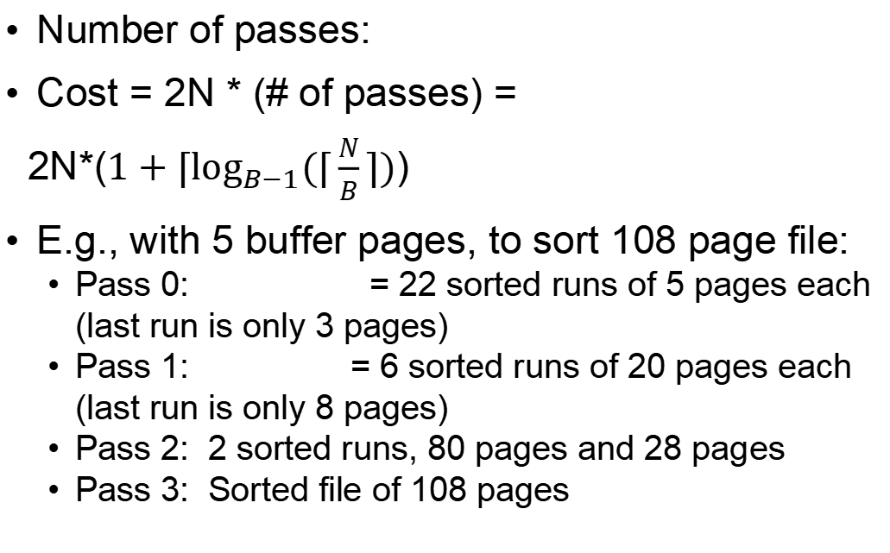
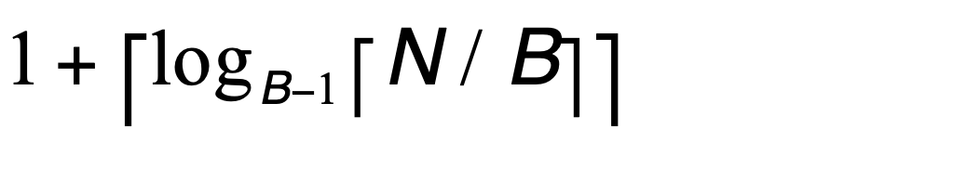
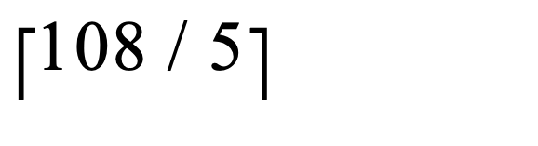
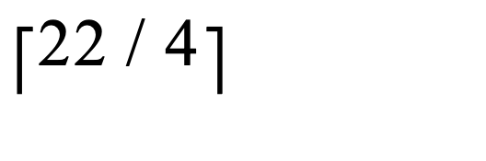
Cost of External Merge Sort
Formula check: 1+┌log₄ 22┐= 1+3 → 4 passes √
Notes:
N/B is the initial number of files created.
one buffer is for output
N is the size of the files
for the number of passes: the 1 is comming from the input layer.

Slide 20
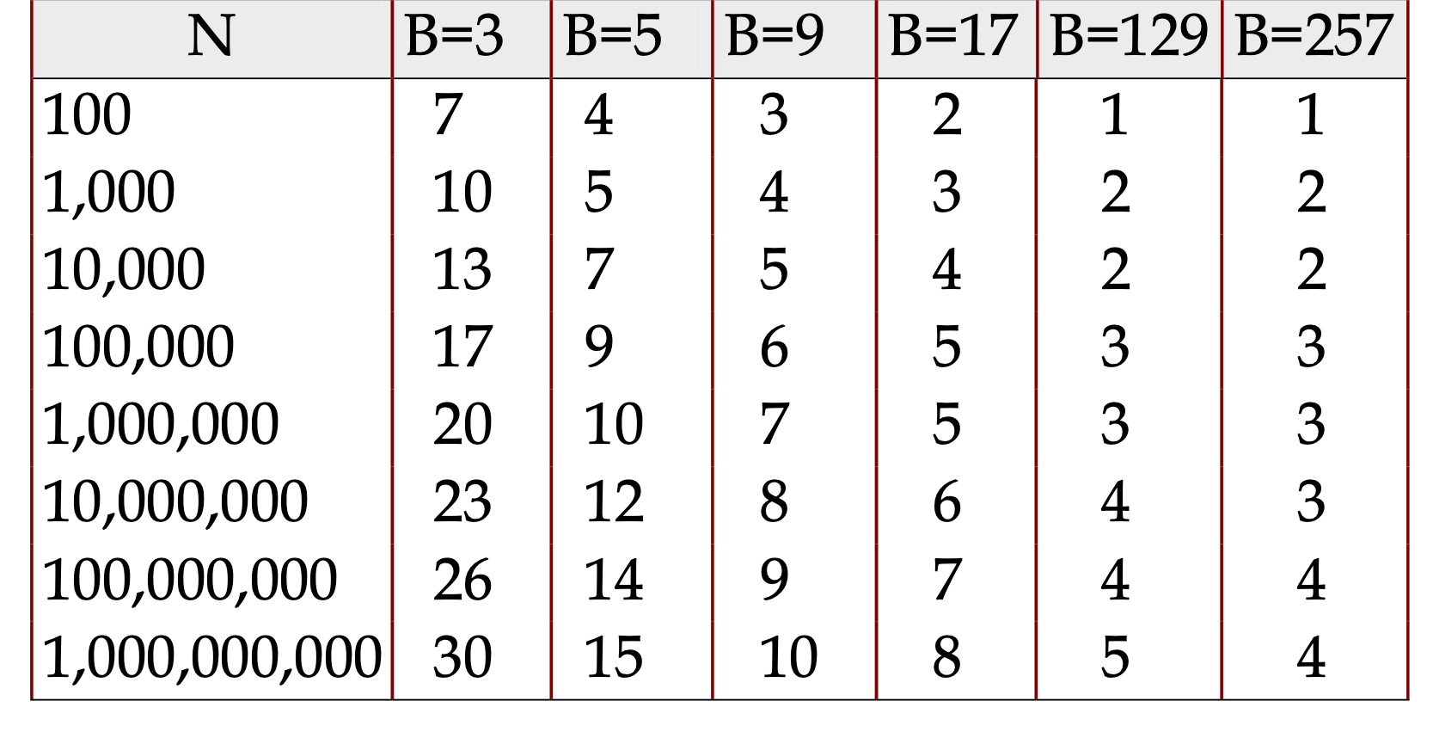
# of Passes of External Sort
( I/O cost is 2N times number of passes)

Slide 21
Memory Requirement for External Sorting
How big of a table can we sort in two passes?
Each “sorted run” after Pass 0 is of size B
Can merge up to B-1 sorted runs in Phase 1
Answer: N=B(B-1).
So, if B= sqrt(N) then we can sort a file in 2 passes!
Notes:
4N i/o
max b-1 files could be merged in two passes

Slide 22
Alternative: Hashing
Idea:
Many times we don’t require order
E.g.: removing duplicates
E.g.: forming groups
Often just need to rendezvous matches
Hashing does this
And may be cheaper than sorting! (Hmmm…!)
But how to do it out-of-core??

Slide 23
Divide
Streaming Partition (divide): Use a hash f’n h_{p} to stream records to disk partitions
All matches rendezvous in the same partition.
Streaming alg to create partitions on disk:
“Spill” partitions to disk via output buffers

Slide 24
Divide & Conquer
Streaming Partition (divide): Use a hash function h_{p} to stream records to disk-based partitions
All matches rendezvous in the same partition.
Streaming alg to create partitions on disk:
“Spill” partitions to disk via output buffers
ReHash (conquer): Read partitions into RAM-based hash table one at a time, using hash function h_{r}
Then go through each bucket of this hash table to achieve rendezvous in RAM
Note: Two different hash functions
h_{p} is coarser-grained than h_{r}

Slide 25
Two Phases
Original
Relation
OUTPUT
Partitions
Partition:
1
1
INPUT
2
hash
function
h_{p}
2
. . .
B-1
B-1
Disk
B main memory buffers
Disk
Notes:
after having partition, you can use a second hash function
hp function for partitioning
split the original file into b-1 files
for the same input, the hash function will output the same file, if the records in the file stay the same.
optimize the cpu time.

Slide 26
Two Phases
Original
Relation
OUTPUT
Partitions
1
1
INPUT
2
hash
function
h_{p}
2
Partition:
Rehash:
. . .
B-1
B-1
Disk
B main memory buffers
Disk
Partitions
Result
Hash table for partition
R_{i} (k <= B pages)
hash
fn
h_{r}
Disk
B main memory buffers
Notes:
second hash function hr
split the records into another set of groups
recursive partitioning if there are more than b files

Slide 27
Cost of External Hashing
cost = 4*N IO’s
Notes:
b* (b-1)

Slide 28

Memory Requirement
How big of a table can we hash in two passes?
B-1 “partitions” result from Phase 0
Each should be no more than B pages in size
Answer: B(B-1).
We can hash a table of size N pages in about space
Note: assumes hash function distributes records evenly!
Have a bigger table? Recursive partitioning!
How many times?
Until every partition fits in memory !! (<=B)

Slide 29
How does this compare with external sorting?

Slide 30
So which is better ??
Simplest analysis:
Same memory requirement for 2 passes
Same I/O cost
But we can dig a bit deeper…
Sorting pros:
Great if input already sorted (or almost sorted) w/heapsort
Great if need output to be sorted anyway
Not sensitive to “data skew” or “bad” hash functions
Hashing pros:
For duplicate elimination, scales with # of values
Not # of items! We’ll see this again.
Can exploit extra memory to reduce # IOs (stay tuned…)

Slide 31
Summing Up 1
Unordered collection model
Read in chunks to avoid fixed I/O costs
Patterns for Big Data
Streaming
Divide & Conquer
also Parallelism (but we didn’t cover this here)

Slide 32
Summary Part 2
Sort/Hash Duality
Sorting is Conquer & Merge
Hashing is Divide & Conquer
Sorting is overkill for rendezvous
But sometimes a win anyhow
Sorting sensitive to internal sort alg
Quicksort vs. HeapSort
In practice, QuickSort tends to be used
Don’t forget double buffering (with threads)

