Slide 1
CAS CS 460
Introduction to Database Systems
Query Evaluation II

Slide 2
Cost-based Query Sub-System
Queries
Select *
From Blah B
Where B.blah = blah
Query Parser
Query Optimizer
Plan Generator
Plan Cost Estimator
Catalog Manager
Schema
Statistics
Query Plan Evaluator

Slide 3
Review - Relational Operations
We will consider how to implement:
Selection ( σ ) Selects a subset of rows from relation.
Projection ( π ) Deletes unwanted columns from relation.
Join ( ⋈ ) Allows us to combine two relations.
Set-difference ( - ) Tuples in reln. 1, but not in reln. 2.
Union ( ∪ ) Tuples in reln. 1 and in reln. 2.
Also: Aggregation (SUM, MIN, etc.) and GROUP BY
Since each op returns a relation, ops can be composed ! After we cover the operations, we will discuss how to optimize queries formed by composing them.

Slide 4
Selection (filter) Operators

Slide 5
Schema for Examples
Sailors (sid: integer, sname: string, rating: integer, age: real)
Reserves (sid: integer, bid: integer, day: date, rname: string)
Similar to old schema; rname added for variation.
(assume pages of 4000 bytes each)
Reserves:
Each tuple is 40 bytes long, 100 tuples per page, 1000 pages.(100K reseravtions)
Sailors:
Each tuple is 50 bytes long, 80 tuples per page, 500 pages. (40K sailors)

Slide 6
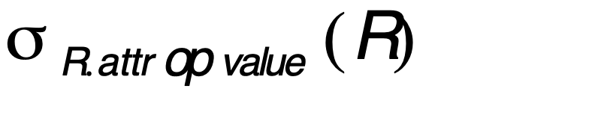
Simple Selections
SELECT *
FROM Reserves R
WHERE R.date > ‘1/1/2015’
Of the form
Question: how best to perform? Depends on:
what indexes/access paths are available
what is the expected size of the result (in terms of number of tuples and/or number of pages)
Size of result approximated as size of R * reduction factor
“reduction factor” is usually called selectivity.
estimate of reduction factors is based on statistics – we will discuss shortly.
Notes:
linear scan or heap scan
Size of the output matter:
If output size is almost the size of the file, linear scan is the best
If output size is small, consider using index
To estimate result size, use statistics, probability.
use histoggram to keep records of the number of file

Slide 7
Alternatives for Simple Selections
With no index, unsorted:
Must essentially scan the whole relation
cost is M (#pages in R). For “Reserves” = 1000 I/Os.
With no index, sorted on day:
cost of binary search + number of pages containing results.
For reserves = 10 I/Os + ⎡selectivity*1000⎤
With an index on selection attribute:
Use index to find qualifying data entries,
then retrieve corresponding data records.
(Hash index useful only for equality selections.)
Notes:
for the first one, linear scan.
for the second example, use the binary search . log_2 1000
for the third one, depends if the data is clustered or unclustered

Slide 8
Using an Index for Selections
Cost depends on #qualifying tuples, and clustering.
Cost:
finding qualifying data entries (typically small)
plus cost of retrieving records (could be large w/o clustering).
In example “Reserves” relation, if 10% of tuples qualify (result size estimate: 100 pages, 10000 tuples).
With a clustered index, cost is little more than 100 I/Os;
if unclustered, could be more than 10000 I/Os! unless…

Slide 9
Selections using Index (cont)
Important refinement for unclustered indexes:
1. Find qualifying data entries.
2. Sort the rid’s of the data records to be retrieved.
3. Fetch rids in order. This ensures that each data page is looked at just once (though # of such pages likely to be higher than with clustering).
Index entries
UNCLUSTERED
CLUSTERED
direct search for
data entries
Data entries
Data entries
(Index File)
(Data file)
Data Records
Data Records

Slide 10
General Selection Conditions
(day<8/9/94 AND rname=‘Paul’) OR bid=5 OR sid=3
Such selection conditions are first converted to conjunctive normal form (CNF):
(day<8/9/94 OR bid=5 OR sid=3 ) AND
(rname=‘Paul’ OR bid=5 OR sid=3)
We only discuss the case with no ORs (a conjunction of terms of the form attr op value).
A B-tree index matches (a conjunction of) terms that involve only attributes in a prefix of the search key.
Index on <a, b, c> matches a=5 AND b= 3, but not b=3.
For Hash index, must have all attributes in search key

Slide 11
Two Approaches to General Selections
First approach: Find the most selective access path, retrieve tuples using it, and apply any remaining terms that don’t match the index:
Most selective access path: An index or file scan that we estimate will require the fewest page I/Os.
Terms that match this index reduce the number of tuples retrieved; other terms are used to discard some retrieved tuples, but do not affect number of tuples/pages fetched.

Slide 12
Most Selective Index - Example
Consider day < 8/9/94 AND bid=5 AND sid=3.
A B+ tree index on day can be used;
then, bid=5 and sid=3 must be checked for each retrieved tuple.
Similarly, a hash index on <bid, sid> could be used;
Then, day<8/9/94 must be checked.
How about a B+tree on <rname,day>?
How about a B+tree on <day, rname>?
How about a Hash index on <day, rname>?
Notes:
<rname,day> could not be used because there is no rname
<day, rname> could be used because it is ordered by day.
hash <day, rname>, better because hashing is good at equity join.

Slide 13
Intersection of Rids
Second approach: if we have 2 or more matching indexes (w/Alternatives (2) or (3) for data entries):
Get sets of rids of data records using each matching index.
Then intersect these sets of rids.
Retrieve the records and apply any remaining terms.
Consider day<8/9/94 AND bid=5 AND sid=3. With a B+ tree index on day and an index on sid, we can retrieve rids of records satisfying day<8/9/94 using the first, rids of recs satisfying sid=3 using the second, intersect, retrieve records and check bid=5.
Note: commercial systems use various tricks to do this:
bit maps, bloom filters, index joins
Notes:
for projections you do linear scan, optimize-> use leaf not of the index to output this

Slide 14
Join Operators

Slide 15
Join Operators
Joins are a very common query operation.
Joins can be very expensive:
Consider an inner join of R and S each with 1M records. Q: How many tuples in the answer?
(cross product in worst case, 0 in the best(?))
Many join algorithms have been developed
Can have very different join costs.

Slide 16
Equality Joins With One Join Column
SELECT *
FROM Reserves R1, Sailors S1
WHERE R1.sid=S1.sid
In algebra: R ⋈ S. Common! Must be carefully optimized. R × S is large; so, R × S followed by a selection is inefficient.
Assume:
M = 1000 pages in R, p_{R} =100 tuples per page.
N = 500 pages in S, p_{S} = 80 tuples per page.
In our examples, R is Reserves and S is Sailors.
Cost metric : # of I/Os. We will ignore output costs.
We will consider more complex join conditions later.

Slide 17
Simple Nested Loops Join
foreach tuple r in R do
foreach tuple s in S do
if r_{i} == s_{j} then add <r, s> to result
For each tuple in the outer relation R, we scan the entire inner relation S.
How much does this Cost?
(p_{R} * M) * N + M = 100,000*500 + 1000 I/Os. ( about 50M I/Os!!)
At 10ms/IO, Total: ???
What if smaller relation (S) was outer?
(p_{s} * N) *M + N = 40,000*1000 + 500 I/Os. (better…. ☺ 40M I/Os)
Prohibitively expensive…
Q: What is cost if one relation can fit entirely in memory?
M+N = 1500 I/Os!!!!!

Slide 18
Page-Oriented Nested Loops Join
foreach page b_{R} in R do
foreach page b_{S} in S do
foreach tuple r in b_{R} do
foreach tuple s in b_{S}do
if r_{i} == s_{j} then add <r, s> to result
For each page of R, get each page of S, and write out matching pairs of tuples <r, s>, where r is in R-page and S is in S-page.
What is the cost of this approach?
M*N + M= 1000*500 + 1000 = 501000
If smaller relation (S) is outer, cost = 500*1000 + 500 = 500500
Notes:
minimize the number of ios.

Slide 19
Block Nested Loops Join
Page-oriented NL doesn’t exploit extra buffers.
Alternative approach: Use one page as an input buffer for scanning the inner S, one page as the output buffer, and use all remaining pages to hold ``block’’ of outer R.
For each matching tuple r in R-block, s in S-page, add <r, s> to result. Then read next R-block, scan S, etc.
R & S
Join Result
block of R tuples
(k <= B-2 pages)
. . .
. . .
. . .
Input buffer for S
Output buffer

Slide 20

Examples of Block Nested Loops
Cost:
Scan of outer + #outer blocks * scan of inner
#outer blocks = ceiling(#pages of outer/blocksize)
With Reserves (R) as outer, and 100 pages/Block (B=102):
Cost of scanning R is 1000 I/Os; a total of 10 blocks (B=102).
Per block of R, we scan Sailors (S); 10*500 I/Os.
Total cost: 10*500+1000 = 6000 I/Os
If space for just 90 pages of R, we would scan S 12 times.
With 100-page block of Sailors as outer:
Cost of scanning S is 500 I/Os; a total of 5 blocks.
Per block of S, we scan Reserves; 5*1000 I/Os.
Total cost: 5 * 1000 + 500 = 5500 I/Os. (Much better ☺)
We may be able to do even better for different B!
Notes:
500 is the size of the sailors

Slide 21
Index Nested Loops Join
foreach tuple r in R do
foreach tuple s in S where r_{i} == s_{j} do
add <r, s> to result
If there is an index on the join column of one relation (say S), can make it the inner and exploit the index.
Cost: M + ( (M*p_{R}) * cost of finding matching S tuples)
For each R tuple, cost of probing S index is about 1.2 for hash index, 2-4 for B+ tree.
Cost of then finding S tuples (assuming Alt. (2) or (3) for data entries) depends on clustering.
Clustered index: 1 I/O per page of matching S tuples.
Unclustered: up to 1 I/O per matching S tuple.

Slide 22
Examples of Index Nested Loops
Hash-index (Alt. 2) on sid of Sailors (as inner):
Scan Reserves: 1000 page I/Os, 100*1000 tuples.
For each Reserves tuple: 1.2 I/Os to get data entry in index, plus 1 I/O to get (the exactly one) matching Sailors tuple. Total: 1000+100*1000*2.2
Hash-index (Alt. 2) on sid of Reserves (as inner):
Scan Sailors: 500 page I/Os, 80*500 tuples.
For each Sailors tuple: 1.2 I/Os to find index page with data entries, plus cost of retrieving matching Reserves tuples. Assuming uniform distribution, 2.5 reservations per sailor (100,000 / 40,000). Cost of retrieving them is 1 or 2.5 I/Os depending on whether the index is clustered. Assume clustered.
Totals: 500 + 80*500*2.2 = 88.5K I/Os!!! (not so good here ☹)
Other scenarios may be better though.

Slide 23
Sort-Merge Join (R ⋈ S)
Sort R and S on the join column, then scan them to do a ``merge’’ (on join col.), and output result tuples.
Particularly useful if
one or both inputs are already sorted on join attribute(s)
output is required to be sorted on join attributes(s)
“Merge” phase can require some back tracking if duplicate values appear in join column
R is scanned once; each S group is scanned once per matching R tuple. (Multiple scans of an S group will probably find needed pages in buffer.)

Slide 24
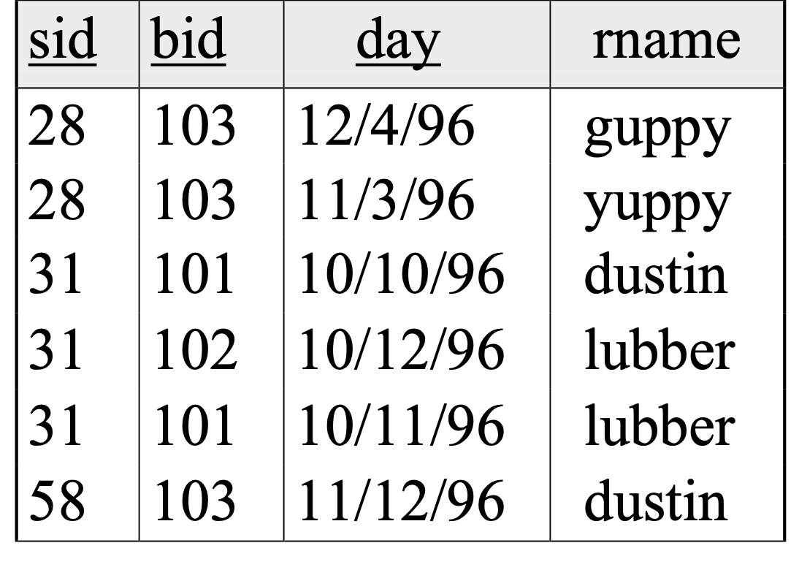
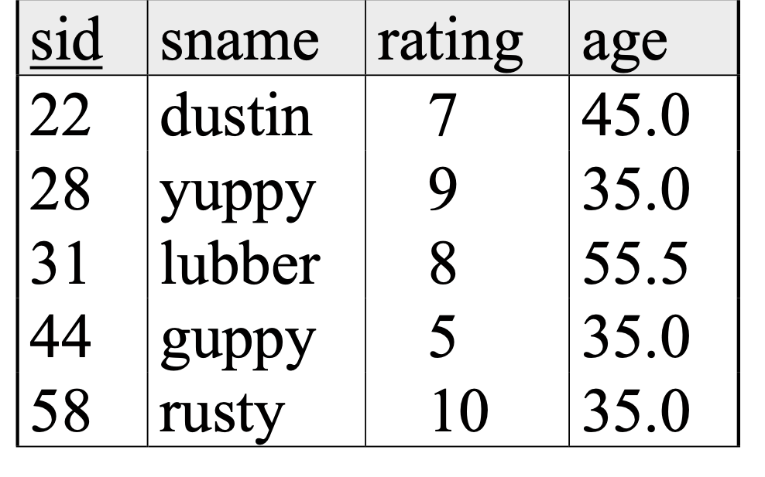
Example of Sort-Merge Join
Cost: Sort S +Sort R + (M+N)
The cost of merging: usually M+N,
worst case is M*N (but very unlikely!)
With 35, 100 or 300 buffer pages, both Reserves and Sailors can be sorted in 2 passes; total join cost: 7500.
(BNL cost: 2500 to 16500 I/Os)

Slide 25
Cost of Sort-Merge
For B = 35
Sort-Merge:
sort R: in two passes=> 4M = 4000
sort S: in two passes => 4N = 2000
merge: M+N (hopefully…) => 1500
Total: 7500
Block Nested Loop:
= 500 + 16*1000 = 16500
Sort-Merge Better for B=35!!!!
For B = 300
Sort-Merge: the same: 7500
BNLJ:
= 2*1000+500 = 2500
Here BNLJ is better!!!!
Notes:
block nested loop:
N+M * [N / B-2]
BNLJ:
N + M * [N/b-2]

Slide 26

Refinement of Sort-Merge Join
We can combine the merging phases in the sorting of R and S with the merging required for the join.
Pass 0 as before, but apply to both R then S before merge.
If B > , where L is the size of the larger relation, using the sorting refinement that produces runs of length 2B in Pass 0, #runs of each relation is < B/2.
In “Merge” phase: Allocate 1 page per run of each relation, and `merge’ while checking the join condition
Cost: read+write each relation in Pass 0 + read each relation in (only) merging pass (+ writing of result tuples).
In example, cost goes down from 7500 to 4500 I/Os for B=300.
In practice, the I/O cost of sort-merge join, like the cost of external sorting, is linear.

Slide 27
Un-Optimized SMJ
Unsorted input relations
Sort Phase
(Ext. Merge Sort)
R
S
Split & sort
Split & sort
Merge
Merge
Merge
Merge
Merge / Join Phase
Joined output file created!

Slide 28
Simple SMJ Optimization: Refinement
Unsorted input relations
Sort Phase
(Ext. Merge Sort)
R
S
Split & sort
Split & sort
Merge
Merge
<= B total runs
B-Way Merge / Join
Merge / Join Phase
Joined output file created!

Slide 29
Simple SMJ Optimization
Now, on this last pass, we only do P(R) + P(S) IOs to complete the join!
If we can initially split R and S into B total runs each of length approx. <= 2B, assuming repacking lets us create initial runs of ~2B- then we only need 3(P(R) + P(S)) + OUT for SMJ!
2 R/W per page to sort runs in memory, 1 R per page to B-way merge / join!
How much memory for this to happen?
Thus, is an approximate sufficient condition
If the larger of R,S has <= B² pages, then SMJ costs 3(P(R)+P(S)) + OUT!

Slide 30
Takeaway points from SMJ
If input already sorted on join key, skip the sorts.
SMJ is basically linear.
Nasty but unlikely case: Many duplicate join keys.
SMJ needs to sort both relations
If max { P(R), P(S) } < B² then cost is 3(P(R)+P(S)) + OUT

Slide 31
Note: Impact of Buffering
If several operations are executing concurrently, estimating the number of available buffer pages is guesswork.
Repeated access patterns interact with buffer replacement policy.
e.g., Inner relation is scanned repeatedly in Simple Nested Loop Join. With enough buffer pages to hold inner, replacement policy does not matter. Otherwise, MRU is best, LRU is worst (sequential flooding).
Does replacement policy matter for Block Nested Loops?
What about Index Nested Loops? Sort-Merge Join?

Slide 32
Hash-Join
Original
Relation
OUTPUT
Partitions
1
1
INPUT
2
Partition both relations on the join attributes using hash function h.
R tuples in partition R_{i} will only match S tuples in partition S_{i}.
2
. . .
hash
function
h
B-1
B-1
Disk
B main memory buffers
Disk
Partitions
of R & S
For i= 1 to #partitions {
Read in partition R_{i}
and hash it using h2 (not h).
Scan partition S_{i} and probe hash table for matches.
}
Join Result
Hash table for partition
Ri (k < B-2 pages)
hash
fn
h2
h2
Input buffer
for Si
Output
buffer
Disk
B main memory buffers
Disk
Notes:
join with the same partition, join partition 1 with partion 1
Because partition of both relations use the same h function, when doing the join, match partion i from 1 relation in memory and partition i from another relation
cost : 2n + 2m + n +m = 3n + 3m
if it is bigger than b-2, recursively partition with a new hash function
ignore the cost of the output.

Slide 33

Observations on Hash-Join
#partitions k < B, and B-2 > size of smaller partition to be held in memory. Assuming uniformly sized partitions, and maximizing k, we get:
k= B-1, and M/(B-1) < B-2, i.e., B must be >
Or M < B²
Since we build an in-memory hash table to speed up the matching of tuples in the second phase, a little more memory is needed.
If the hash function does not partition uniformly, one or more R partitions may not fit in memory. Can apply hash-join technique recursively to do the join of this R-partition with corresponding S-partition.

Slide 34
Cost of Hash-Join
In partitioning phase, read+write both relns; 2(M+N). In matching phase, read both relns; M+N I/Os.
If min { P(R), P(S) } < B² then cost is 3(P(R)+P(S)) + OUT
In our running example, this is a total of 4500 I/Os.
Sort-Merge Join vs. Hash Join:
Given a minimum amount of memory (what is this, for each?) both have a cost of 3(M+N) I/Os. Hash Join superior if relation sizes differ greatly (e.g., if one reln fits in memory). Also, Hash Join shown to be highly parallelizable.
Sort-Merge less sensitive to data skew; result is sorted.
Notes:
cost of 3(m+n) based on the size of the smaller and the bigger partition
sort merge another adavantageL output is sortel better for some other operations.
P(R)

Slide 35
Set Operations
Intersection and cross-product special cases of join.
Union (Distinct) and Except similar; we’ll do union.
Sorting based approach to union:
Sort both relations (on combination of all attributes).
Scan sorted relations and merge them.
Alternative: Merge runs from Pass 0 for both relations.
Hash based approach to union:
Partition R and S using hash function h.
For each S-partition, build in-memory hash table (using h2), scan corr. R-partition and add tuples to table while discarding duplicates.

Slide 36
General Join Conditions
Equalities over several attributes
(e.g., R.sid=S.sid AND R.rname=S.sname):
For Index NL, build index on <sid, sname> (if S is inner); or use existing indexes on sid or sname.
For Sort-Merge and Hash Join, sort/partition on combination of the two join columns.
Inequality conditions (e.g., R.rname < S.sname):
For Index NL, need (clustered!) B+ tree index.
Range probes on inner; # matches likely to be much higher than for equality joins.
Hash Join, Sort Merge Join not applicable!
Block NL quite likely to be the best join method here.
Notes:
nested loop join: multiple checks

Slide 37
Review
Implementation of Relational Operations as Iterators
Focus largely on External algorithms (sorting/hashing)
Choices depend on indexes, memory, stats,…
Joins
Blocked nested loops:
simple, exploits extra memory
Indexed nested loops:
best if 1 rel small and one indexed
Sort/Merge Join
good with small amount of memory, bad with duplicates
Hash Join
fast (if enough memory), bad with skewed data
Relatively easy to parallelize

Slide 38
Aggregation Operators

Slide 39
Schema for Examples
Sailors (sid: integer, sname: string, rating: integer, age: real)
Reserves (sid: integer, bid: integer, day: dates, rname: string)
Similar to old schema; rname added for variations.
Reserves:
Each tuple is 40 bytes long, 100 tuples per page, 1000 pages. So, M = 1000, p_{R} = 100.
Sailors:
Each tuple is 50 bytes long, 80 tuples per page, 500 pages.
So, N = 500, p_{S} = 80.

Slide 40
Aggregate Operations (AVG, MIN, etc.)
Without grouping:
In general, requires scanning the relation.
Given a tree index whose search key includes all attributes in the SELECT or WHERE clauses, can do index-only scan.
With grouping:
Sort on group-by attributes, then scan relation and compute aggregate for each group. (Better: combine sorting and aggregate computation.)
Similar approach based on hashing on group-by attributes.
Given a tree index whose search key includes all attributes in SELECT, WHERE and GROUP BY clauses, can do index-only scan; if group-by attributes form prefix of search key, can retrieve data entries/tuples in group-by order.

Slide 41
Sort GROUP BY: Naïve Solution
Aggregate
The Sort iterator naturally permutes its input so that all tuples are output in sequence
The Aggregate iterator keeps running info (“transition values” or “transVals”) on agg functions in the SELECT list, per group: Example transVals:
For COUNT, it keeps count-so-far
For SUM, it keeps sum-so-far
For AVERAGE it keeps sum-so-far and count-so-far
As soon as the Aggregate iterator sees a tuple from a new group:
It produces an output for the old group based on the agg function
E.g. for AVERAGE it returns (sum-so-far/count-so-far)
It resets its running info.
It updates the running info with the new tuple’s info
Sort

Slide 42
Sort GROUP BY: Naïve Solution
A, 3
B, 2
C, 1
D, 1
<B,2>
<A, 3>
<A, 1>
<A, 2>
<B,1>
Aggregate
A
B
C
A
A
B
Sort
A
B
D
C
A
B
A
A
B
C
D
A
B
A

Slide 43
Hash GROUP BY: Naïve Solution (similar to the Sort GROUPBY)
Aggregate
Hash
The Hash iterator permutes its input so that all tuples are output in groups.
The Aggregate iterator keeps running info (“transition values” or “transVals”) on agg functions in the SELECT list, per group
E.g., for COUNT, it keeps count-so-far
For SUM, it keeps sum-so-far
For AVERAGE it keeps sum-so-far and count-so-far
When the Aggregate iterator sees a tuple from a new group:
It produces an output for the old group based on the agg function
E.g. for AVERAGE it returns (sum-so-far/count-so-far)
It resets its running info.
It updates the running info with the new tuple’s info

Slide 44
External Hashing
Original
Relation
OUTPUT
Partitions
1
Partition:
Each group will
be in a single
disk-based partition file. But those files have many groups inter-mixed.
Rehash:
For Each Partition i:
hash i into an in-memory hash table
Return results until
records exhuasted then i++
1
INPUT
2
hash
function
h_{p}
2
. . .
B-1
B-1
Disk
B main memory buffers
Disk
Partitions
Result
Hash table for partition
R_{i} (k < B-1 pages)
fn
INPUT
hash
function
h2_{p}
Disk
B main memory buffers

Slide 45
We Can Do Better!
HashAgg
Put summarization into the hashing process
During the ReHash phase, don’t store tuples, store pairs of the form <GroupVals, TransVals>
When we want to insert a new tuple into the hash table
If we find a matching GroupVals, just update the TransVals appropriately
Else insert a new <GroupVals,TransVals> pair
What’s the benefit?
Q: How many pairs will we have to maintain in the rehash phase?
A: Number of distinct values of GroupVals columns
Not the number of tuples!!
Also probably “narrower” than the tuples

Slide 46
Projection (DupElim)
SELECT DISTINCT
R.sid, R.bid
FROM Reserves R
Issue is removing duplicates.
Basic approach is to use sorting
1. Scan R, extract only the needed attrs (why do this 1st?)
2. Sort the resulting set
3. Remove adjacent duplicates
Cost: Reserves with size ratio 0.25 = 250 pages. With 20 buffer pages can sort in 2 passes, so 1000 +250 + 2 * 2 * 250 + 250 = 2500 I/Os
Can improve by modifying external sort algorithm:
Modify Pass 0 of external sort to eliminate unwanted fields.
Modify merging passes to eliminate duplicates.
Cost: for above case: read 1000 pages, write out 250 in runs of 20 pages, merge runs = 1000 + 250 +250 = 1500.

Slide 47
DupElim & Indexes
If an index on the relation contains all wanted attributes in its search key, can do index-only scan.
Apply projection techniques to data entries (much smaller!)
If an ordered (i.e., tree) index contains all wanted attributes as prefix of search key, can do even better:
Retrieve data entries in order (index-only scan), discard unwanted fields, compare adjacent tuples to check for duplicates.
Same tricks apply to GROUP BY/Aggregation

Slide 48
Summary of Query Evaluation
Queries are composed of a few basic operators;
The implementation of these operators can be carefully tuned (and it is important to do this!).
Operators are “plug-and-play” due to the Iterator model.
Many alternative implementation techniques for each operator; no universally superior technique for most.
Must consider alternatives for each operation in a query and choose best one based on statistics, etc.
This is part of the broader task of Query Optimization, which we will cover next!

